Slide 1
Phase 2 Comprehension
Look out for the symbols below to indicate recorded outcomes and downloadable resources
Downloadable
resource
Graphic outcome
Written outcome
Creative Outcome

Slide 2
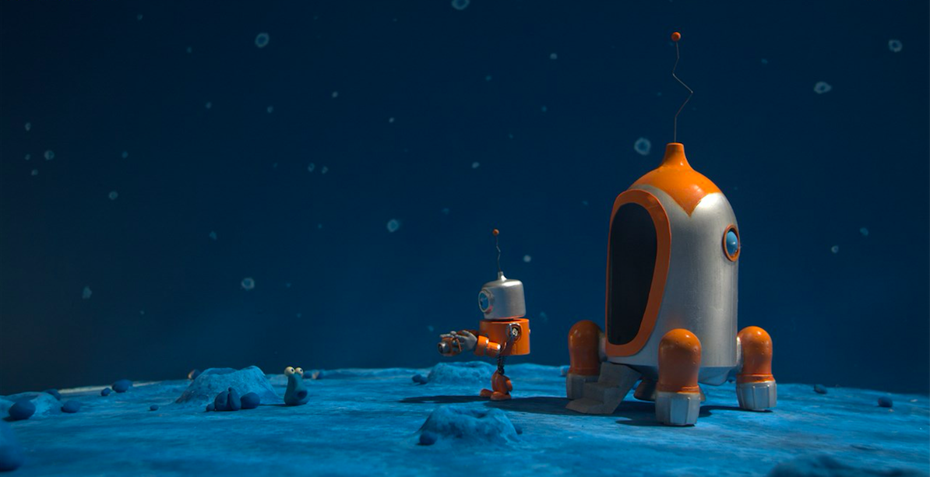
Contents
Decision wheel
C and S questions
Character
  Role on the wall
  Venn diagram
  Trading card / character study
  Design a character - collage
  Axis of emotion
Setting
  Setting description
  Shoebox set design
Comprehension questions
A film by Steve Boot
Produced by McKinnon and Saunders

Slide 3
Decision Wheel
Play the film and pause it around 2:55 (just after the rocket has gone) and then undertake the decision wheel activity.
This is used when a character has a decision to make or faces a dilemma. Write the dilemma in the centre. In the middle circle children identify up to four possible actions. In the outer circle, they write the positives and negatives of each course of action. The next two slides explain more.
Following the completion of the decision wheel, write a note to the robot explaining what he or she should do next.
Downloadable
resource
Graphic outcome
Written outcome

Slide 4
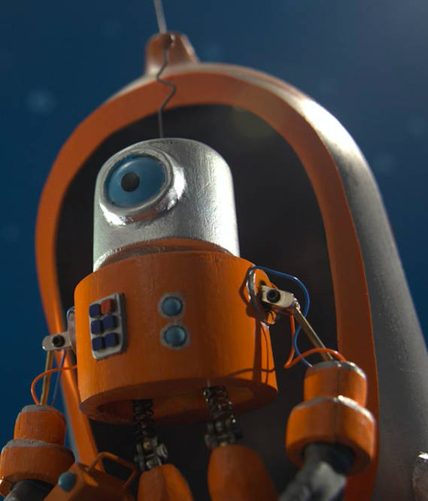
Decision Wheel
Positives and negatives of
each suggestion
+
What should
the robot do?
-
Downloadable
resource
Up to 4 suggestions

Slide 5
Decision Wheel
Positives
4 options
Negatives

Slide 6
C and S Questions
On the next slide are questions based upon the 3 Cs and 3Ss. These can be answered after watching the whole film. The questions can also be found on the downloadable resources 3C questions and 3S questions.
See the page on my website for more information about the Cs and Ss
Downloadable
resource
Written outcome

Slide 7
Camera
Colour
Character
Give one example of a long shot,
a medium shot
and a close up shot.
What do the main characters look like?
How do they speak and what do they say?
How do they behave towards other characters?
What colours do you see?
Are any colours associated with particular characters?
What mood do you think the colours create?
Story
What are the most important things (events) that happen in the story?
Who or what is the story about?
What might happen next, after the end of the story?
Setting
Sound
List the different sounds that you can hear.
Can you hear any sound effects?
When do you hear the music/sounds change?
What is happening on screen when the sounds change?
Do any of the characters ‘speak’?What do they sound like?
Where does the action take place?
How often (when) does the setting affect the characters and the way they behave?
Could the same story have happened in a different place?

Slide 8
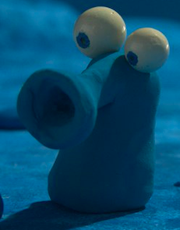
Character Comprehension

Slide 9
Role on the Wall
To deepen understanding of a character. What we know – the literal – is recorded on the outside and what we infer – thoughts and feelings – are recorded on the inside.
Downloadable
resource
Graphic outcome

Slide 10
What we know - retrieval
Feelings - or what we can infer

Slide 11
Venn Diagram
Once the role on the wall for both characters has been completed, compare their similarities and differences using a Venn diagram
Downloadable
resource
Graphic outcome

Slide 12
Trading Cards
Use your detailed knowledge of the characters to make a trading card for each of them.
Give them marks out of ten in the boxes.
How friendly?
How lonely?
How busy?
Downloadable
resource
Written outcome

Slide 13
Trading Cards
How friendly?
How lonely?
How busy?
Downloadable
resource
Written outcome

Slide 14
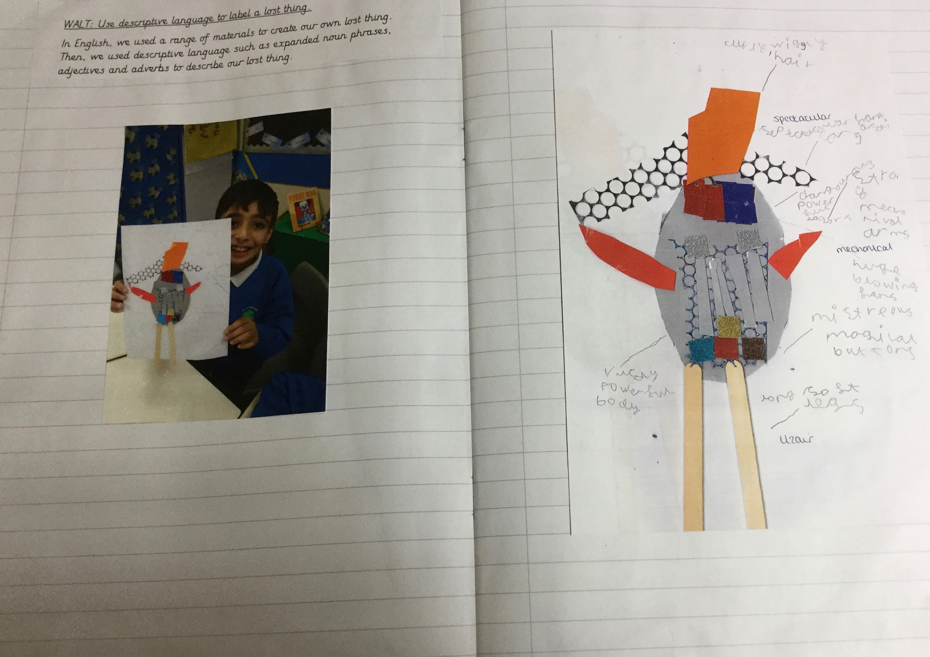
Design and make your own robot explorer
Use scrap materials to make a collage of the explorer robot or use your imagination to design your own explorer or rocket.
The collage on the right is an example using The Lost Thing by Shaun Tan.
Creative Outcome

Slide 15
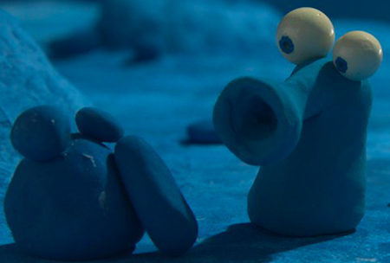
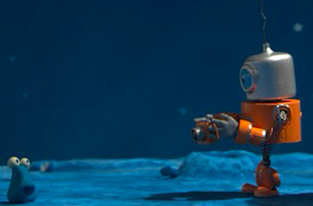
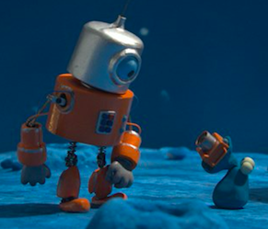
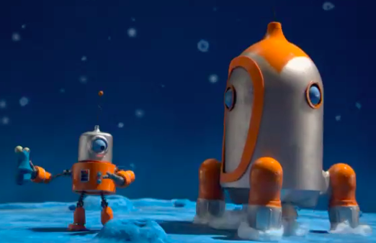
Print the slide to make the resources
Axis of Emotion - sequenced

Slide 16
Axis of Emotion - unsequenced

Slide 17
Describing a Scene
Thanks to Into Film for this idea

Slide 18
Describing a Scene
Write a sentence to describe an object in the scene on slide X using words related to colour and shade.
Write a sentence to describe the setting using words related to colour and shade.
Describe a noise you might be able to hear.
Write down what is happening in the scene.
The next few slides give an example of what this looks like using Flood by Alvaro F Villa.

Slide 19


Slide 20
Flood
object | A bright light shines on the side of a shadowy grey and white house.
setting | The landscape is submerged in murky, brown floodwater.
noise | The only sound is the water gurgling and lapping against the forlorn house.
happening | Slowly, gradually, inevitably the grey building is invaded by the irresistible force.

Slide 21
object
setting
noise
happening
Downloadable
resource
Written outcome

Slide 22
Put the sentences together…
A bright light shines on the side of a shadowy grey and white house.The landscape is submerged in murky, brown floodwater. The only sound is the water gurgling and lapping against the forlorn house. Slowly, gradually, inevitably the grey building is invaded by the irresistible force.
… and edit to taste!
A bright light shines on the side of a shadowy grey and white house as the landscape is submerged in murky, brown floodwater. The only sound is the water gurgling and lapping against the forlorn house. Slowly, gradually, inevitably the grey building is invaded by the irresistible force.

Slide 23

Shoebox Set Design
Another idea by Into Film

Slide 24
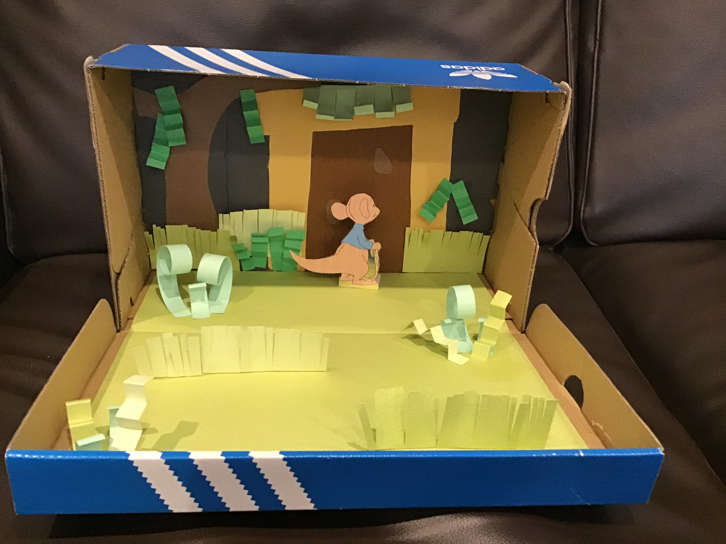
Construct the setting of a scene
from the film in a shoe box using found materials
and possibly cut outs from stills.

Slide 25
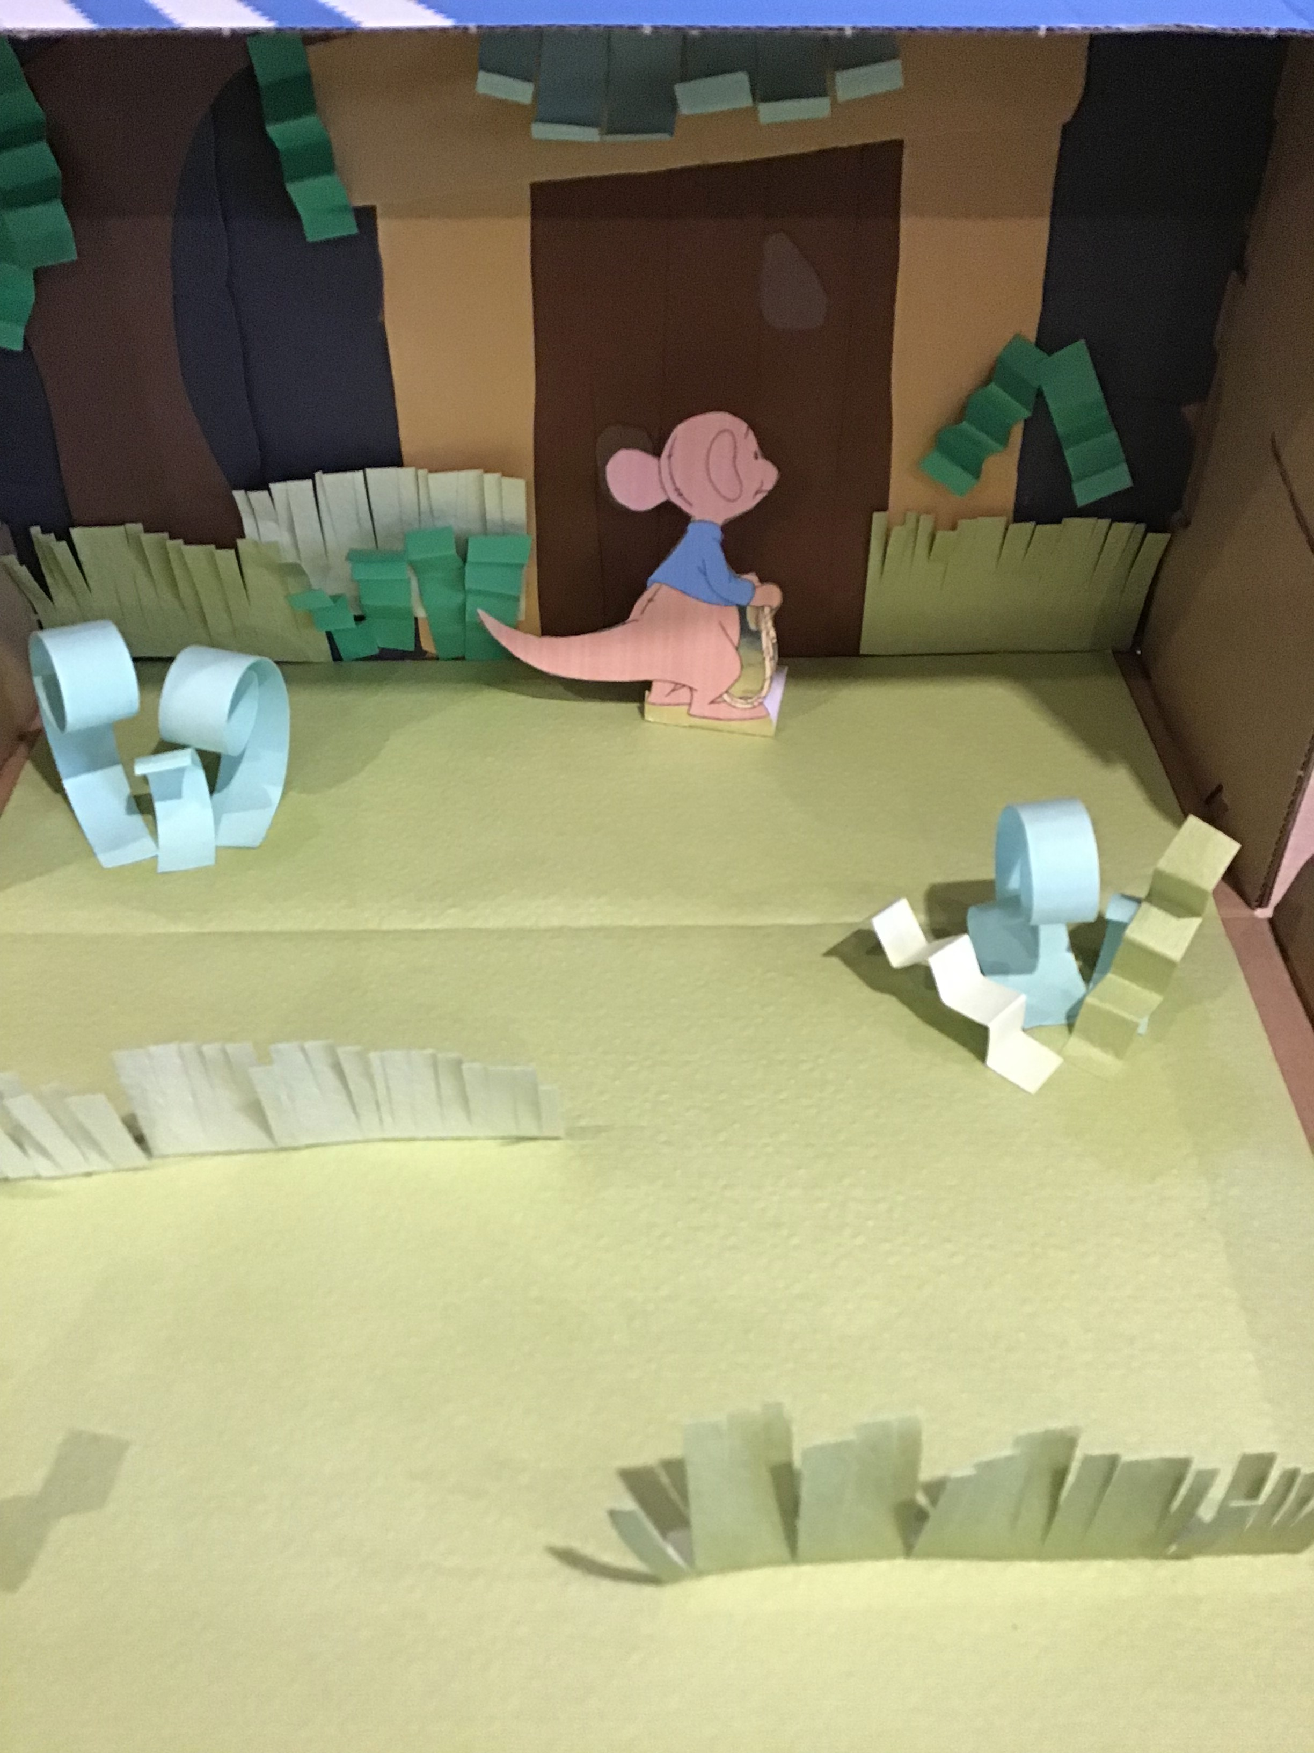
This example of a shoe box set design
is based upon a scene from
Pooh’s Heffalump Movie.

Slide 26
Comprehension Questions
1) How is the alien feeling at the start of the film?
2) What is the alien trying to do when we first meet him?
3) What made him feel fed up after doing this for a while?
4) How does the alien feel when the explorer robot arrives?
5) What did the alien want the explorer robot to do?
6) Name at least two things that annoyed the explorer robot?
7) What was the main problem at the end of the story?
Downloadable
resource
Written outcome

Slide 27
More challenging comprehension questions
1) What do we learn about the alien’s personality when he takes the camera?
2) Describe the planet.
3) How do the film-makers show how the alien is feeling?
4) What was the alien curious about? How was this shown?
5) Did the explorer robot break any of the rules?
Downloadable
resource
Written outcome

