Slide 1
Bouncing Back in Comprehension in Y2

Slide 2
NFER Findings
Children continue to need support with inference, for events and emotions.
Developing understanding of narrative sequencing may be beneficial.
Children may need support to understand a character’s motivation.
Comprehension was sometimes affected by reliance on illustrations.
Children need support to organise and utilise key information.
Children may benefit from more experience with a range of non-fiction texts.
Children may struggle to interpret question words.
More experience needed with a range non-fiction texts

Slide 3
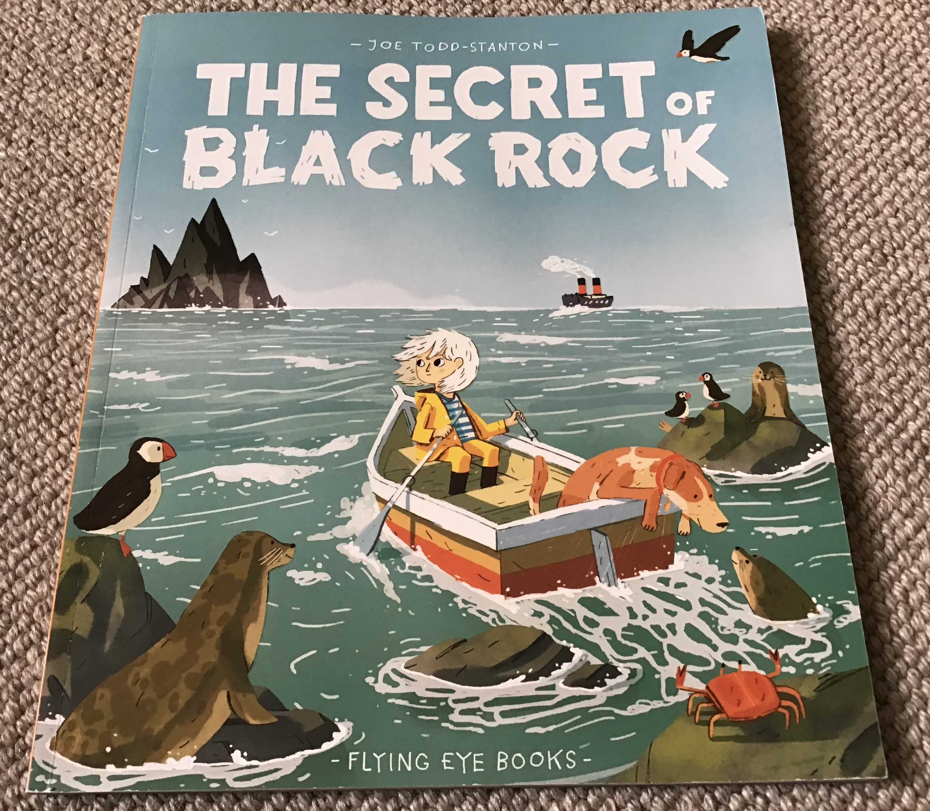
Contexts
English unit
Whole Class Reading
Group reading
Intervention

Slide 4

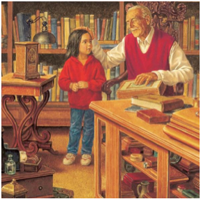
Phase 1
Phase 2
Phase 3
Phase 4
Phase 5
Reading
Planning
Drafting
Editing
Prediction
Comprehension
Publishing
SPaG
and TSO
Gap filling
ARE Grammar
    Revise - Practise - Introduce - Practise - Apply
Notes:
this our foundation

Slide 5
Group Reading
Introduction to the text
Teaching strategies
Independent reading
Return to the text
Response

Slide 6
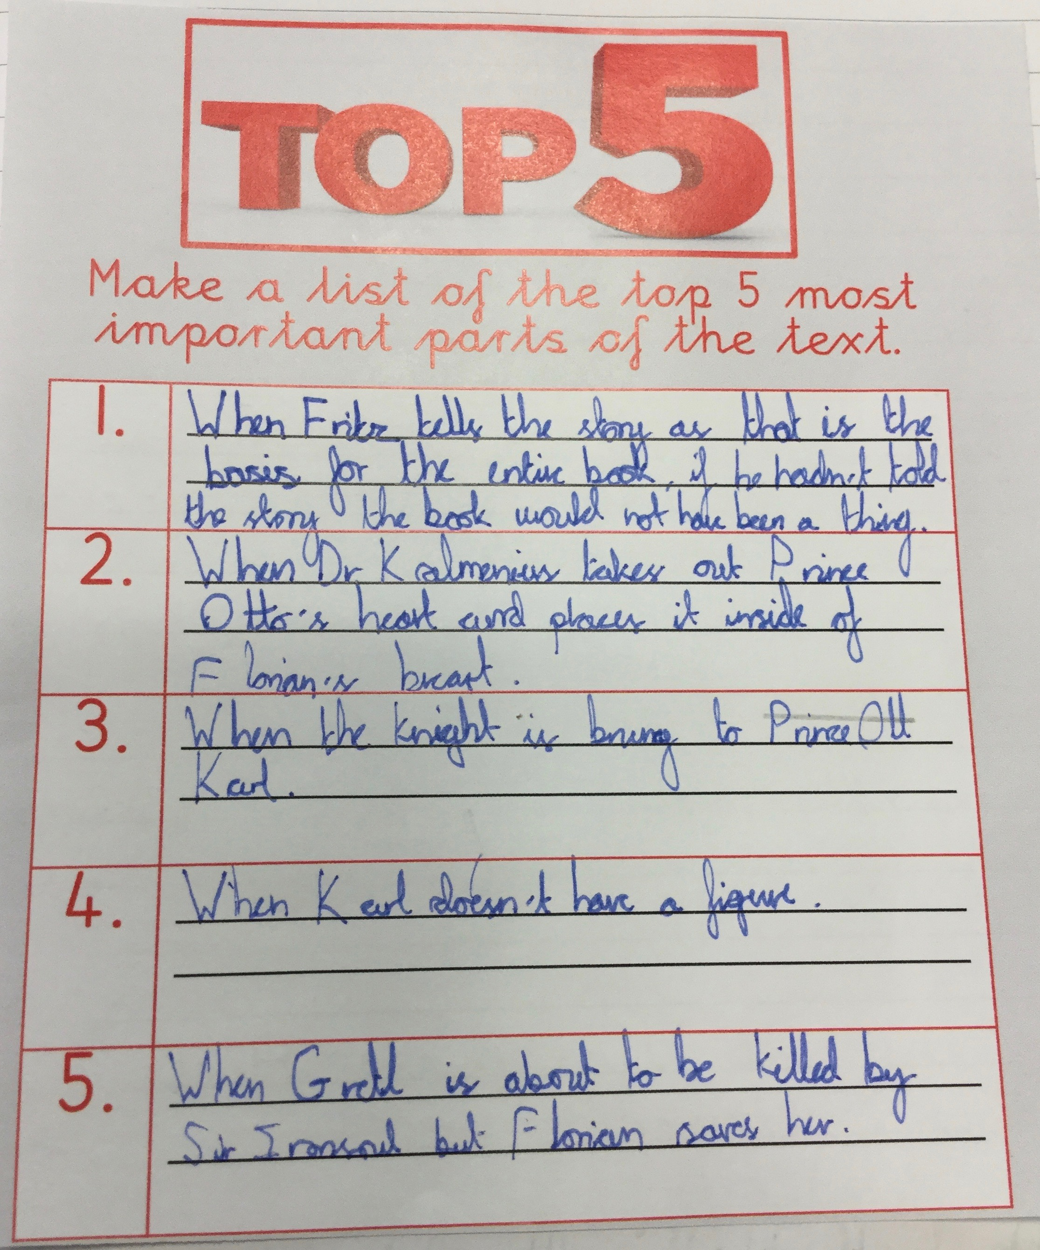
Top 5
Top 5
Top 5
Introduction
Resources: A Top 5 grid
Method: Ask children to discuss and/or complete the Top 5 grid stating the top 5 most important parts of the text.
Strategies
Independent Reading
Return to Text and Response
Content Domain
2a | 2b | 2c | 2d | 2e | 2f | 2g | 2h
1a | 1b | 1c | 1d | 1e

Slide 7
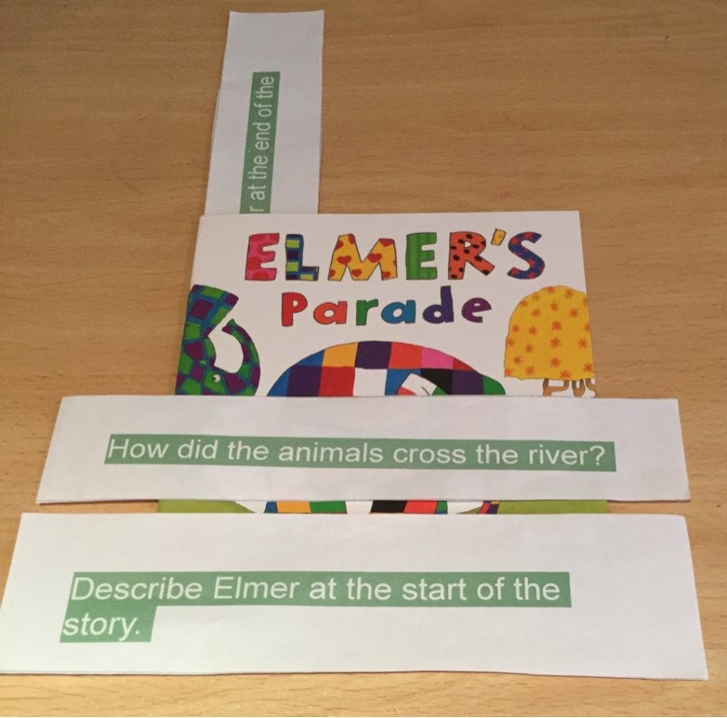
Bookmarking
Introduction to the text
Teaching strategies
Independent reading
Return to the text
Response
Bookmarking

Slide 8
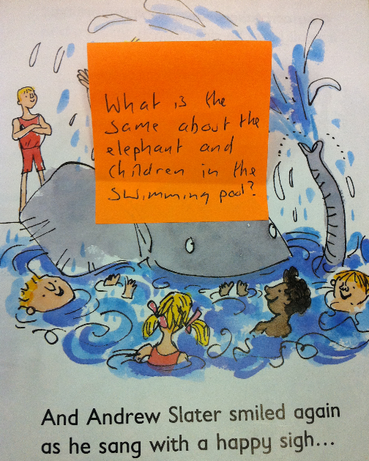
Guided Reading
Introduction to the text
Teaching strategies
Independent reading
Return to the text
Response
Give two
Find and Copy
1.
Golden Ticket
2.
Notes:
Typical structure
Note the need to teach strategies for comprehension as well as for decoding and ensure that children don’t tolerate not understanding text/
Think about what strategies you might be teaching your GR groups at the moment re Comprehension.
importance of:
targeting the direct teaching in a way that can’t be done during whole class teaching
grouping children for guided reading according to their curricular targets
tightly focused teaching (WHAT is being learned, can be as small a step as necessary for those children) and the opportunity to ASSESS what the next steps should be

Slide 9
Whole class reading: adapted for reading fluency
Prediction | SoVo Trailer Cover
Vocabulary Check - 7 Steps | Militarised Contrast Bristle Firepower
Modelling and Echo Reading | p7 to p10
Repeated re-reading | p7 to p10
Performance Reading | Children’s choice
Timed retrieval p7/8 | Who pressed his forepaws against the flight desk window? What thudded into the hull? Where was the silver airship at the start of the chase? 4) Why wouldn’t John leave his ship 5) When should John have told Lily about her past? 6) How did the pod bays open?
Find and copy p9 | A word that means similar to bending A word that means similar to smelling A word that means the opposite of shiny
The IQ question p10 | Do John and Malkin get on well? How do you know?
Summary | 3:2:1
 | 3 things you are sure of 2 things you are not so sure about 1 question you would like to ask

Slide 10
Content Domain
1a | 1b | 1c | 1d | 1e
Draw on knowledge of vocabulary to understand texts. | Identify and explain key aspects of fiction and non- fiction texts, such as characters, events, titles and information. | Identify and explain the sequence of events in texts. | Make inferences from the text. | Predict what might happen on the basis of what has been read so far.

Slide 11
Key Stage 1
KS1 Reading Paper 1 2016
KS1 Reading Paper 1 2017
Inference
Retrieval
Inference
Retrieval
Vocab’
Vocab’

Slide 12
Seven Steps
Erin Pike lived with her mum and her dog near a big fishing town. She longed to go out to sea but it was too dangerous because of.....
.....the legend of BLACK ROCK!
longed
mysterious
outsmart
desperately
echoed
translucent
plotting
Seven Steps
Contextualise
Repeat the word
Child friendly definition
Give other examples
Relate to experience
Engage in other ways
Record

Slide 13
mysterious
Contextualise
Repeat the word
Child friendly definition
Give other examples
Relate to experience
Engage in other ways
Record

Slide 14
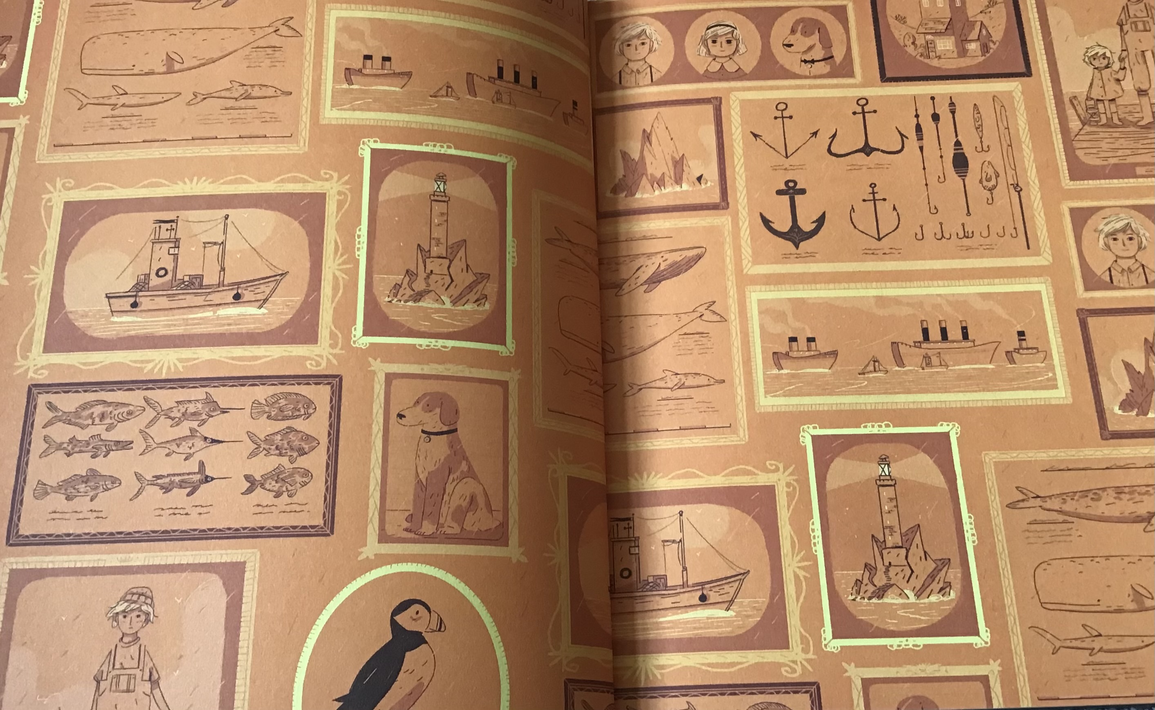

Slide 15
Developing understanding of narrative sequencing may be beneficial.
Evidence suggests that children struggled to fully understand the sequence of events in the stories. In some instances, lower attaining readers misunderstood when major plot points occurred, with their knowledge of what happened later in the story confusing how they understood earlier events.
Several of children’s misunderstandings about character emotions stemmed from confusion over what events had already occurred and / or what the characters knew / were aware of at that point in the story.

Slide 16
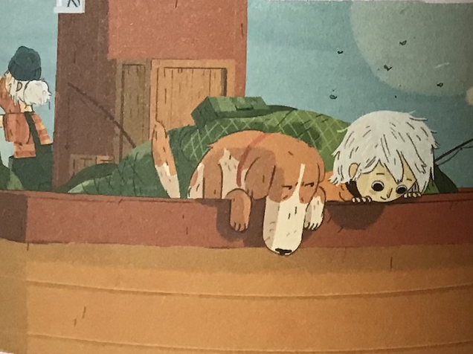
Developing understanding of narrative sequencing may be beneficial.
Perfect predictions
Story mapping
Story ladder
Axis of emotion
Matching text and picture
Top 3

Slide 17
‘breaking down stories into different lessons across days, so that children can practise recapping and predicting the next events’
Erin outsmarted
Archie
The fog
came
Erin in
the sea
Black Rock
Woke up
Erin and
Black Rock
back to the shore
She explained
but no-one listened
Downloadable
resource

Slide 18
Perfect Predictions
One day, Erin came up with a very smelly plan to outsmart Archie’s nose. Her mum was far too busy to notice Erin was on board. As the day got later, a fog appeared...
...which got thicker...
... and thicker...
Suddenly, a huge, dark shape loomed right into the boat’s path! The boat turned wildly and as it swept back into the fog...
...Erin disappeared into the sea unnoticed.

Slide 19
Perfect Predictions
What has happened | What I think will happen | What did happen
One day, Erin came up with a very smelly plan to outsmart Archie’s nose. Her mum was far too busy to notice Erin was on board. As the day got later, a fog appeared... ...which got thicker... ... and thicker... Suddenly, a huge, dark shape loomed right into the boat’s path! The boat turned wildly and as it swept back into the fog... ...Erin disappeared into the sea unnoticed.
Downloadable
resource

Slide 20
Downloadable
resource

Slide 21
Picture and sentence matching
One day, Erin came up with a very smelly plan to outsmart Archie’s nose.
Her mum was far too busy to notice Erin was on board.
As the day got later, a fog appeared...
...which got thicker...
... and thicker...
Suddenly, a huge, dark shape loomed right into the boat’s path!

Slide 22
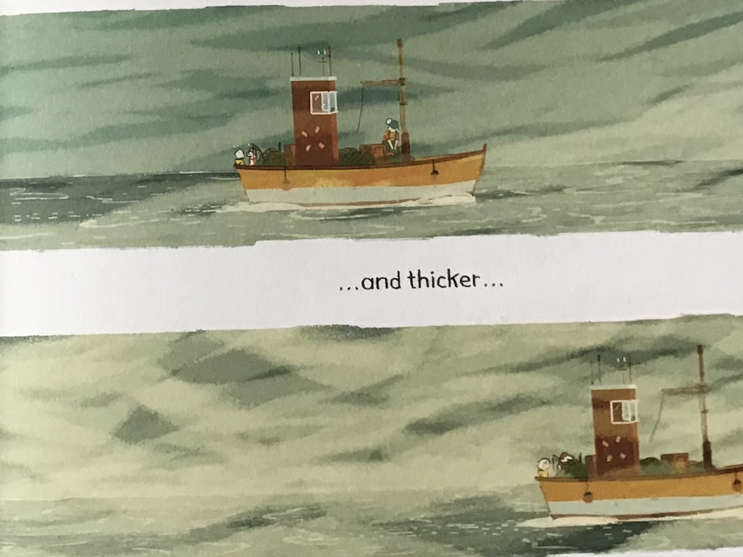
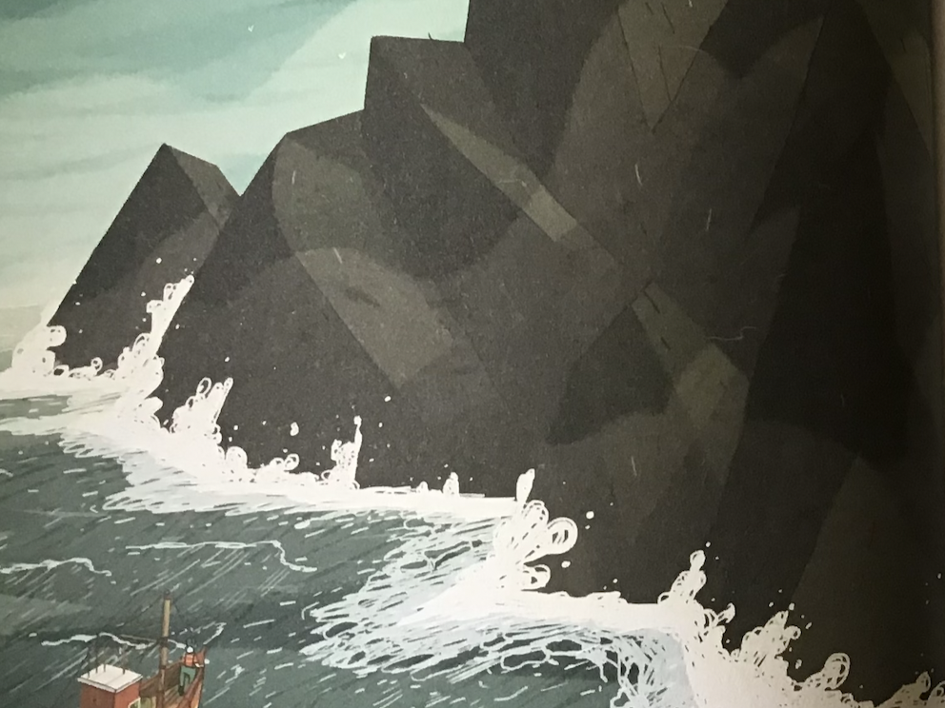
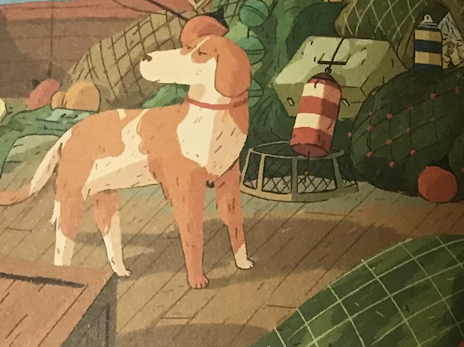

Slide 23
Her mum was far too busy to notice Erin was on board.
One day, Erin came up with a very smelly
plan to outsmart Archie’s nose.
Suddenly, a huge, dark shape loomed
right into the boat’s path!
As the day got later, a fog appeared...
...which got thicker...
... and thicker...

Slide 24
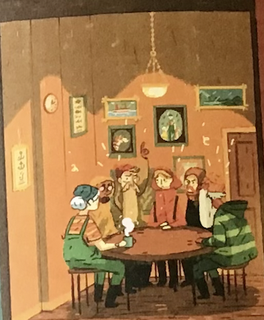
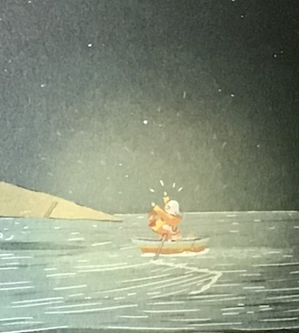
Problem
The islanders were plotting
to destroy Black Rock
The islanders realised
they were wrong
Solution
Downloadable
resource

Slide 25
Top 3
What are the top 3 most important parts of this text?
1
2
3

Slide 26
Children continue to need support for with inference for events and emotions
Children found questions requiring inference skills the most challenging overall in both 2017 and 2020. This skill involves using information in the text to arrive at another piece of information which is implicit. Some children struggled to give specific inferences that were supported sufficiently by the text. These children tended to give generic inferences, e.g. ‘He was kind’, instead of more contextualised answers such as ‘He looked after her pet’.
When inferring emotions, children were more likely to provide generic emotion words such as ‘happy’ or ‘sad’, rather than more specific emotions such as ‘relieved’ or ‘lonely’, which were more relevant to the story events.

Slide 27
Children may need support to understand a character’s motivation.
When children were asked to complete a speech bubble showing what question a character asked in the story, the majority of children were able to structure their response as a question in the 2nd person.
However, one of the common misconceptions was related to children misunderstanding the character’s motivation and providing a question which, though relevant to the story, would not help the character achieve their goal.

Slide 28
Word Wheel
miserable
unhappy
gloomy
sad | happy | worried | brave
unhappy | cheerful | anxious | daring
gloomy | joyful | bothered | courageous
miserable | content | upset | bold
worried
happy
sad
brave
cheerful
joyful
content
Downloadable
resource

Slide 29
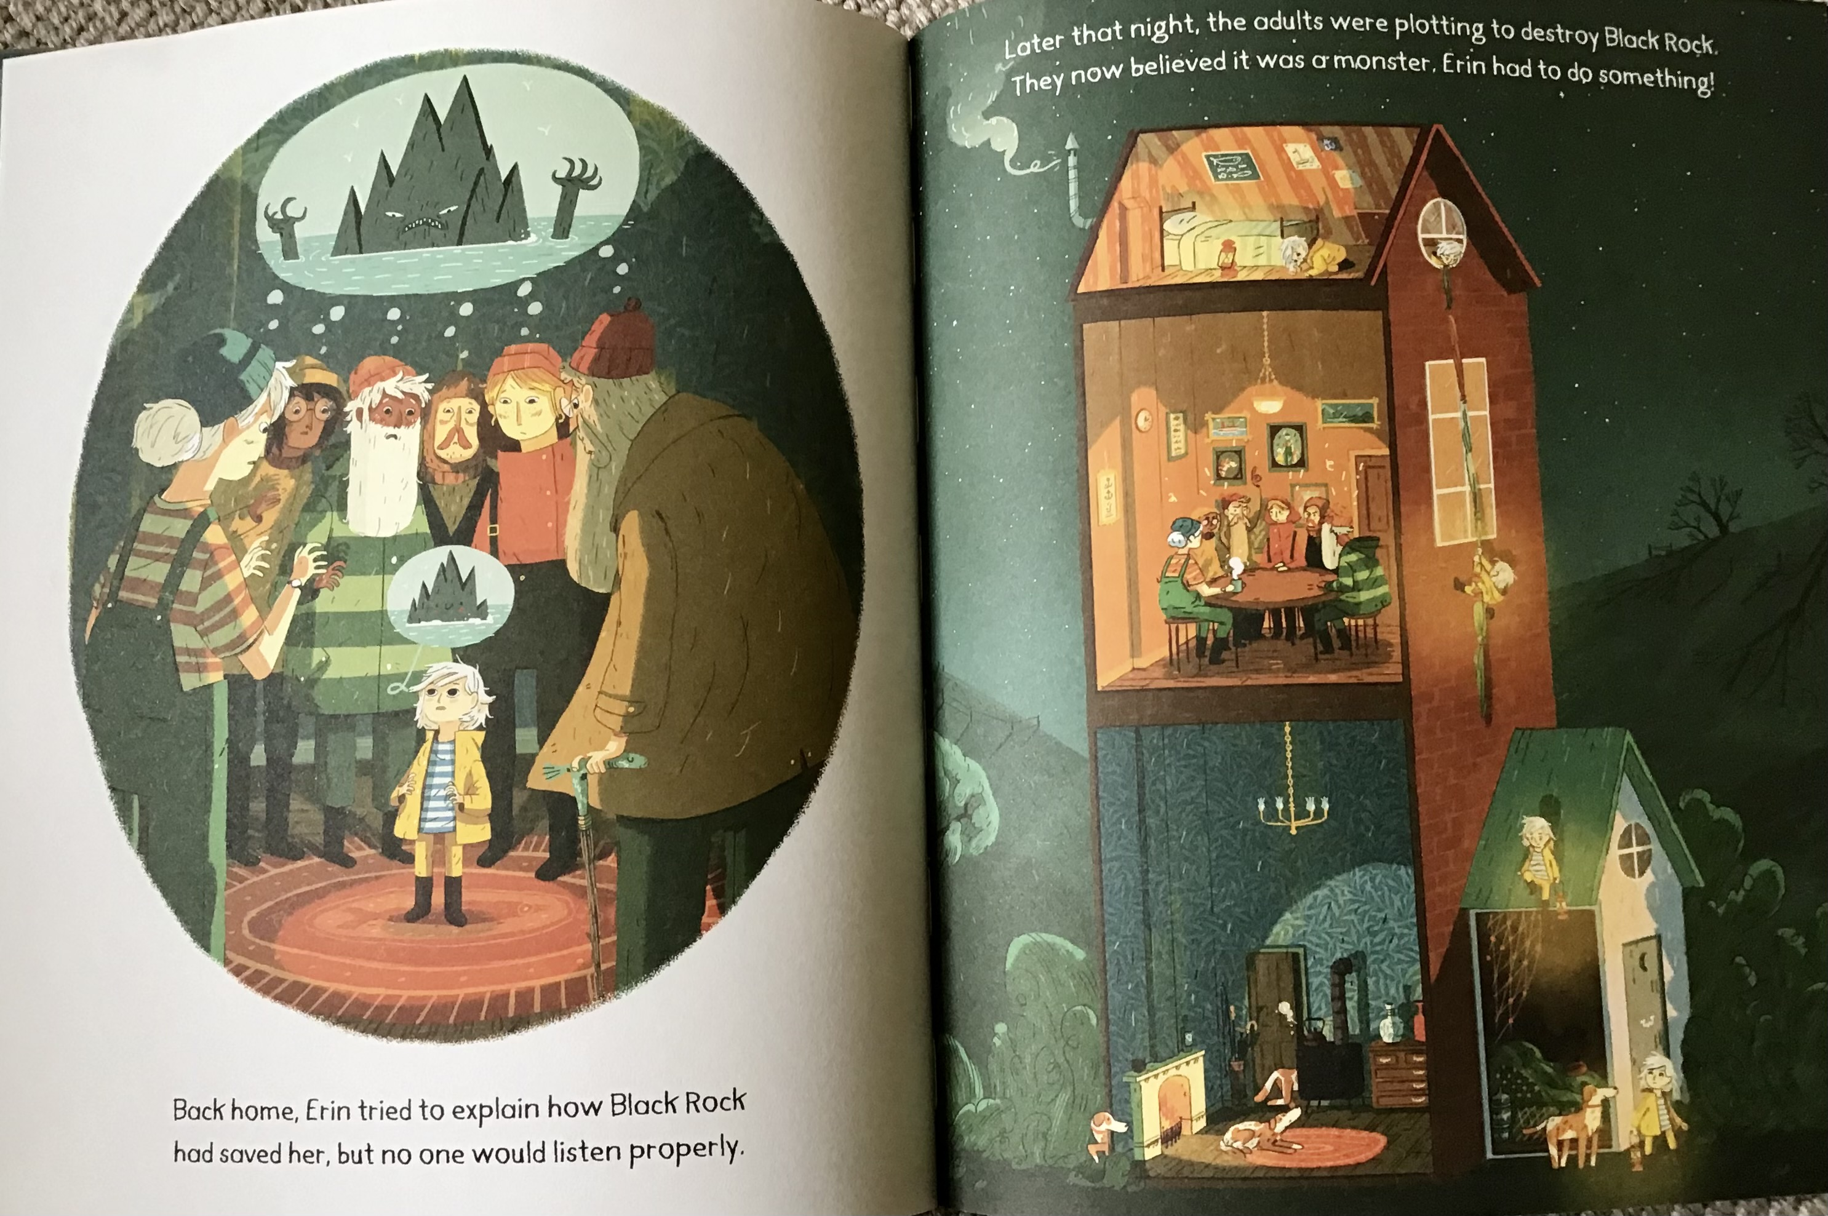
worried
anxious
bothered
upset

Slide 30
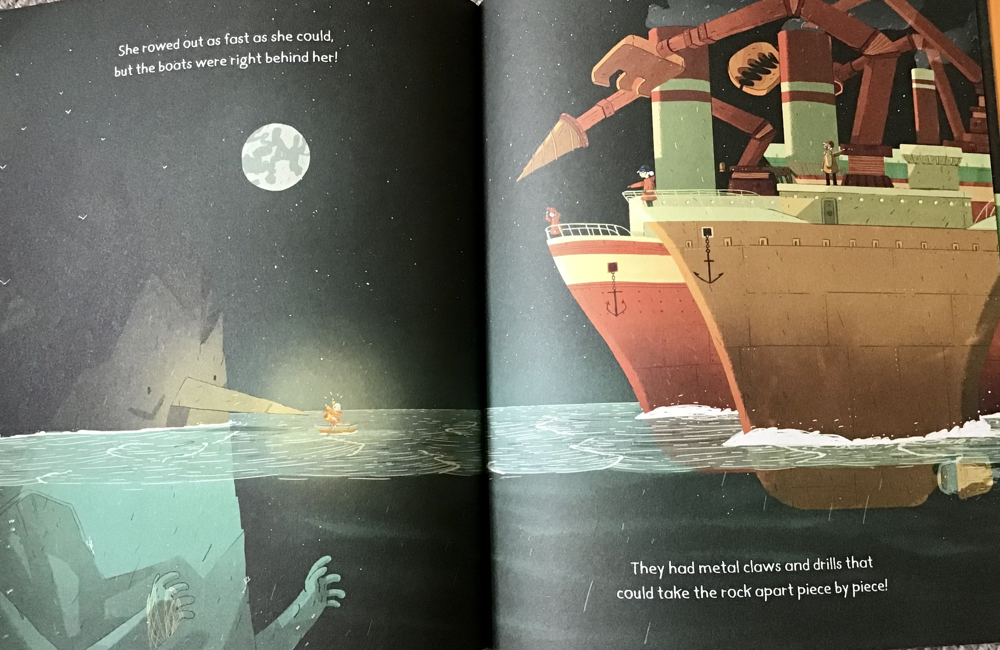
brave
daring
courageous
bold

Slide 31
Children may need support to understand a character’s motivation.
Teacher modelling
Thought bubbles - at different points in a story
Dialogue / emotion tracking other character’s emotions

Slide 32
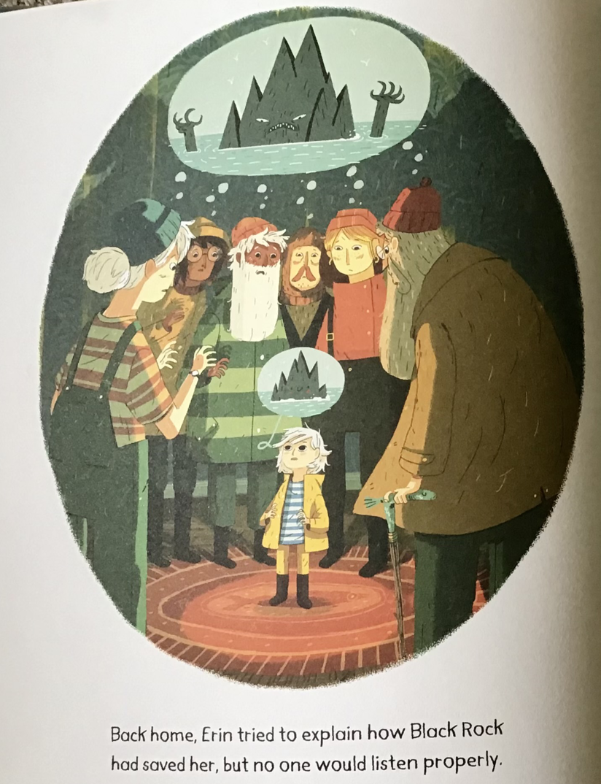
Hot seating
What are they saying?
What is their motivation?
Collective Character
Speech bubbles
Teacher in role as Erin - what is Erin’s motivation?

Slide 33
Children continue to need support with inference, for events and emotions.
Children continue to need support for with inference for events and emotions
Role playing/hot seating and role on the wall
Exploring one scene of a story in detail and using stepped questioning
    ‘What is the character thinking?’
    ‘How do you know this?’’
    Can you underline the part of the text that tells you this?’
Exploring shades of emotion - the intensity line

Slide 34
Stepped Questioning
Back home, Erin tried to explain how Black Rock had saved her but no one would listen properly. Later that night, the adults were plotting to destroy Black Rock. They now believed it was a monster. Erin had to do something!
Why was Erin so worried about Black Rock?

Slide 35
Stepped Questioning
Teacher modelling
Back home, Erin tried to explain how Black Rock had saved her but no one would listen properly. Later that night, the adults were plotting to destroy Black Rock. They now believed it was a monster. Erin had to do something!
Why was Erin so worried about Black Rock?
Write your model answer

Slide 36
The Intensity Line
Later that night..
brave
bold
daring
courageous

Slide 37

Role on the wall / Hot Seating / Collective Character
literal
inferential
Back home, Erin tried…
Downloadable
resource

Slide 39
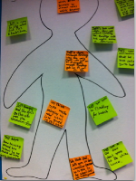
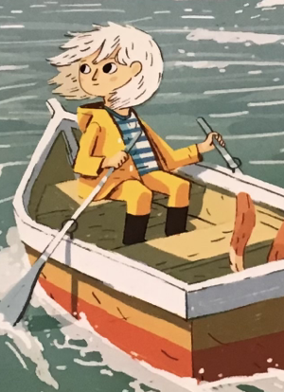
Role on the Wall
Erin wears…
She…
Outside…
Inside…
This girl…
Downloadable
resource

Slide 40
Children need support to organise and utilise key information.
In 2020, children found retrieval questions, where they have to identify key information and events from fiction and non-fiction texts, harder than in 2017. Disadvantaged children found these questions comparatively hard. A common error identified was where children incorrectly answered retrieval questions with other prominent information in the text. This suggests children are able to pick out the key information, but struggle to organise or utilise it to answer specific questions.

Slide 41
Children may struggle to interpret question words.
Analysis of performance in 2020 suggested that children were confusing question words such as how, why or what, causing them to misread or misinterpret questions about the text. Children’s responses suggested that sometimes they were responding to the question topic as a “why” or “what” question when the phrasing was actually “how”. In particular, children struggled to answer ‘how can you tell’ questions, confusing these with ‘why’.

Slide 42
Children need support to organise and utilise key information.
The Reading Ladder
Trapping fingers
Highlighting
Trading card / factfile
Modelling and scaffolding

Slide 43
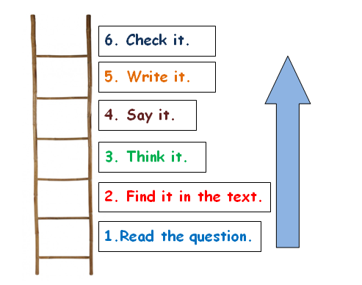
The Reading Ladder
Notes:
But ..

Slide 44

Guided Reading - Developing Inference Skills
6. Check it.
5. Write it.
4. Say it.
3. Think it.
2. Find the evidence in the text.
Read the question.

Slide 45
Trapping fingers

Slide 46
Highlighting
She rowed out as fast as she could but the boats were right behind her. They had metal claws and drills that could take the rock apart piece by piece! As the first claw was about to crash into the rock, Erin jumped up into its nose. The whirring and chugging came to a sudden halt! And as it did, one by one all the creatures that lived on Black Rock swam up to the surface.
How fast did Erin row?

Slide 47
Highlighting
She rowed out as fast as she could but the boats were right behind her. They had metal claws and drills that could take the rock apart piece by piece! As the first claw was about to crash into the rock, Erin jumped up into its nose. The whirring and chugging came to a sudden halt! And as it did, one by one all the creatures that lived on Black Rock swam up to the surface.
How fast did Erin row?

Slide 48
Highlighting
She rowed out as fast as she could but the boats were right behind her. They had metal claws and drills that could take the rock apart piece by piece! As the first claw was about to crash into the rock, Erin jumped up into its nose. The whirring and chugging came to a sudden halt! And as it did, one by one all the creatures that lived on Black Rock swam up to the surface.
How fast did Erin row?

Slide 49
Highlighting
She rowed out as fast as she could but the boats were right behind her. They had metal claws and drills that could take the rock apart piece by piece! As the first claw was about to crash into the rock, Erin jumped up into its nose. The whirring and chugging came to a sudden halt! And as it did, one by one all the creatures that lived on Black Rock swam up to the surface.
Find and copy one word to describe the sound the boats behind Erin made.

Slide 50
Highlighting
She rowed out as fast as she could but the boats were right behind her. They had metal claws and drills that could take the rock apart piece by piece! As the first claw was about to crash into the rock, Erin jumped up into its nose. The whirring and chugging came to a sudden halt! And as it did, one by one all the creatures that lived on Black Rock swam up to the surface.
Find and copy one word to describe the sound the boats behind Erin made.

Slide 51
Erin
Being brave
Doing as she is told
Loving animals
Notes:
short, sharp writing in comprehension phase - practise grammar here

Slide 52
Children may struggle to interpret question words.
Analysis of performance in 2020 suggested that children were confusing question words such as how, why or what, causing them to misread or misinterpret questions about the text. Children’s responses suggested that sometimes they were responding to the question topic as a “why” or “what” question when the phrasing was actually “how”. In particular, children struggled to answer ‘how can you tell’ questions, confusing these with ‘why’.

Slide 53
Question Words
Teaching could focus on children’s understanding of question words, for example:
• explore examples of question words used in everyday contexts as well as in stories and non-fiction texts
Based on children’s own experience
What is your name?
Where do you live?
What do you like to do?

Slide 54
Question Words
Teaching could focus on children’s understanding of question words, for example:
• Model questioning … check understanding through high-quality language interactions about texts
• Through guided reading activities, which could ask about the same topic using different question words e.g., What is the character doing? How can you tell? Why might they be doing it?

Slide 55
Easy texts - difficult questions

Slide 56

Who? |  | What?
Where? |  | When?
Why? |  | How?
Downloadable
resource

Slide 57
Boo!
She didn’t like it at all when her father had to go down to London and, for the first time, she had to sleep alone in the old house.
She went up to her bedroom early. She turned the key and locked the door. She latched the windows and drew the curtains. She peered inside her wardrobe and pulled open the bottom drawer of her chest of drawers; she got down on her knees and looked under the bed.
She undressed; she put on her nightdress.
She pulled back the heavy linen cover and climbed into bed. Not to read but to try and sleep - she wanted to sleep as soon as she could. She reached out and turned off the lamp.
“That’s good,“ said a little voice. “Now we’re safely locked in for the night.”
From Short by Kevin Crossley-Holland

Slide 58
who?
had to go to London?
what?
did the little voice say?
where??
Matching the rest of the
question to the question word
did she look first?
when?
did she go to bed?
why?
did she have to sleep alone?
how?
did she look inside her wardrobe?

Slide 59
Matching the rest of the
question to the question word
who?
did she go to bed?
what?
had to go to London?
where??
did the little voice say?
when?
did she look first?
why?
did she look inside her wardrobe?
how?
did she have to sleep alone?

Slide 60
who?
Children may struggle to interpret question words.
her father
what?
‘That’s good’…
where??
wardrobe
when?
early
why?
Father had gone to London?
how?
peered

Slide 61
who?
Children may struggle to interpret question words.
what?
Flash spelling
The pairs game
Kim’s game
Tracing the letters
Matching the rest of the question to the question word
Matching the answer
where??
when?
why?
how?

Slide 62
Children may struggle to interpret question words.
why?
Tracing

Slide 63
Flash Spelling
who?
who?
what?
what?
where?
where?
Notes:
accommodate
cemetery
embarrassed
harassed
necessary
unparalleled
ecstasy
lady’s

Slide 64
The pairs game - Kim’s game
who?
what?
how?
where?
why?
when?

Slide 66
Reading Fluency: possible intervention
‘Fluent reading supports comprehension because pupils’ cognitive resources are freed from focusing on word recognition and can be redirected towards comprehending the text.’ EEF

Slide 67
What does reading feel like to those with limited fluency?
A
riverrun, past Eve and Adam’s, from swerve of shore to bend of bay, brings us by a commodius vicus of recirculation back to Howth Castle and Environs.
Sir Tristram, violer d’amores, fr’over the short sea, had passen-core rearrived from North Armorica on this side the scraggy isthmus of Europe Minor to wielderfight his penisolate war: nor had topsawyer’s rocks by the stream Oconee exaggerated themselse to Laurens County’s gorgios while they went doublin their mumper all the time:
B
nor avoice from afire bellowsed mishe mishe to tauftauf thuartpeatrick not yet, though venissoon after, had a kidscad buttended a bland old isaac: not yet, though all’s fair in vanessy, were sosie sesthers wroth with twone nathandjoe. Rot a peck of pa’s malt had Jhem or Shen brewed by arclight and rory end to the regginbrow was to be seen ringsome on the aquaface.

Slide 68
Establish these terms
Echo reading
Re-reading
Performance reading

Slide 69

Fluent readers can read quickly, accurately, and with appropriate stress and intonation.
Fluent reading supports comprehension because pupils’ cognitive resources are freed from focusing on word recognition and can be redirected towards comprehending the text.
This can be developed through:
guided oral reading instruction—teachers model fluent reading of a text,
then pupils read the same text aloud with appropriate feedback; and
repeated reading—pupils re-read a short and meaningful passage a set number of times or until they reach a suitable level of fluency.
It is important to understand pupils’ current capabilities and teach accordingly. Most pupils will need an emphasis on developing reading fluency, but some pupils may need a focus on more basic skills, such as decoding and phonological awareness.

Slide 70
‘I'm going to have a go at echo reading whole class. We've tried it in small groups which has significantly improved comprehension the day after. Amazing stuff!’

Slide 71
Reading Fluency and Prosody
Noun
prosody (countable and uncountable, plural prosodies)
(linguistics) The study of rhythm, intonation, stress, and related attributes in speech.
(poetry) The study of poetic meter; the patterns of sounds and rhythms in verse.
Derived terms
prosodic

Slide 72

Dance like nobody’s watching

Slide 73
Read like nobody’s listening: developing reading fluency
stumbling - stopping - starting - erratic - no melody - no tune - no flow
treating each word as an island

Slide 74
Modelling
I/We/You
I - you explain and model
We - paired or guided
You - independent

Slide 75
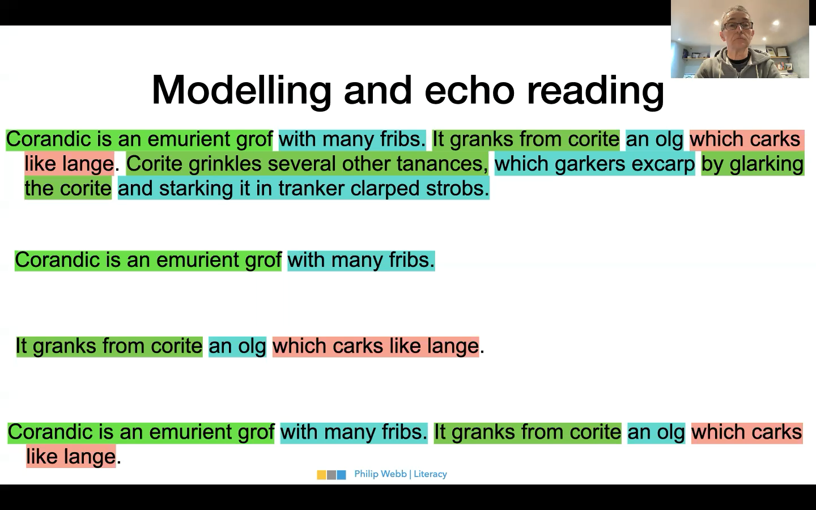

Slide 76
Surveying the text
Punctuation
Names
Run ons
Chunking
Dialogue
Speech verbs
Challenging vocabulary
Text Organisation clues

Slide 77
Run ons
Word by word readers often assume that a sentence finishes at the. End of line of text they place a non existent full stop at the end of.
each line.
But texts are written to flow – to follow an idea to its conclusion and often the words in a sentence flow over the line end. They run on.

Slide 78

Surveying a text
Y2?
Tricky name
The Dark
Laszlo was afraid of the dark. The dark lived in the same house as Laszlo. A big place with a creaky roof, smooth, cold windows and several flights of stairs.
Sometimes the dark hid in the cupboard. Sometimes it sat behind the shower curtain.
But mostly it spent its time in the basement.
All day long, the dark would wait in a distant corner, far from the squeaks and rattles of the washing machine, pressed up against some old, damp boxes and a chest of drawers nobody ever opened.
At night, of course, the dark went out and spread itself against the windows and doors of Laszlo’s house. But in the morning, the dark would be back in the basement, where it belonged. Laszlo would peek at the dark every morning.
“Hi,” he would say. “Hi, dark.”
Run on sentence
Long sentence
Dialogue

Slide 79
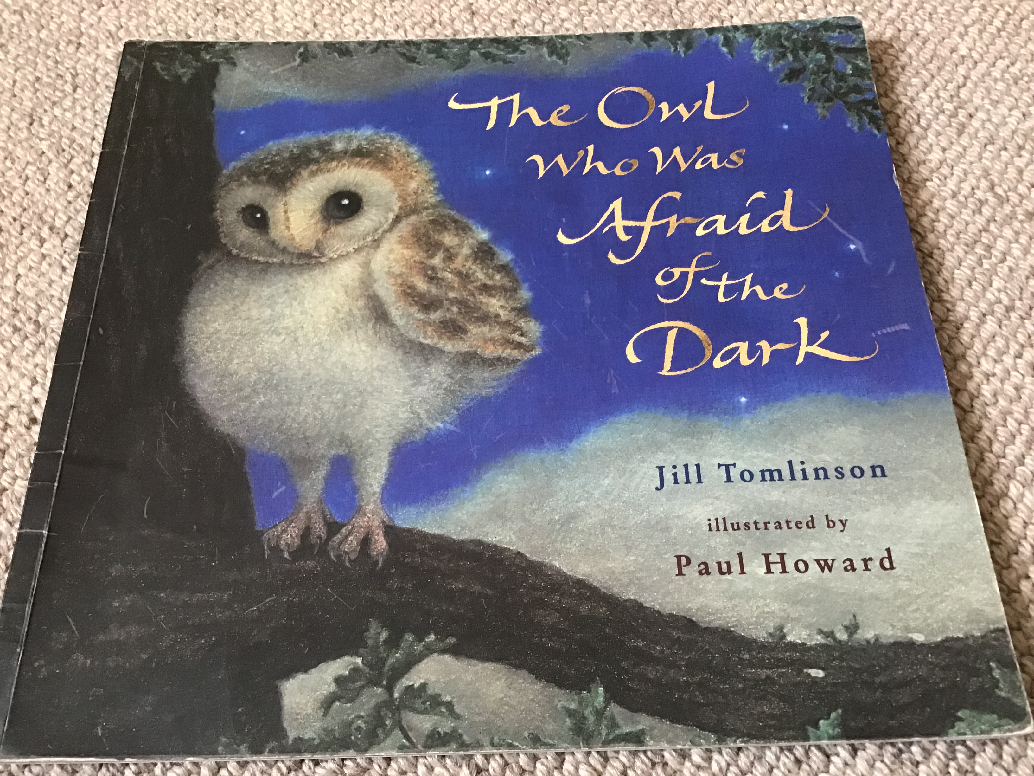
Dialogue: speech verbs, text clues and punctuation
Y2?
“Because - oh, because it’s the fashion,” said the little girl.
“Don’t you know anything?
The Owl Who Was Afraid of the Dark
“Hello!” said Plop. “I’ve come to see what’s going on.”
“I’m guarding the camp-fire,” said the boy.
“The others have gone to play games in the dark, lucky things.”
“Do you like the dark?” asked Plop.
“It’s super!” the boy replied.
“DARK IS FUN. We’re going to make cocoa and sing round the fire. Would you like to stay?”

Slide 80
Chunking
Back home, Erin tried to explain how Black Rock had saved her but no one would listen properly. Later that night, the adults were plotting to destroy Black Rock. They now believed it was a monster. Erin had to do something!

Slide 81
Intervention: session A
Step 1. The teacher reads a text modelling expert prosody.
Step 2. Pupils echo the modelled prosody.
Step 3. The teacher repeats a modelled prosody read of a section of the text.
Step 4. Pupils echo the modelled prosody. (Using text marking when appropriate)
Step 5. Pupils practise reading a section of modelled text in pairs or small groups.
Step 6. Pupils ‘performance read ‘ the section of text to the group.
Step 7. The teacher and pupils provide feedback to each other.

Slide 82
Session A
Erin Pike lived with her mum and her dog near a big fishing town. She longed to go out to sea but it was too dangerous because of.....
.....the legend of BLACK ROCK!
Every fisherman and fisherwoman had a scary story to tell. “ It never stays in the same place and it could smash a boat to pieces!”
“It’s as big as a mountain and as sharp as a swordfish!”
Echo reading
Re-reading
Performance reading

Slide 83
Intervention:Session B
Step 1 . Pupils re-read a small section of the text in unison;
Step 2. The teacher asks a series of retrieval questions: what? where? when? why? how? who?
Step 3. The teacher allows the pupils to share any points of interest with the group about the text;
Step 4. The teacher asks the IQ (Inference Question) and models a possible response.
Step 5. Pupils read through the text, in pairs, and prepare their response to the IQ

Slide 84
Erin Pike lived with her mum and her dog near a big fishing town. She longed to go out to sea but it was too dangerous because of.....
.....the legend of BLACK ROCK!
Every fisherman and fisherwoman had a scary story to tell. “ It never stays in the same place and it could smash a boat to pieces!”
“It’s as big as a mountain and as sharp as a swordfish!”
But Erin wasn’t scared. Every day she would hide on her mum’s fishing boat. And every day Archie would sniff her out. At night, she would wait for her mum’s safe return ...
...hoping she might catch a glimpse of the mysterious Black Rock.

Slide 85
Who? |  | What?
Who lived with her mum and her dog? |  | What did Erin long to do?
Where? |  | When?
Where did Erin live? |  | When did Erin wait for her Mum’s return?
Why? |  | How?
Why couldn’t Erin go to sea? |  | How big tdid he the people say that Black Rock was?
Downloadable
resource

Slide 86
Who? |  | What?
Where? |  | When?
Why? |  | How?
Downloadable
resource

Slide 87
Intervention:Session B
Step 1 . Pupils re-read a small section of the text in unison;
Step 2. The teacher asks a series of retrieval questions: what? where? when? why? how? who?
Step 3. The teacher allows the pupils to share any points of interest with the group about the text;
Step 4. The teacher asks the IQ (Inference Question) and models a possible response.
Step 5. Pupils read through the text, in pairs, and prepare their response to the IQ

Slide 88
Comprehension was sometimes affected by reliance on illustrations.
Several of the misconceptions that children demonstrated on the fiction texts seemed to arise from an over-reliance on illustrations. Though illustrations can be useful to support comprehension, they only depict part of the story and so over-dependence on these can cause ‘gaps’ in comprehension. This may be children who are struggling to decode or make inferences from a text, and so may resort to using the illustrations to inform their understanding. There was some evidence that boys were more likely to show this pattern.

Slide 89
Comprehension was sometimes affected by reliance on illustrations.
Practice matching different pictures to points in a story
Explaining what a story illustration is showing them and finding the part of the text that supports this - find the bit where

Slide 90
Her mum was far too busy to notice Erin was on board.
One day, Erin came up with a very smelly
plan to outsmart Archie’s nose.
Suddenly, a huge, dark shape loomed
right into the boat’s path!
As the day got later, a fog appeared...
...which got thicker...
... and thicker...

Slide 91
Responding to illustration 1
Responding to illustration – approach 1
Ask children what do they notice/see in the image?
Have they they seen anything like this before?
Ask them to discuss the image in their groups and make notes of these initial thoughts. What can they see? Does it prompt any questions? Is there anything that puzzles them?

Slide 92
Responding to illustration 2
Responding to illustration – approach 2
Working with a partner, ask children to write down a list of 3 things that they can see in the illustration.
Ask each pair of children to work with another pair to compare their lists – did anybody notice something new?
Gather children’s ideas to make a class list of what they can see

Slide 94
Children may benefit from more experience with a range of non-fiction texts.
Children struggled with interpreting information from a non-fiction text, compared to fiction texts. This was true for the children in 2020 as well as the 2017 cohort. Children’s confusion of prominent information in response to retrieval questions, already discussed, contributes to this overall difficulty with non-fiction texts. Children who did not locate their answers in the text performed less well across the reading assessment as a whole.

Slide 95
Increasing children’s experience with a range of non-fiction texts would help them to become more familiar with the different ways information is presented across text types. This could be by, for example:
• exploring different non-fiction texts such as instructions, recipes, leaflets and newsletters among others
• using simplified non-fiction text exemplars to introduce this genre in an easier and supported way
• giving children the opportunity to create non-fiction texts to support their understanding of its features.

Slide 96
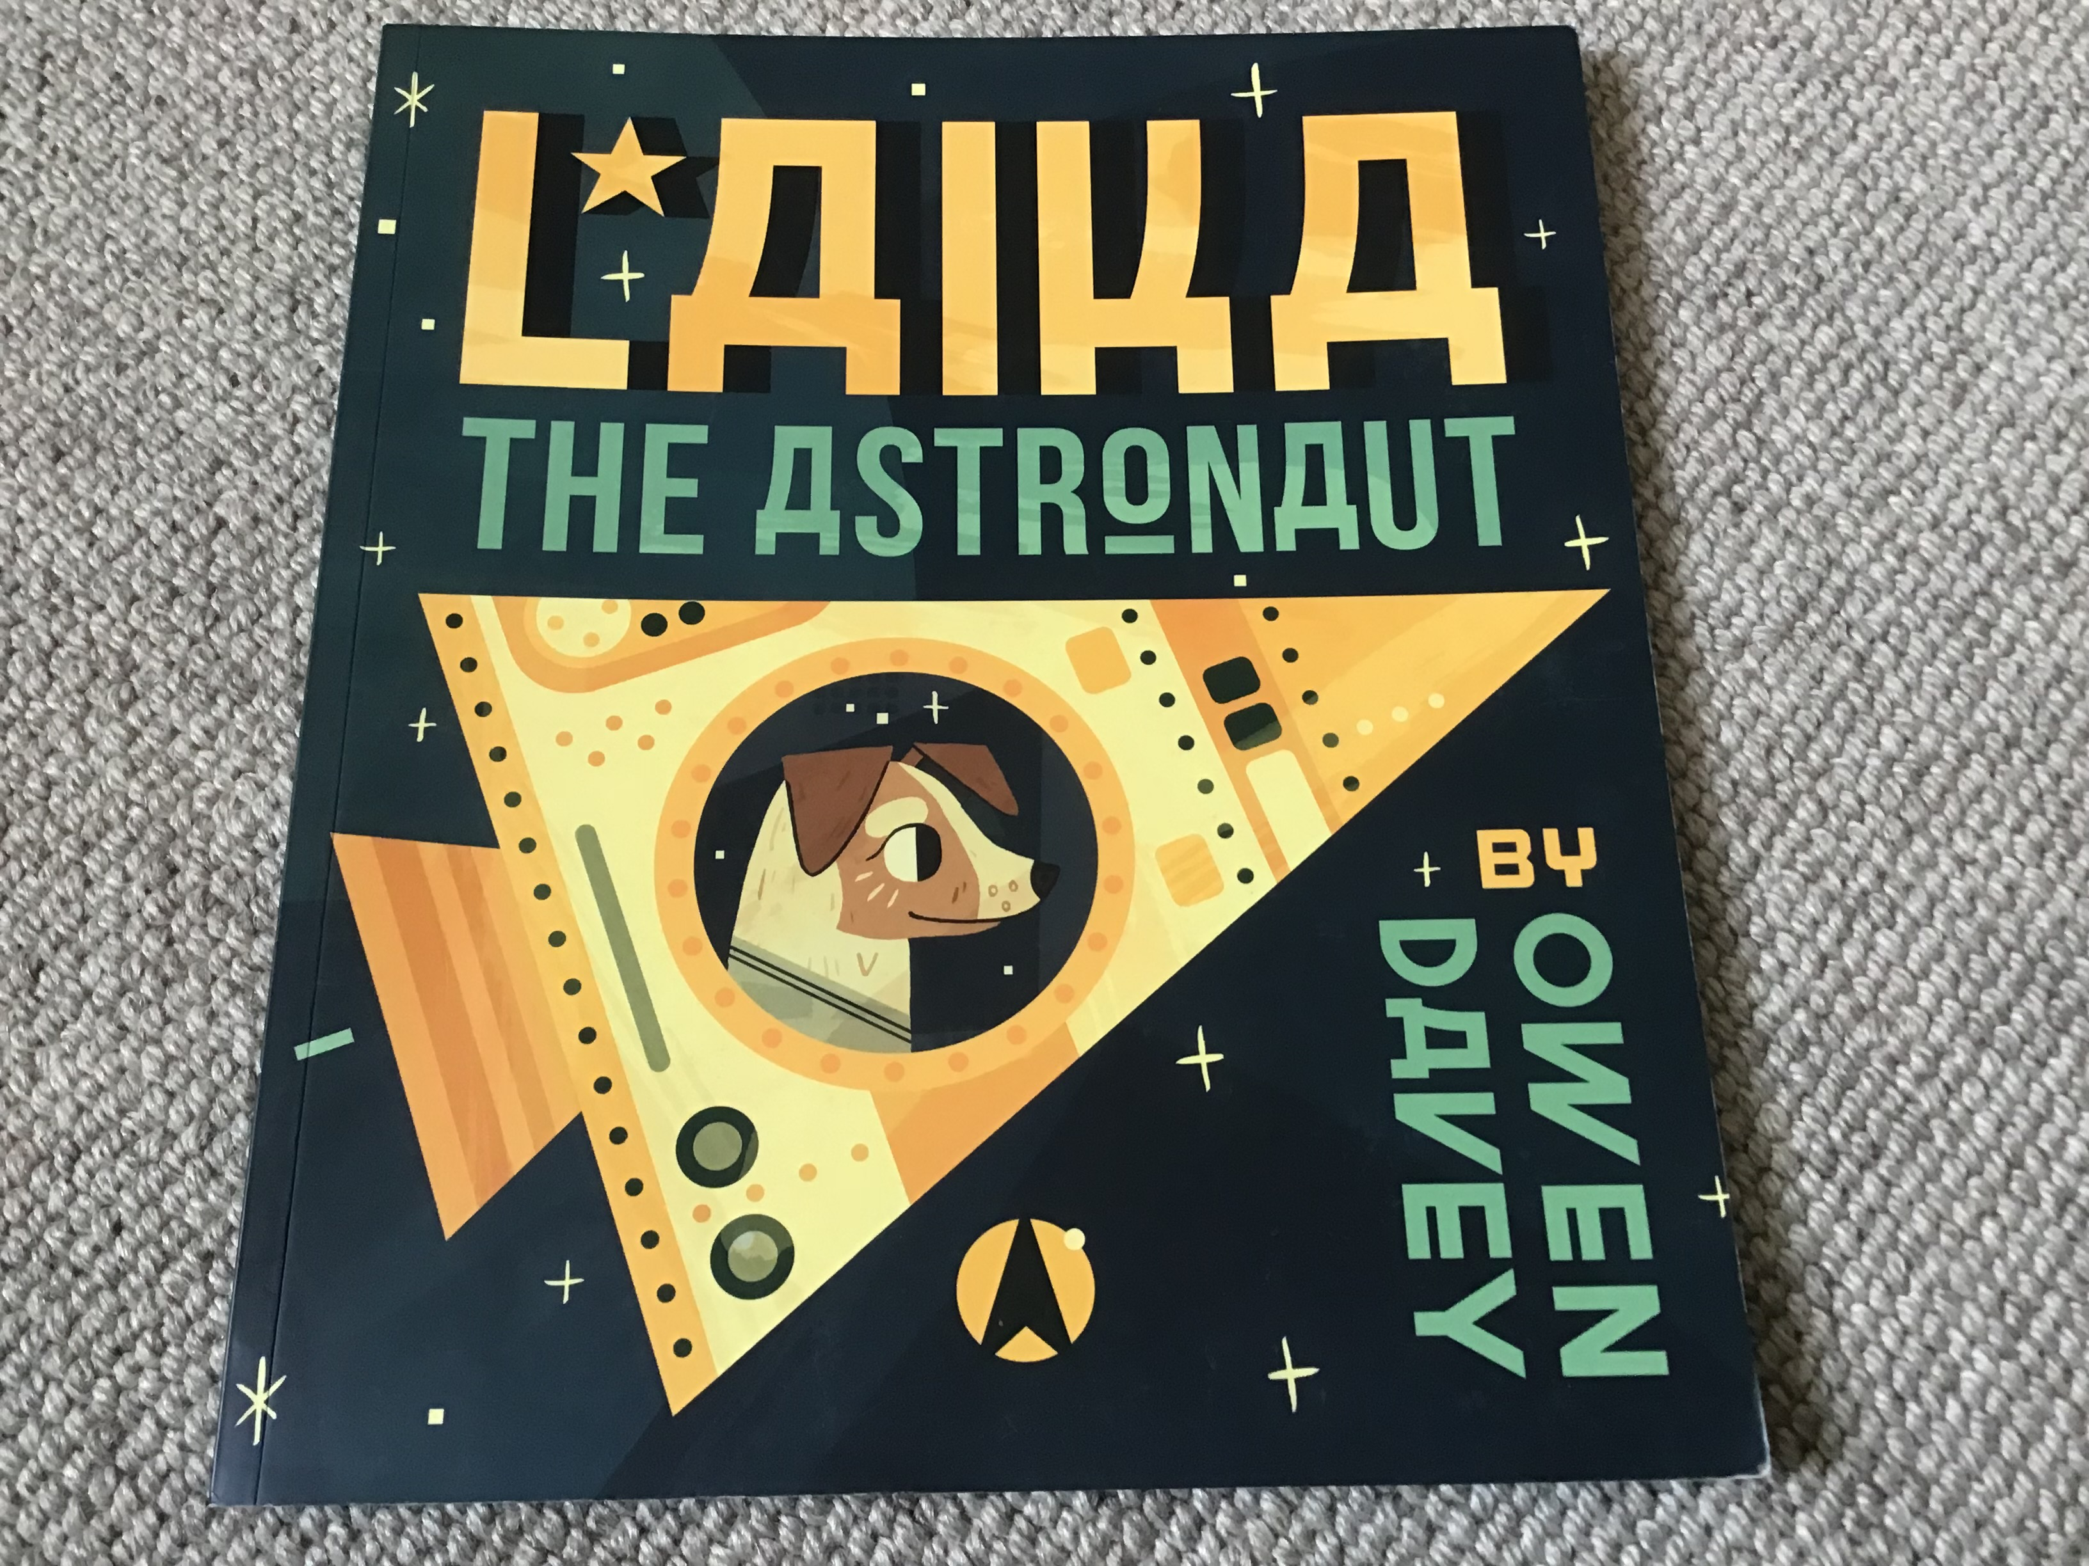
Y2?
Laika The Astronaut
Laika was a stray dog, wandering the streets of Moscow. She had no family and nowhere to call home. Laika was all alone.
At night, she looked at the stars and made a wish - a wish to find a family who would love her. Then someone noticed Laika was alone and decided she would be perfect for a very special job....
A group of scientists wanted her to try out their new spacecraft. She trained very hard and was tested many times until finally...
Laika was ready to go into space. She climbed aboard her rocket and waited.
10...9...8...7...6...5...4...3...2...1...
BLAST OFF!

Slide 97
Take it apart
https://www.skiptoncastle.co.uk/uploads/Skipton-Castle-Leaflet-2020.pdf

Slide 98


Slide 99
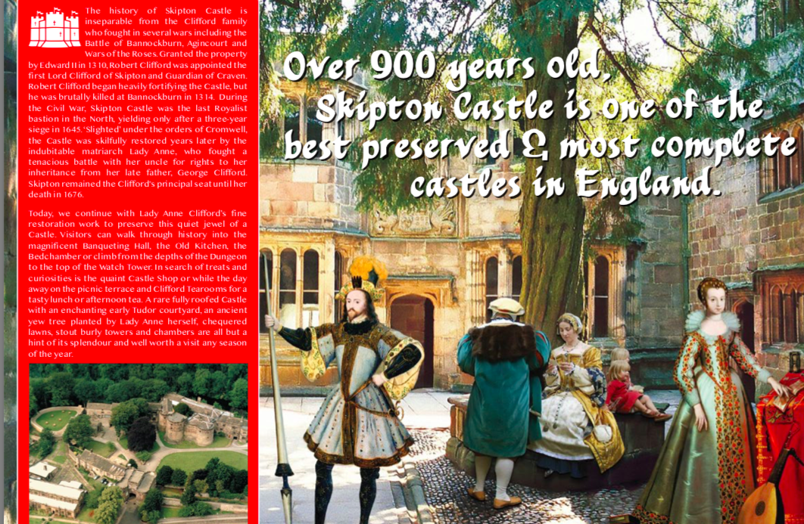

Slide 100
Heading
Aerial Photograph
Opening Times
Prices

Slide 101
Information about the castle
Maps

Slide 102
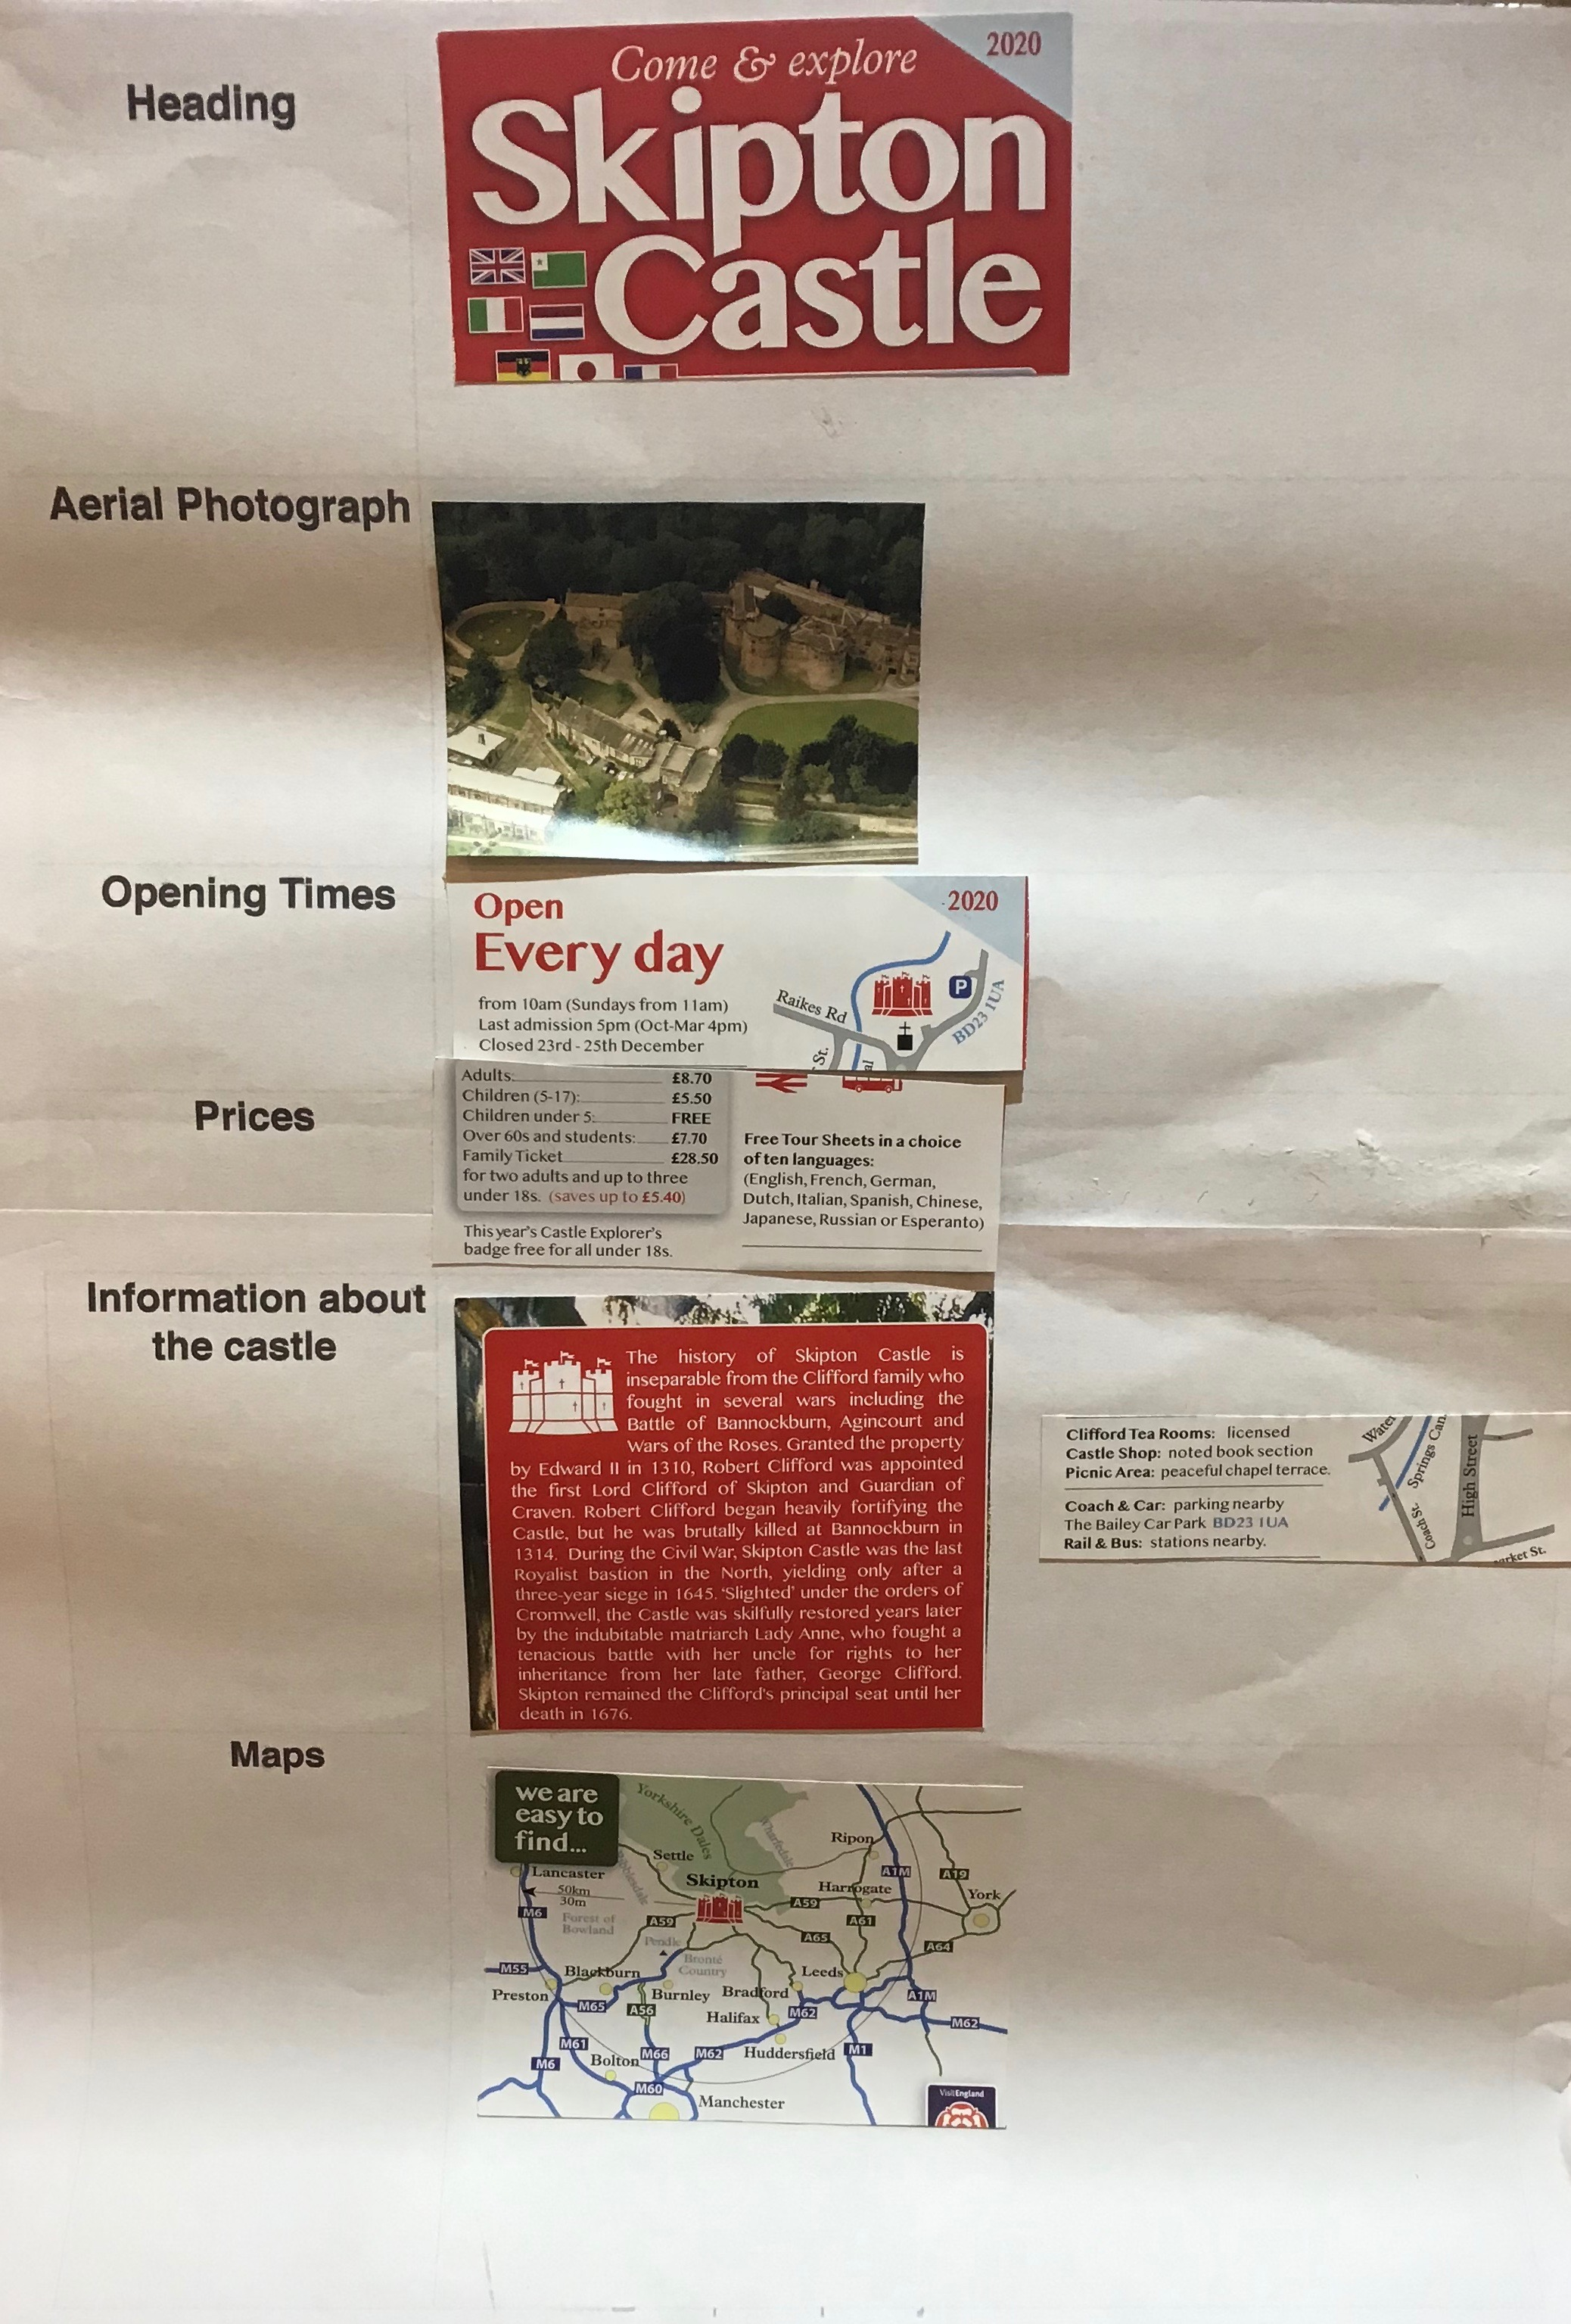

Slide 103

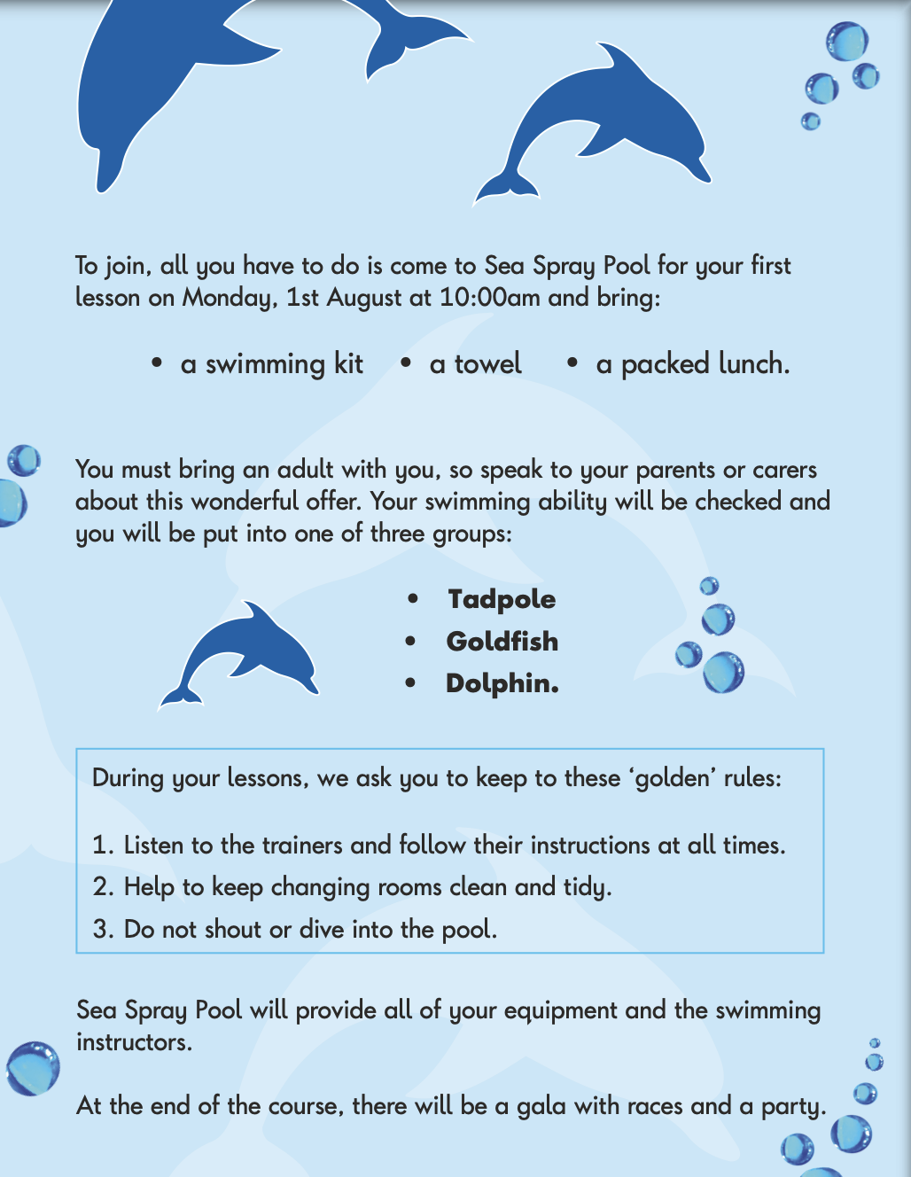

Slide 104
Key Feature

Slide 105
Increasing children’s experience with a range of non-fiction texts would help them to become more familiar with the different ways information is presented across text types. This could be by, for example:
• exploring different non-fiction texts such as instructions, recipes, leaflets and newsletters among others
• using simplified non-fiction text exemplars to introduce this genre in an easier and supported way
• giving children the opportunity to create non-fiction texts to support their understanding of its features.

Slide 106
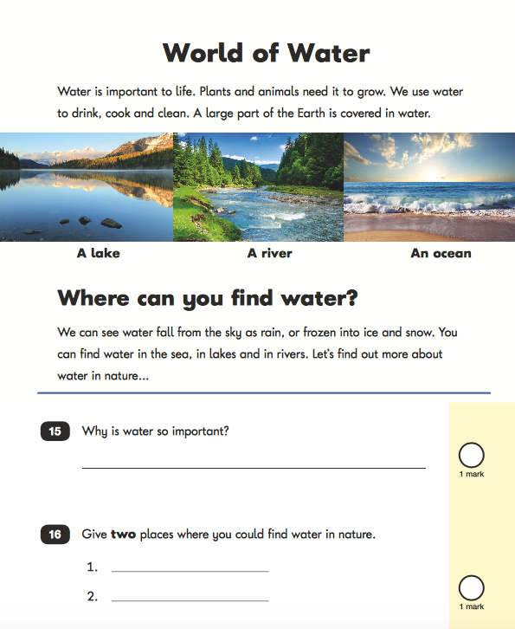
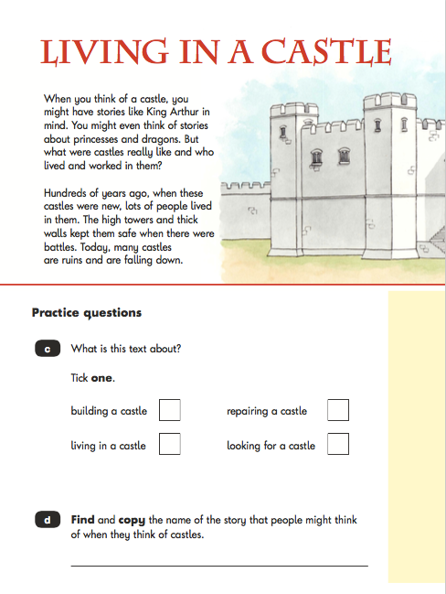
Non-fiction SATS

Slide 107
KS 1 Non-fiction 2018 - number of questions

Slide 108
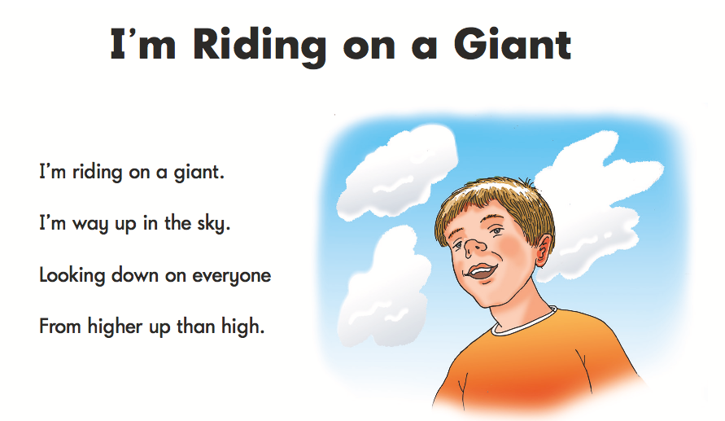
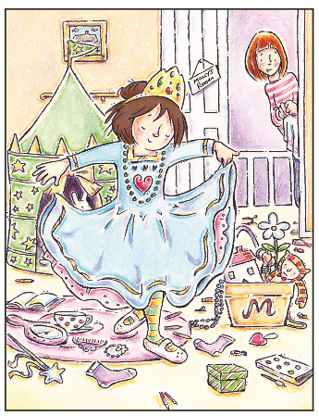
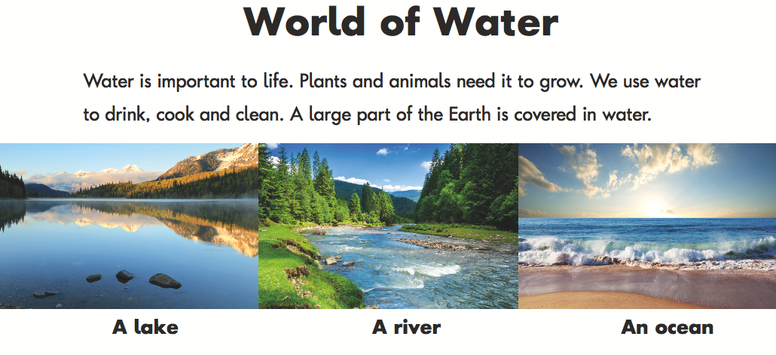
KS1 Reading Paper 1 2017 - Text Type
Poem
Story
Non-fiction

Slide 109
KS 1 Non-fiction 2018 - type of questions
What…?
Tick one x3
Write two words … x2
Where… x 2
When…?
Find and copy x2
Number the sentences
Paper 1

Slide 110
KS 1 Non-fiction 2018 - type of questions
Paper 2
Why is…?
What do the words …. mean?
What are they doing differently ?
Draw 4 lines to match
True or false chart
 | TRUE | FALSE
Ananasi said that he would pay for some stories,
Tiger and Snake were friends.
Anansi waited outside Snake’s hole.

Slide 111

World of Water
Why is …
Give 2 …
What is … tick one
What is…
The text tells us….
  Name two…
Draw three lines…
oceans
large areas of salt water

Slide 112
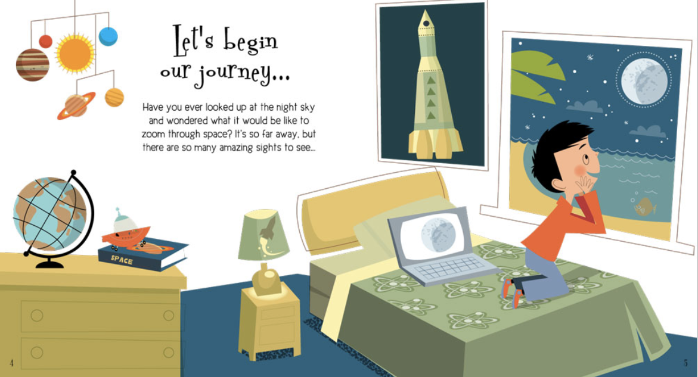
Where is the journey to?

Slide 113
A Journey Through Space - Steve Parker

Slide 114
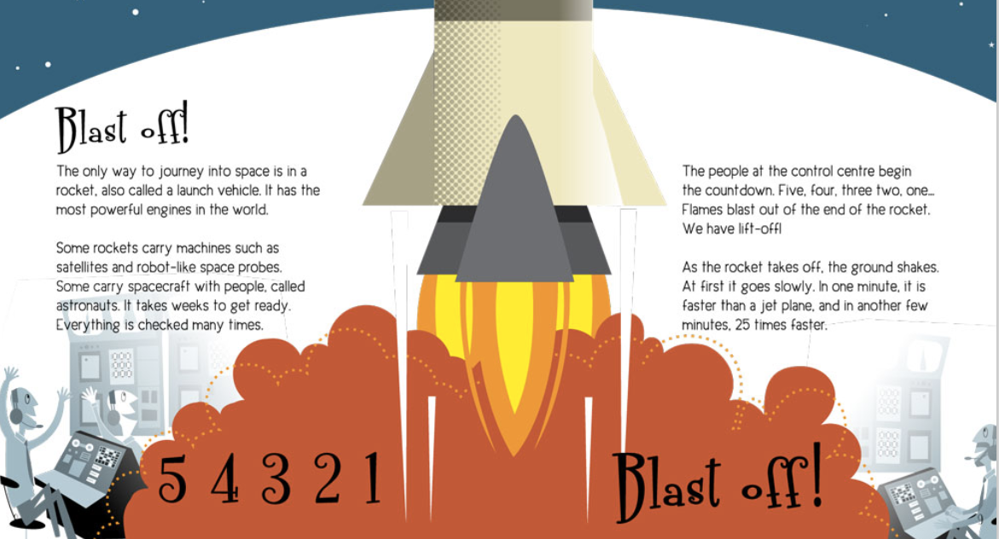
What is the only way to journey into space?
Give two things that spacecraft can carry.
1.
2.

Slide 115
What blasts out at the end of the rocket?
Tick one.
gas
air
flames
fuel
What does the rocket travel 25 times faster than?

Slide 116
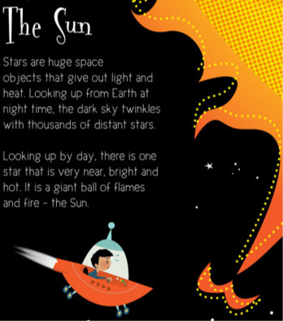
Across the universe
The universe is all of space and everything in it – planets, stars, galaxies, black holes and the rest.
No one really knows the shape or size of the universe. It could be round like a ball, curved like at dome, or ring-shaped. Some space experts think it is flat – like a sandwich!
The universe started 13,800 million years ago. At first it was a tiny spot with everything squeezed into it.
Then Boom! –the Big Bang. The Universe started to get bigger. Stars and all the space objects formed. The Universe is still getting bigger today. It will probably keep growing for millions of years, maybe even forever.
Stars are huge space objects that gave out light and heat. Looking up from earth at nighttime, the dark sky twinkles is with thousands of distant stars.
Looking up by day, there is one star that is very nearAnd hot. It is a giant ball of flames and fire - the sun.
Stars give out two things.
Name both of them.
1.
2.

Slide 117
Across the universe
The universe is all of space and everything in it – planets, stars, galaxies, black holes and the rest.
No one really knows the shape or size of the universe. It could be round like a ball, curved like at dome, or ring-shaped. Some space experts think it is flat – like a sandwich!
The universe started 13,800 million years ago. At first it was a tiny spot with everything squeezed into it.
Then Boom! –the Big Bang. The Universe started to get bigger. Stars and all the space objects formed. The Universe is still getting bigger today. It will probably keep growing for millions of years, maybe even forever.
Draw two lines to finish the sentences
The Universe
was when the universe started to get bigger.
The Big Bang
is all of space and everything in it.

Slide 118
Simplified Texts

Slide 119

Read text aloud to group
Shorter text
Simpler layout
Scaffolded answer
The only way to journey into space is in a rocket, also called a launch vehicle.
Q
What is the only way to journey into space?
A
The only way to journey into spaces is in a ?

Slide 120
Shorter text
Stars are huge space objects that give out light and heat. Looking up from earth at nighttime, the dark sky twinkles with thousands of distant stars.
Stars give out two things.
Name both of them.
1.
2.

Slide 121
Read text aloud to group
Shorter text
Fewer options
The people in the control centre begin the countdown. Flames blast out of the end of the rocket.
What blasts out at the end of the rocket?
Tick one.
gas
flames

Slide 122
Read text aloud to group
Shorter text
Simpler layout
Some rockets carry machines such as satellites and robot like space probes. Some carry people called astronauts.
Q
Give two things that rockets carry.
1
2

Slide 123
Across the Universe
The universe is all of space and everything in it – planets, stars, galaxies, black holes and the rest.
No one really knows the shape or size of the universe. It could be round like a ball, curved like at dome, or ring-shaped. Some space experts think it is flat – like a sandwich!
The universe started 13,800 million years ago. At first it was a tiny spot with everything squeezed into it.
Then Boom! –the Big Bang. The Universe started to get bigger. Stars and all the space objects formed. The Universe is still getting bigger today. It will probably keep growing for millions of years, maybe even forever.

Slide 124

Who? |  | What?
Where? |  | When?
Why? |  | How?
Downloadable
resource

Slide 125
Children found it more difficult to provide longer written responses.
In 2020, children found questions which require a longer written response harder than in 2017. Although this pattern is true for all groups, evidence suggests that boys performed less well on all written questions (short and long), in comparison to girls. All children were also more likely to miss out these types of question.
There may be several different underlying reasons why children struggle with longer written responses. These include confidence, reading or handwriting fluency and self-regulation of planning, monitoring and writing responses.

Slide 126
Winter Morning
Teacher Read Aloud
Winter is the king of showmen
Turning tree stumps into snow men
And houses into birthday cakes
And spreading sugar over lakes
Smooth and clean and frosty white
The world looks good enough to bite
That's the season to be young
Catching snowflakes on your tongue
Snow is snowy when it's snowing
I'm sorry it's slushy when it's going

Slide 127
Graphic question
 | TRUE | FALSE
Snow is slushy when it’s snowing.
The world looks good enough to bite.
The snow is rough and cold and frosty blue.

Slide 128
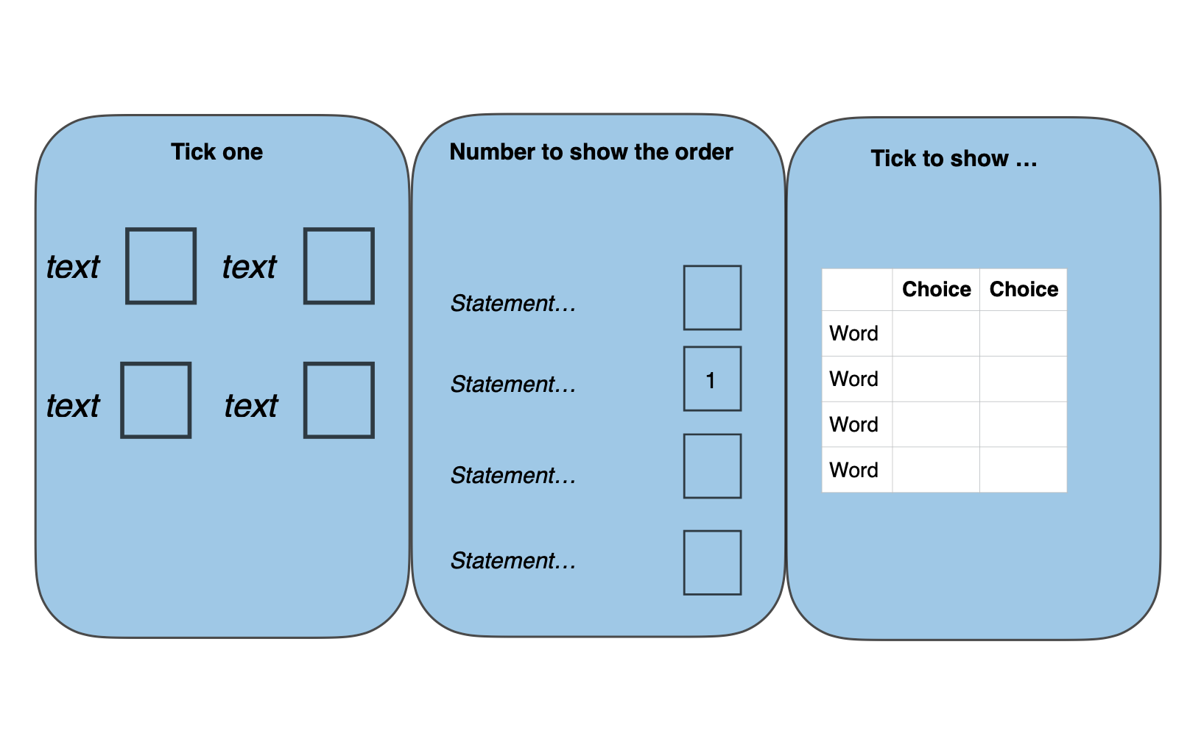

Slide 129
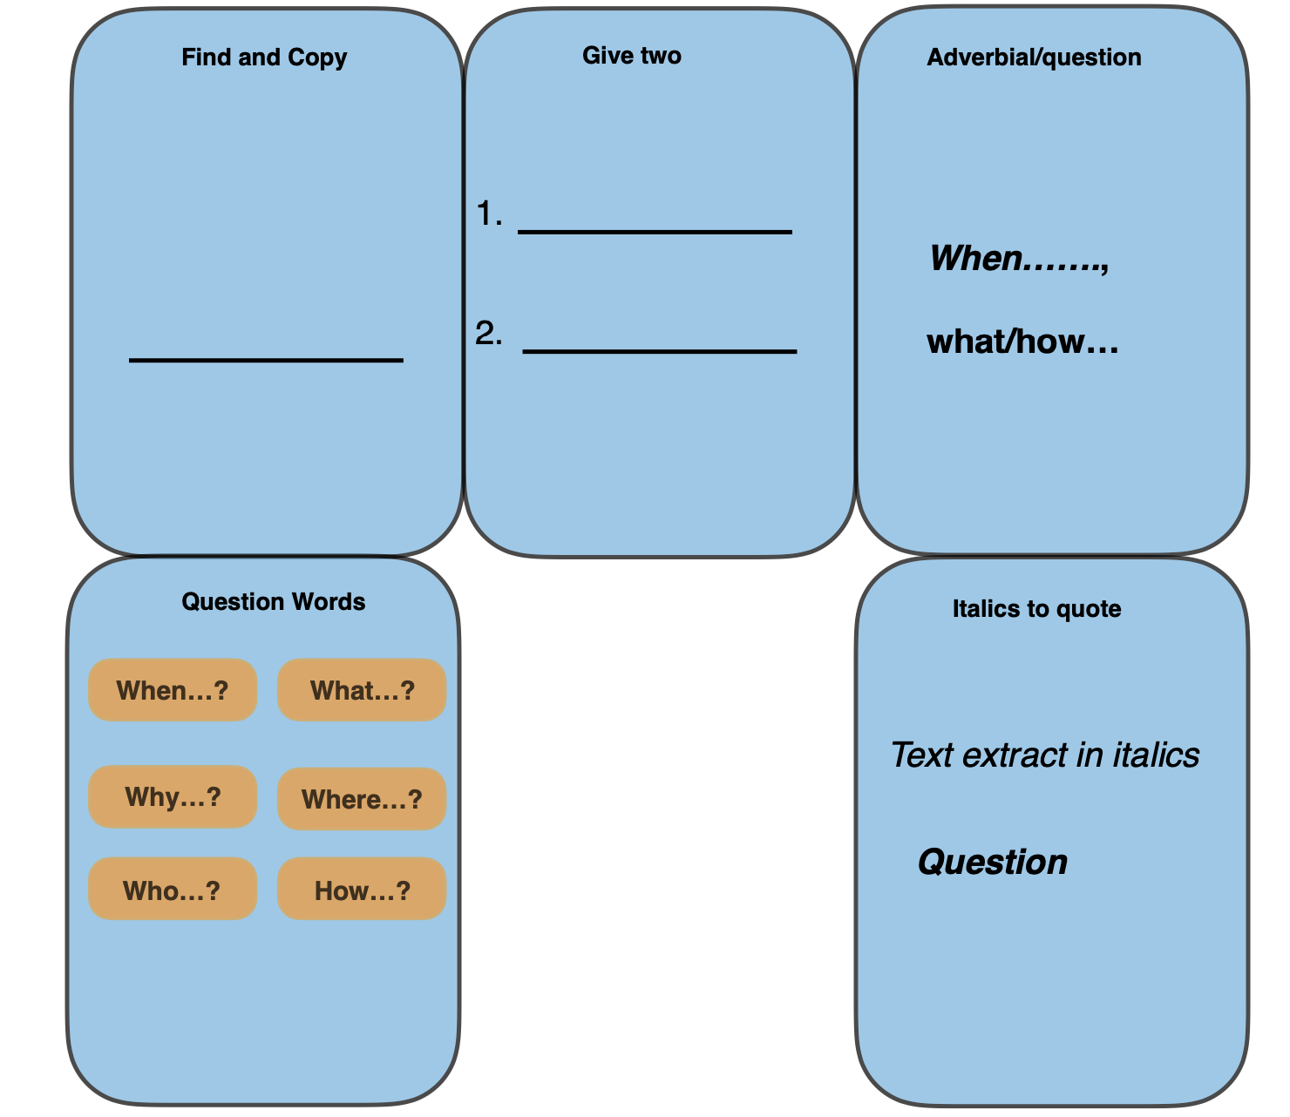

Slide 130
Children found it more difficult to provide longer written responses.
Activities which support children’s engagement with texts through writing are likely to promote their confidence and fluency with written responses. Suggestions for practice will vary depending on the underlying reasons for children’s difficulties with written responses, but could include:
templates / writing frames …. to scaffold children’s responses to texts in varied ways
modelling the planning and editing of extended written responses, encouraging children to evaluate their own writing and that of their peers.

Slide 131
Read text aloud to group
Shorter text
Simpler layout
Scaffolded answer
The only way to journey into space is in a rocket, also called a launch vehicle.
Q
What is the only way to journey into space?
A
The only way to journey into spaces is in a ?

Slide 132
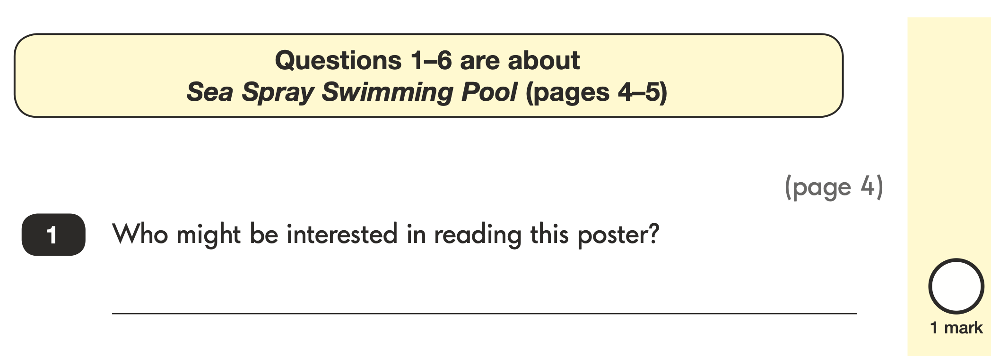
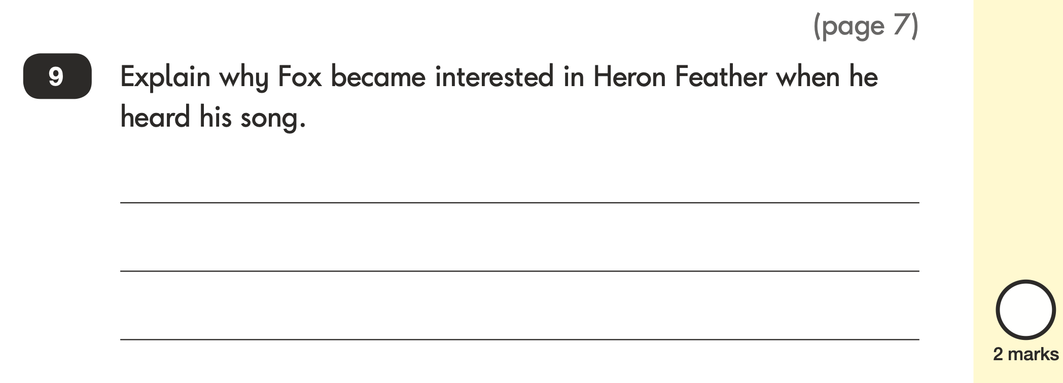
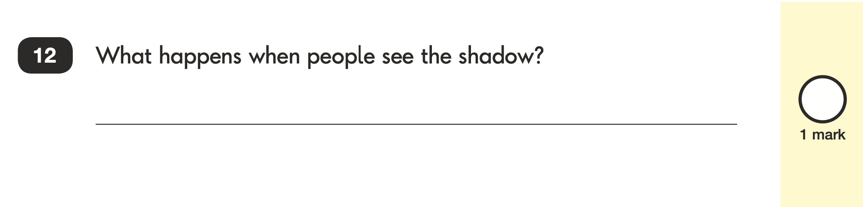
Non-fiction
Fiction
Poetry

Slide 133
Poetry
People down below us
Simply stop and stare.
Then when they see our shadow, Oh wow! They get a scare.
I’m taller than the tree-tops. I’m high enough to fly. Another centimetre and I’d
Bump into the sky.
What happens when people see the shadow?

Slide 134
Poetry
People down below us
Simply stop and stare.
Then when they see our shadow, Oh wow! They get a scare.
I’m taller than the tree-tops. I’m high enough to fly. Another centimetre and I’d
Bump into the sky.
What happens when people see the shadow?

Slide 135
Fiction
One fine day, a hungry fox was walking down the road. His tummy was rumbling so loudly that he almost didn’t hear the sound of someone coming…
Fox didn’t care if the man was handsome, but he pricked up his ears at the word ‘fisherman’, for where there are fishermen, there are fish. And a tasty fish would just suit Fox. His nose twitched. A delightful fishy smell was coming out of the man’s leather bag.
Award 2 marks for reference to Heron Feather being a fisherman / having fish and any reference to Fox being hungry / liking fish or thinking he might have a chance of getting fish / a meal, e.g.
• his song said he was a fisherman and so he might have fish with him
• because he mentioned the word fish and he might of hoped there was a fish
in his bag
• because he said he was a fisherman and Fox wants fish
• the fox likes fish and the man is a fisherman
• Heron Feather was singing that he was a good fisherman and Fox was hungry.

Slide 136
Modelling
First go
Add
Replace
Check

Slide 137
Modelling
His song said he was a fisherman.
First go
Add
Replace
Check

Slide 138
Modelling
His song said he was a fisherman and
the fox was hungry.
First go
Add
Replace
Check

Slide 139
Year 2 - Poetry

Slide 140
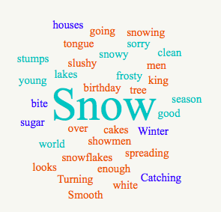
Prediction
‘warmed up’ and ‘readied’ for content through an introductory task or scene-setting. DfE

Slide 141
Prediction - sequence the first four lines
Winter is the king of showmen
Turning tree stumps into snow men
And houses into birthday cakes
And spreading sugar over lakes

Slide 142
Winter Morning
Paired Read Aloud
Winter is the king of showmen
Turning tree stumps into snow men
And houses into birthday cakes
And spreading sugar over lakes
Smooth and clean and frosty white
The world looks good enough to bite
That's the season to be young
Catching snowflakes on your tongue
Snow is snowy when it's snowing
I'm sorry it's slushy when it's going

Slide 143
Vocabulary check
slushy
tree stumps
lakes

Slide 144
Winter Morning
Ogden Nash
Winter is the king of showmen
Turning tree stumps into snow men
And houses into birthday cakes
And spreading sugar over lakes
Smooth and clean and frosty white
The world looks good enough to bite
That's the season to be young
Catching snowflakes on your tongue
Snow is snowy when it's snowing
I'm sorry it's slushy when it's going

Slide 145

Rapid Retrieval
Who or what is the king of showmen?
What does winter turn houses into?
most important knowledge or concepts pupils need to know. Focus on those. DfE
Low-stakes quizzes can be built in to remote education, as can written assignments and retrieval practice activities. DfE

Slide 146
Vocabulary question
Find and copy the word that is the opposite of rough.
most important knowledge or concepts pupils need to know. Focus on those. DfE

Slide 147
Graphic question
 | TRUE | FALSE
Snow is slushy when it’s snowing.
The world looks good enough to bite.
The snow is rough and cold and frosty blue.

Slide 148
Inference questions
Why does the world look good enough to bite?
Why do you think the writer is sorry that snow is slushy when it’s going?
most important knowledge or concepts pupils need to know. Focus on those. DfE

Slide 149
Whole text
Likes
Dislikes
Puzzles
Patterns
Notes:
a version of the tell me grid - quick go

