Slide 1
The journey through a book
From Prediction…
… to Publishing
phases
Previously… The Matchbox Diary

Slide 2

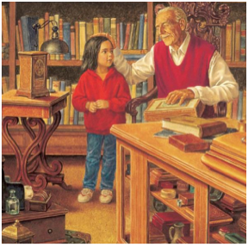
Phase 1
Phase 2
Phase 3
Phase 4
Phase 5
Reading
Writing
Prediction
Comprehension
Drafting
Editing
Publishing
SPaG
and TSO
Gap filling
ARE Grammar
    Revise - Practise - Introduce - Practise - Apply
Notes:
this our foundation

Slide 3
Writing
SPaG in context
Using structures
Reading
Prediction
Active involvement
Visual texts
Engagement
Extending vocabulary
Notes:
writing like an iceberg - esp' for our children
below the surface are elements that contribute to success in writing
will cover today

Slide 4

Phase 1 - Prediction

Slide 5

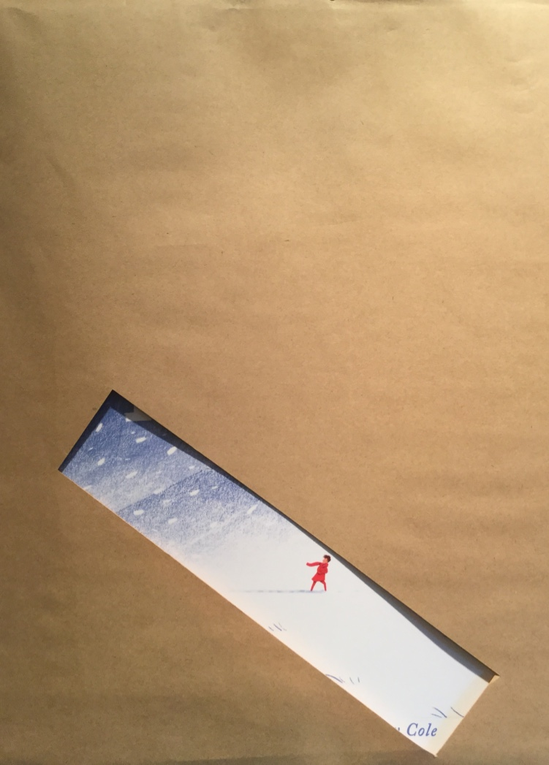
Why Picture Books?
Easy to adapt the structure
Does not take long to
read the full story
I predict that the characters are…
The setting…
I think the story will be …
A question I would like to ask is …
Easy access to good
examples
of sentence types
Visual support for children
Provide good story structures
They are beautiful!
Notes:
1st clue
Tell me grid
What grammar did you use? Which year group?
.CAP - ?
conjunctions before - after while so because

Slide 6
cold place
boy
story
time

Slide 7
People
Places
Story
Time

Slide 8
Giving Children a Voice
A high quality text to explore by the class
  Audience and purpose
  Vocabulary development
  Grammatical structures
  Layout
  Writing opportunities
Providing and developing sound understanding of:
  Plot
  Character
  Setting
Responding to books and discussing the purpose of language used

Slide 9

Anagram?
_ _ _ _ _ _ _ _ _ _ _ _
Notes:
3 x E
1 x C
1 x D
1 x H
1 x I
1 x N
1 x P
2 x R
1 x T

Slide 10

_ _ _ _ _ _ _ _ _ _ _ _
chirped enter
Notes:
Use this to write a prediction - TM grid

Slide 11
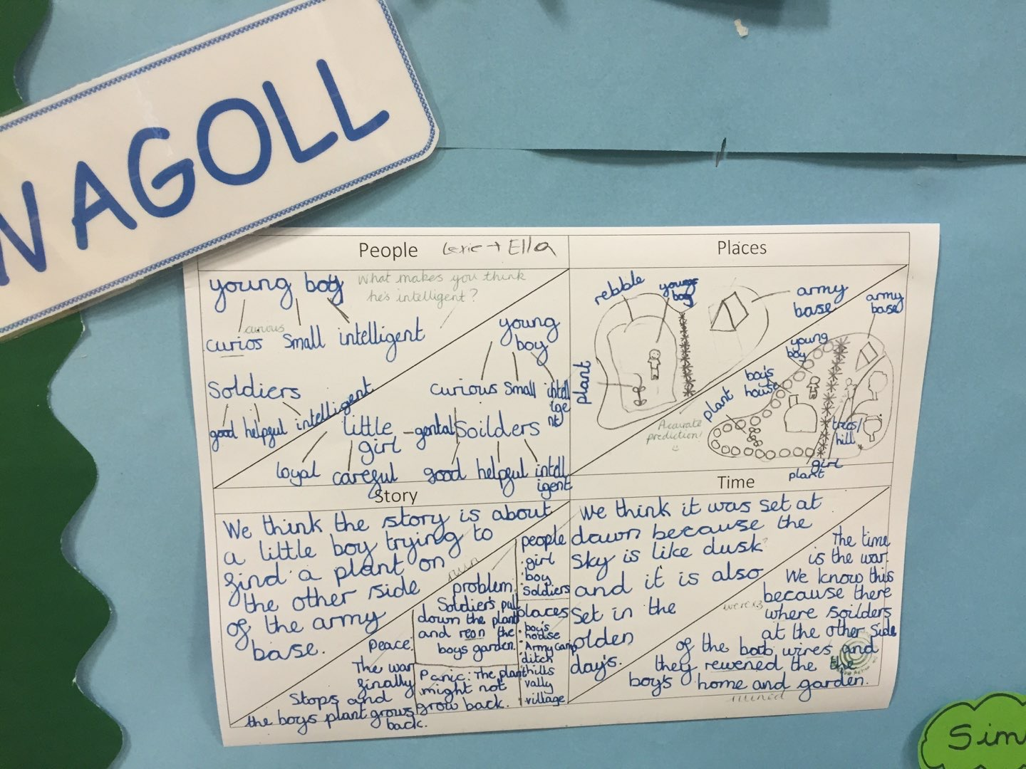

Slide 12
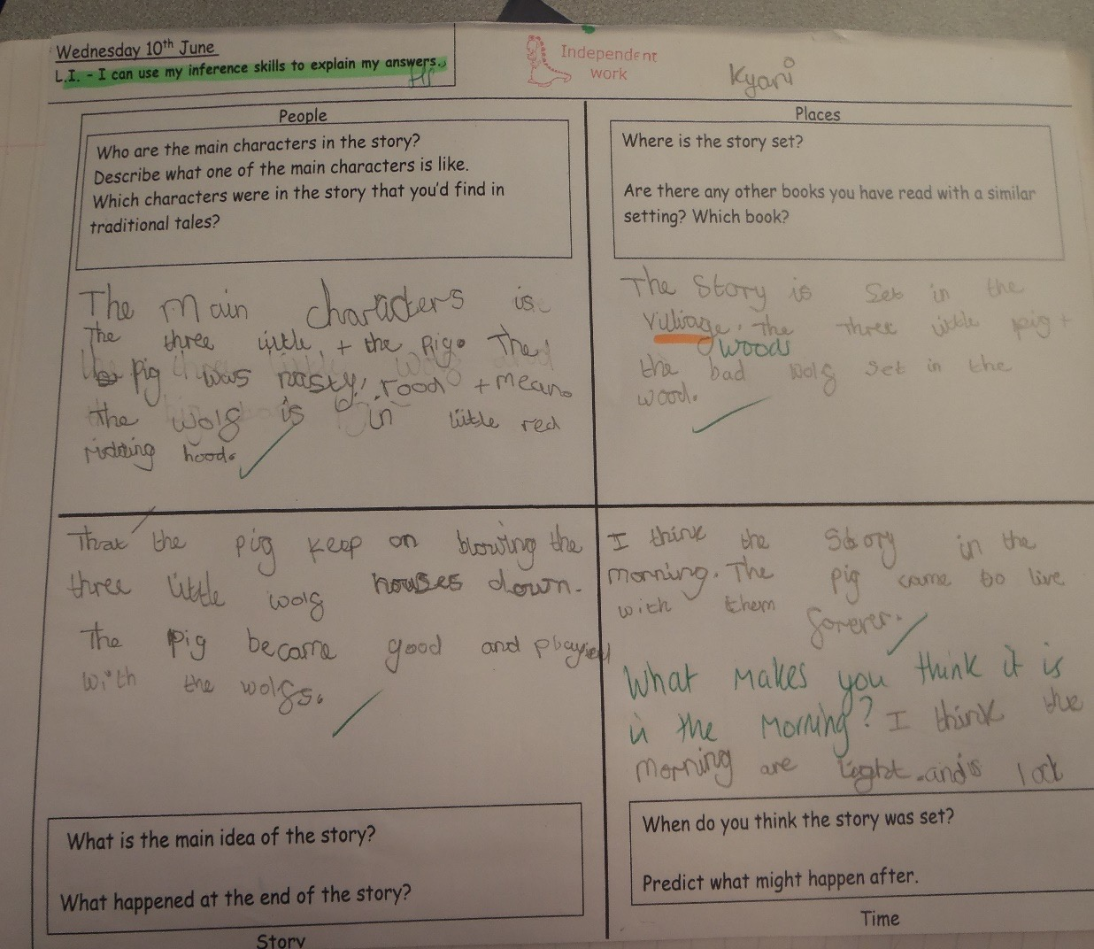
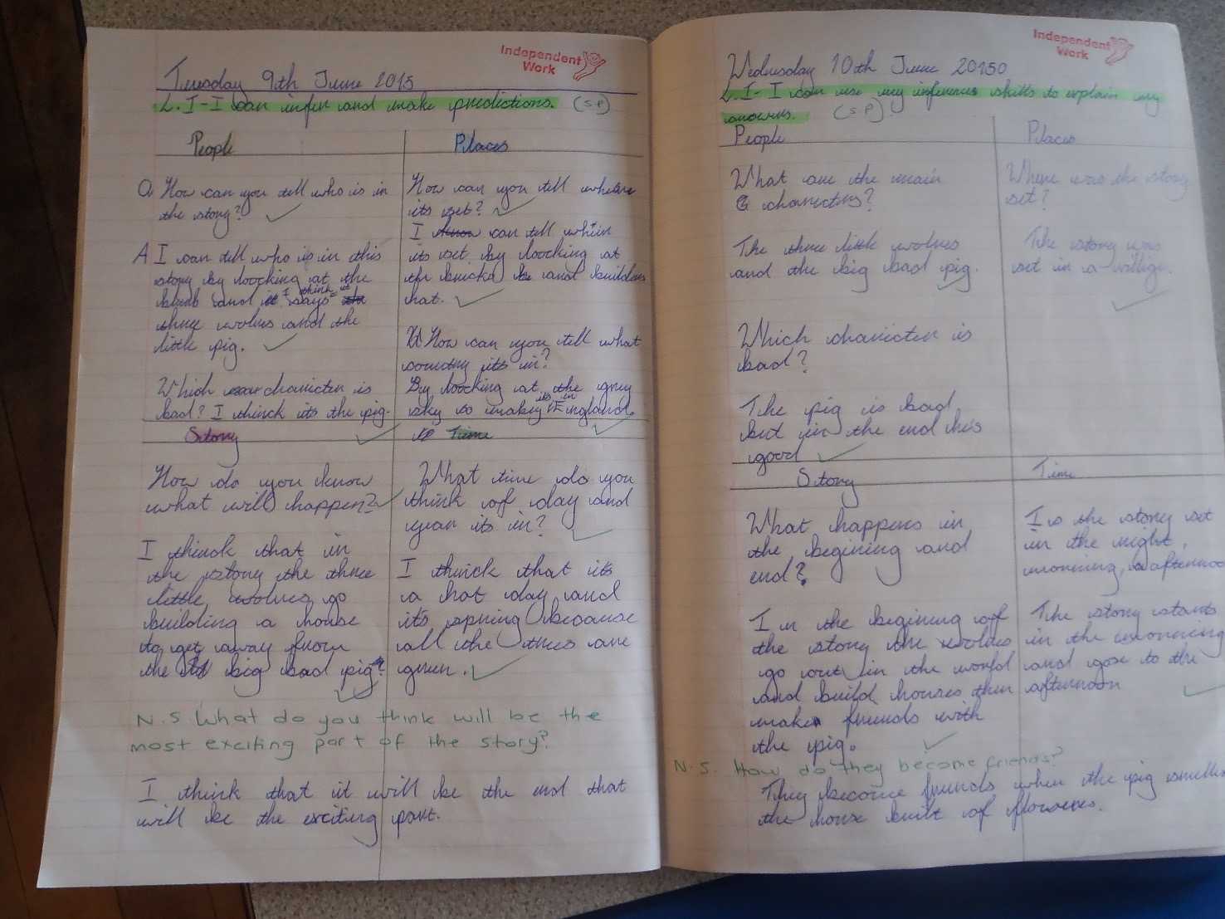
Tell me grid
Prediction grid first lesson then actual tell me grid for comprehension.

Slide 13
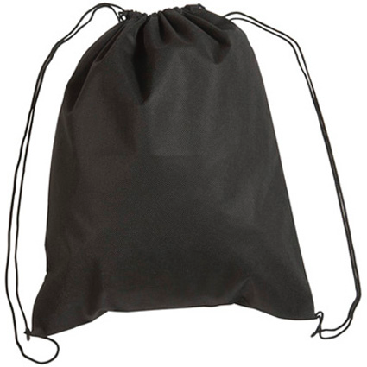
I can make predictions
I can use conjunctions to explain what I am thinking.
I think the story ………. because …..
I think ………. and …..
I think ………. but …..
I think ………. or …..
Notes:
Props bag - talk partner - can you use these - after each artefact

Slide 14
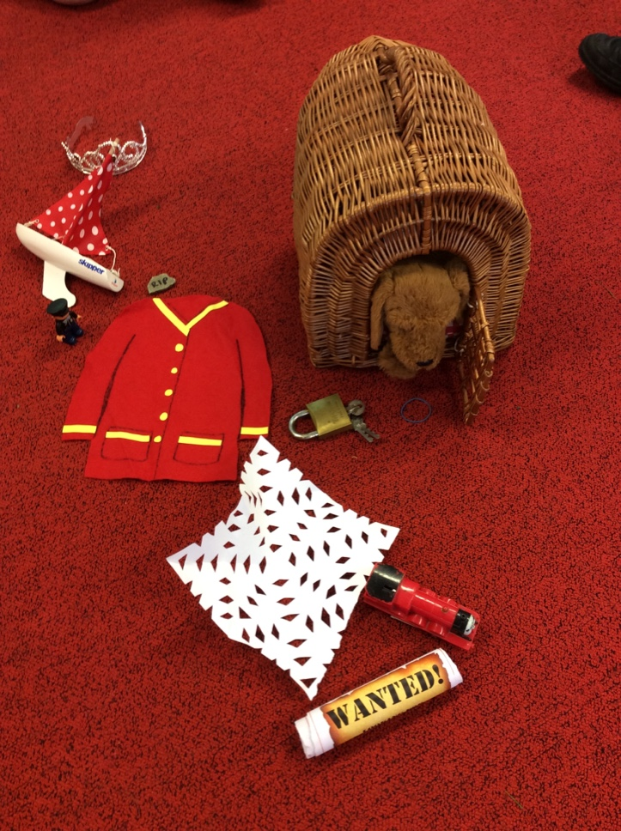
I predict….
Y3 conjunctions - when… so … if … before … after … while .. because
Y3 prepositions - before… after … during … because of … after … while .. because
Y3 adverbs - then… next … soon … therefore
Notes:
Props bag - talk partner - can you use these - after each artefact

Slide 15
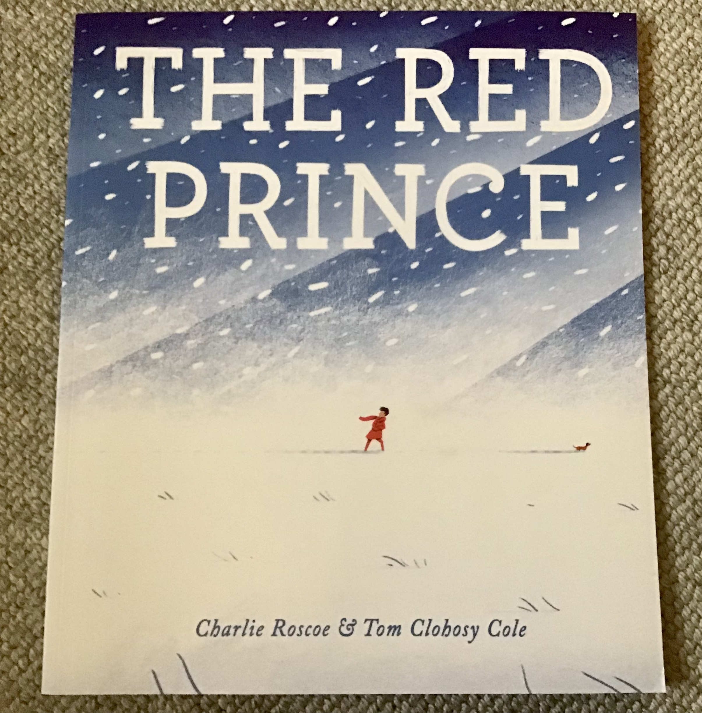

Slide 16
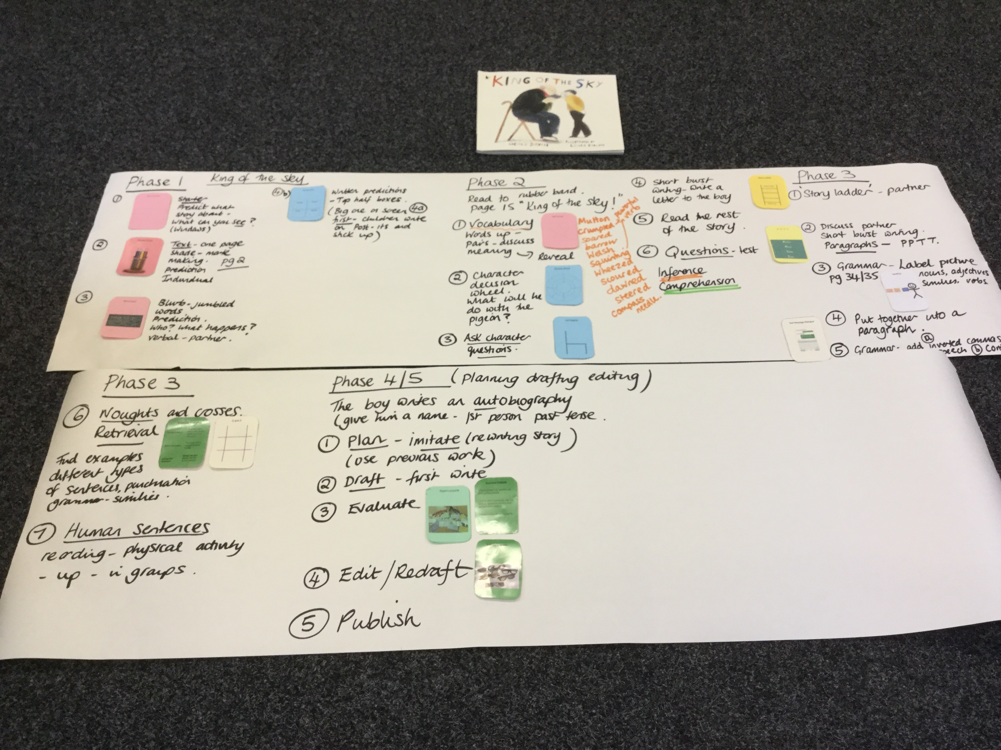

Slide 17
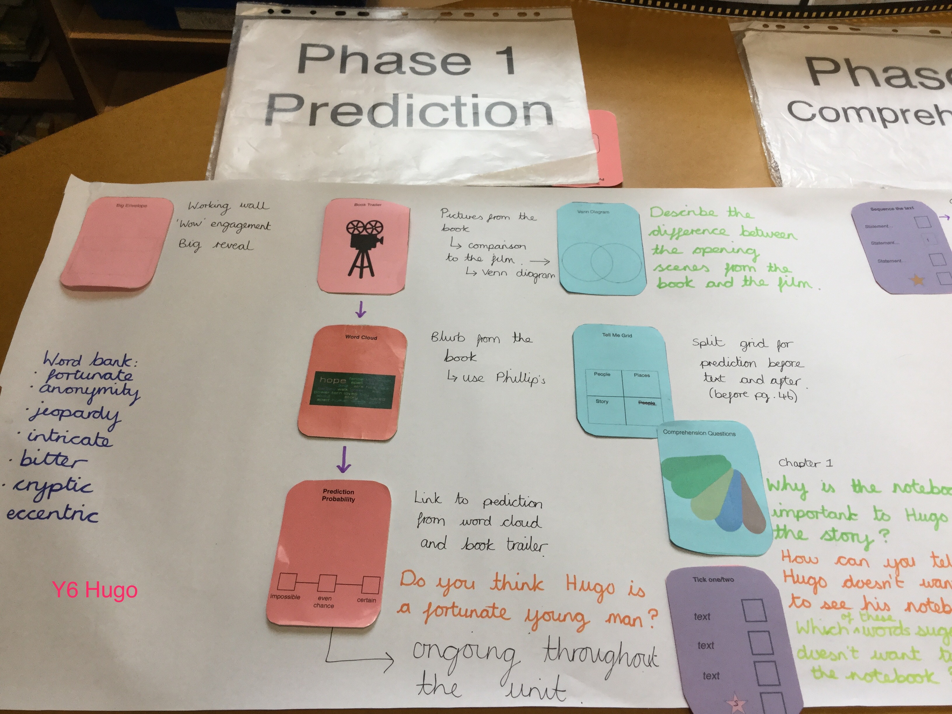

Slide 18
Phase 2
comprehension

Slide 19
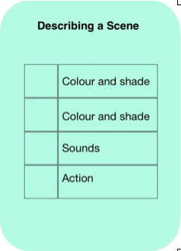

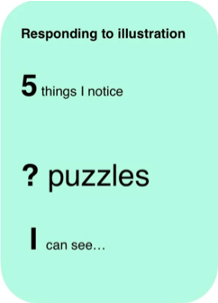
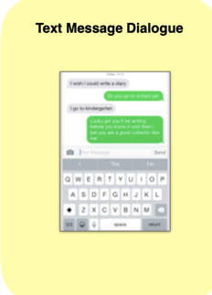

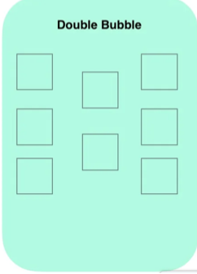
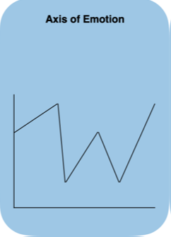
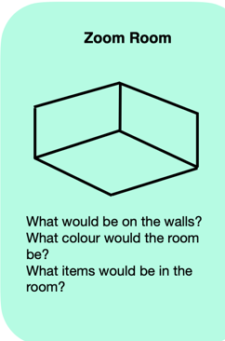
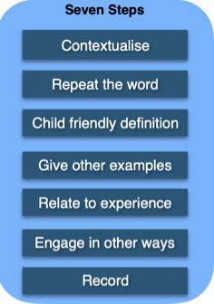
Phase 2 - Comprehension
To do
2 choices
note to boy
we/you
I
meets the girl
boy
girl

Slide 20
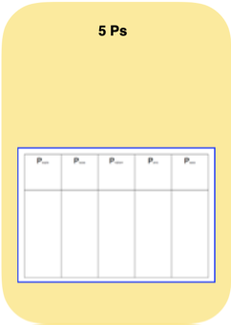
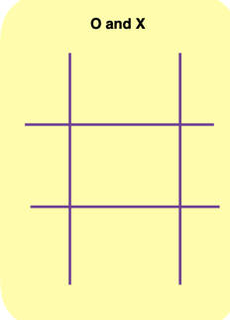
Phase 3 - TSO
Phase 3 - SPaG

Slide 21


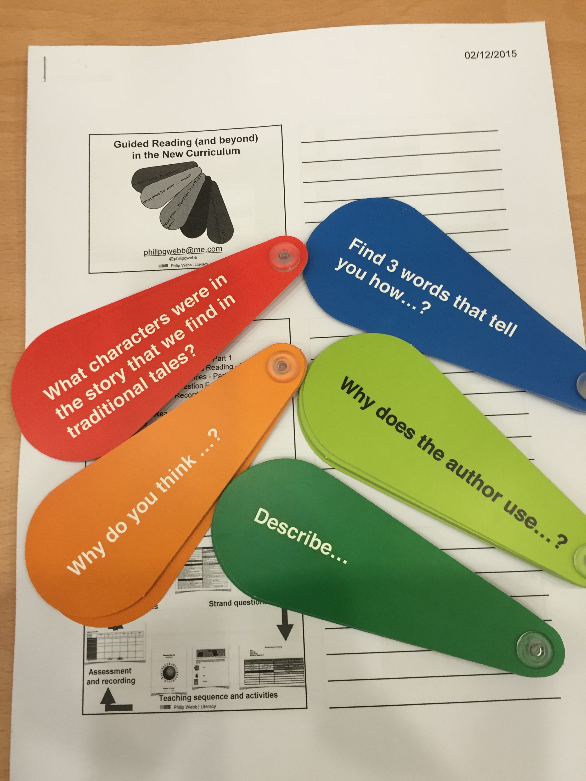
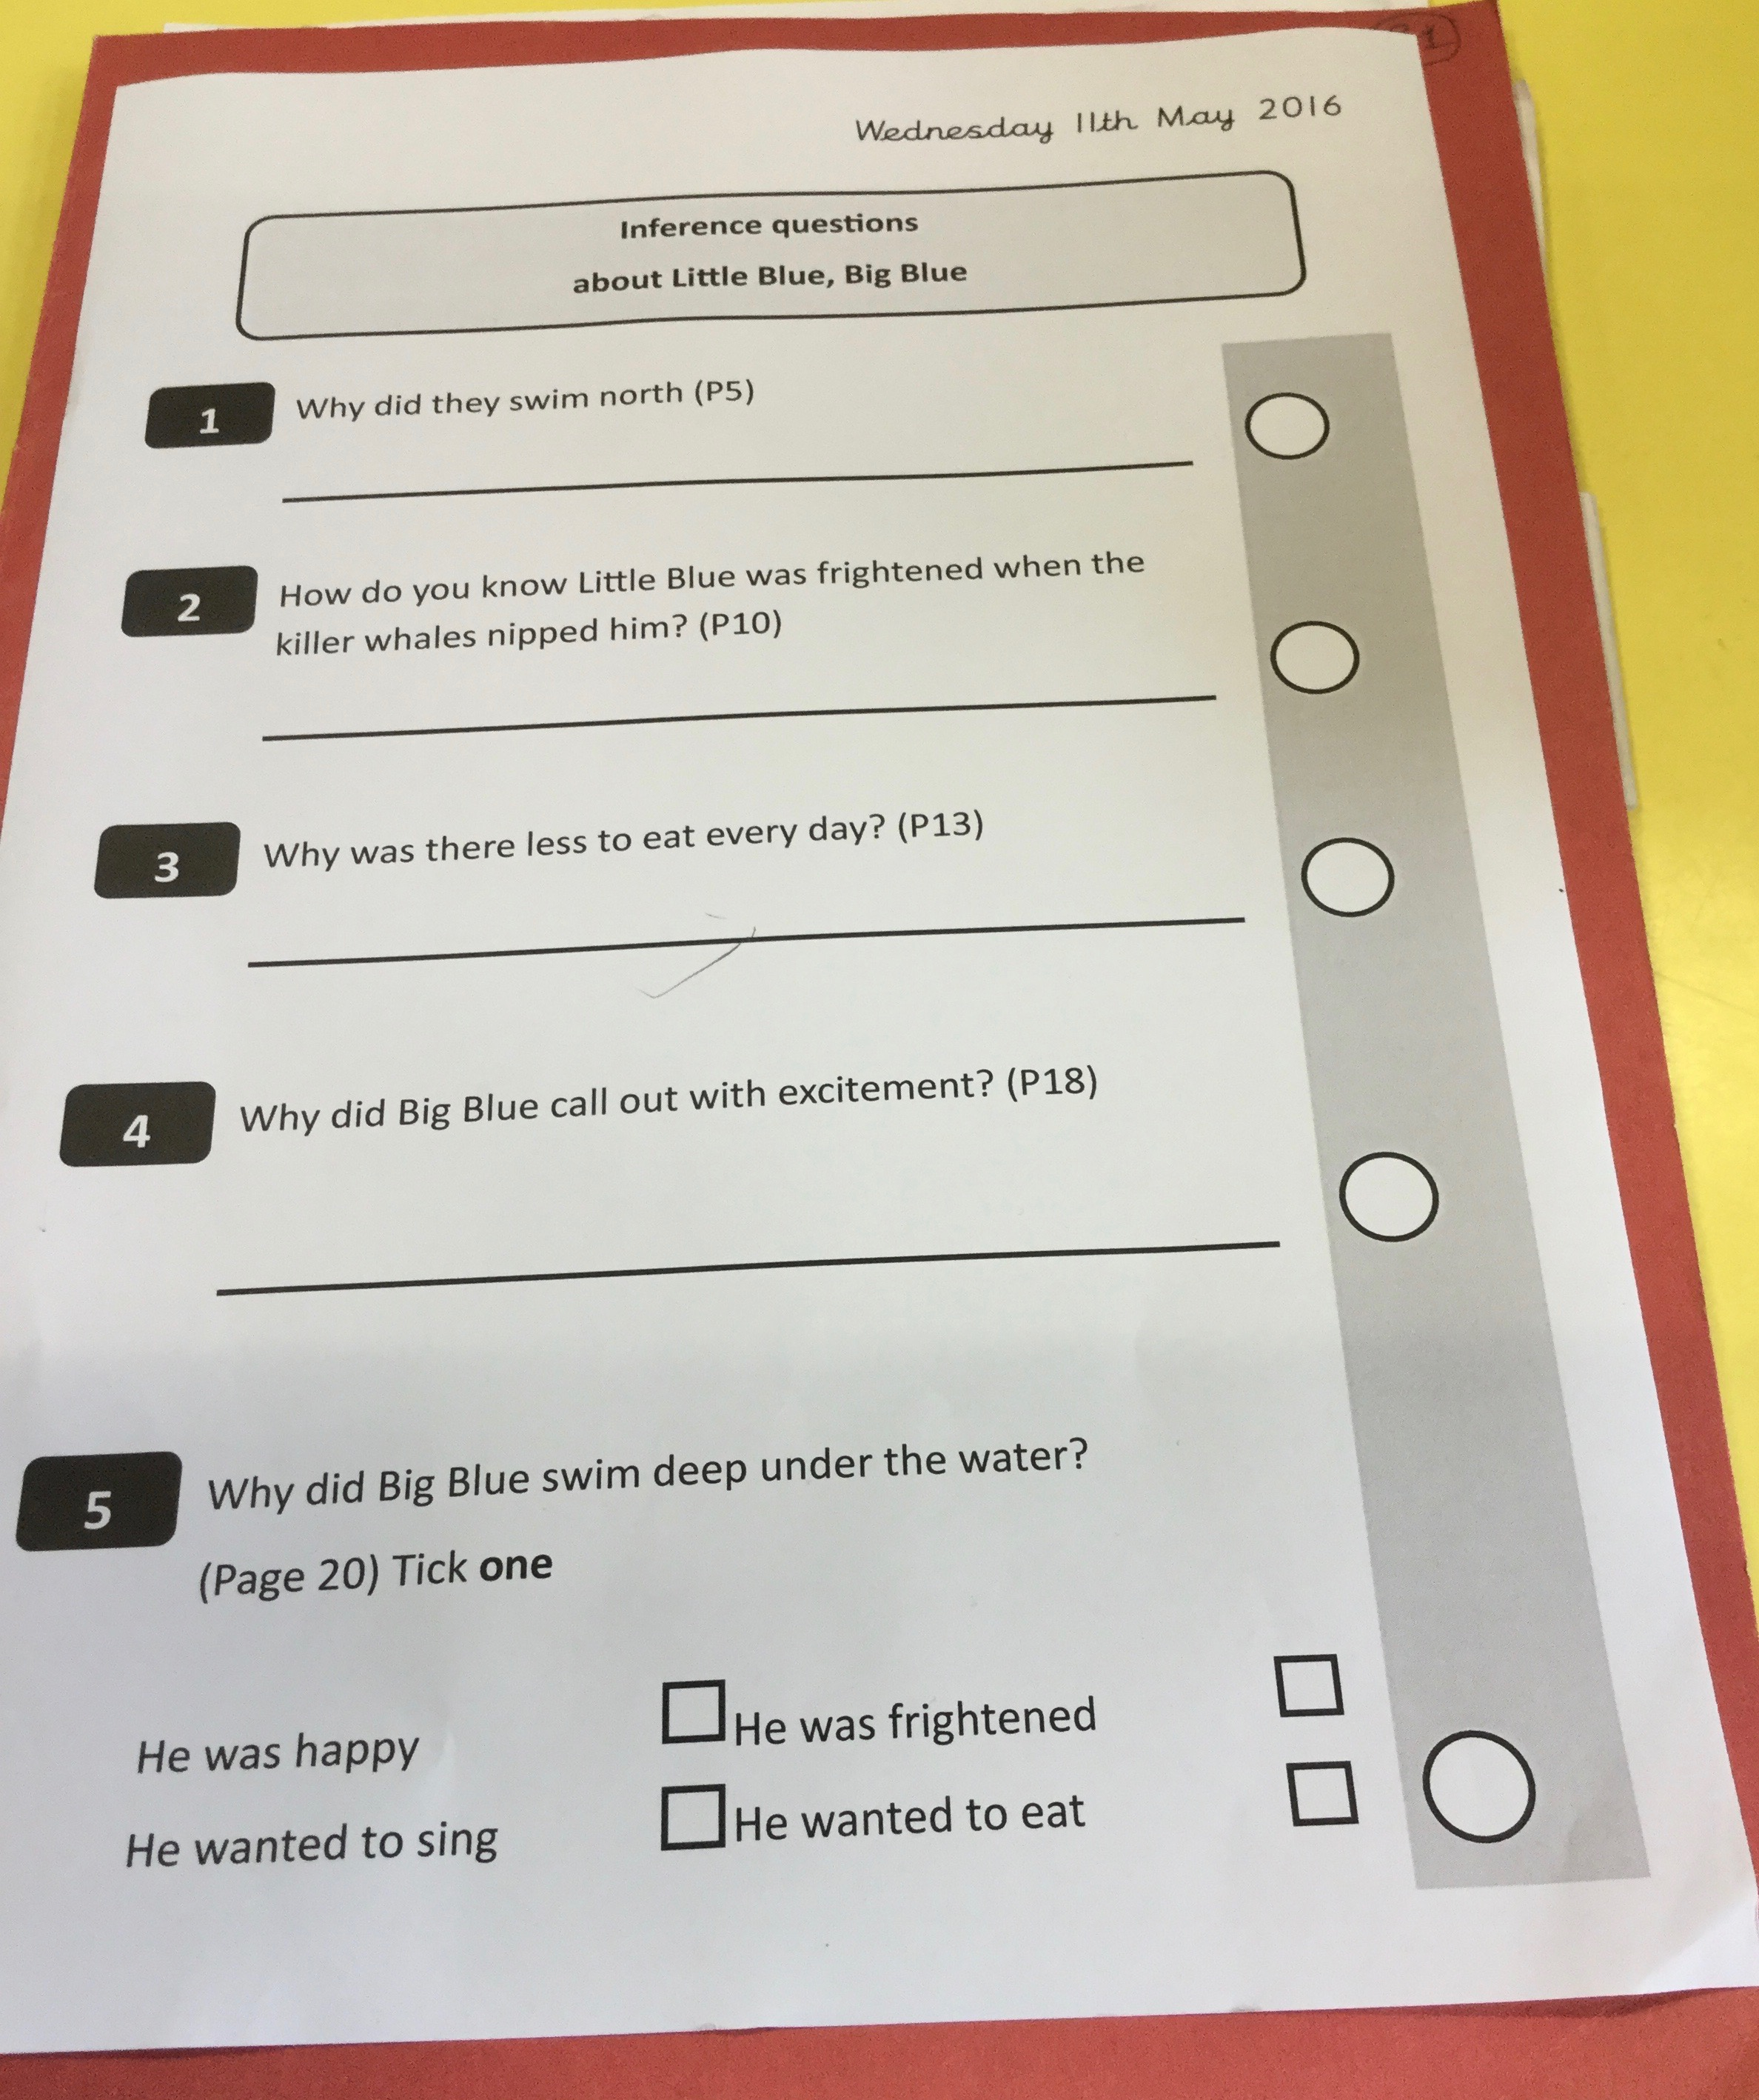


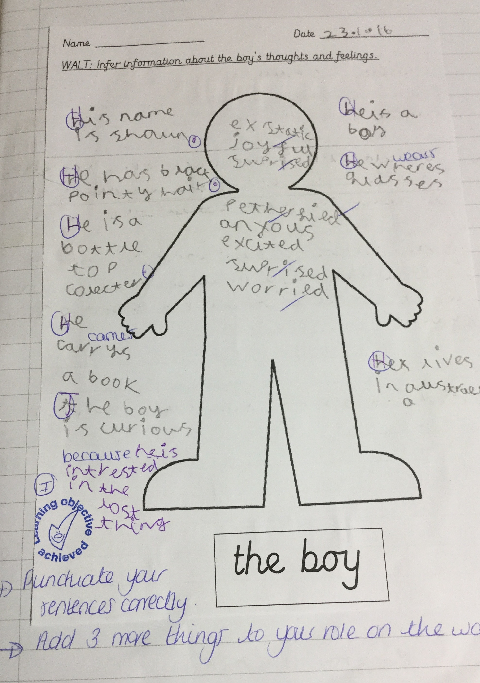
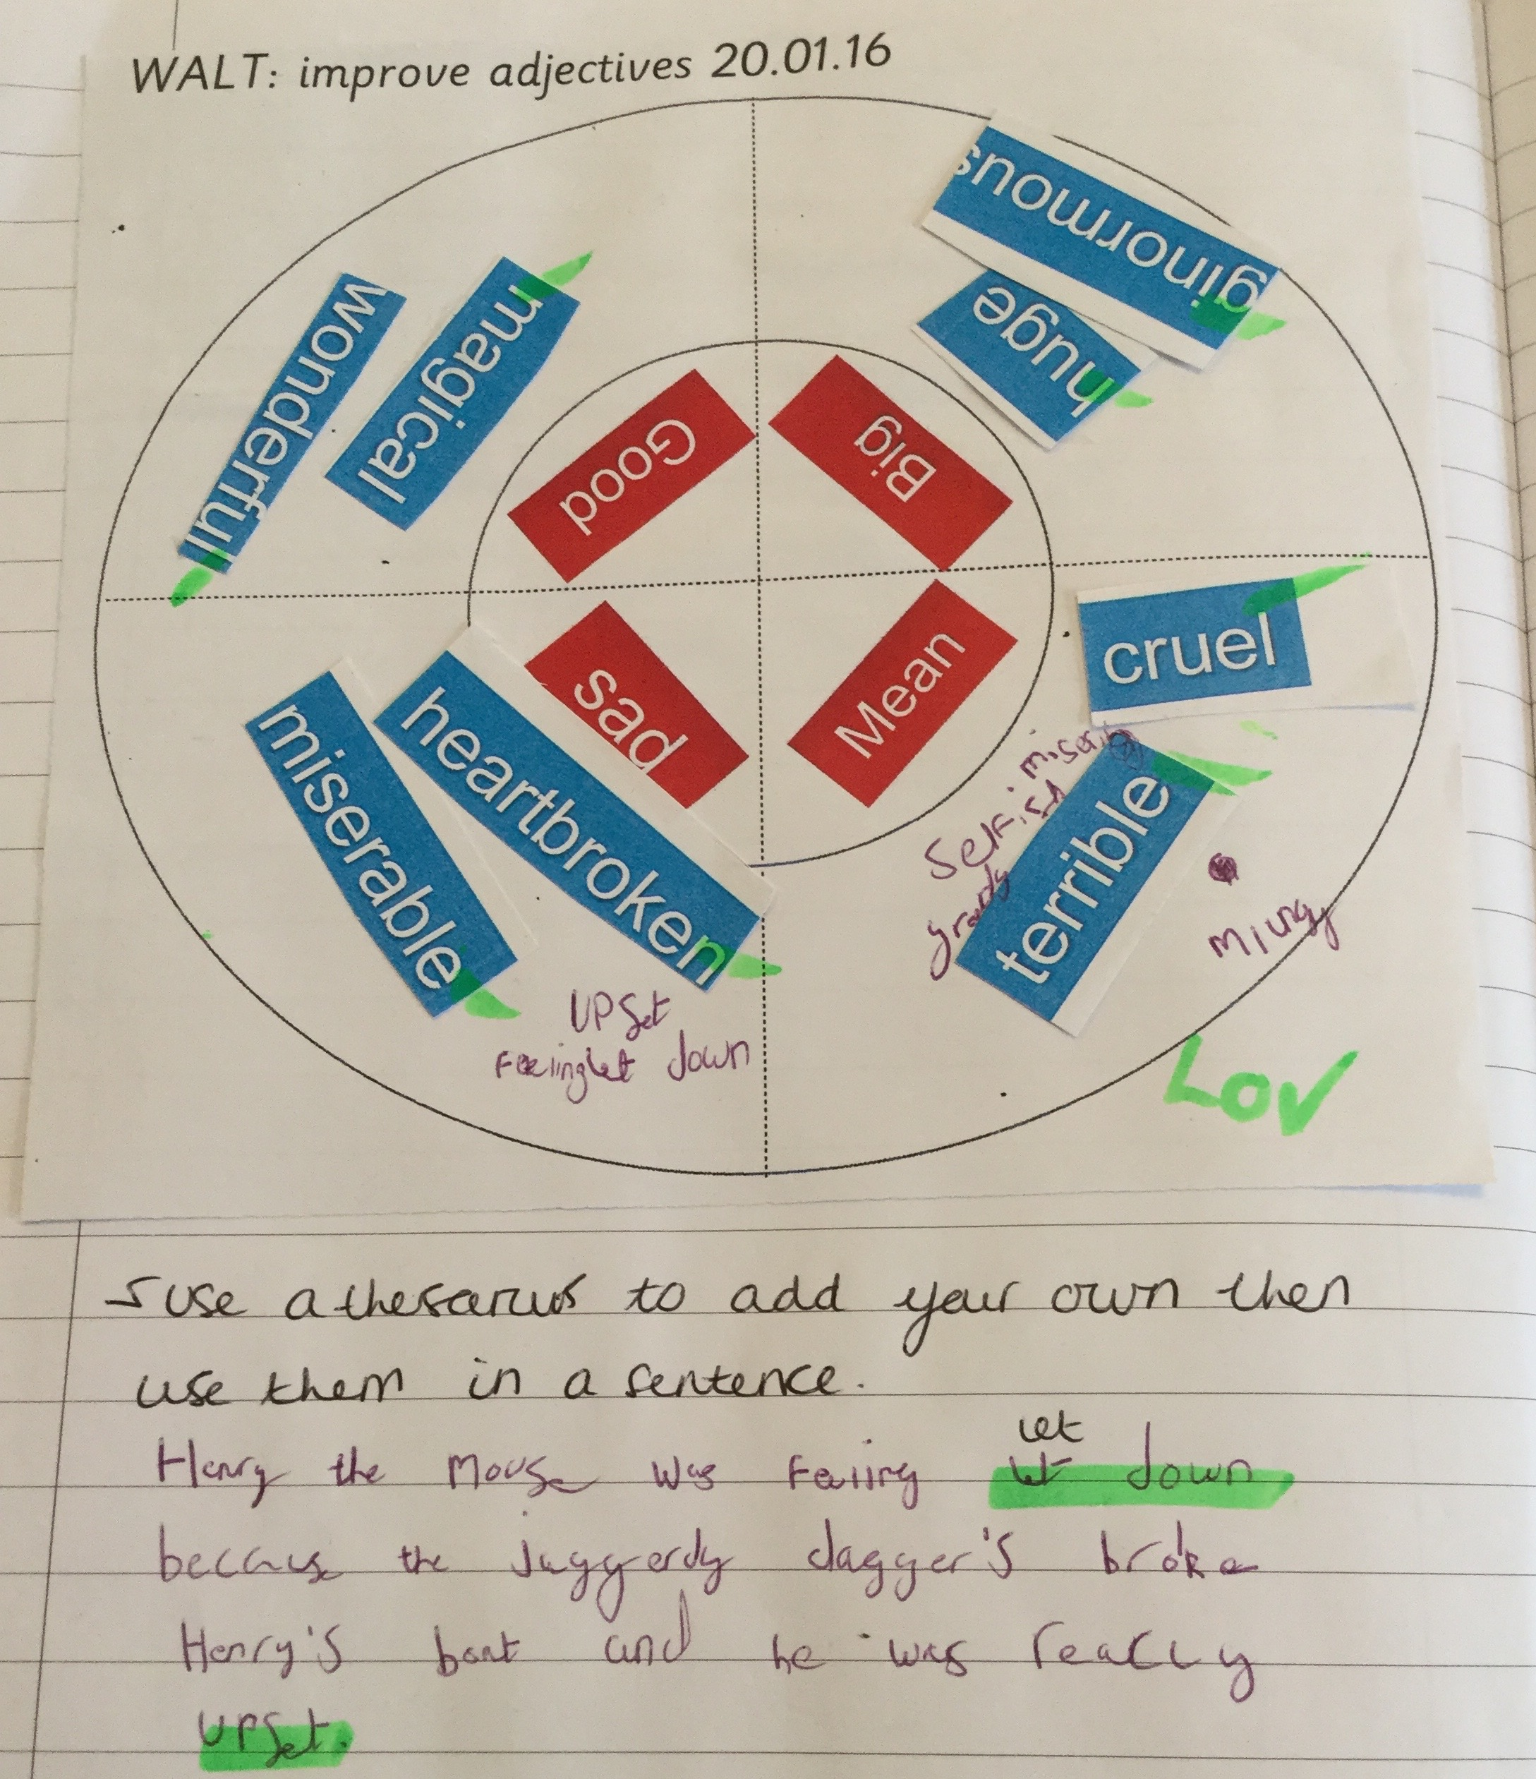
Phase 2 - Comprehension

Slide 22
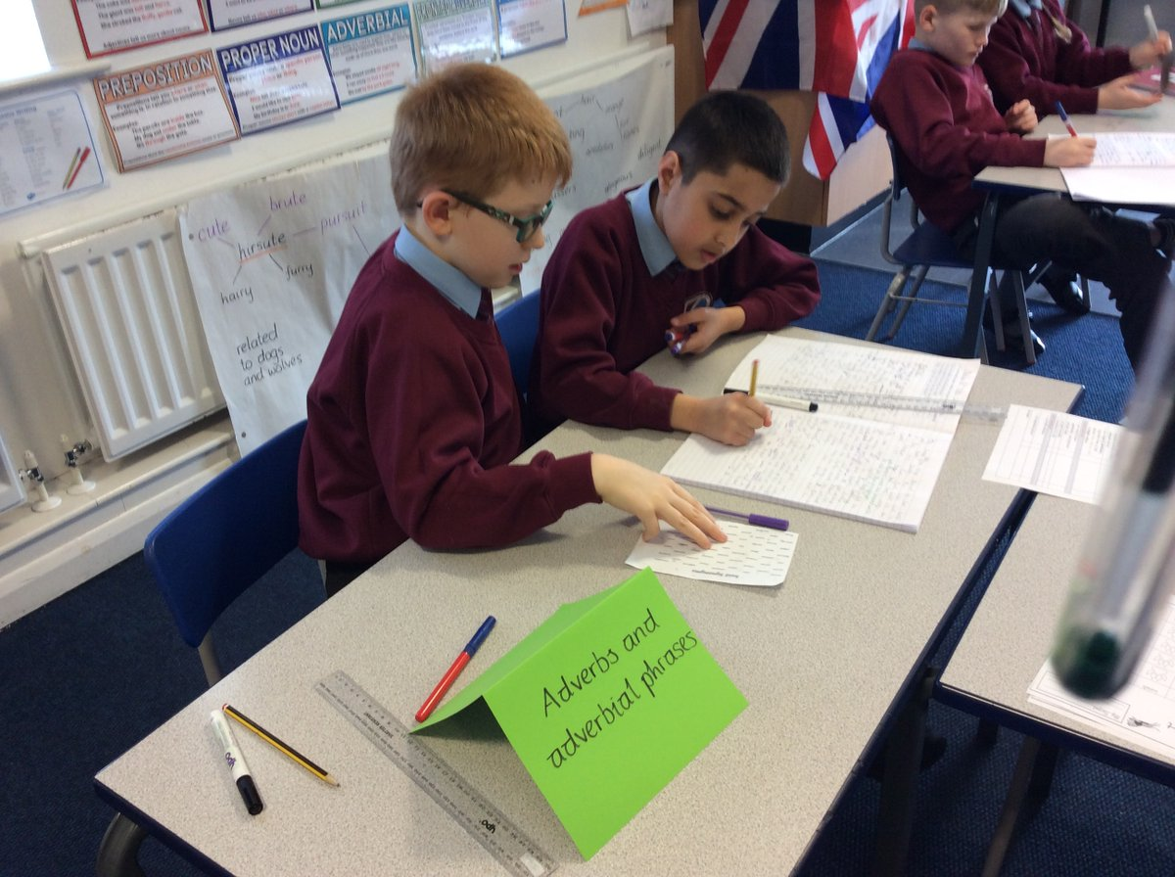
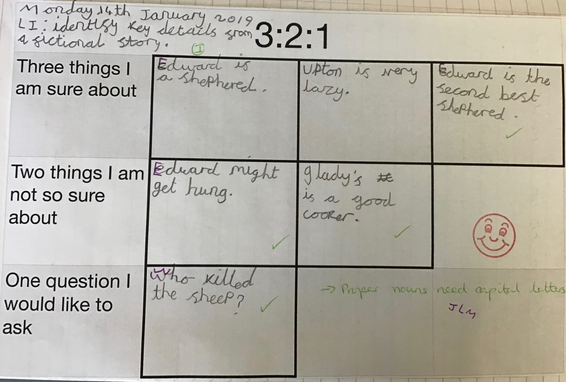
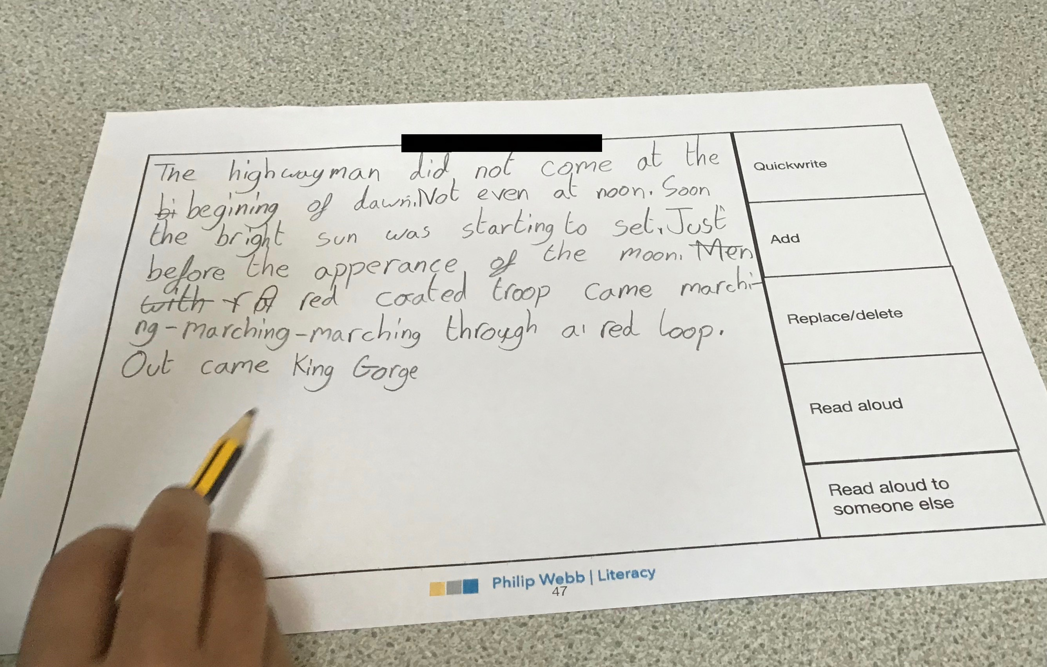
  Episodes
The text
Speaking and
Listening with
graphic organiser
Teacher led
feedback
and discussion
Written
outcome

Slide 23

Knowledge of the writing process and how to teach it
Repeated meta-analyses have identified several factors that are positively linked to teaching pupils to write effectively:^{[footnote 213]}
explicit teaching of foundational writing skills (sentence construction and control of grammar and syntax, as well as spelling and handwriting), aiming for fluency
a ‘process approach’ to writing (see below for an explanation)
direct instruction about writing knowledge and targeted practice
encouraging pupils’ self-regulation, such as pupils monitoring their own performance, setting goals for improvement and making self-assessments of their writing
opportunities to write frequently
opportunities to work cooperatively on different aspects of writing and stages of the writing process

Slide 24
Short burst writing
Phase 1 | Tell Me grid - Oral prediction | Tell Me grid - Written prediction
Phase 2 | Decision wheel - letter/postcard to character/agony aunt Persuasion or discussion text | Role on the Wall - Character Study Lists Though bubbles | Visualisation Responding to illustration Double Bubble
 | Character trading card | Perfect Predictions | Describing a scene
 | Venn Diagram - similarities and differences | ChatterPix app | Poem for character or setting Chain poem Word - Phrase -Sentence
Phase 3 - P and G TSO | Labelling - setting description | 0 and X
 | Axis of Emotion - written account of how emotions change

Slide 25
Written outcomes
Short purposeful outcome - prediction-
diary/note to character - description -
might be part of a lesson
Shorter written outcomes
Longer purposeful outcome - longer letter -
character comparison - more formal outcomes -
may be a full lesson.
Longer written outcomes
End of unit pieces following the planning, drafting,
editing process
worked over a couple of days.
Extended written outcomes

Slide 26
Setting Activities

Slide 28
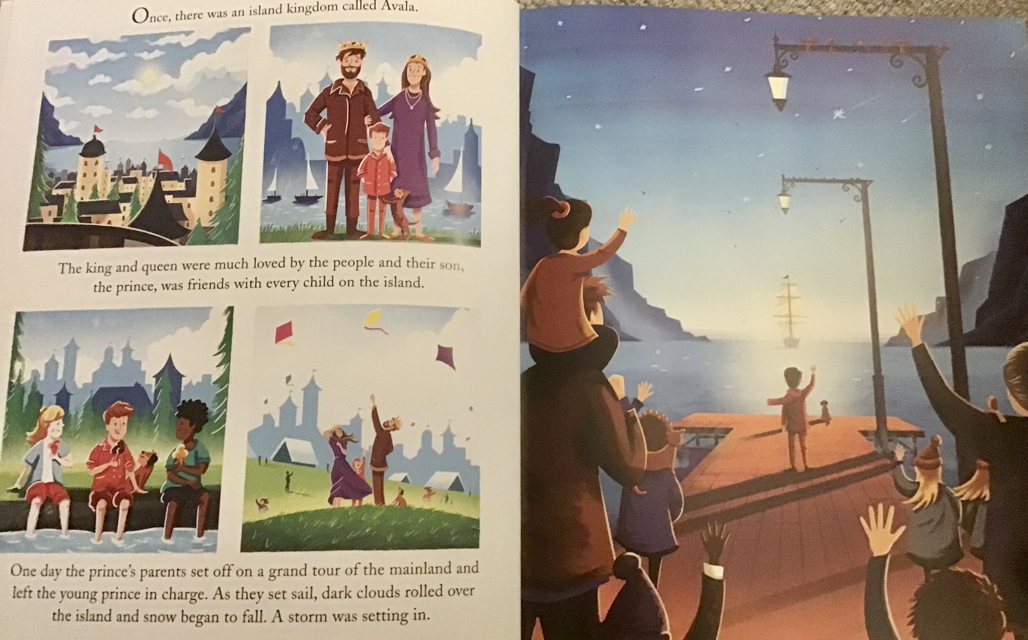

Slide 29
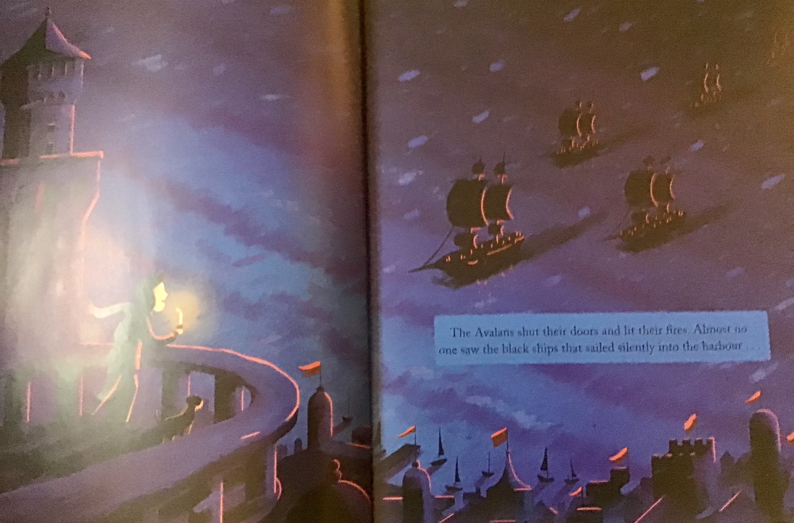

Slide 30
Responding to illustration

Slide 31
Responding to illustration
Ask children for their initial reflections on the image – what do they notice/see in the image?
Have they seen anything like this before?
Ask them to discuss the image in their groups and annotate the A3 paper with these initial thoughts. What do can they see? Does it prompt any questions? Is there anything that puzzles them?
Collate children’s thoughts and initial responses and questions using an enquiry grid that can be used throughout this sequence or as a stimulus for wider curricular study.

Slide 32
Responding to illustration
Working with a partner, ask children to write down a list of 3 things that they can see in the illustration.
Ask each pair of children to work with another pair to compare their lists – did anybody notice something new?
Gather children’s ideas to make a class list of what they can see
Model how children could expand single word responses into short noun phrases or descriptive sentences.

Slide 33
Silent Reading
Read to prison
Read to There, he …
Read to ‘red page’ TPS
Notes:
read to prison
decision wheel as example
read rest of book

Slide 34
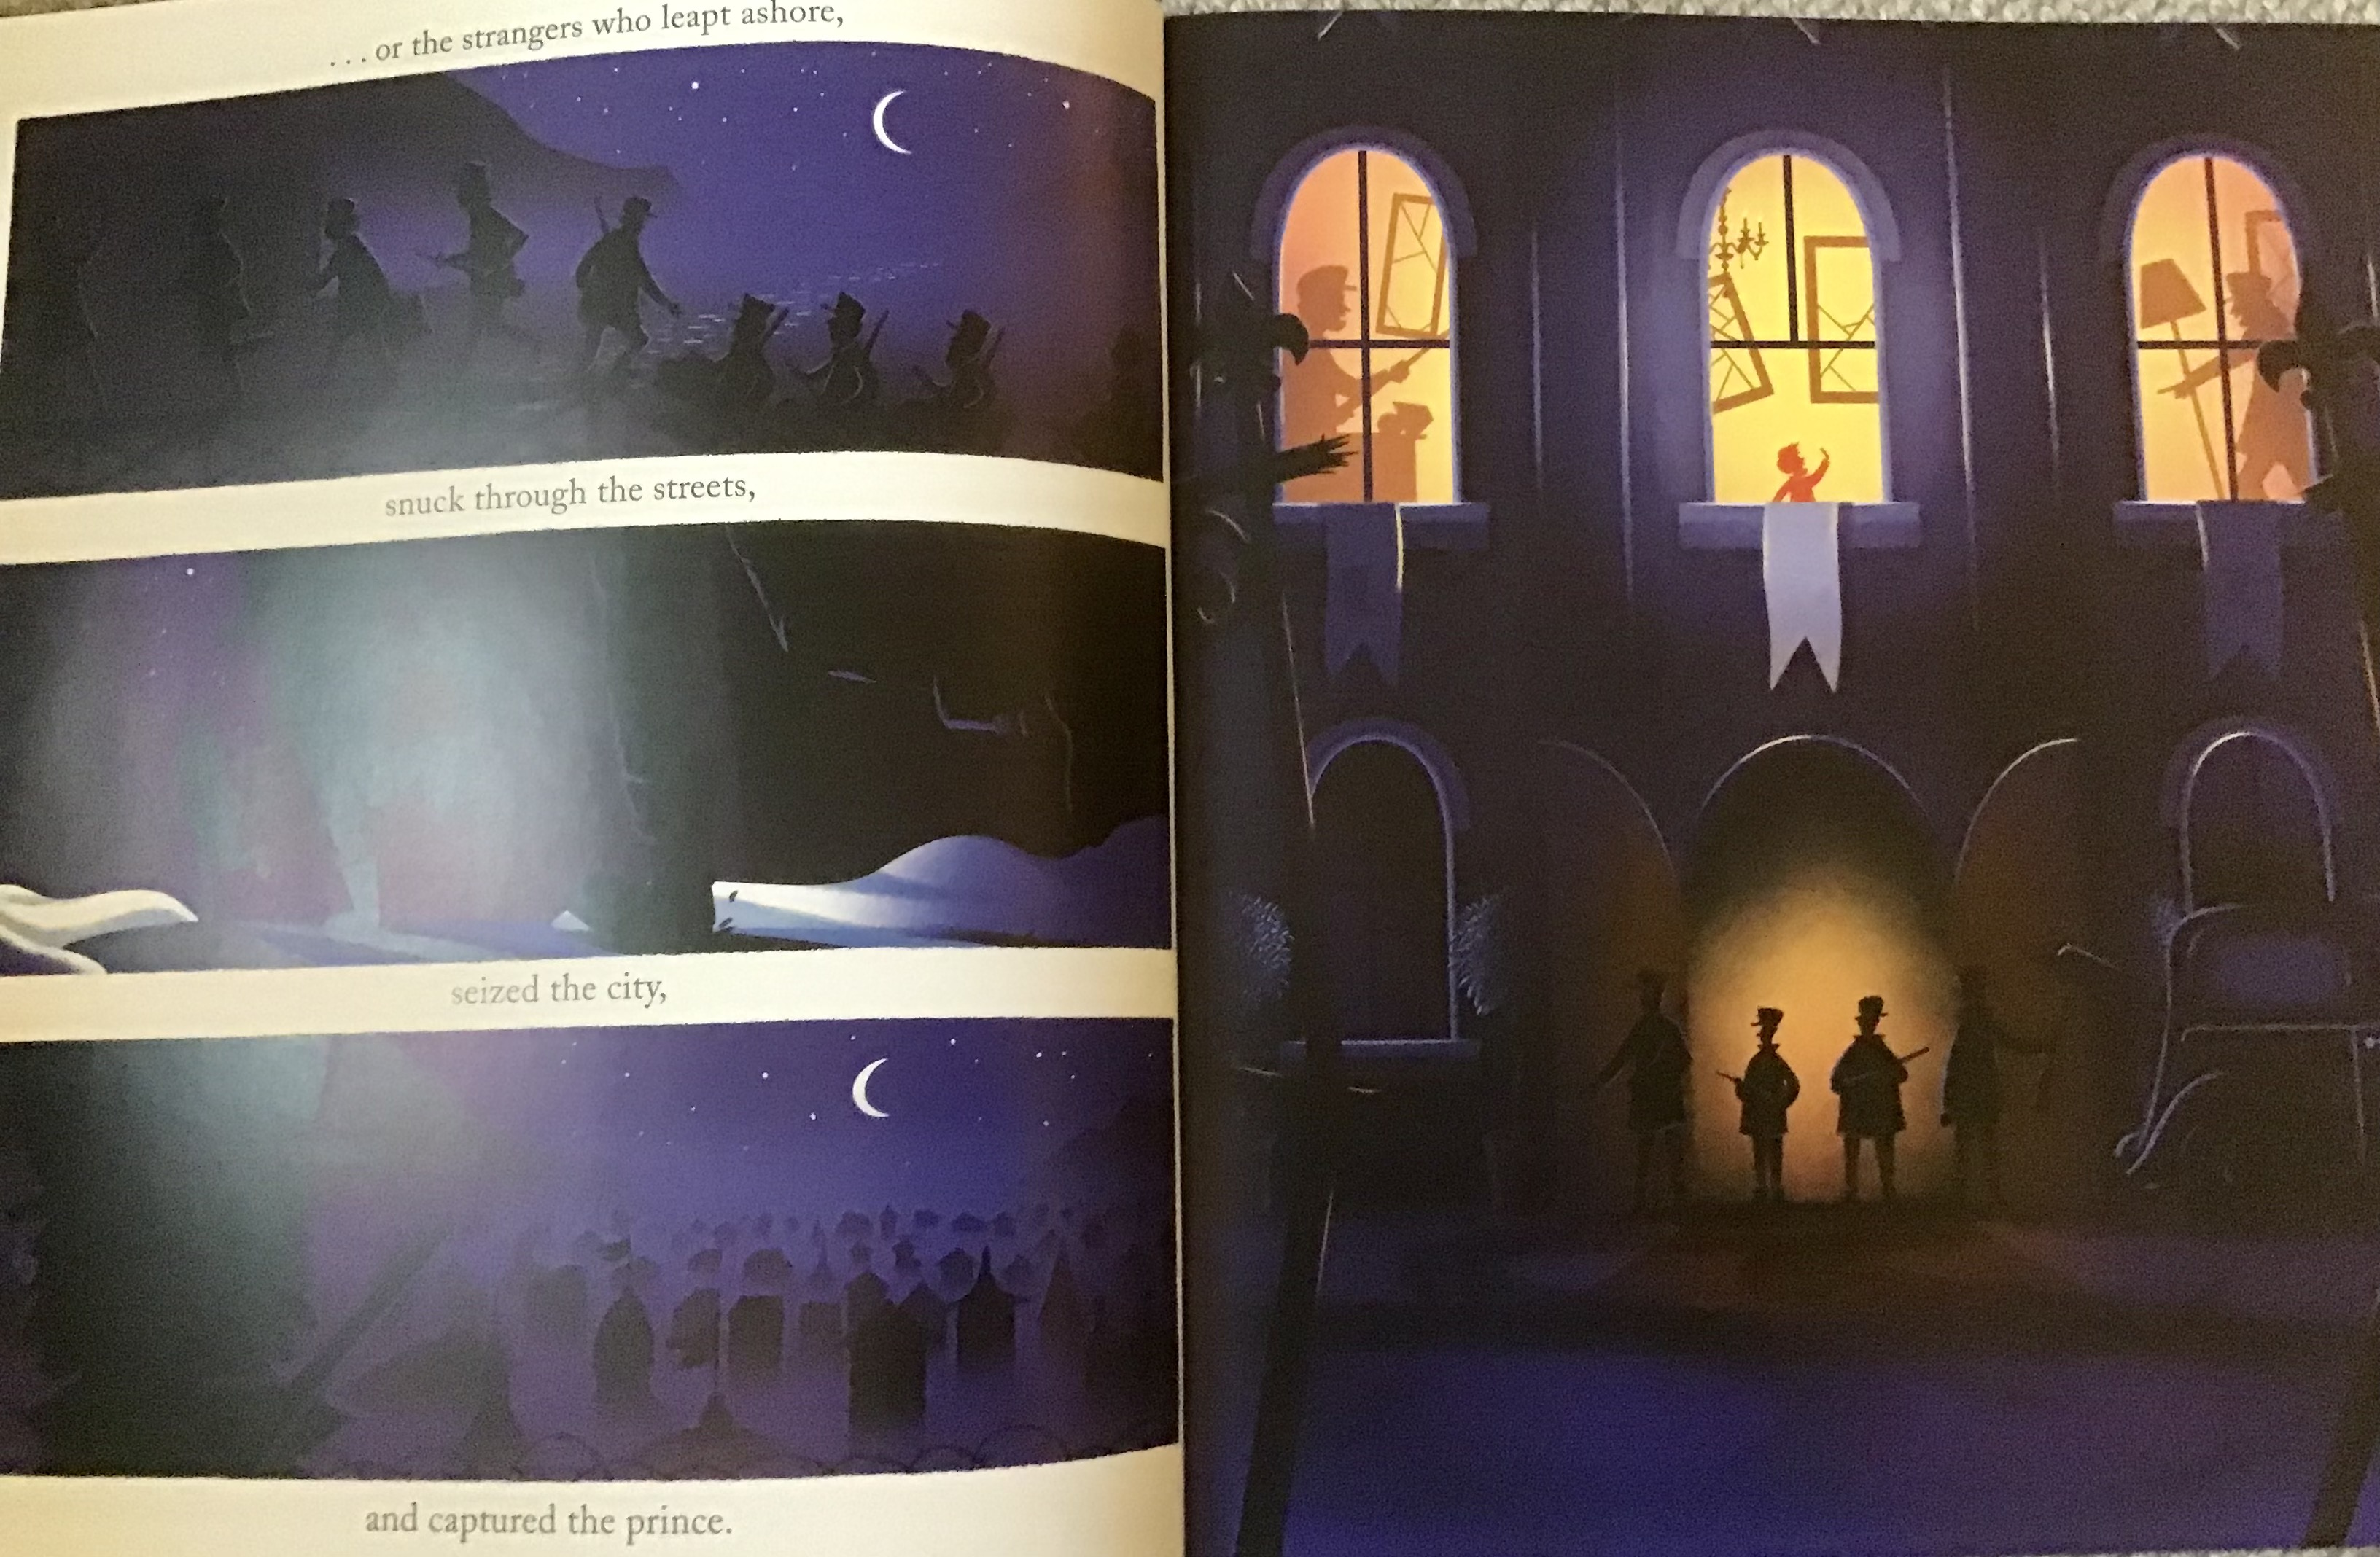

Slide 35
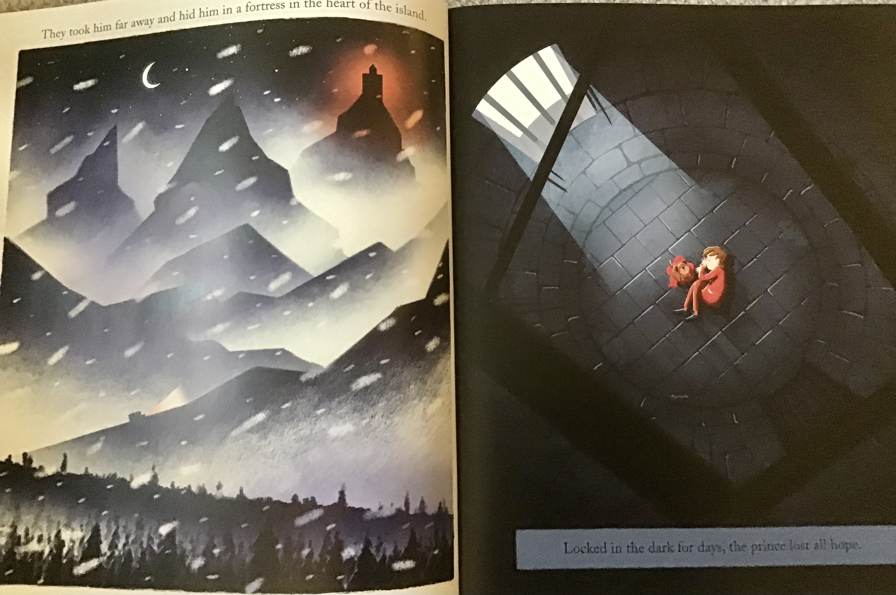

Slide 36
Plot Activities 1

Slide 37
Decision Wheel
What should
the prince do?

Slide 38
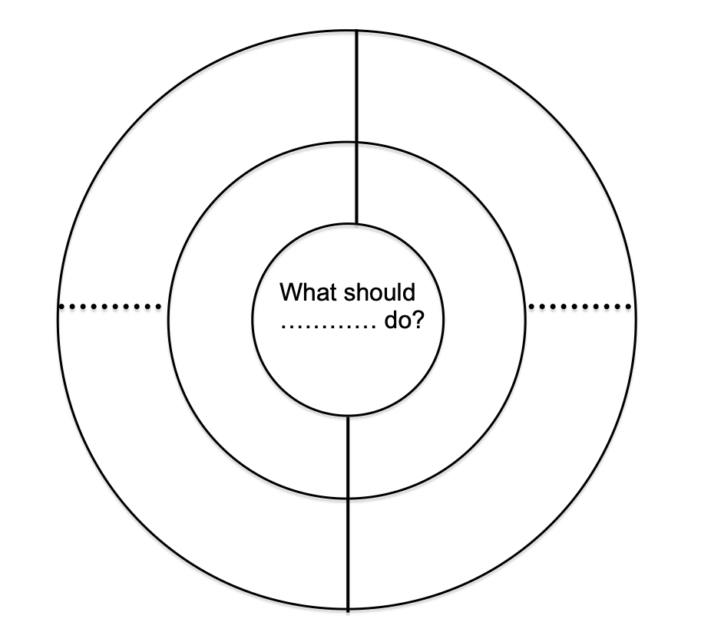
Decision wheel - two options

Slide 39
Comprehension - Graphic Organisers
Notes:
Give out cards
sort cards into what you know - what you want to know
these develop comprehension and give writing opps

Slide 41
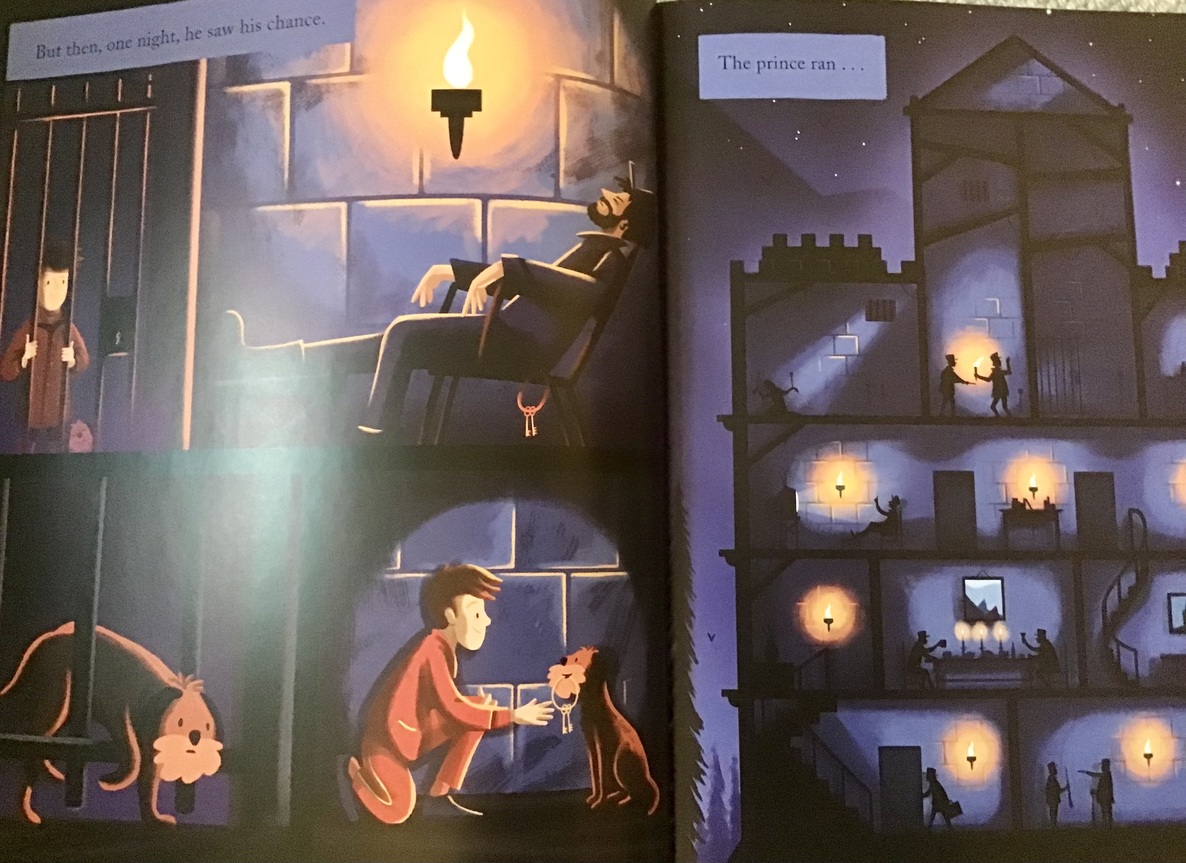

Slide 42
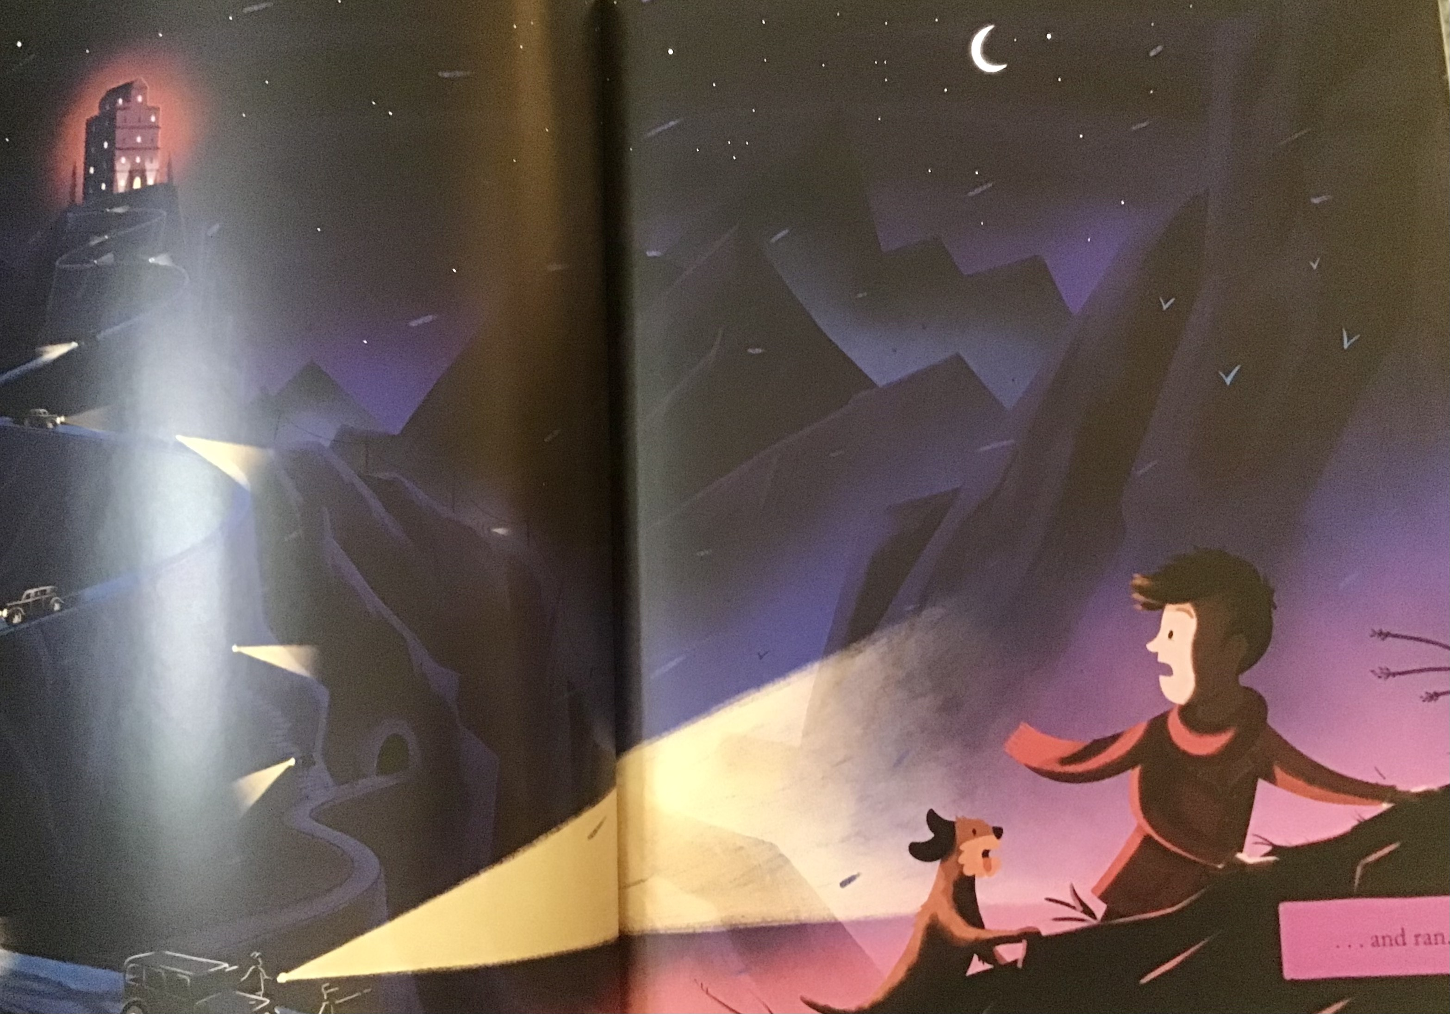

Slide 43
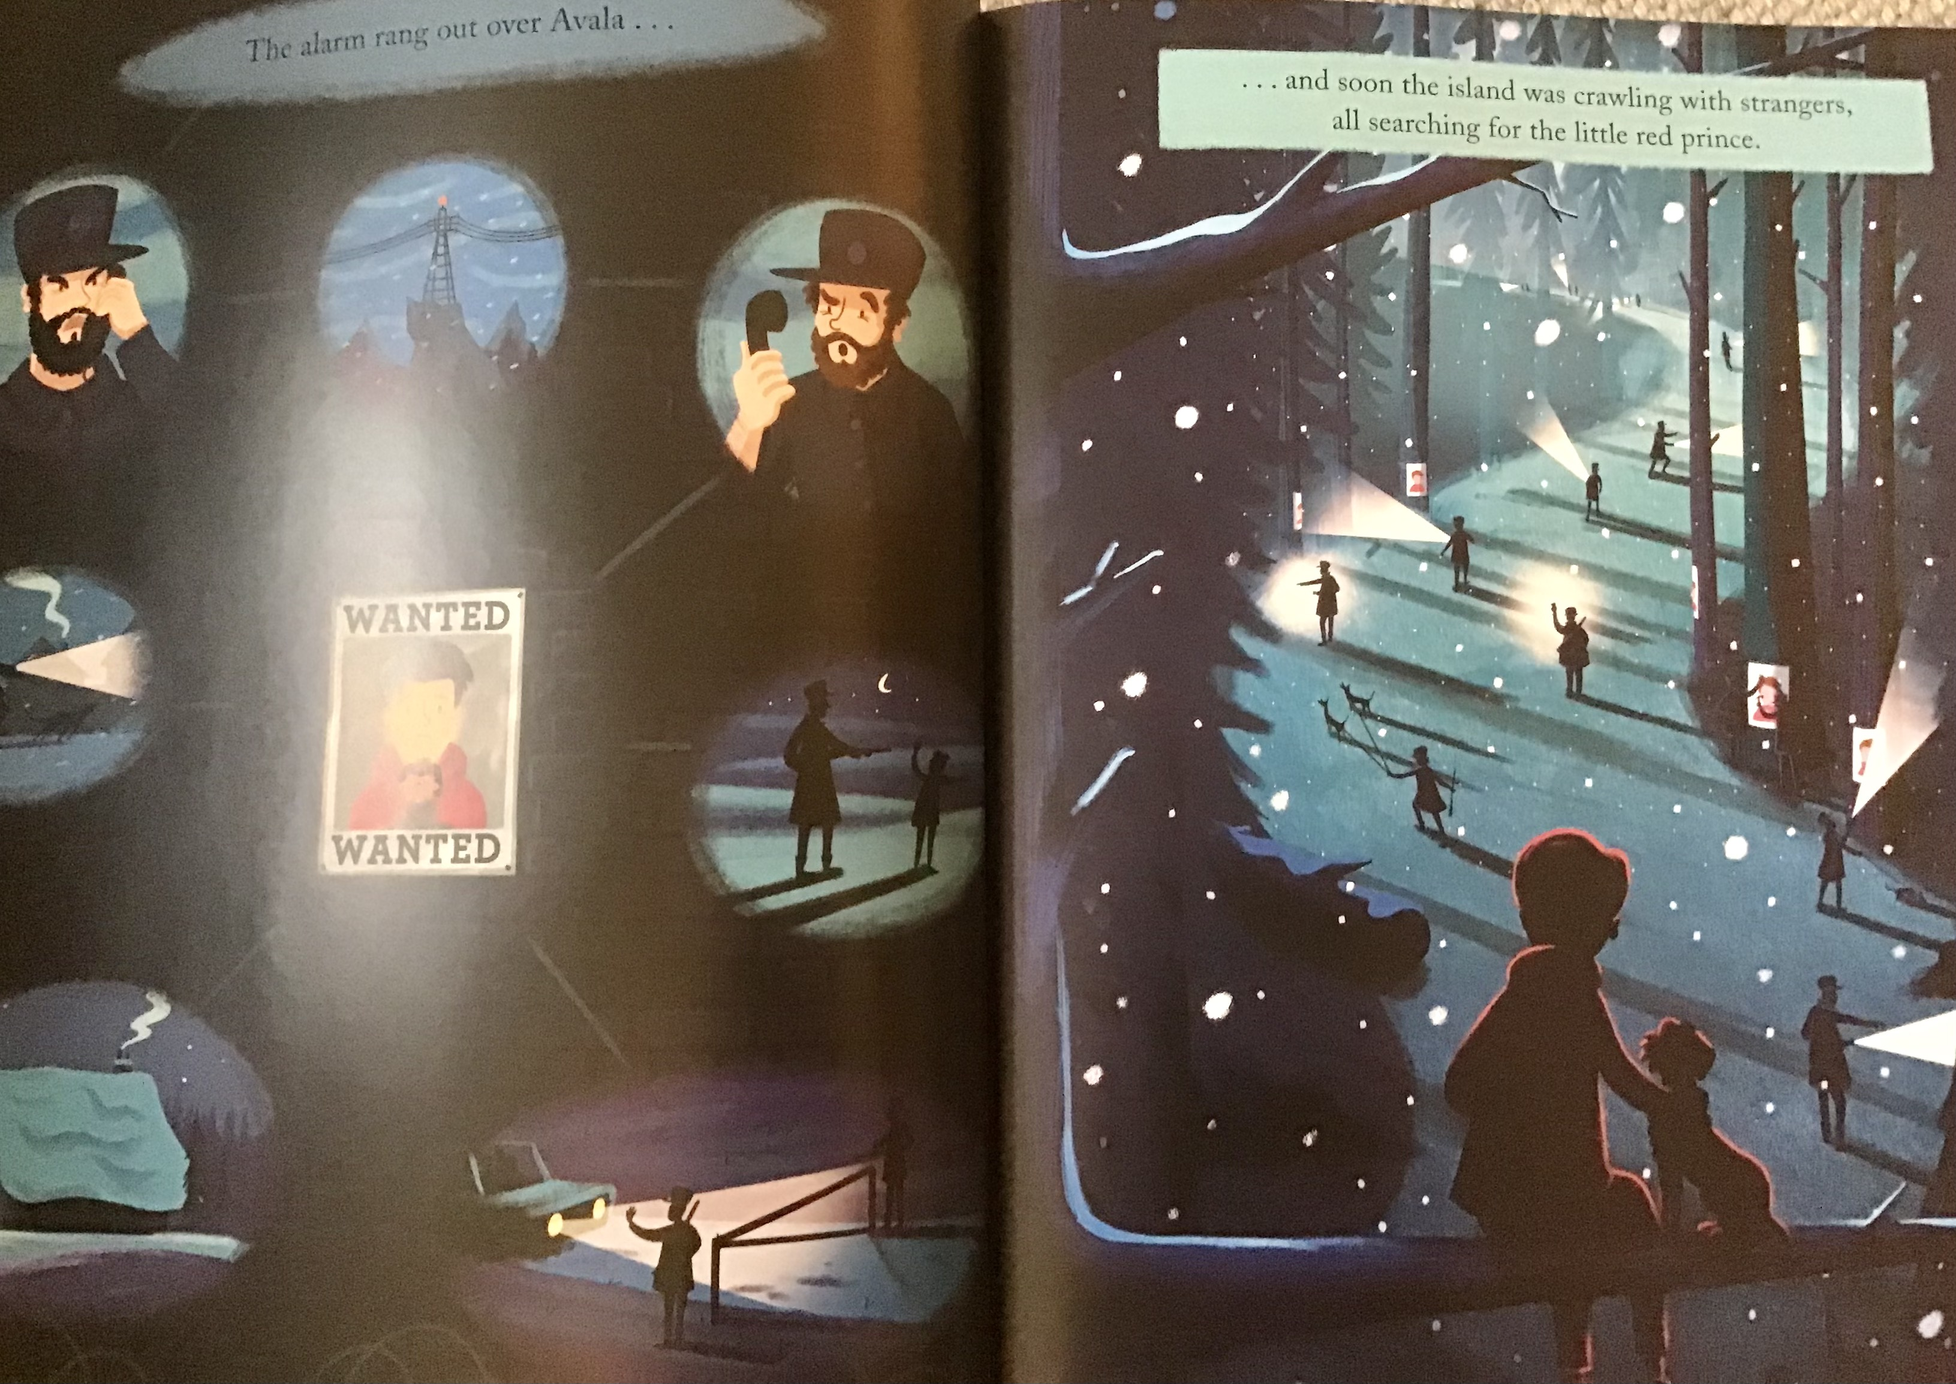

Slide 44
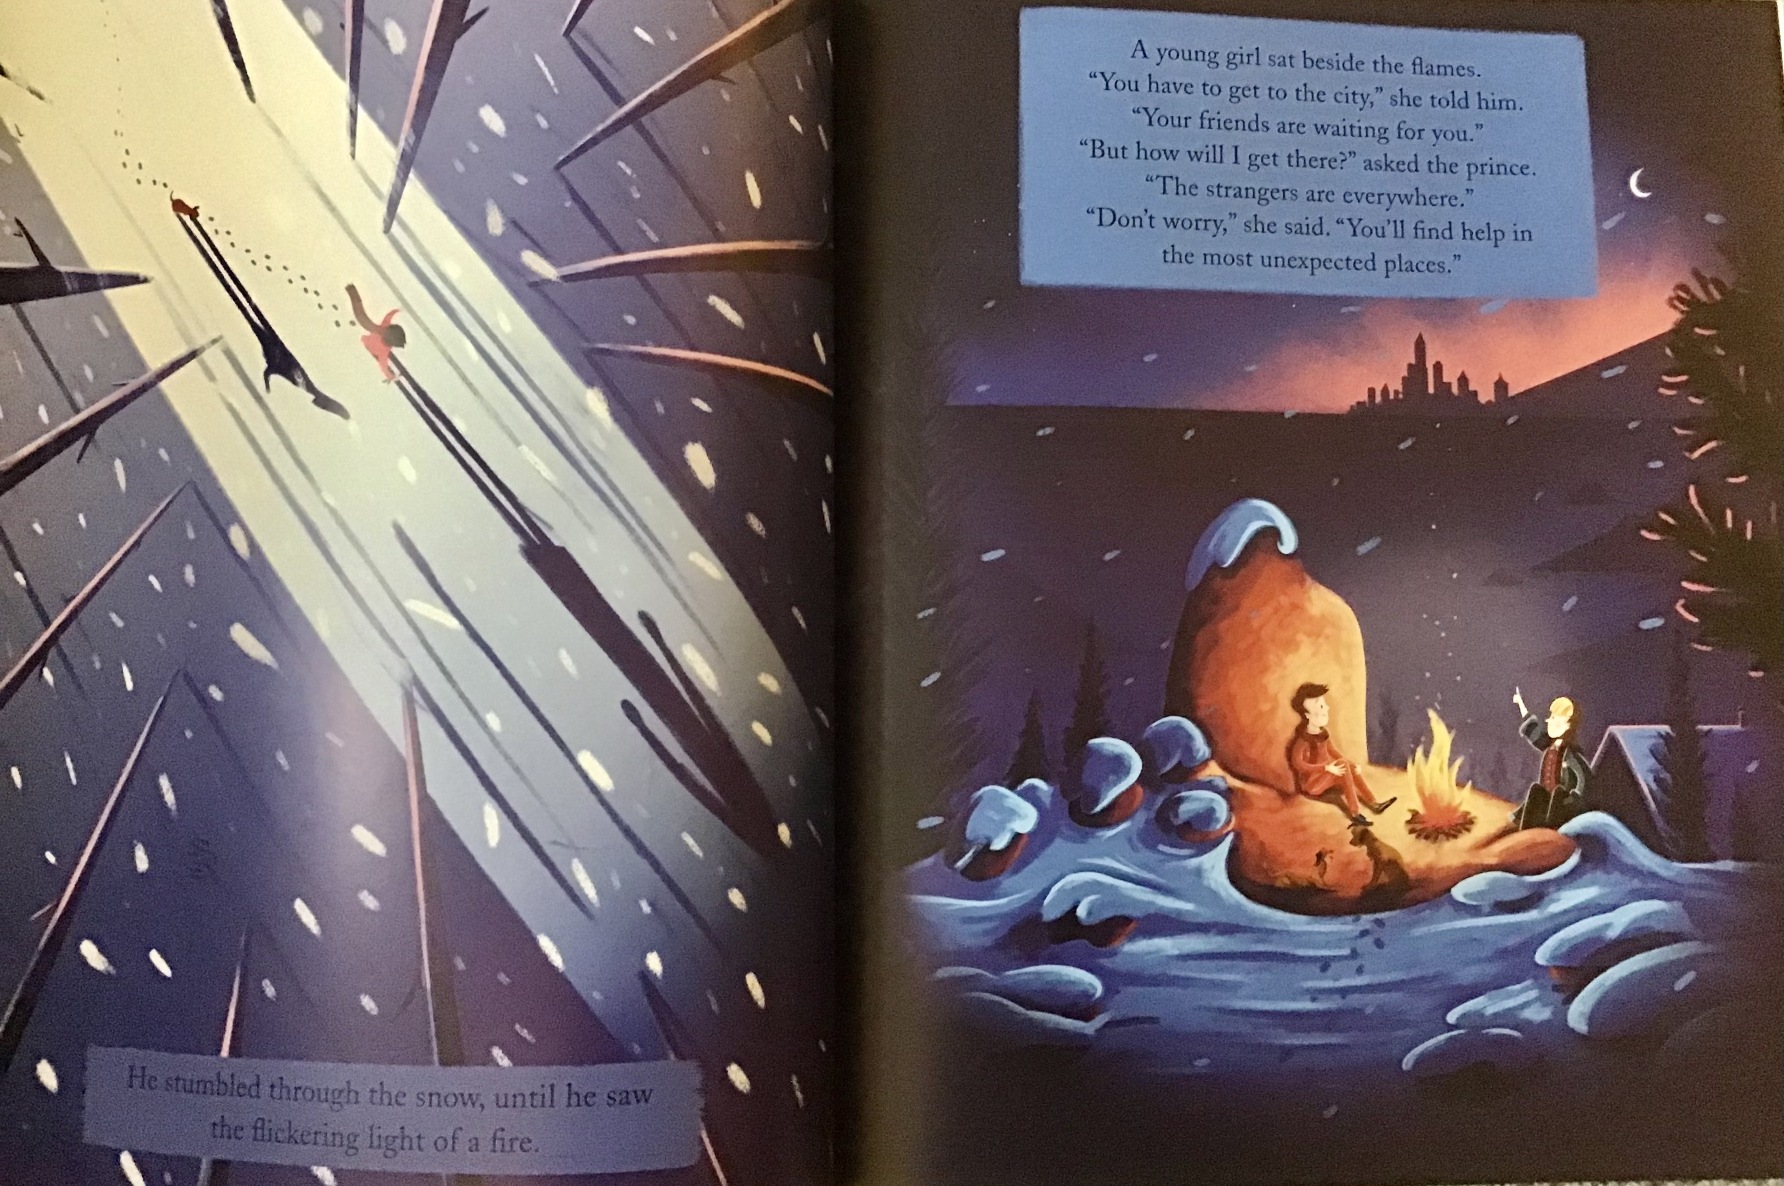

Slide 45
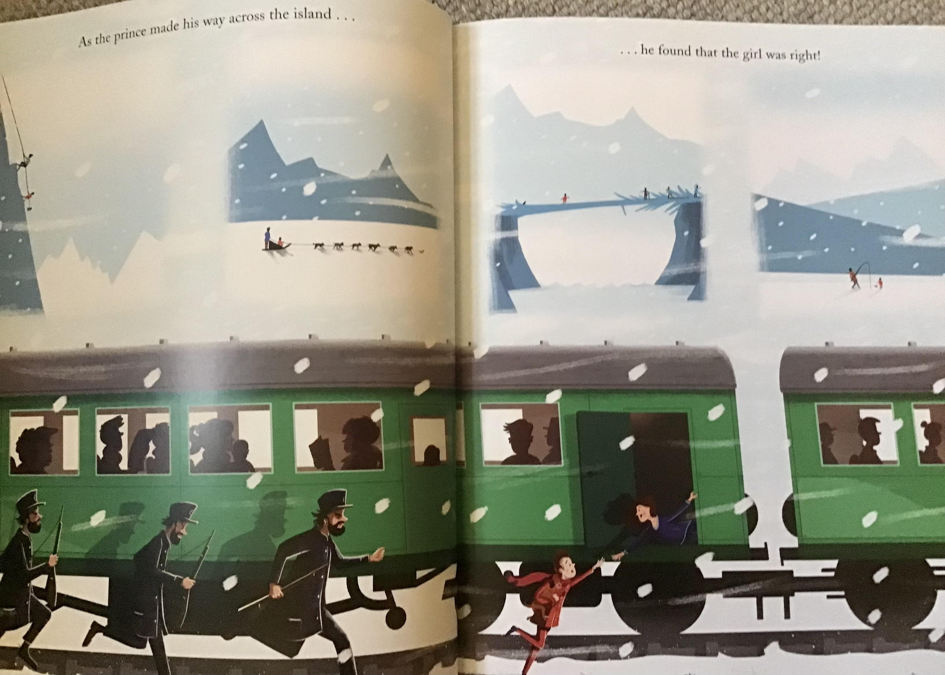

Slide 46
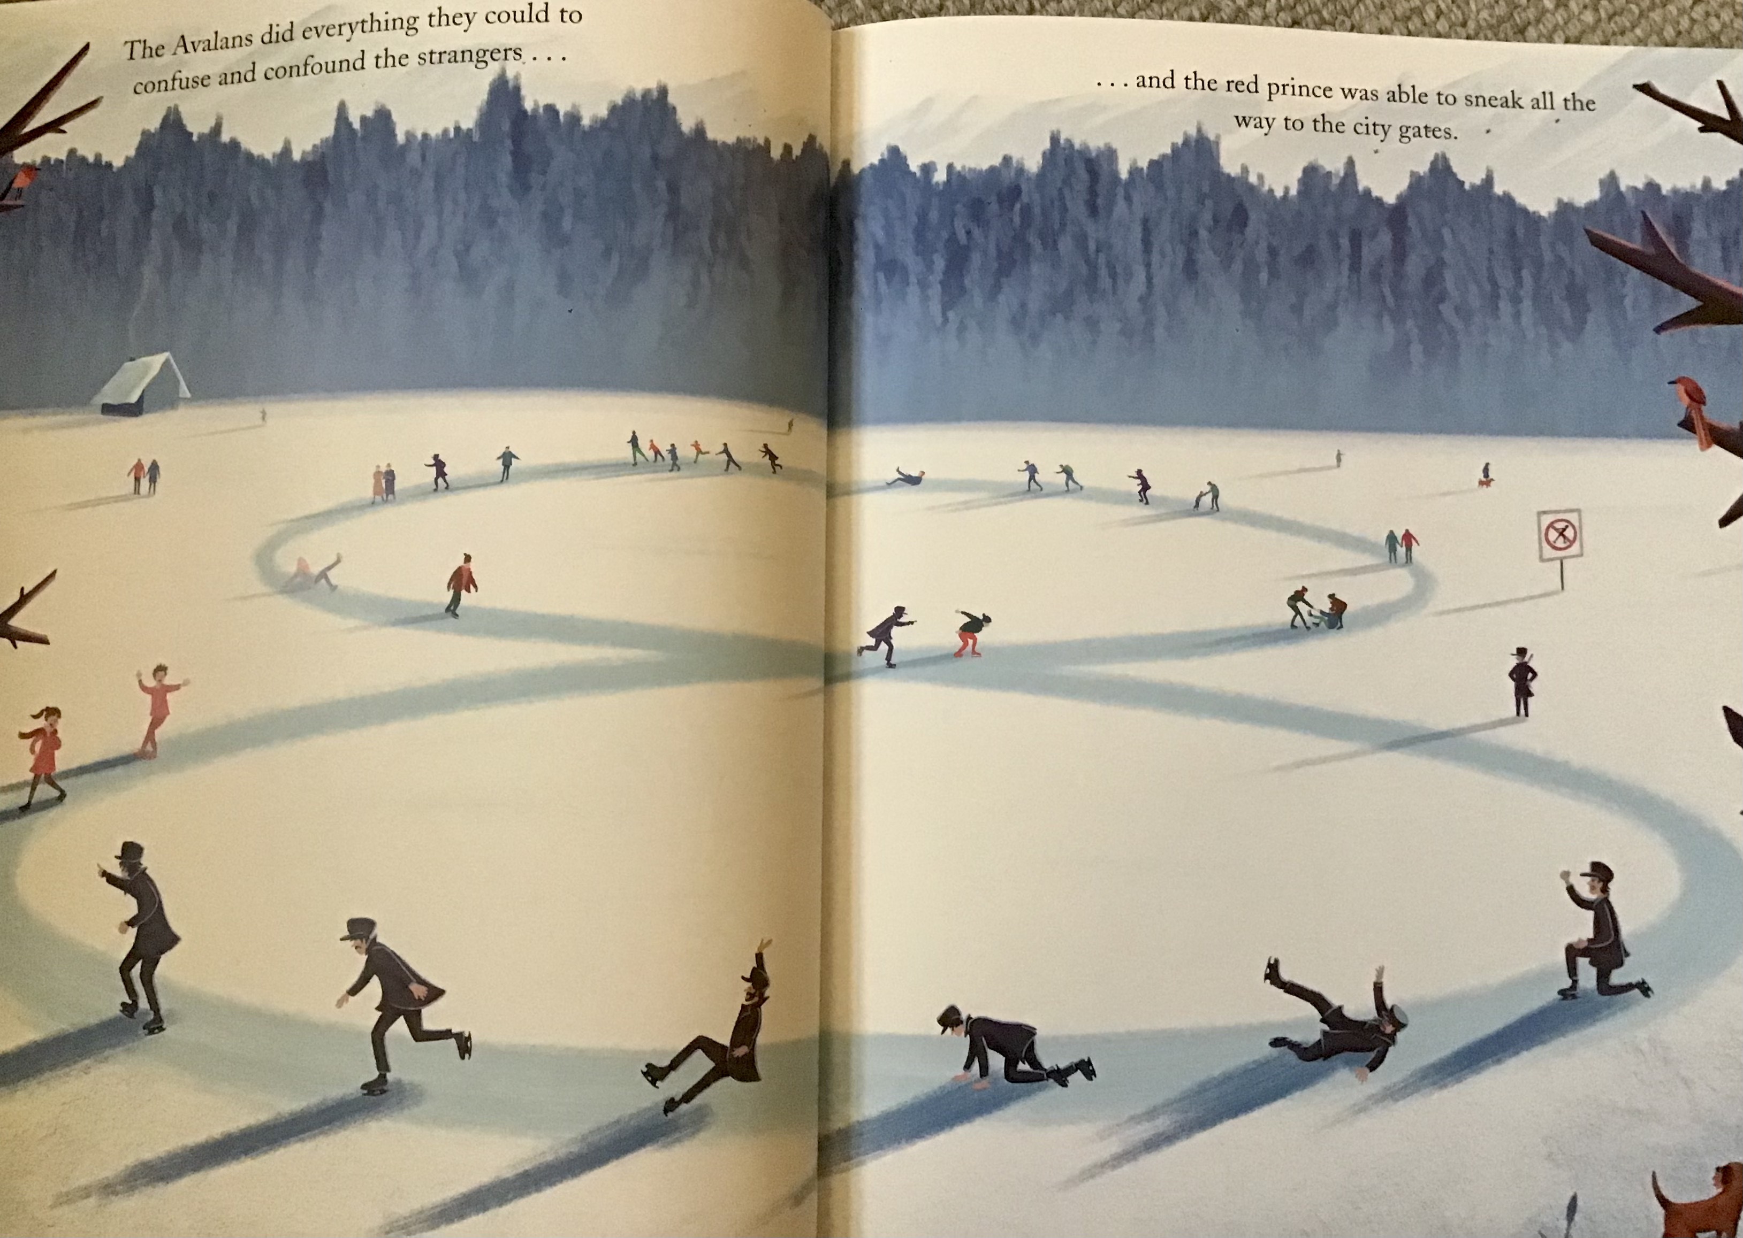

Slide 47
Character Activities

Slide 48
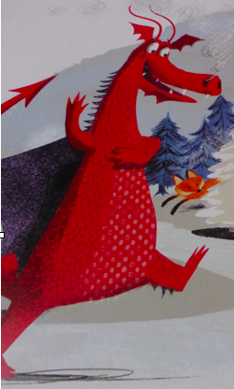

Role on the wall - Dragon
literal
inferential

Slide 49
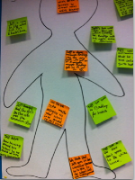
feelings face

Slide 50
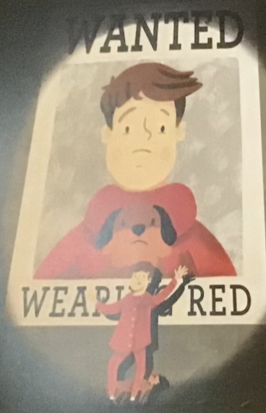
Outside…
Inside…
This boy…

Slide 51
Stealing the Style

Slide 52
Author examples - character
From chapter 4. I Am David Anne Holm
There were two little boys, much smaller than himself and a girl who was somewhat bigger, perhaps ten or even eleven. Shouting and laughing, all three talking at once, running round a small building.
David could not take his eyes off the girl. She was as pretty as the fine, delicate pink and white blossom that covered the nearby trees. She had black, curly hair, very long and tied with a red ribbon. Everything about her was so beautiful, not just her fine, red dress but everything. Her laughter sounded like the light tinkling of polished glass and when she moved, she reminded David of the flowers swaying in the wind.
‘as’ simile
expanded noun phrase
power of 3
like simile
controlled repetition

Slide 53
Teacher Scribed

Slide 54
At different points in the story

Slide 55
Small Group - adult support

Slide 56
With a partner - independent writing

Slide 57
Comparing characters
Character A
Character B

Slide 58
Independent

Slide 59
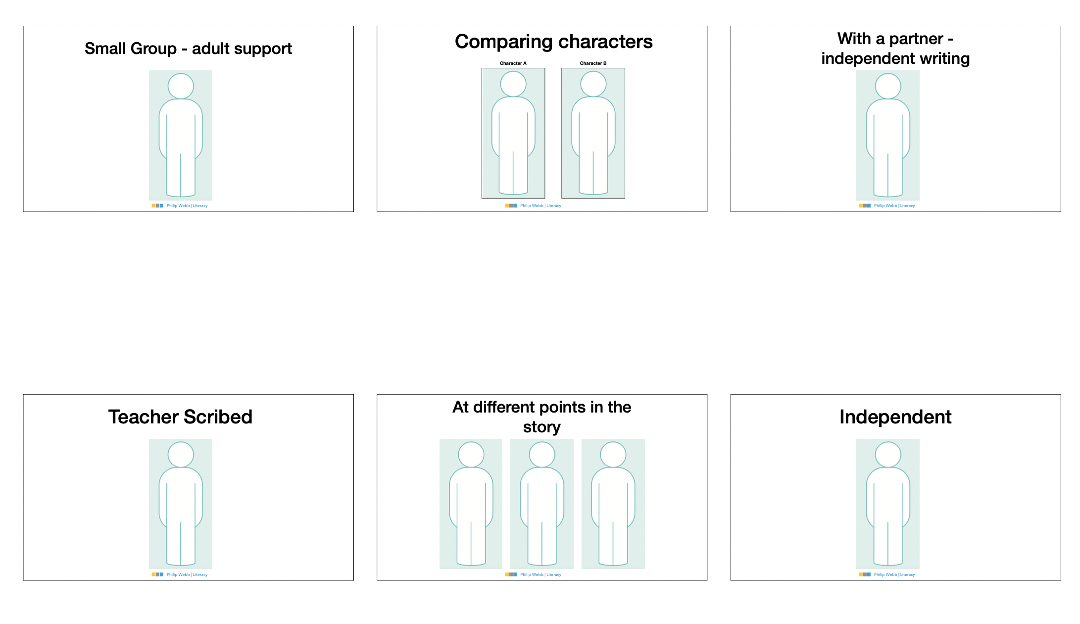
1) Sequence
2) apply to year groups

Slide 60
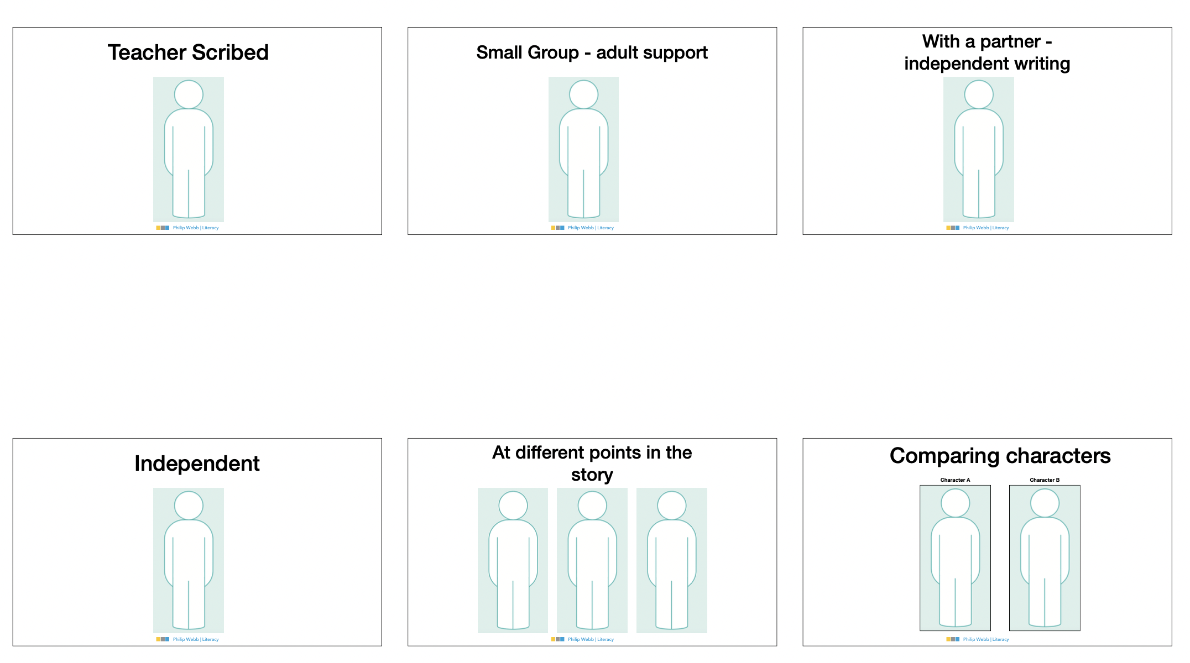
sorting task: sequence - apply to year groups

Slide 61
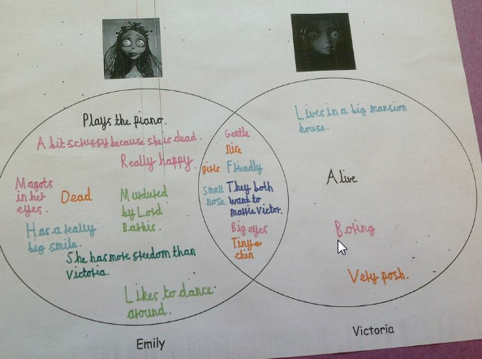
Venn diagram

Slide 62
Double Bubble
How are they the same?
Colin
Lee

Slide 63
Comprehension - Questioning
3D Comprehension

Slide 64
KS2 Overall 2016

Slide 65
2a | 2b | 2c | 2d | 2e | 2f | 2g | 2h
Give/explain the meaning of a word in context | Retrieve and record info’ / identify key details from F and NF | Summari-se main ideas from more than one para’ | Make inferenc-es from the text / explain and justify inferenc-es with evidence from the text | Predict what might happen from details stated and implied | Identify / explain how info’ / narrative content is related and contribut-es to meaning as a whole | Identify / explain how meaning is enhanced through choice of words and phrases | Make compari-sons within a text

Slide 66
Tick one/two
Sequence the text
Circle the correct option
text
Statement…
Statement…
1
text
text
text
text
text
G
text
Statement…
Gold
text
Statement…
Draw Lines
True or False
Silver
Bronze

Slide 67
Find and Copy
Explain (your choice) fully
Short Sentence
G
Gold
Give two
Long Sentence Sentence
Write down…
Silver
1.
Bronze
2.

Slide 68
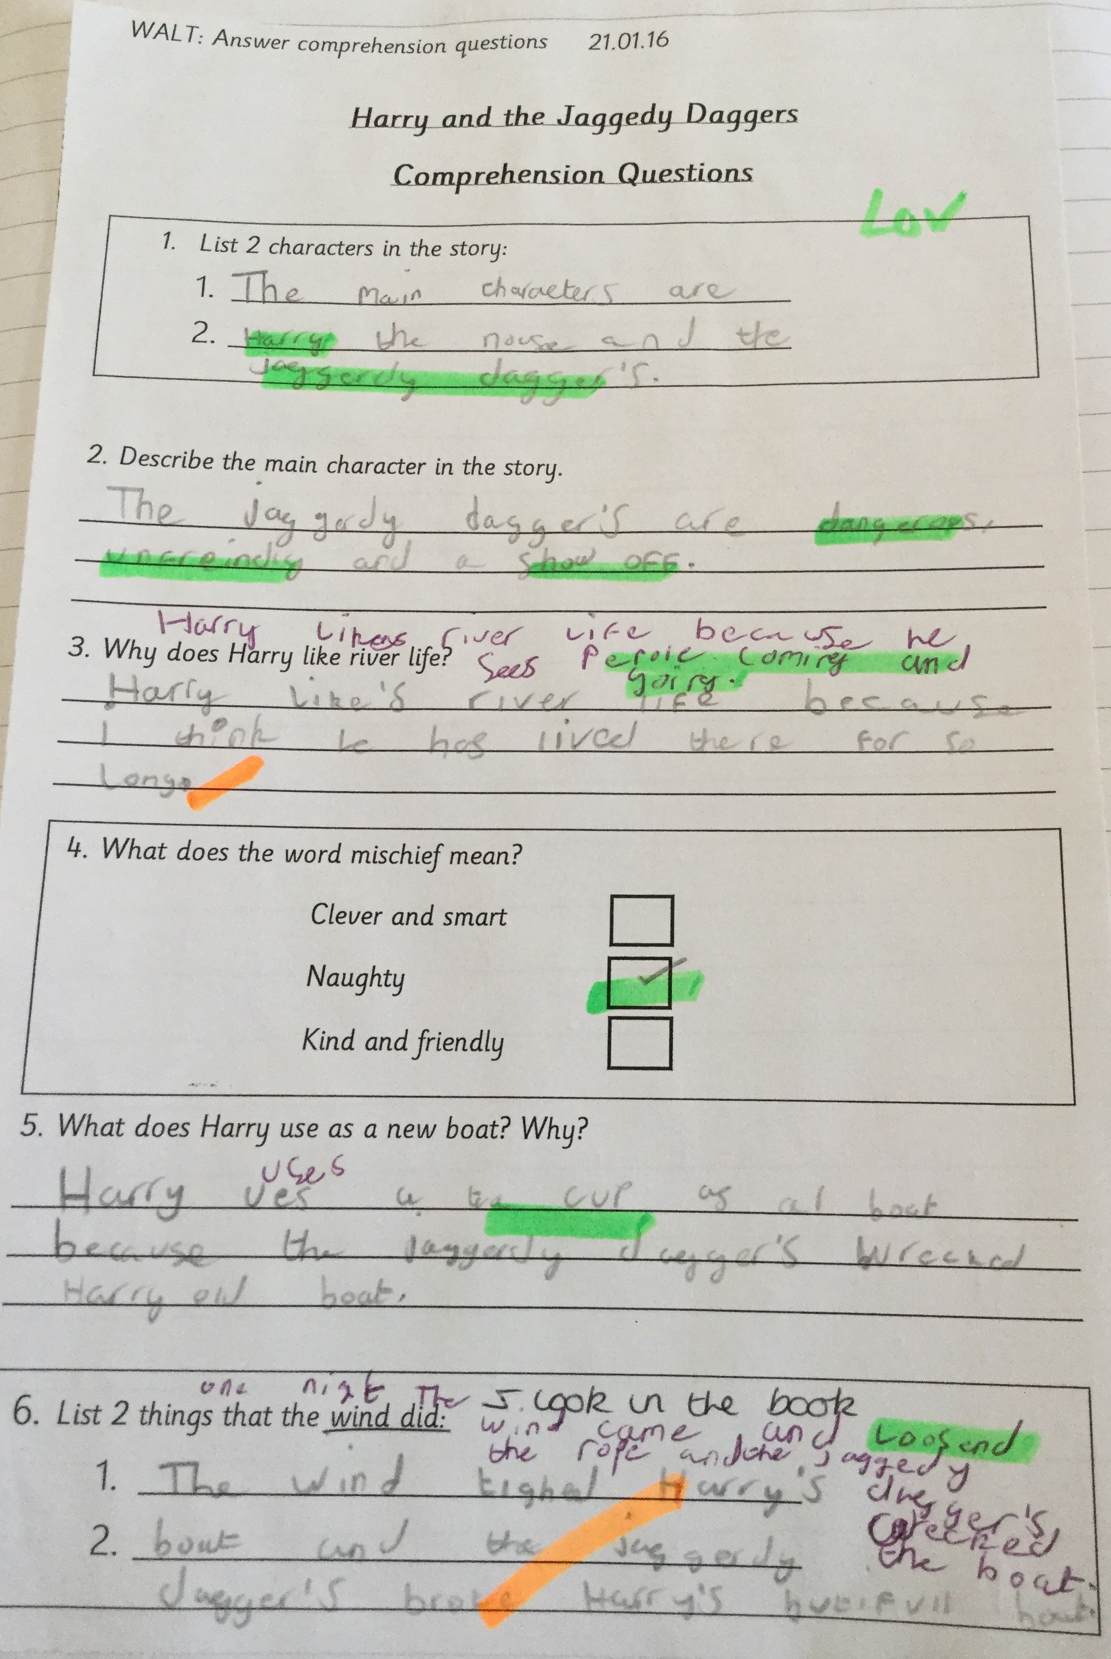

Slide 69

brave
imaginative
friendly
fearless

Slide 70
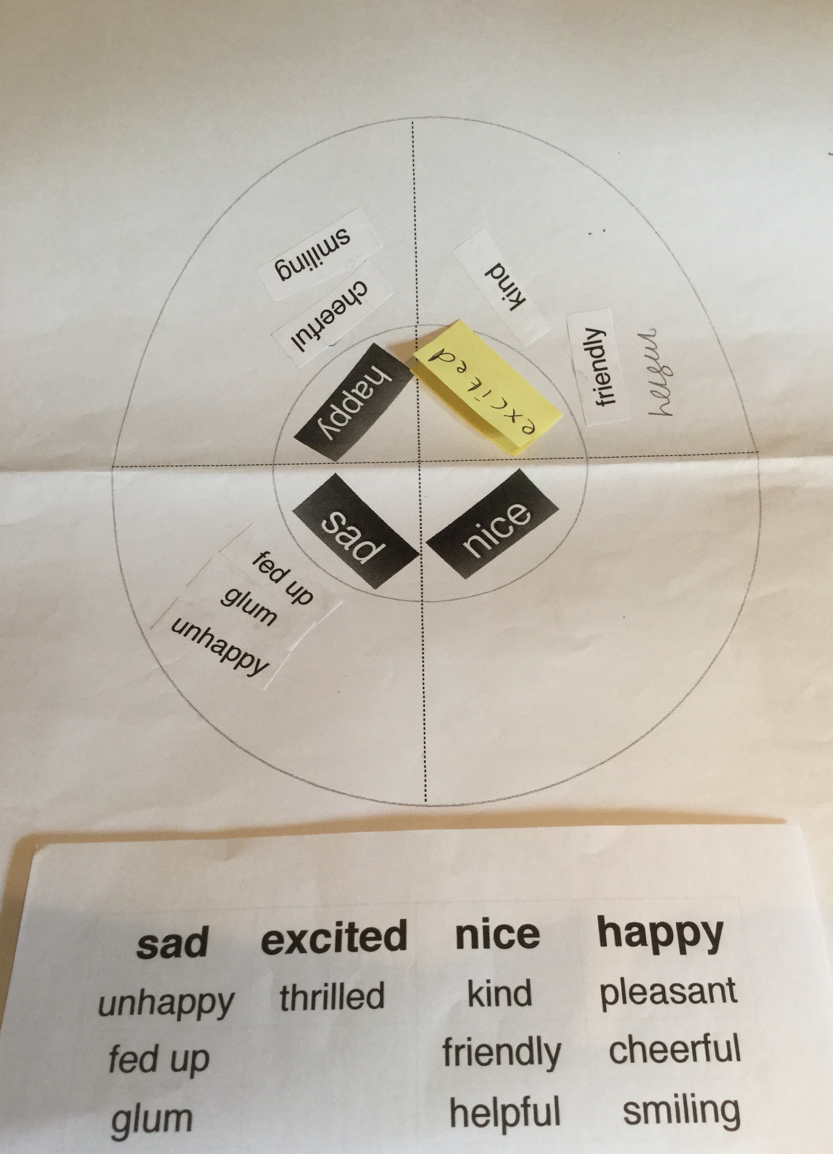
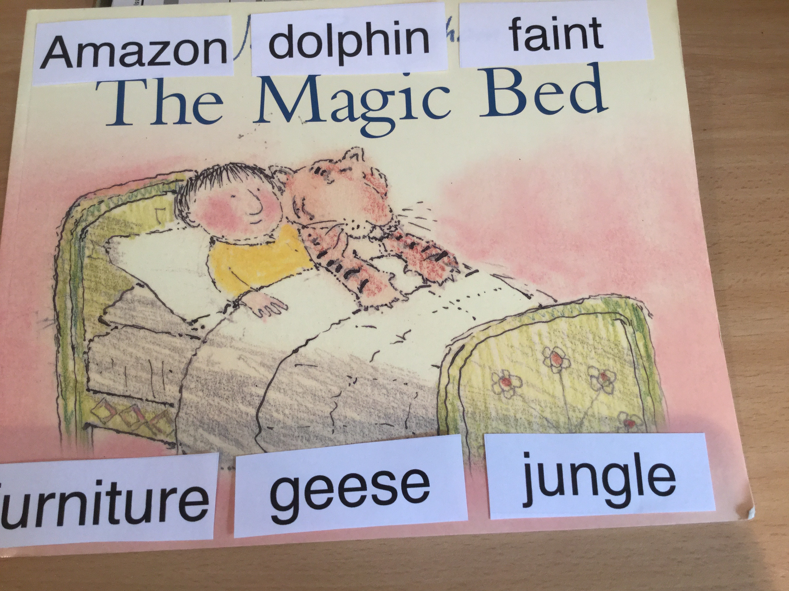

Slide 72
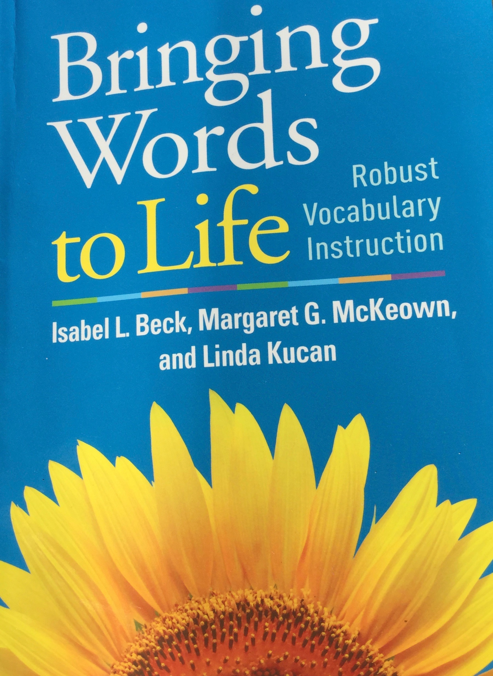

Slide 73
Seven Steps
Seven Steps
Contextualise
confound
commotion
distracted
Repeat the word
Child friendly definition
Give other examples
Relate to experience
Engage in other ways
Record

Slide 74
3 tiers of vocabulary
mainland
Tier 3
distracted
commotion
Tier 2
confound
island
Tier 1
Everyday basic words that usually occur in conversation.
Notes:
Tier 2 you see in books but rarely hear in speech

Slide 75
3 tiers of vocabulary
Tier 3
mainland
island
Tier 2
confound - commotion
distracted
Tier 1
Everyday basic words that usually occur in conversation.
Notes:
Tier 2 you see in books but rarely hear in speech

Slide 76
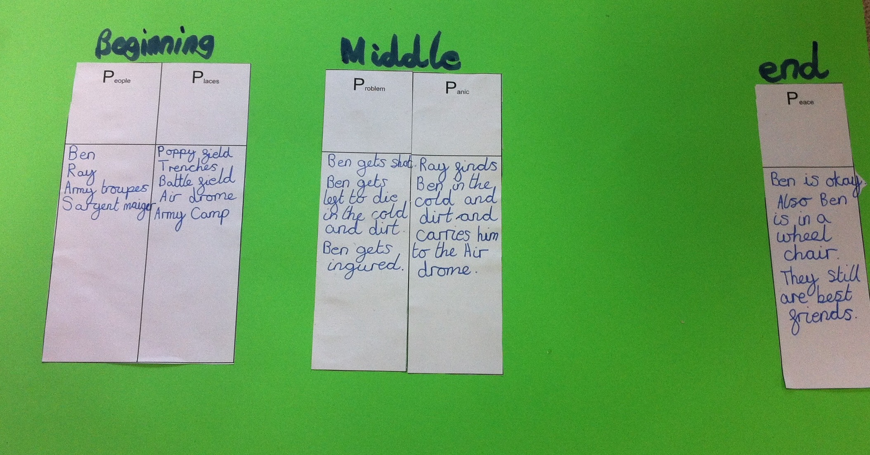


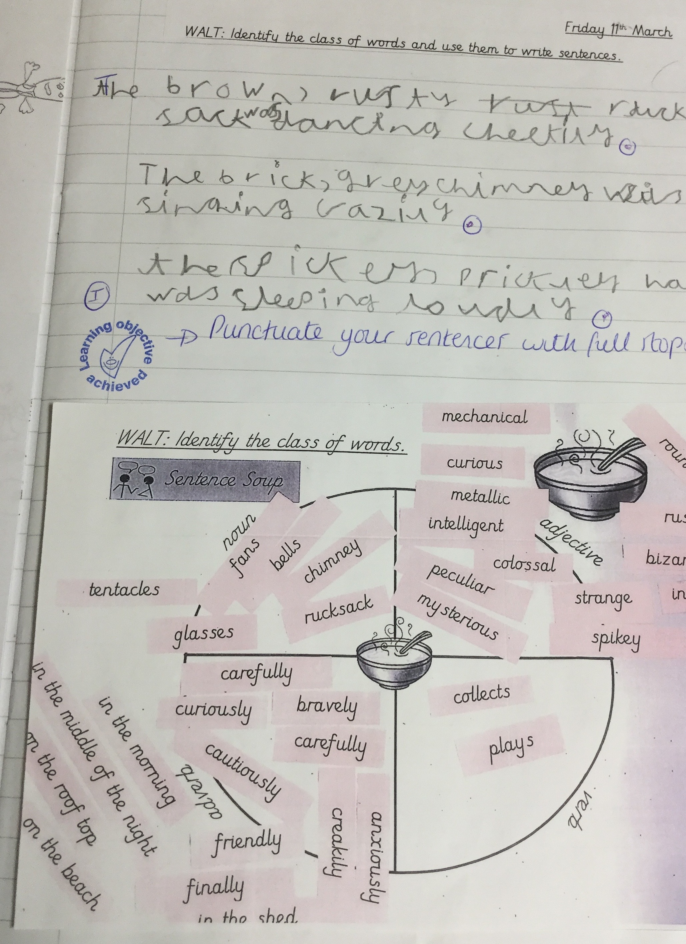
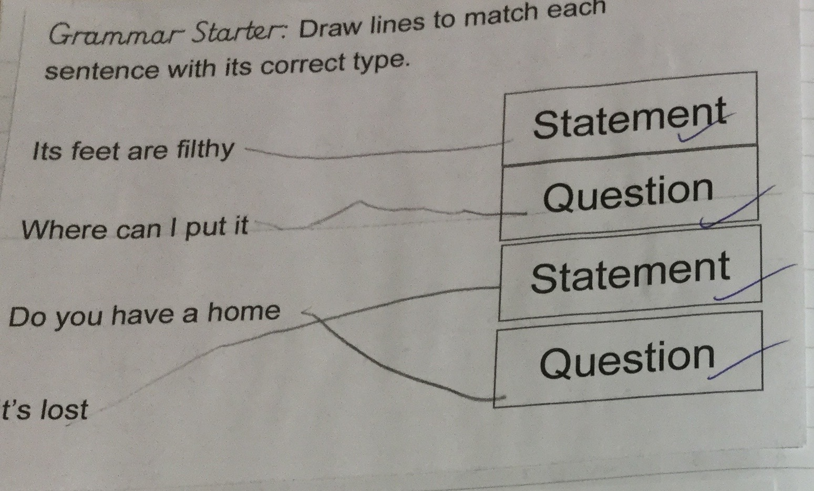
Phase 3 - TSO and SPaG

Slide 77
Reading
Writing
Prediction
Comprehension
Drafting
Editing
Publishing
SPaG
and TSO
Gap filling
ARE Grammar
    Revise - Practise - Introduce - Practise - Apply
Notes:
this our foundation

Slide 78
Axis of Emotion
Parents went on grand tour
The prince was captured
Running away from the soldiers
The soldiers go back to their ship
Living on Avala
The prince escaped
The people helping him
Notes:
digging deeper - do this
how could this support writing?
boys like these graphic organisers - use to support writing later

Slide 79
Plot Activities 2

Slide 80


Slide 81
Perfect Predictions
What has happened | What I think will happen | What did happen

Slide 82
Perfect Prediction Progression
1
2
3
4
Continued

Slide 83
Perfect Prediction Progression
5
4
What has happened | What I think will happen | What did happen
Continued

Slide 84
Perfect Prediction Progression
Adult modelling and scaffolding
Children making inferences with the support of an adult
Adult planned tasks for peer modelling and support
Independent and/or peer supported inferencing
Continued
I think the mummy will come home soon.
My brother is just like the boy in the story
I predict…
I wonder…
Can Bob see the aliens?

Slide 85
Perfect Prediction Progression
Written recording - adult modelling and scaffolding - grid completed with the support of an adult - paired and/or independent work
Independent and/or peer supported inferencing
What has happened | What I think will happen | What did happen
Continued
Can Bob see the aliens?

Slide 86


Slide 87


Slide 88


Slide 89


Slide 90
Three Wishes for The Red Prince
because…

Slide 91
Zoom Room
What would be on the walls?
What colour would the room be?
What items would be in the room?
Label your room with reasons behind your choices with evidence from the text.
Describe the room - The colour scheme…On the walls… The floor would be… There would be a…

Slide 92

Text Structure and Organisation

Slide 93
Saviour Pirotta’s Story Ladder
Problem
Shark kills people
Harpoon
Poison
Blow it up
Solution
People kill shark

Slide 94
Problem
The owl is afraid
of the dark
Dark is exciting
Dark is kind
Dark is fun
Dark is wonderful
Dark is beautiful
Solution
The owl is not afraid
of the dark

Slide 95
Problem
His family leave
the island
Solution
His family return to
the island

Slide 96


Slide 97
SPaG Phase
What writing are you going to do?
What grammar do you need to practice?
What activities will you choose?
Notes:
work in year groups

Slide 98
Singling out Sentences: SoS
Singling out sentences. When reading a text, from the textbook to a poem, pupils can be guided to single out the most successful sentence. By discussing and isolating the best vocabulary choices in the sentences pupils enhance their awareness of words and create a story of useful vocabulary items for their writing
Closing the writing gap: p104

Slide 99

The Robot and the Bluebird
He lay there through the long, dark nights and empty days.
He lay there rusting in the autumn rain.
He lay there rusting when the first snows of winter fell.

Slide 100

A Brave Bear
The sun was hot. The air was hot. Even the shade was hot.
On the way home, the sun was glowing. The air was glowing… Even tomorrow was glowing.

Slide 101
There is no Dragon in this Story
No, no, no that’s not how it goes says…
There is no dragon in this story

Slide 102
Oh no, George
What will George do?
Oh no, George!

Slide 103
Stanley’s Stick
Stanley stands on Stockport station with his stick.
And four times now he has used his stick to pick up slugs from pathway, platform and pavement…

Slide 104
Singling out Sentences: SoS
Singling out sentences. When reading a text, from the textbook to a poem, pupils can be guided to single out the most successful sentence. By discussing and isolating the best vocabulary choices in the sentences pupils enhance their awareness of words and create a story of useful vocabulary items for their writing
Closing the writing gap: p104

Slide 105
Singling out Sentences: SoS
Once, there was an island kingdom called Avala…
The king and queen were much loved by the people, and their son, the Prince, was friends with every child on the island.
One day, the prince’s parents set off on a grand tour of the mainland and left the young prince in charge. As they set sail, dark clouds rolled over the island and snow began to fall. A storm was setting in.
The Avalans shut their doors and lit their fires. Almost no one saw the black ships that sailed silently into the harbour…
…or the sailors who crept ashore, snuck through the streets, seized the city and captured the prince.
They took him far away and hid him in a fortress in the heart of the island.
Locked in the dark for days, the prince lost all hope.
But then, one night, he saw his chance.

Slide 106
Singling out Sentences: SoS
The prince ran…
… and ran.
The alarm rang out over Avala…
…and soon the island was crawling with strangers, all searching for the little red prince.
He stumbled through the snow, until he saw the flickering light of a fire.
A young girl sat beside the flames. “ You have to get to the city,” she told him. “Your friends are waiting for you.”
“But how will I get there?” asked the prince. “The strangers are everywhere.”
“ Don’t worry, “ she said. “You’ll find help in the most unexpected places.”
As the prince made his way across the island…
…he found that the girl was right.
The Avalans did everything they could to confuse and confound the strangers….
….and the Red prince was able to sneak all the way to the city gates.
He could hear a great commotion from behind the walls but saw no way past the guards…
…when suddenly they were distracted and he slipped inside.

Slide 107
Singling out Sentences: SoS
There, he saw something he couldn’t believe.
All of Avala were dressed as red princes! The city was filled with ruby red and rang with laughter and music.
The prince danced through the streets for hours, invisible in a sea of brilliant colour.
Until he left the safety of the crowd. The strangers chased him down but the prince was no longer afraid…
…for he knew he was not alone.
The strangers scrabbled to their boats, rowed to their ship and sailed away from the island of Avala.
Never to return.

Slide 108
What are your top three sentences?
Why?

Slide 109
Progression through retrieval questions
More than one element to be retrieved
Simple questions -
location indicated
Simple questions
often with question words
Retrieval from the full text
Multiple pages
Adult modelling and scaffolding
Children searching with support of an adult
Adult planned tasks for peer modelling and support
Independent and/or peer supported retrieval

Slide 110
Progression through retrieval activities
Adult modelling and scaffolding
Children searching with support of an adult
Adult planned tasks for peer modelling and support
Independent and/or peer supported retrieval

Slide 111
Short and Snappy
Question |  | Answer
Who could see the flashes of lightning? |  | Juliana
Why did she feel scared? |  | Storm closing in
How long did the violent pitching last for? |  | Nearly ten minutes
What was plugged into darkness? |  | The cabin
When did she wake up? |  | The following morning - Christmas day
Where did she land? |  | The Jungle

Slide 113
Short and Snappy
Question |  | Answer
Who?
Why?
How?
What?
When?
Where?

Slide 114
Fact Dump - Pair and Share
1
2
3
4
5
Now compare with a friend and add anything you might have missed.
Finally re-read the text to see how much you remembered - tick everything that was correct:
Correct anything that was incorrect: add anything that you missed.

Slide 115

3:2:1
3:2:1
3:2:1
Introduction
Resources: A 3:2:1 grid
Method: Ask children to discuss and/or complete the 3:2:1 grid:
3 things I’m sure about
2 things I’m not so sure about
1 question I would like to ask
Strategies
Independent Reading
Return to Text and Response
Content Domain
2a | 2b | 2c | 2d | 2e | 2f | 2g | 2h
1a | 1b | 1c | 1d | 1e

Slide 116

Top 5
Top 5
Top 5
Introduction
Resources: A Top 5 grid
Method: Ask children to discuss and/or complete the Top 5 grid stating the top 5 most important parts of the text.
Strategies
Independent Reading
Return to Text and Response
Content Domain
2a | 2b | 2c | 2d | 2e | 2f | 2g | 2h
1a | 1b | 1c | 1d | 1e

Slide 117
Working with Novels
Main issue is not finishing
  Work on selected chapters in depth
  Summarise chapters as you work through the book - Axis of emotion - Storyboard - Story Ladder
Needs for visuals especially for second language learners
  Orientation with in depth study of cover detail in prediction - big envelope - end papers etc -
Reading fluency techniques
  modelling and echo reading
  Q words and the IEW

Slide 118
Visualisation
Far below him lay the sea, a sea bluer than any sky he had ever seen. The land curved in and out along its edge: in and out, up and down, all green and golden with here and there the red flowers too far off to be clearly seen. Down by the sea a road ran along the foot of the mountain and near it lay villages whose bright colours gleamed dazzlingly. There were trees with many changing hints of green and over it all shone the warming sun - not white-hot and spiteful and scorching, as the sun had shone upon the camp in the summertime, but with a warm, golden loveliness.
They might choose to draw a series of images, like a comic book, or one drawing to encapsulate
what they are visualising. After pupils have had enough time to draw, ask them to annotate their
illustration with any words or phrases that particularly inspired their depiction.

Slide 119
It was a hot summer’s evening and the princess had found a shady spot among the trees beside a deep, blue pool

Slide 120


Slide 121
Timeline of Events

Slide 122
Summary
Beehive

Slide 123
Flow Chart
Main Event

Slide 124
Phase 1
Phase 2
Phase 3
Phase 4
Phase 5
Reading
Writing
Prediction
Comprehension
Drafting
Editing
Publishing
SPaG
and TSO
Gap filling
ARE Grammar
    Revise - Practise - Introduce - Practise - Apply
Notes:
this our foundation

Slide 125
Giving Children a Voice
A high quality text to explore by the class
  Audience and purpose
  Vocabulary development
  Grammatical structures
  Layout
  Writing opportunities
Providing and developing sound understanding of:
  Plot
  Character
  Setting
Responding to books and discussing the purpose of language used

