Slide 1
Non-fiction teaching sequences
New (or not) to Y5/6 - Day 2
Writing at Greater Depth
Sentence support ideas
A poetry teaching sequence
Spelling in Y5/6

Slide 2
Stepping stones - sequencing sentences
The girl opened the door.
What she saw took her breath away

Slide 3
Stepping stones - sequencing sentences
The girl opened the door.
What she saw took her breath away

Slide 4
Next Time…18 January 2024
Any requests?
More ideas for writing - SEND ideas
More of the next 20% in reading comprehension
GD in Writing
Non-fiction
Poetry
Spelling

Slide 5
Recording

Slide 6
Scaffolding Reading
Physical and Visual | Skeletons and Grids | Oracy
Modelling - partial and mid task | Graphic organisers | Drama
Surveying the text / 360 | Guided Reading planning cards
Echo reading | Timelines / storyboards | Speaking and Listening techniques
Choral reading | Test question cards | Readers’ Theatre
Performance reading | Stepped questioning????
Background knowledge - pictures and videos
Background knowledge - 7 step vocabulary

Slide 7
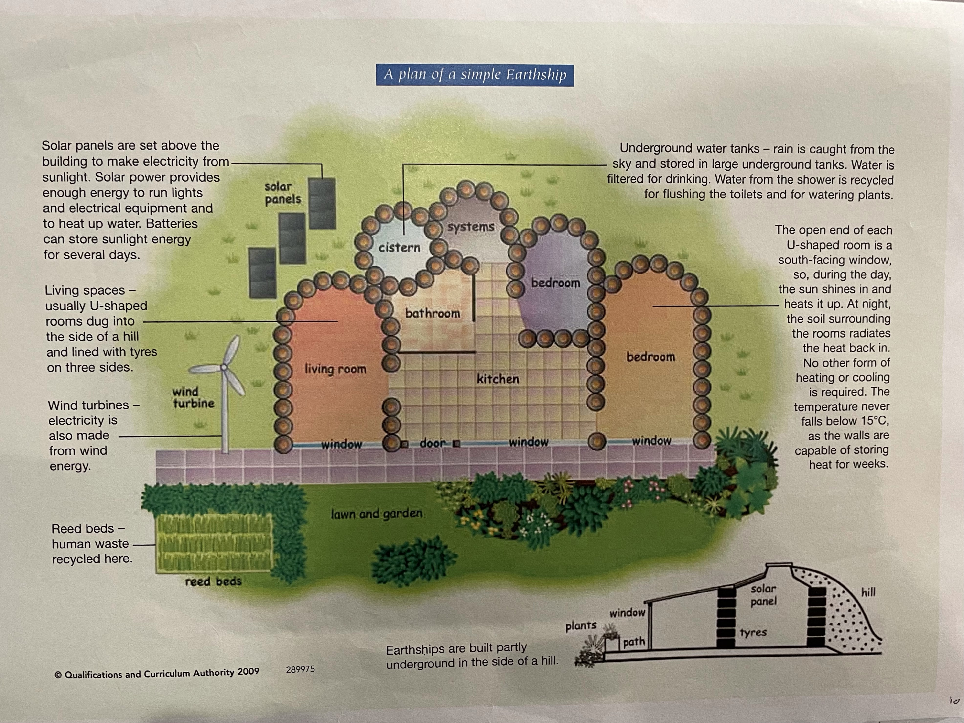

Slide 8
Surveying the text
Punctuation
Names
Run ons
Chunking
Dialogue
Speech verbs
Challenging vocabulary
Text Organisation clues

Slide 9

Y2?
The Dark
Laszlo was afraid of the dark. The dark lived in the same house as Laszlo. A big place with a creaky roof, smooth, cold windows and several flights of stairs.
Sometimes the dark hid in the cupboard. Sometimes it sat behind the shower curtain.
But mostly it spent its time in the basement.
All day long, the dark would wait in a distant corner, far from the squeaks and rattles of the washing machine, pressed up against some old, damp boxes and a chest of drawers nobody ever opened.
At night, of course, the dark went out and spread itself against the windows and doors of Laszlo’s house. But in the morning, the dark would be back in the basement, where it belonged. Laszlo would peek at the dark every morning.
“Hi,” he would say. “Hi, dark.”

Slide 10
Surveying a text
The Dark
Laszlo was afraid of the dark. The dark lived in the same house as Laszlo. A big place with a creaky roof, smooth, cold windows and several flights of stairs.
Sometimes the dark hid in the cupboard. Sometimes it sat behind the shower curtain.
But mostly it spent its time in the basement.
All day long, the dark would wait in a distant corner, far from the squeaks and rattles of the washing machine, pressed up against some old, damp boxes and a chest of drawers nobody ever opened.
At night, of course, the dark went out and spread itself against the windows and doors of Laszlo’s house. But in the morning, the dark would be back in the basement, where it belonged. Laszlo would peek at the dark every morning.
“Hi,” he would say. “Hi, dark.”
Tricky name
Run on sentence
Long sentence
Dialogue

Slide 11
Run ons
Word by word readers often assume that a sentence finishes at the. End of line of text they place a non existent full stop at the end of.
each line.
But texts are written to flow – to follow an idea to its conclusion and often the words in a sentence flow over the line end. They run on.

Slide 12
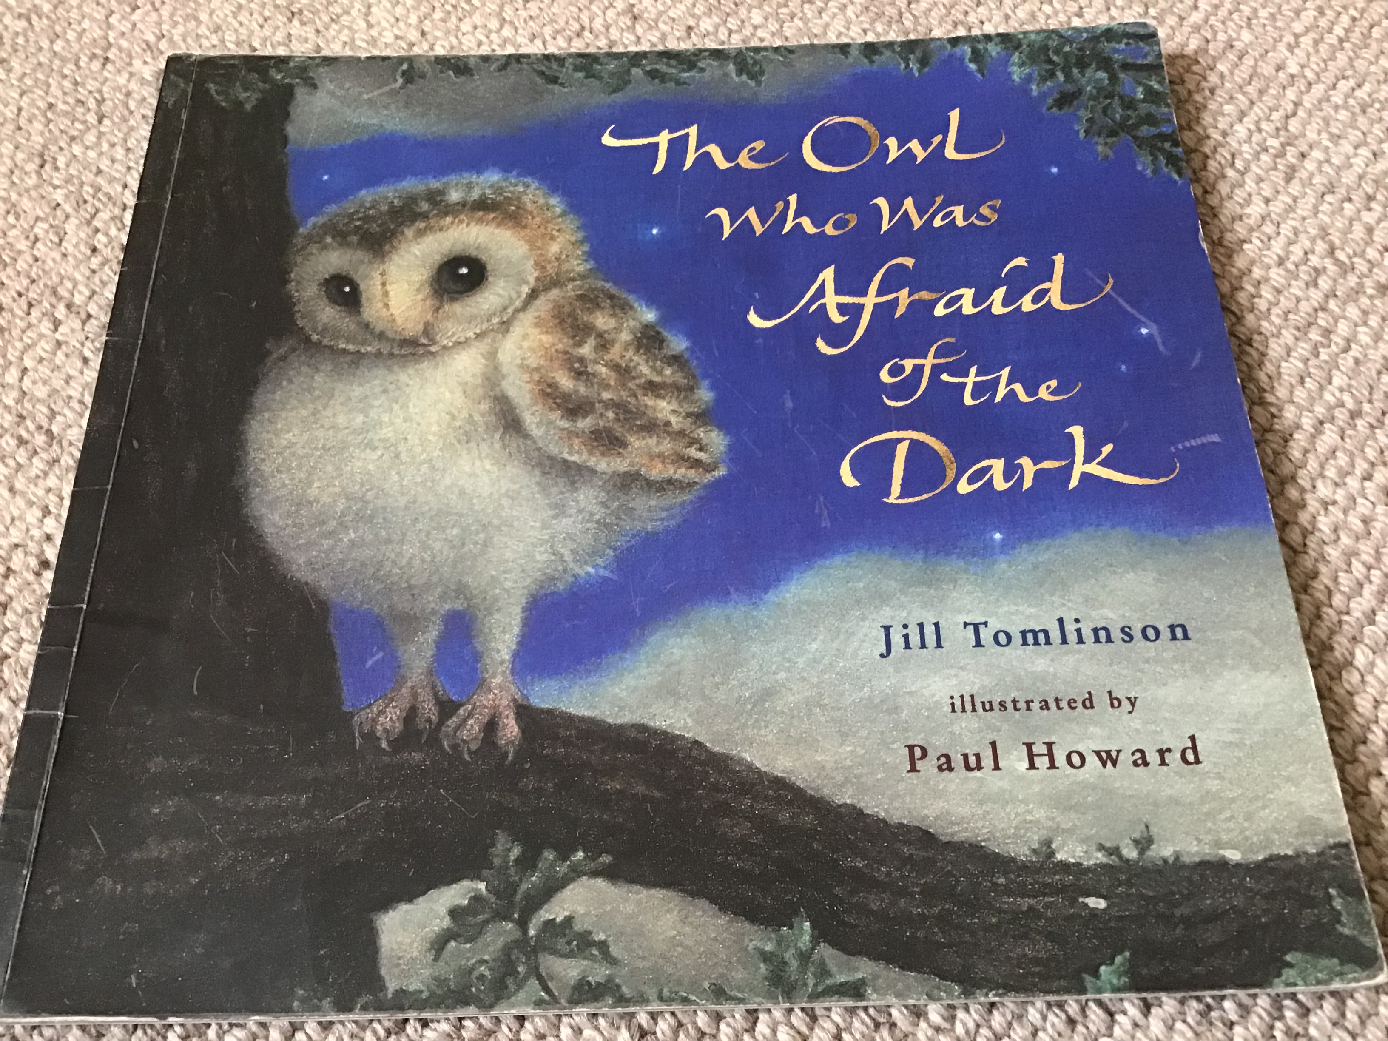
Dialogue: speech verbs, text clues and punctuation
Y2?
“Because - oh, because it’s the fashion,” said the little girl.
“Don’t you know anything?
The Owl Who Was Afraid of the Dark
“Hello!” said Plop. “I’ve come to see what’s going on.”
“I’m guarding the camp-fire,” said the boy.
“The others have gone to play games in the dark, lucky things.”
“Do you like the dark?” asked Plop.
“It’s super!” the boy replied.
“DARK IS FUN. We’re going to make cocoa and sing round the fire. Would you like to stay?”

Slide 13
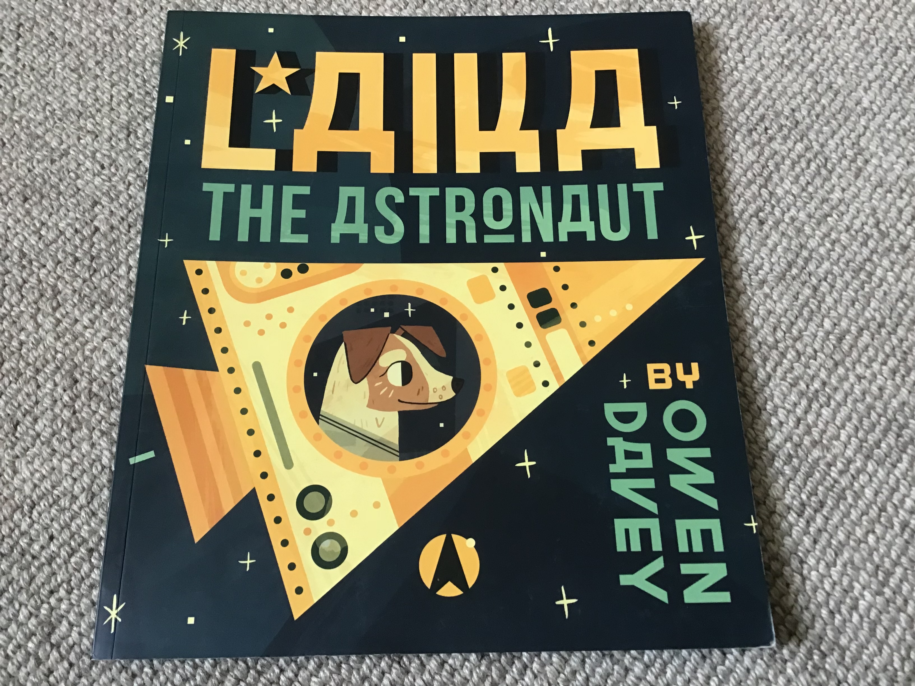
Y2?
Laika The Astronaut
Laika was a stray dog, wandering the streets of Moscow. She had no family and nowhere to call home. Laika was all alone.
At night, she looked at the stars and made a wish - a wish to find a family who would love her. Then someone noticed Laika was alone and decided she would be perfect for a very special job....
A group of scientists wanted her to try out their new spacecraft. She trained very hard and was tested many times until finally...
Laika was ready to go into space. She climbed aboard her rocket and waited.
10...9...8...7...6...5...4...3...2...1...
BLAST OFF!

Slide 14
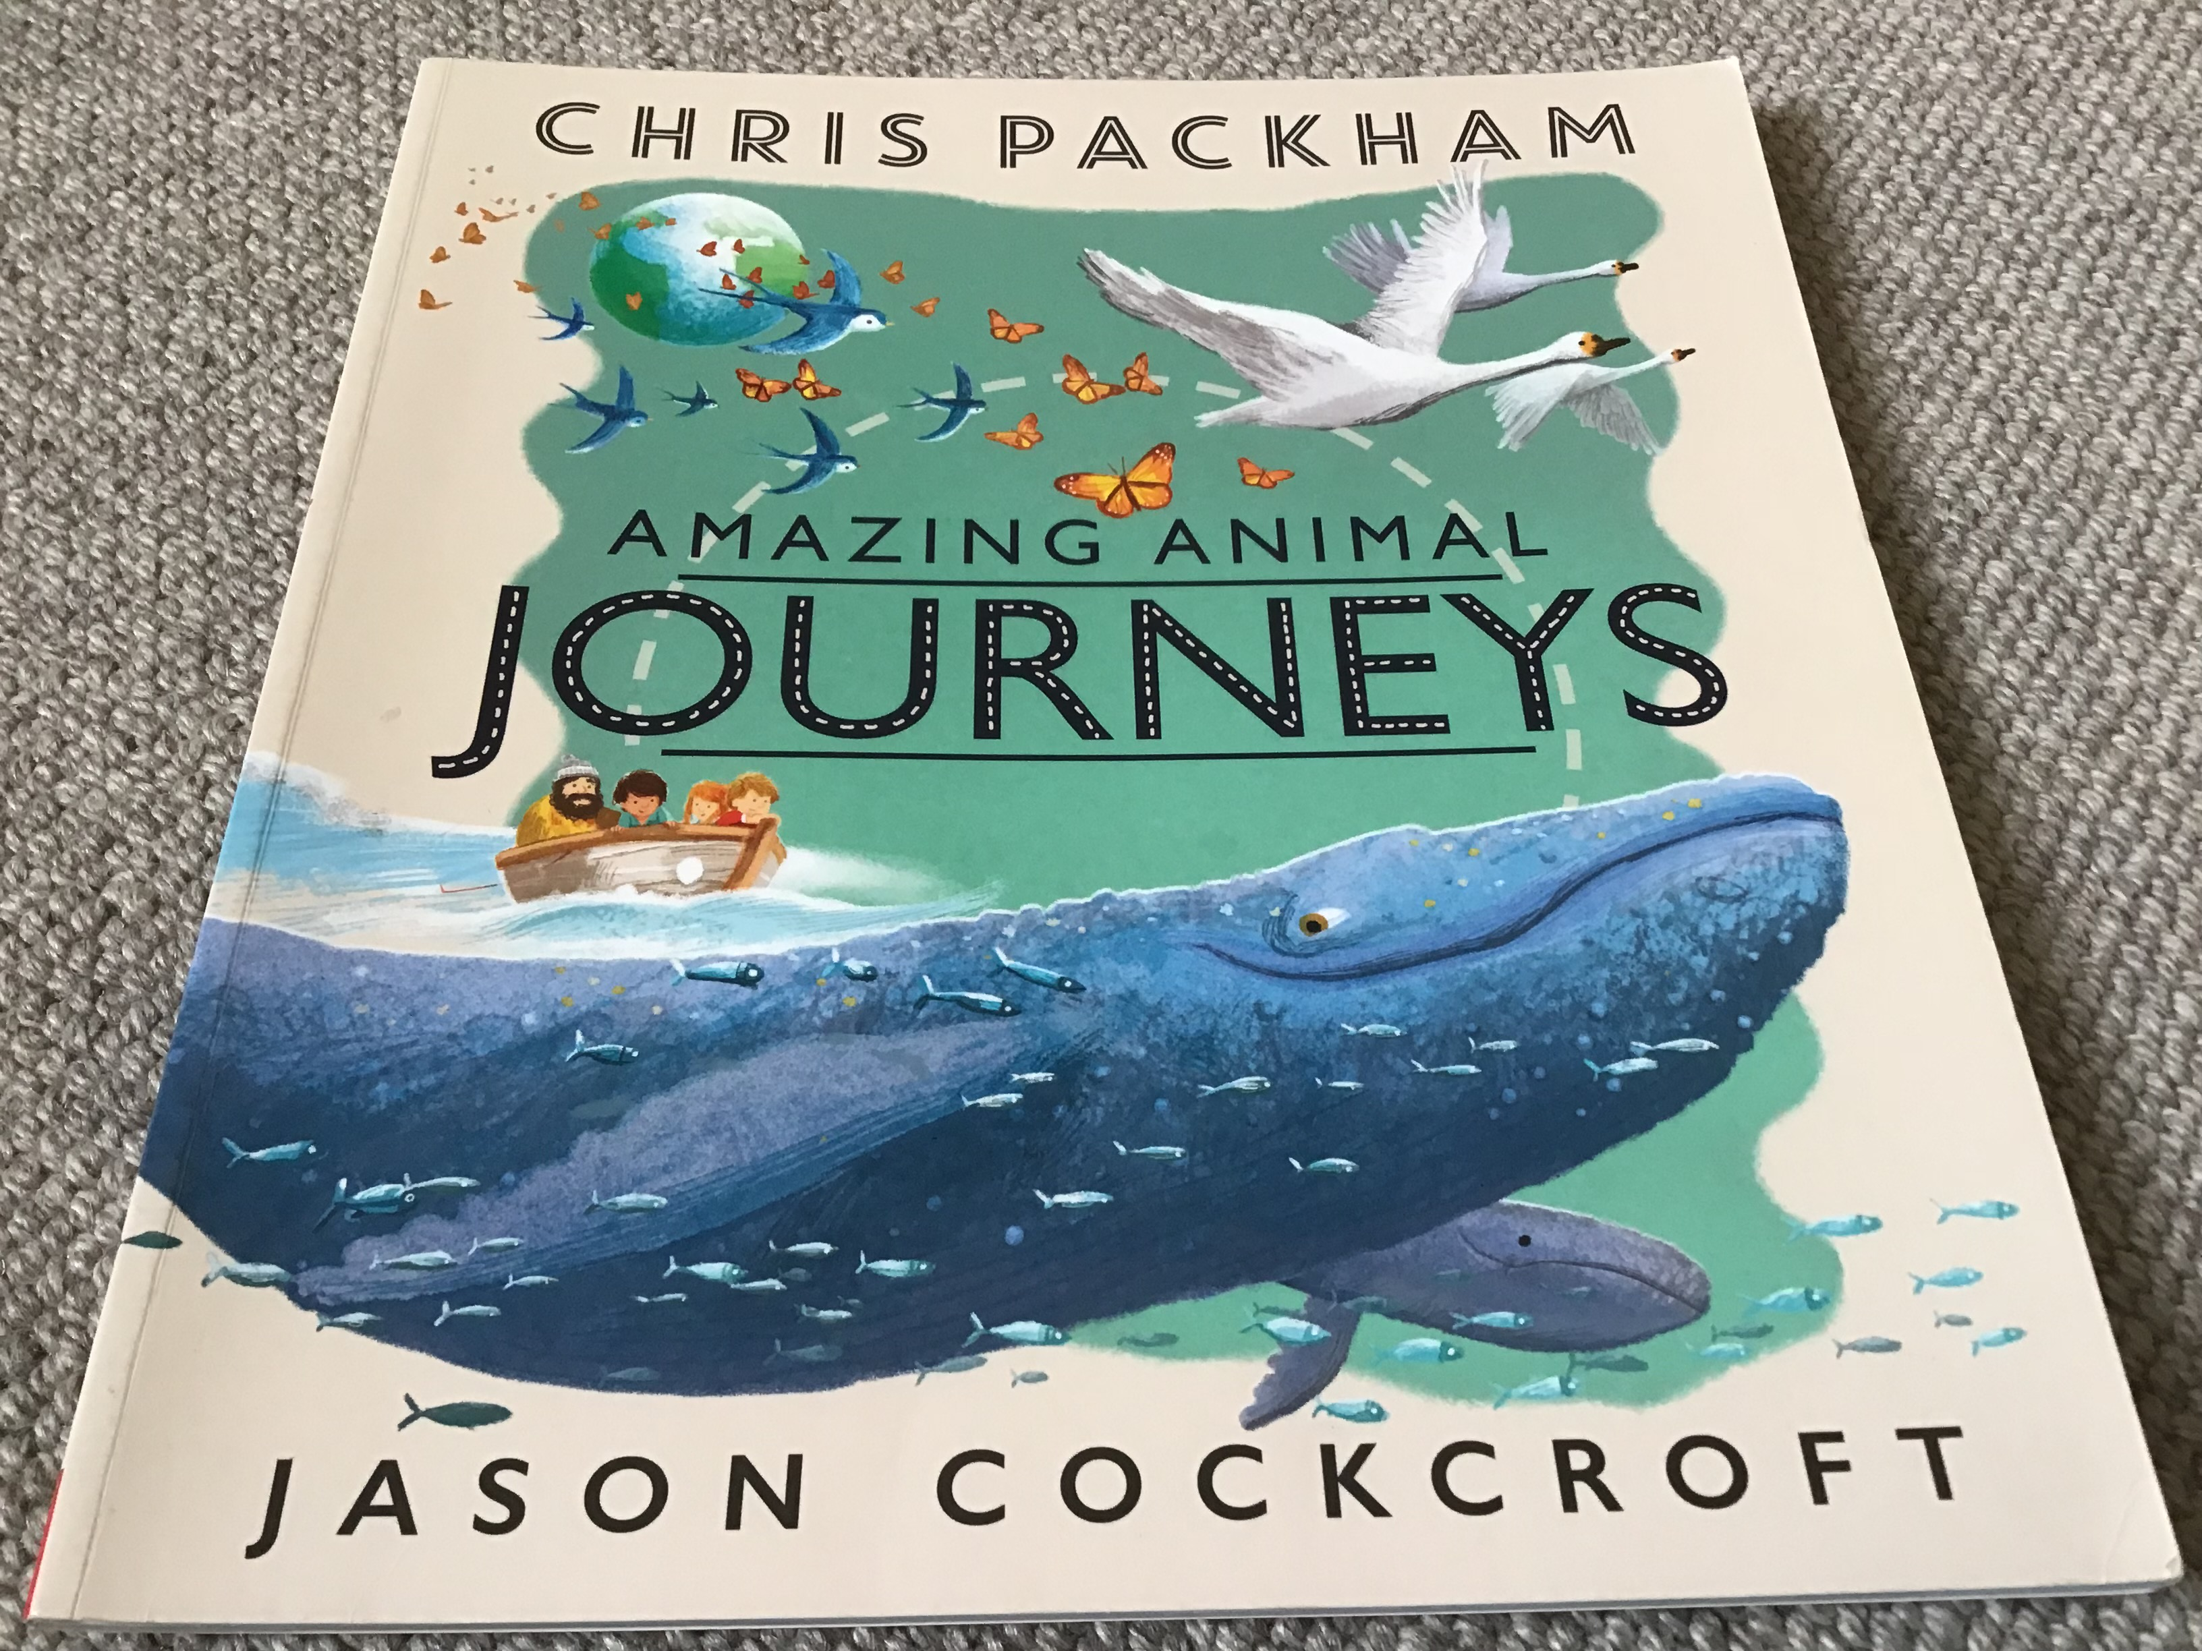
Y3?
Amazing Animal Journeys
Everything about the blue whale is big! It’s the largest creature to have ever lived on Earth and it has a big appetite too!
Cold, polar seas swarm with animal life and every day the adults can each eat more than three tonnes of food.
They have to migrate to warmer, tropical waters to give birth so the young whales don’t get too cold. But don’t worry, the little ones grow quickly and in spring the whole family heads back for a massive meal!

Slide 15
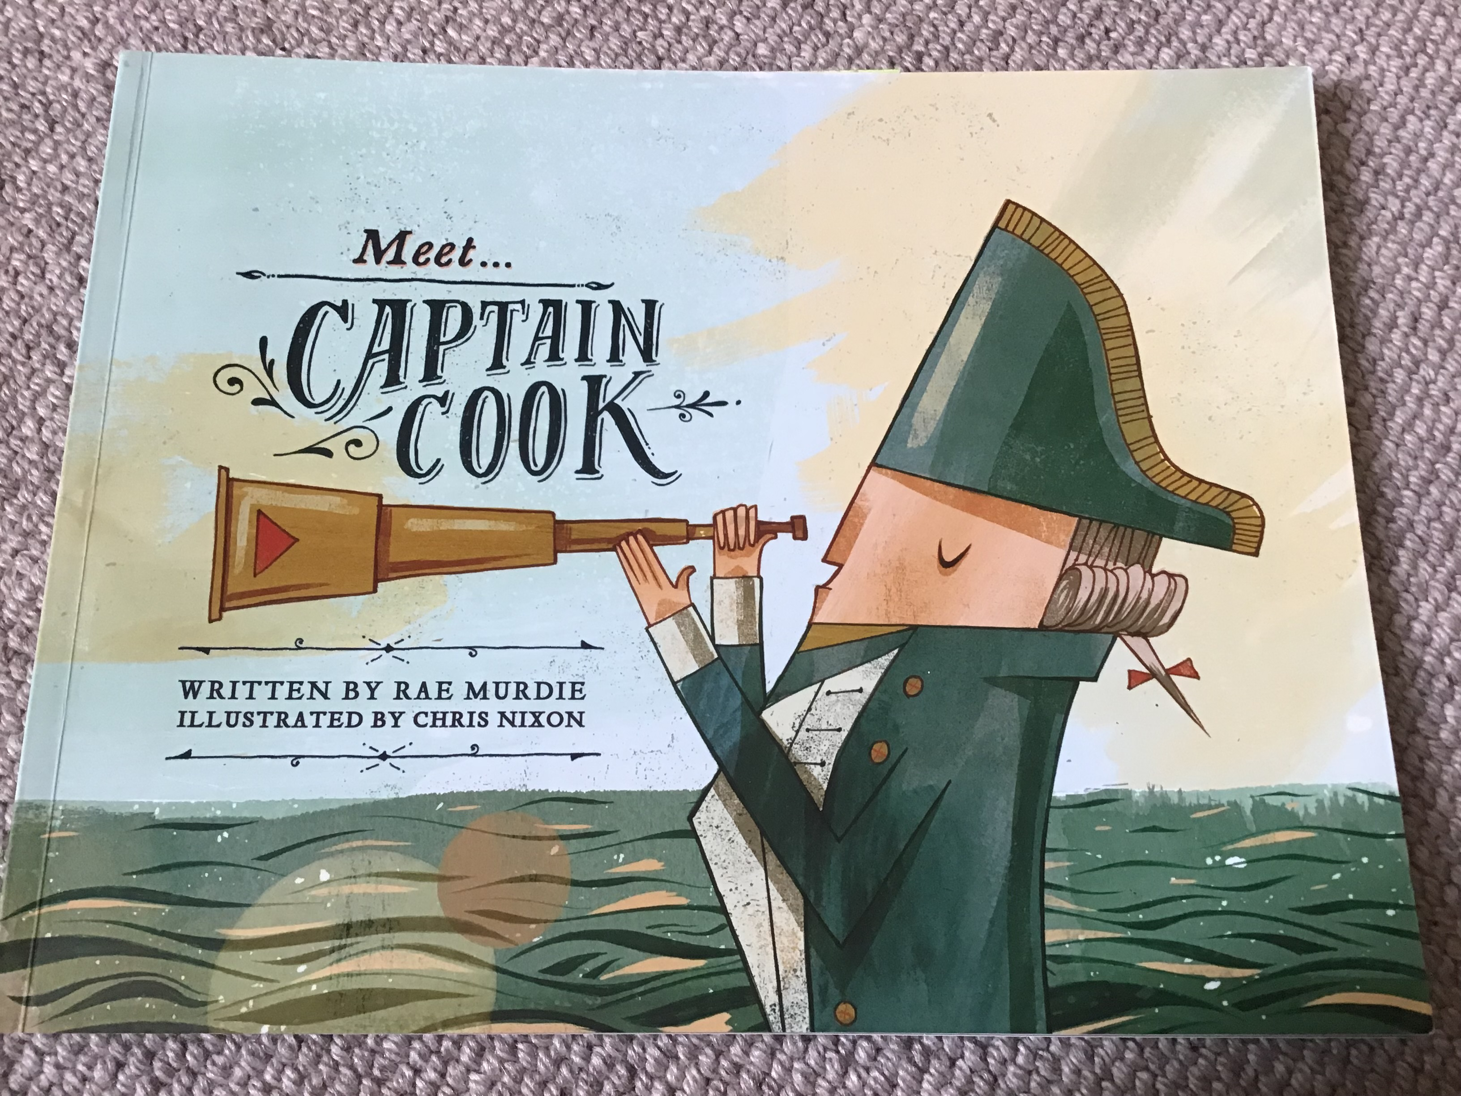
Y4?
Meet Captain Cook
In August 1768, the Endeavour embarked on her maiden voyage with great pomp and fanfare. Among those onboard were a variety of animals, 55 sailors, a one-handed cook, an astronomer, four artists and a botanist by the name of Joseph Banks.
This motley crew readied themselves for the dangers of the open seas and the strange lands that were rumoured to lie ahead.
The Endeavour made her way down the coast of Africa in fine weather. The crew caught sharks and marvelled at flying fish. Joseph Banks spotted penguins and collected giant kelp.
But the tropics soon gave way to the violent weather of the South Atlantic. Captain Cook and his crew prepared for the challenge of rounding Cape Horn. After three failed attempts, the Endeavour overcame icy winds and bitter gales to forge through the dreaded passage and emerge into the South Pacific.
After eight long months at sea, the crew dropped anchor off the coast of King George’s Island. The locals paddled out to welcome them. They traded fresh food in exchange for beads and metal tools.
Captain Cook and his men built a fort and an observatory, where on a clear day they gathered to watch Venus pass across the sun.
At last, it was time to open the King’s letter. It revealed a new and most important task: to venture south in search of new land.
The Dutch had already discovered New Zealand and parts of the neighbouring continent of New Holland. But both were still unmapped. And there were whispers that the Pacific Ocean was also home to a great southern land, Terra Australis.
Captain Cook was to find it and claim it for the King.

Slide 16
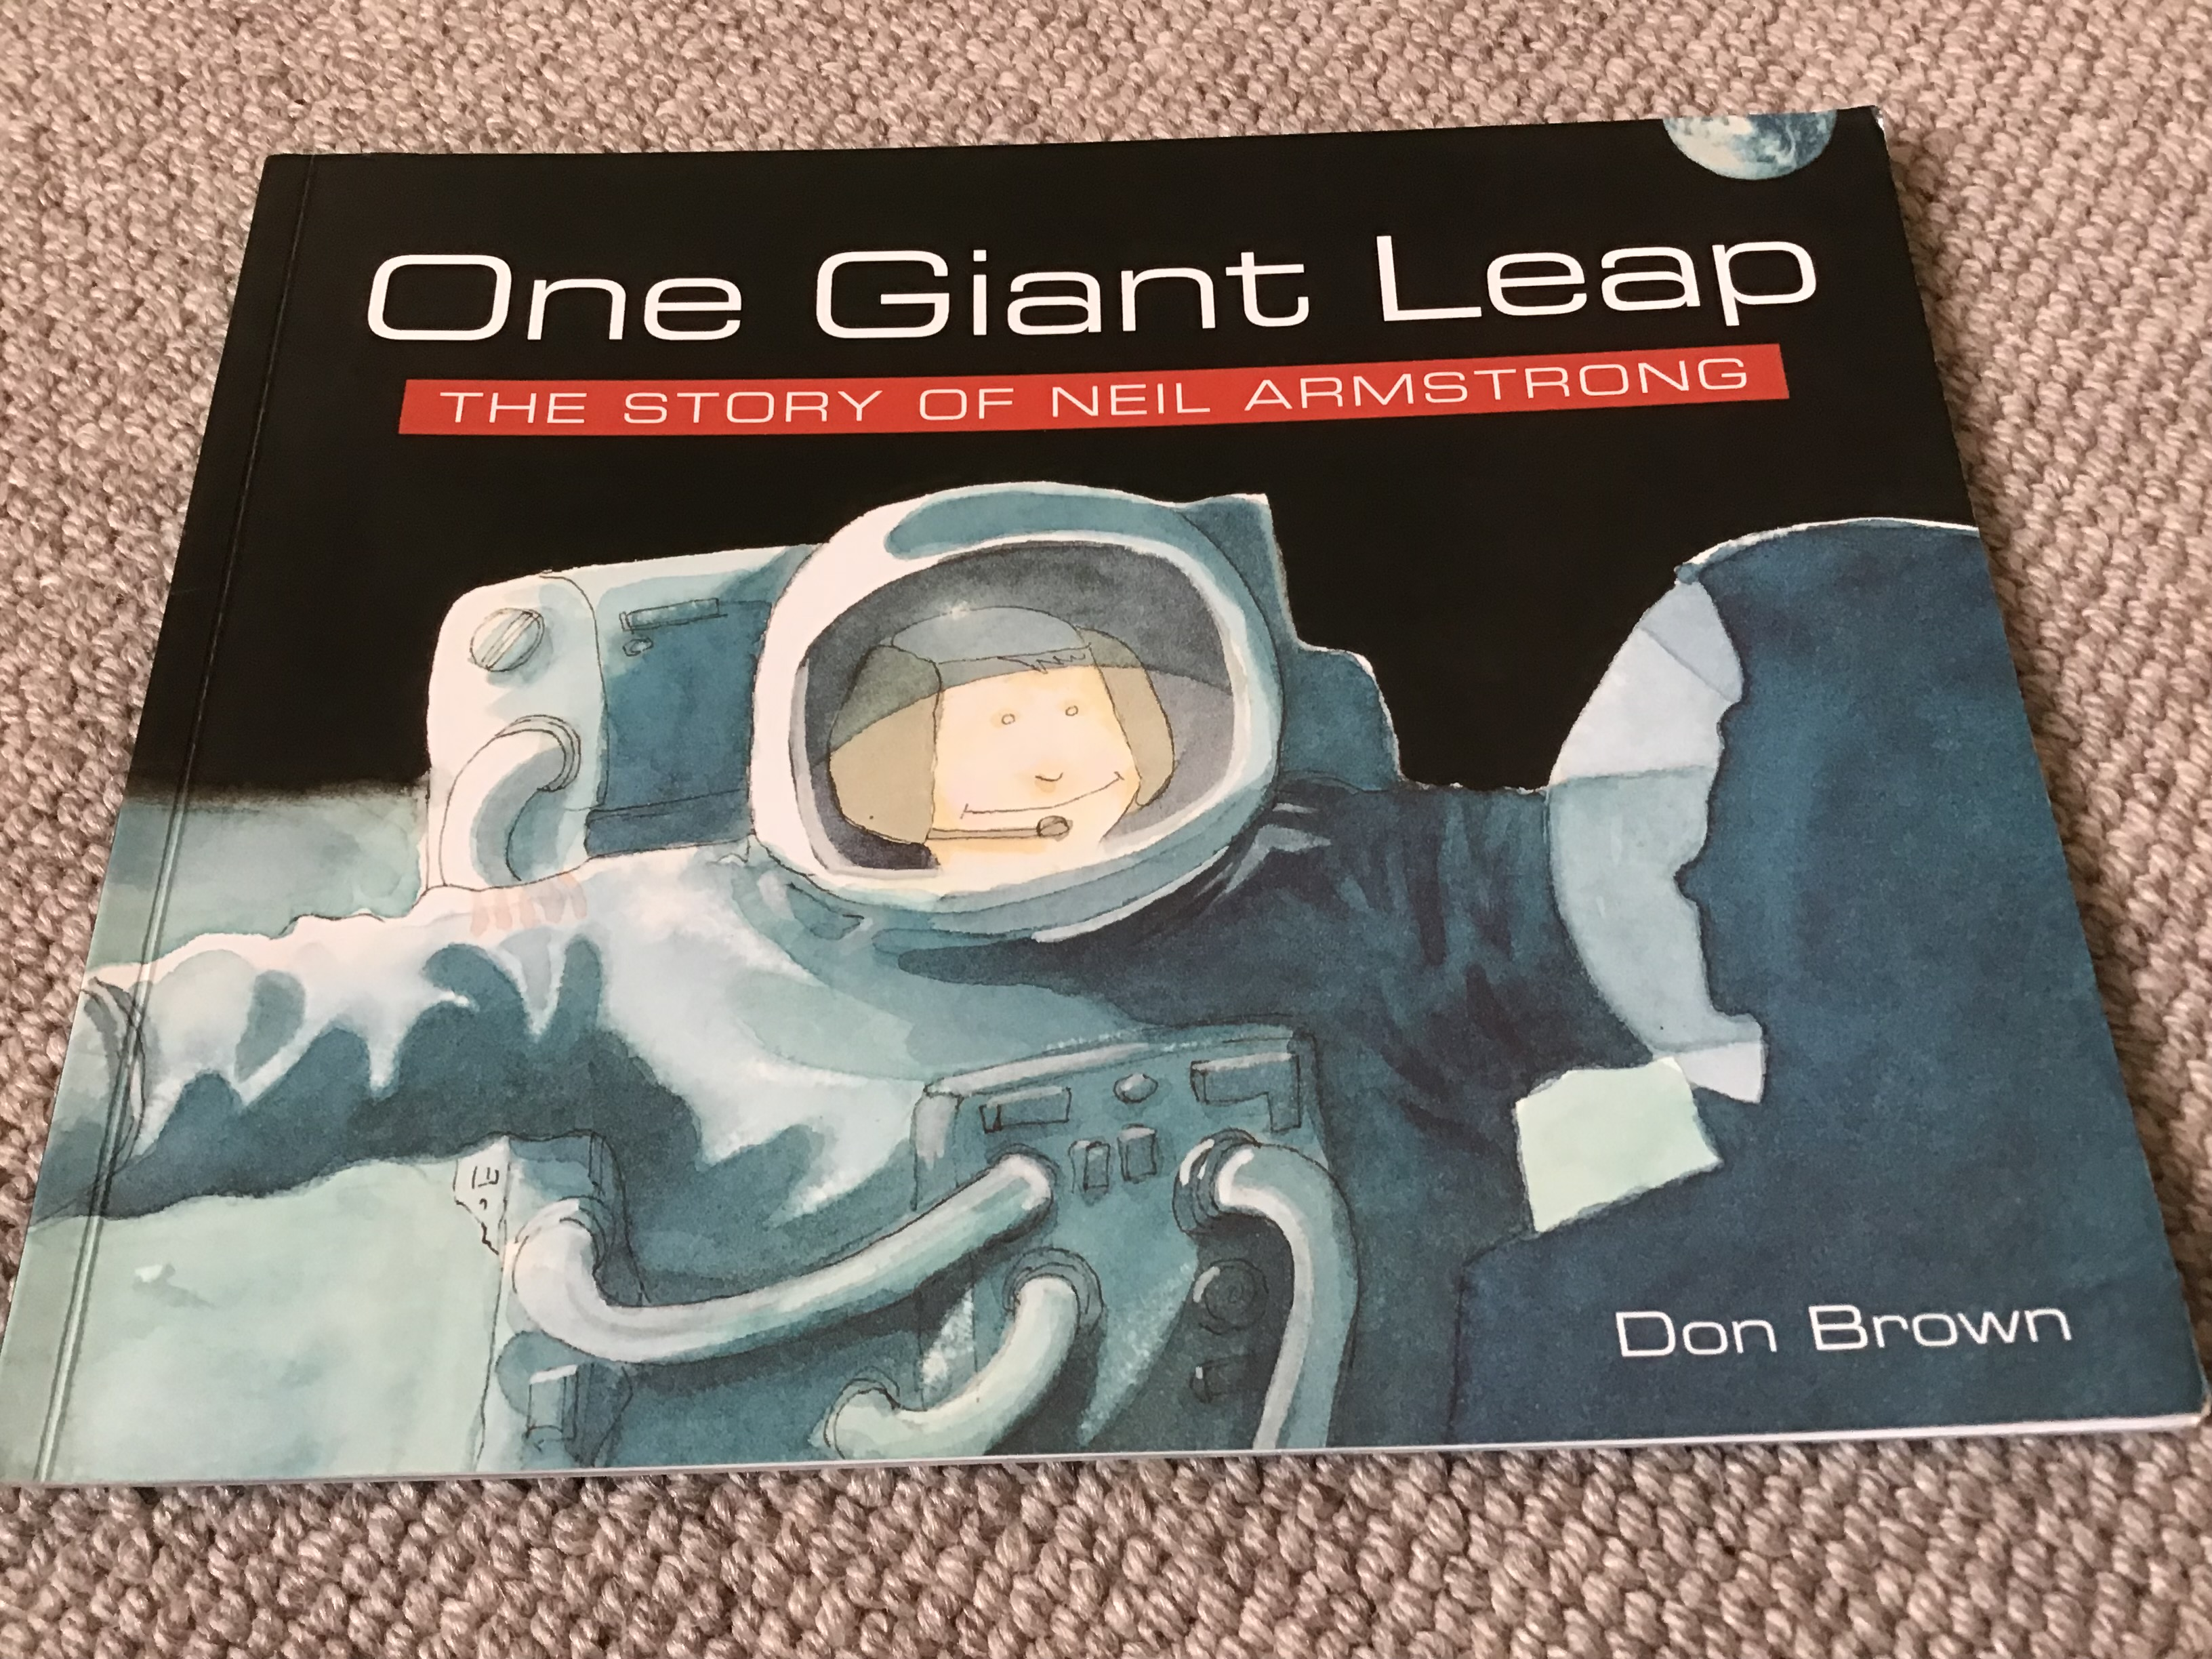
Y3?
Punctuation
Names
Run ons
Chunking
Dialogue
Speech verbs
Challenging vocabulary
Text Organisation clues
One Giant Leap
Earthlings Neil Armstrong and Buzz Aldrin had finally reached the moon!
Wearing space suits and helmets, they opened the hatch of the spacecraft.
Before them was the moon, magnificent and empty. Neil climbed down a ladder and hopped to the ground. Special cameras allowed 600 million people on Earth to watch and listen.
“That’s one small step for man, one giant leap for mankind, “ Neil said into his microphone.
He gathered moon rocks for scientists to study later. As he worked, his boots left marks in the dust. Neil’s footprints may remain there for millions of years. There is no wind, no rain on the moon to disturb them.

Slide 17
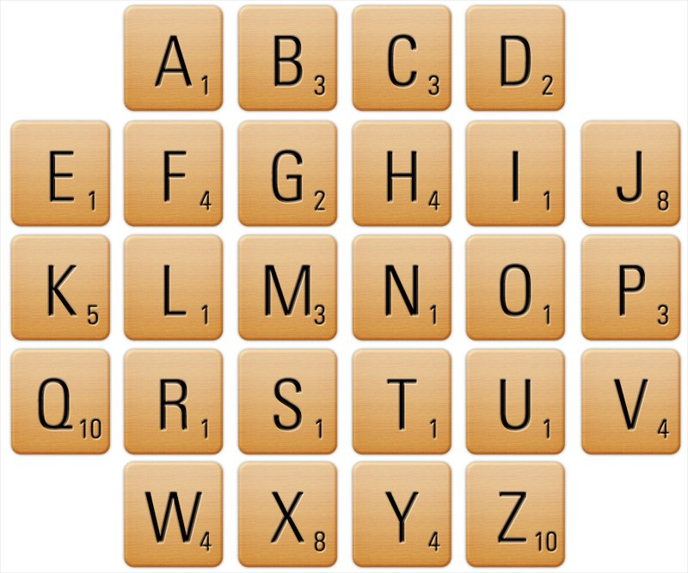

Slide 18
Scrabble Endings
likely |  |  |  |  |  |  |  |  |  |  | Total
l | i | k | e | l | y
originally
o | r | i | g | i | n | a | l | l | y
ferociously
f | e | r | o | c | i | o | u | s | l | y

Slide 19
Endings
likely |  |  |  |  |  |  |  |  |  |  | Total
l | i | k | e | l | y
1 | 1 | 5 | 1 | 1 | 4 |  |  |  |  |  | 13
originally
o | r | i | g | i | n | a | l | l | y
1 | 1 | 1 | 2 | 1 | 1 | 1 | 1 | 1 | 4 |  | 14
ferociously
f | e | r | o | c | i | o | u | s | l | y
4 | 1 | 1 | 1 | 3 | 1 | 1 | 1 | 1 | 1 | 4 | 19

Slide 20
Last Time
Agenda - Morning Session
» Prediction
» Prediction in tests
» Reading Comprehension
» English Units
» Immersion
» Comprehension
» Vocabulary
» Test question practice
» Character inference questions
» Reading Fluency
» Preparing for tests

Slide 21
Last Time
Agenda - afternoon Session
» Punctuation and Grammar Test
» ‘Interim’ Assessment Framework for Writing
» Text Structure and Cohesion
» Planning, Drafting and Editing

Slide 22
Agenda - Morning Session
Non-fiction teaching sequences
Non-fiction SATS
Reading to writing ideas
Writing expectations and effective practice
Greater Depth in writing
        CIA
        Exemplar materials

Slide 23
Agenda - afternoon Session
Poetry
  A teaching sequence and ideas
  SATS
Previous tests
Ideas for teaching spelling
Memory strategies
Spelling games and resources

Slide 24
2018

Slide 25
Teaching Non-Fiction - KS2
A Teaching Sequence
Non-fiction reading and research activities
Reading comprehension and test question practice
Punctuation and Grammar
Text Structure and Organisation
Planning, drafting, editing and publishing
Writing at Greater Depth

Slide 26
2a | 2b | 2c | 2d | 2e | 2f | 2g | 2h
Give/explain the meaning of a word in context | Retrieve and record info’ / identify key details from F and NF | Summarise main ideas from more than one para’ | Make inferences from the text / explain and justify inferences with evidence from the text | Predict what might happen from details stated and implied | Identify / explain how info’ / narrative content is related and contribut-es to meaning as a whole | Identify / explain how meaning is enhanced through choice of words and phrases | Make compari-sons within a text

Slide 27
KS2 Overall 2016
KS2 Overall 2017
KS2 Overall 2018
2:2:1
2b: Retrieve and record info’ / identify key details from F and NF
2d: Make inferences from the text / explain and justify inferences with evidence from the text

Slide 28
Non-fiction 2018 - number of questions

Slide 29
Text breakdown 2024
Streaky and Squeaky
The girl…
the Leopard
2b: Retrieve and record info’ / identify key details from F and NF
2d: Make inferences from the text / explain and justify inferences with evidence from the text

Slide 30

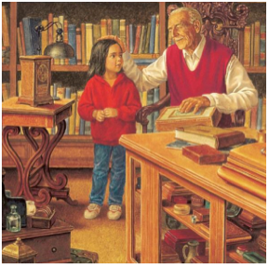
Phase 1
Phase 2
Phase 3
Phase 4
Phase 5
Reading
Writing
Prediction
Comprehension
Drafting
Editing
Publishing
SPaG
and TSO
Gap filling
ARE Grammar
    Revise - Practise - Introduce - Practise - Apply
Notes:
this our foundation

Slide 31
Cross Curricular
Phase 2
Phase 1
Phase 3
Phase 4
Reading
Writing
How are these texts organised?
How are they written?
Test Question Practice
Shared
Writing
Independent Writing
Publishing
TSO
Spag
    Revise - Practise - Introduce - Practise - Apply
Notes:
variation for NF

Slide 32
Cross Curricular
Phase 2
Phase 1
Phase 3
Phase 4
Reading
Writing
How are these texts organised?
How are they written?
Comprehension
Test question practice
Shared
Writing
Independent Writing
Publishing
TSO
Spag
Planning drafting and editing our outcomes - school policy
Planning to organise our own texts
Spag activities to practise our big outcome
Notes:
variation for NF

Slide 33

KS2 - Non-Fiction
Write:
  Instructions
  Recounts
  Persuasion
  Explanations
  Non chronological reports
  Biographies
  Journalistic style
  Arguments
  Formally
…but remember the curriculum is not genre driven

Slide 34
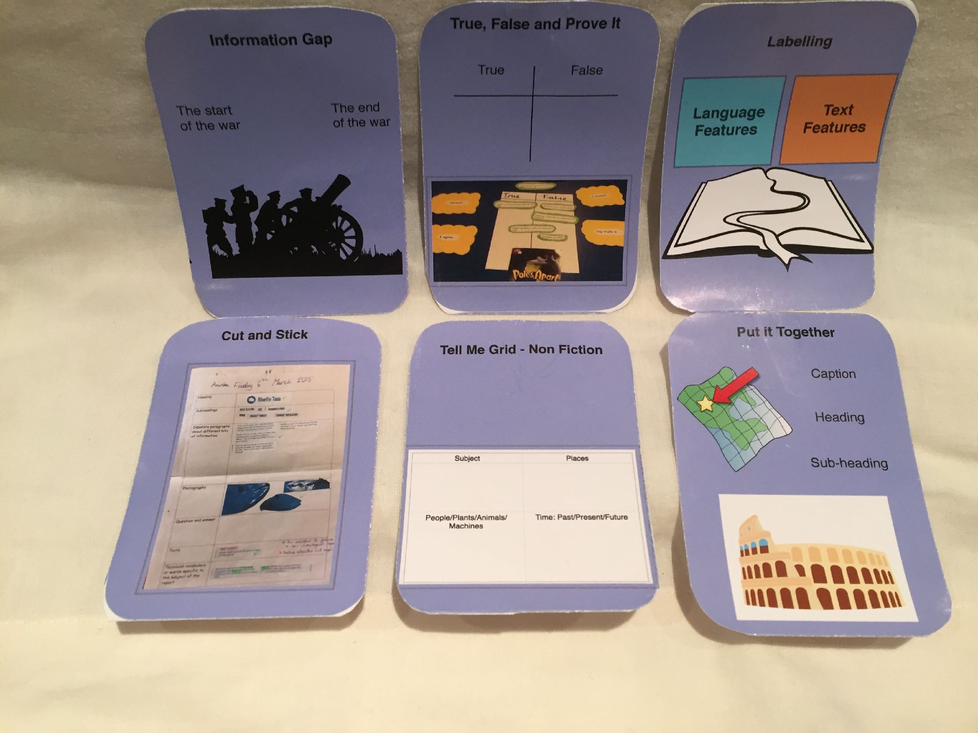

Slide 35
Phase 1 - Reading
How is it organised?
How is it written?

Slide 36
Warm ups/quick tasks
Fiction/Non-fiction sorting
Make a contents page
Glossary matching game
Caption matching game
Index sort
Quick Tasks/Warm Ups
Fiction/Non-fiction sorting
Make a contents page
Glossary matching game
Caption matching game
Index sort

Slide 37
Glossary matching game
school |  | A large group of fish that swim closely together
pup |  | a baby shark
prey |  | An animal that is hunted or killed by a predator
predator |  | An animal that hunts, eats or kills other animal
dorsal fin |  | One of the fins located on the midline of a fish’s back to stop it rolling from side to side
species |  | A group of plants or animals that have common features

Slide 38






Glossary matching game

Slide 39
Index sort
blue shark
blind shark
basking shark
rays
dorsal
sawfish
saw shark

Slide 40
Phase 2 - TSO and SPaG
How is it organised?
How is it written?
  teach and practise

Slide 41
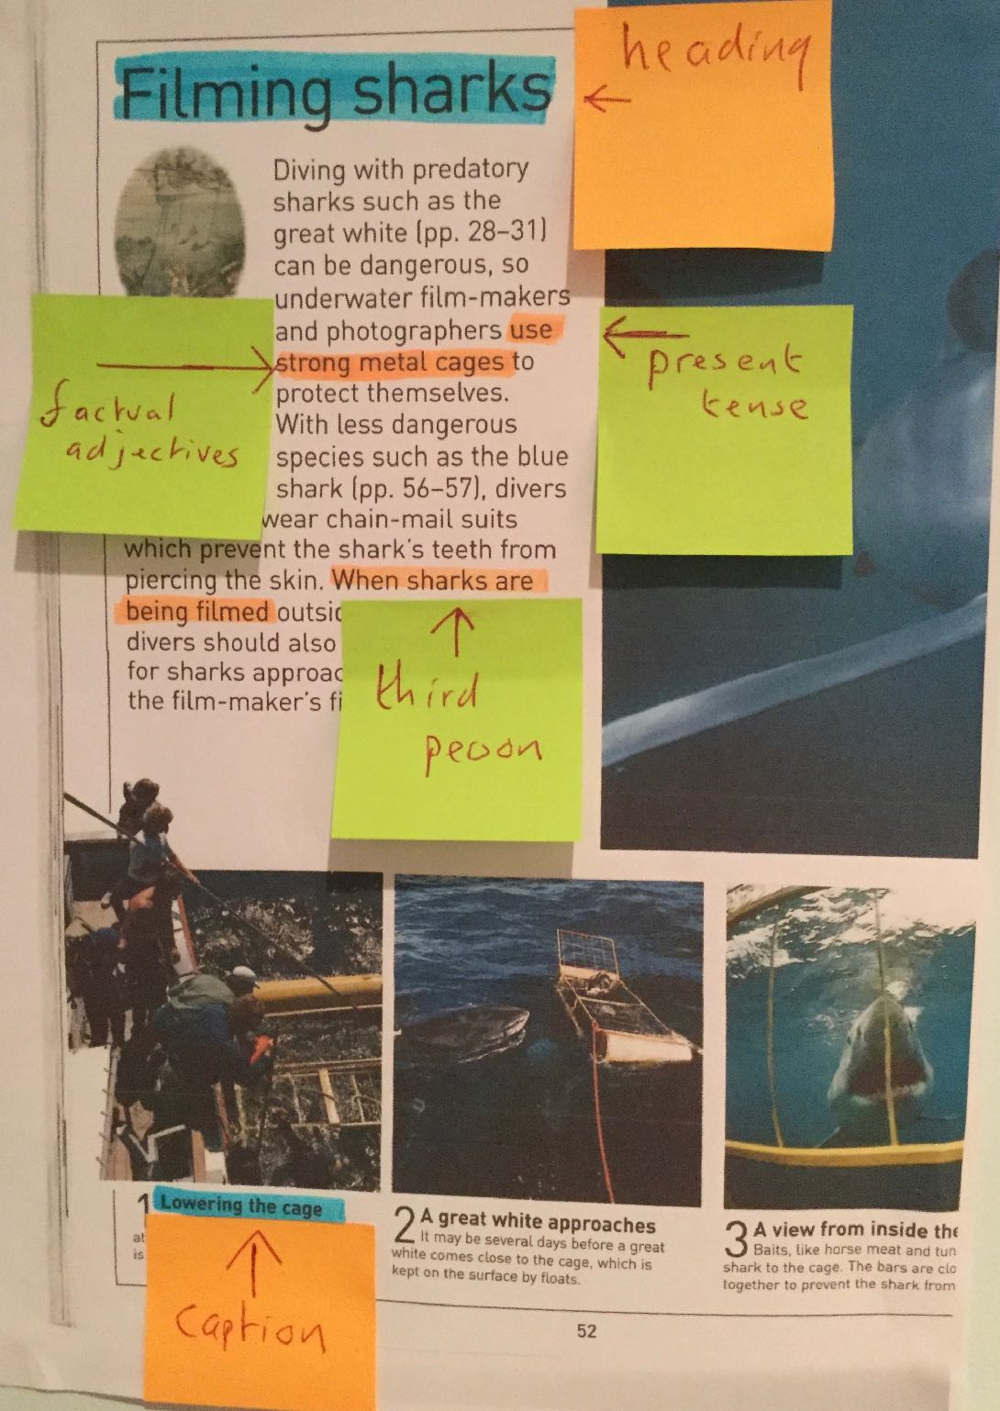
Labelling

Slide 42
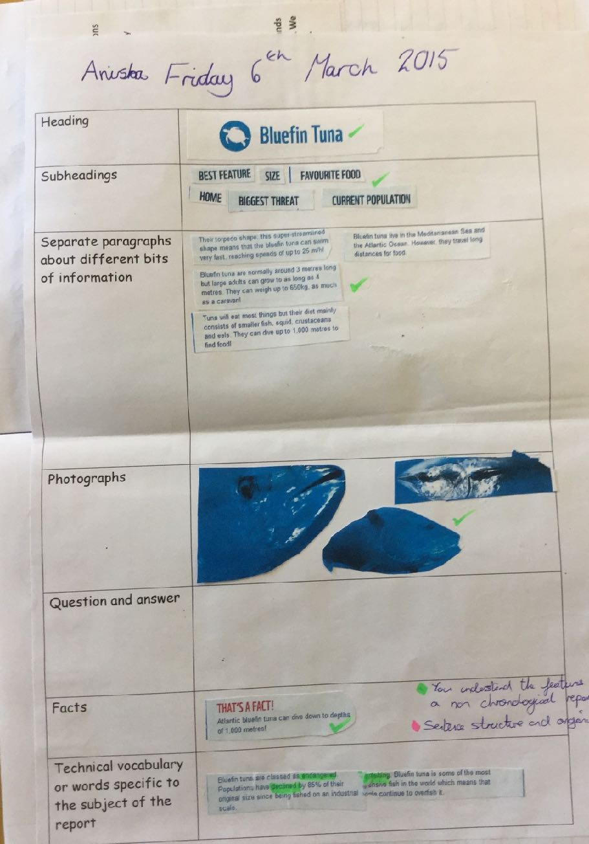
Take it Apart
Notes:
formatting ideas

Slide 43
Put it together

Slide 44
Please enter the postcode HU9 1TU when using a Sat Nav. This will take you to Tower Street, Hull, which is the nearest main road to The Deep. The Deep has its own car park with space for 280 vehicles. The cost is £2 per vehicle for four hours. Please note parking for conference delegates is free of charge.

Slide 45
Buses/rail - There are no direct buses to The Deep, but a number of services travel nearby from Hull Interchange. For up to date information on bus timetables from Hull Interchange to The Deep please call Traveline on 0871 200 22 33 open daily from 8am - 8pm (calls to Traveline cost 10p per minute, plus any charges your network provider makes). Train times into Hull can be found via National Rail. To walk to The Deep from the station, exit the station and cross the road towards House of Fraser department store and then follow the pedestrian signs to The Deep.

Slide 47
We have a large selection of workshops for pupils aged between 5 and 7 including Lost at Sea and My Polar Home.
We have lots of workshop choices available for pupils aged 7 to 11 including Mackerel Mondays and Puzzling Penguins.

Slide 48
Every year, The Deep welcomes over 30,000 primary and secondary pupils to our purpose built Learning Centre. Let your students enjoy a unique and memorable experience as you travel from the beginning of time and into the future. Dive into exciting exhibits including our breath-taking coral reef at the Lagoon of Light, interesting creatures in our Slime exhibit, some of our biggest sharks in Endless Oceans and creatures of the Amazon in the Flooded Forest. To see more of what The Deep has to offer, take a look at our Deep tour.

Slide 49
The Deep is open daily from 10am until 6pm
Last admission is at 5pm, although we recommended you to arrive no later than 4pm
We are closed on Christmas Eve & Christmas Day

Slide 50
Introduction
Opening times
School visits
Admission
Getting there

Slide 51
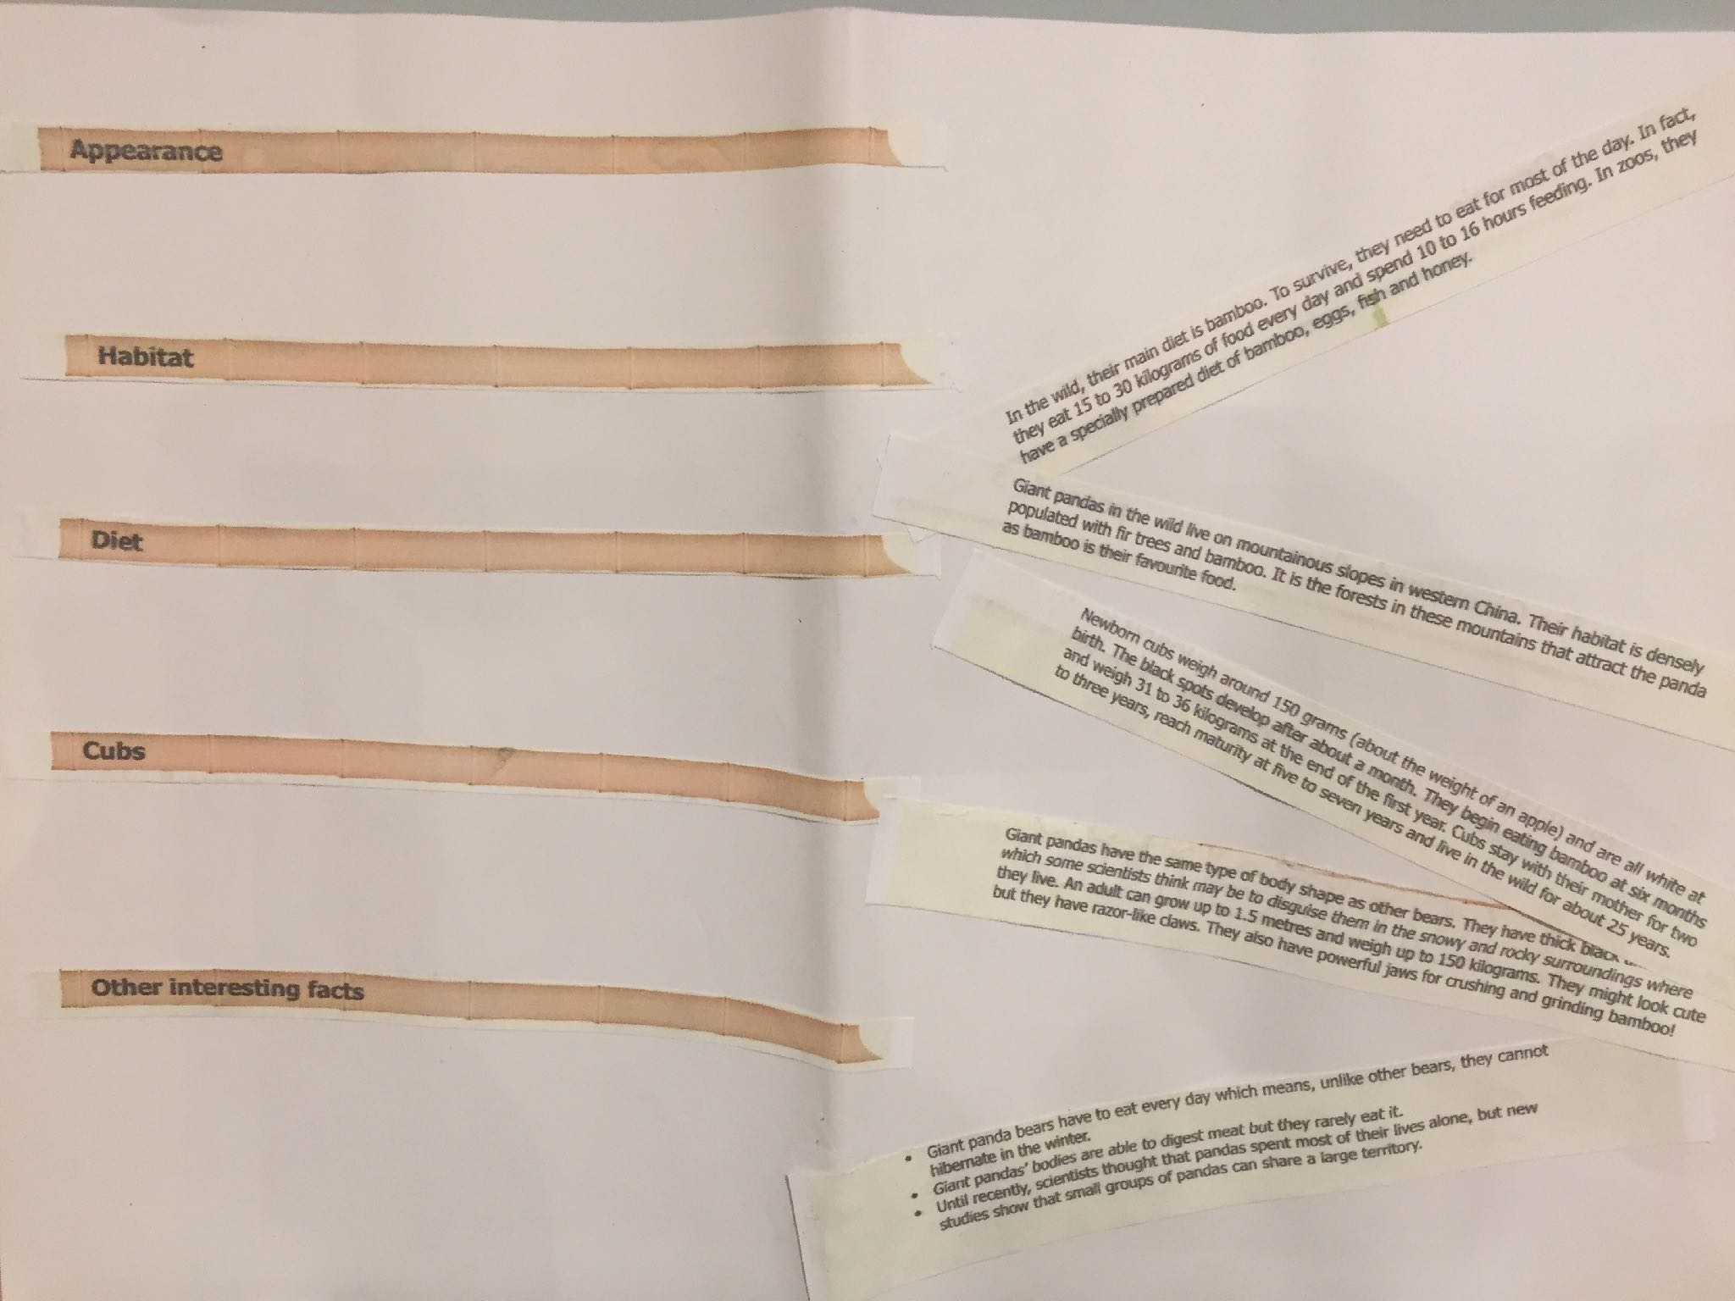

Slide 52
Reading to Writing Ideas
How is it written?
Tell Me grid for non-fiction
Information Gap
Dictogloss
Quickwrite
Describing a …

Slide 53
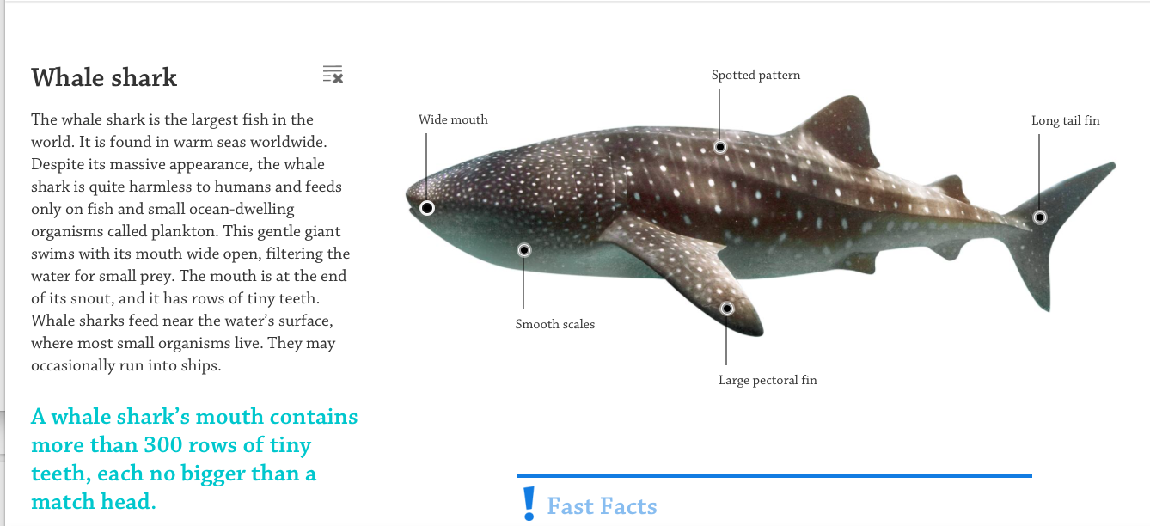
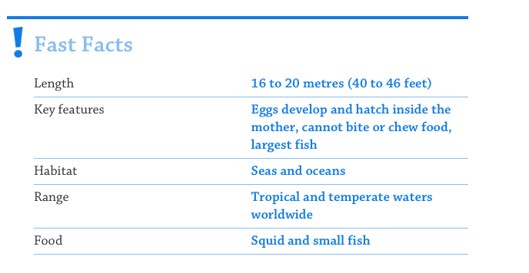

Slide 54
Recording

Slide 55
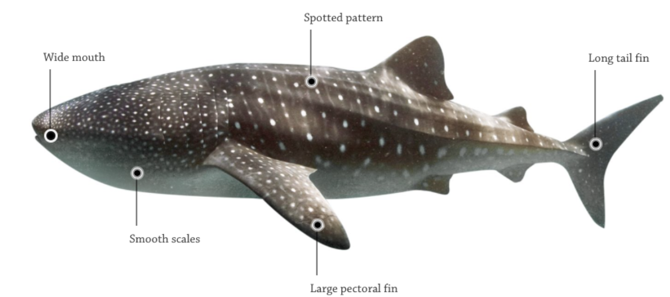
Tell Me Grid Non-Fiction
Subject
Places
People/plants/
animals/machines
Time –
Past/present/future
Notes:
choose one chapter as a four - feed back

Slide 56
Tell Me Grid Non-Fiction
Subject
Places
Timeline
Notes:
choose one chapter as a four - feed back

Slide 57
Tell Me Grid Non-Fiction
Man made features
Natural features
Map
Notes:
choose one chapter as a four - feed back

Slide 58
Written outcomes
Sentence work
Shorter written outcomes
Short purposeful outcome - prediction-
diary/note to character - description -
might be part of a lesson
Longer written outcomes
Longer purposeful outcome - longer letter -
character comparison - more formal outcomes -
may be a full lesson.
Extended written outcomes
End of unit pieces following the planning, drafting, editing process
worked over a couple of days.

Slide 59
sentence daily
Technique
Adding in - adding on - changing words - changing word order - joining sentences - adding sentences to complete the text

Slide 60
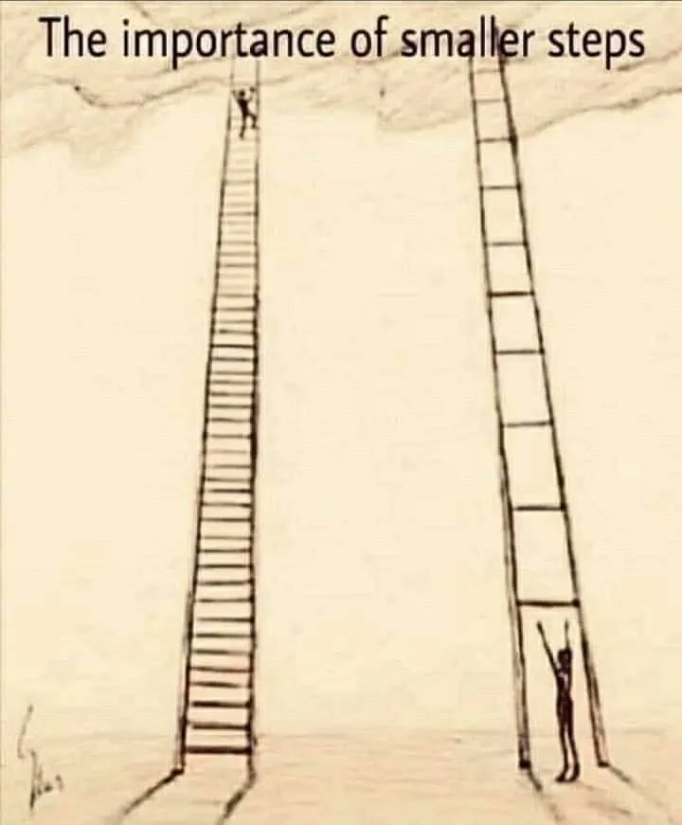

Slide 61
Subject knowledge
when
where
why

Slide 62
Building Writing Stamina
Monday: Introduce the basic sentence + adding in
Tuesday: Revisit the basic sentence + adding in + can we add on?
Wednesday: Revisit the basic sentence + adding in + adding on can we change words?
Thursday: Add another sentence
Friday: Could we join sentences?
character
setting
diary
note to character

Slide 63
Recording

Slide 64
Information gap
Hammerhead Shark
Great White Shark
Where it lives
Where it lives
What it eats
What it eats
How big it is
How big it is
What is special about it?
What is special about it?

Slide 65
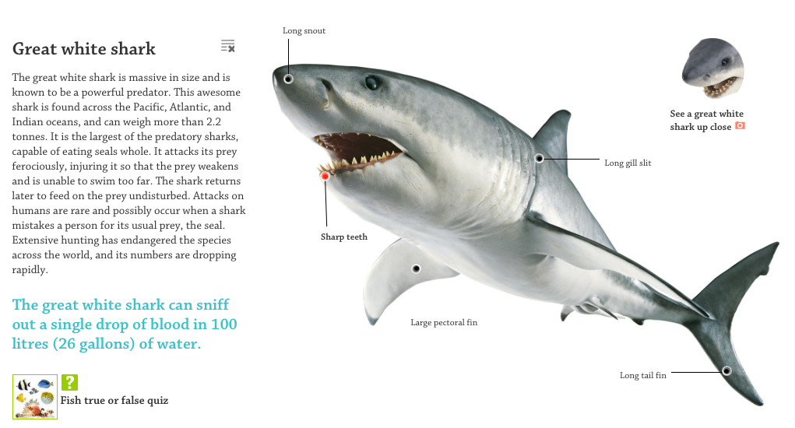
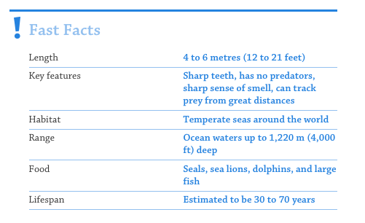

Slide 66
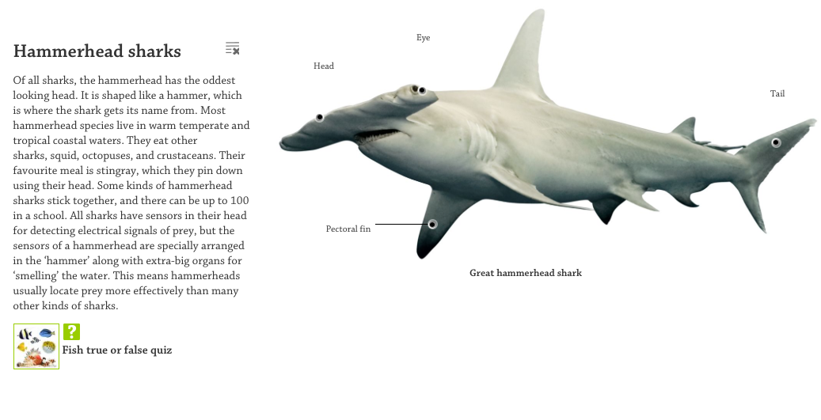
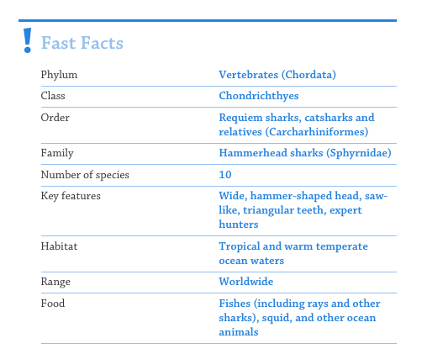

Slide 67
Modelling
I
We
You
Partial - an interactive approach led by a teacher who initiates a writing model, but then hands over responsibility to the children to complete the writing task
Mid-task - introducing the model text partway through the writing or at least after the planning has been undertaken to reduce imitation while still exemplifying writerly techniques for the opportunity to make revisions and edits

Slide 68
Building and joining sentences
The whale shark is big.
Monday: Introduce the basic sentence + adding in
Tuesday: Revisit the basic sentence + adding in + can we add on?
Wednesday: Revisit the basic sentence + adding in + adding on can we change words or word order?
Thursday: Add another sentence
Friday: Could we join sentences?
The remarkable Whale Shark is big.
The remarkable Whale Shark is big at 16 to 20 metres long.
The remarkable Whale Shark is huge at 16 to 20 metres long.
At 16 to 20 metres long, the remarkable Whale Shark is huge.

Slide 69
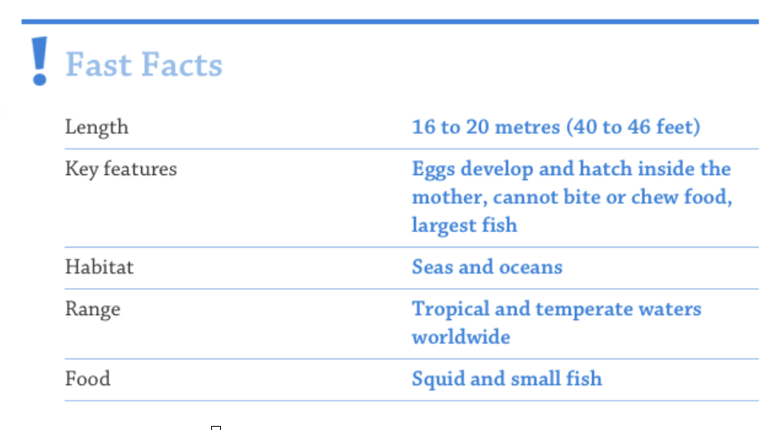
Partial modelling then continue…
At 16 to 20 metres long, the remarkable Whale Shark is huge.
The eggs develop and hatch inside the mother.

Slide 70
Differences
Similarities
Differences

Slide 71
The infamous great white shark is very large (4 to 6 metres).
At 16-20 metres long, the remarkable whale shark is huge. Scary right? Don't worry though, it is harmless to humans with it only using its large mouth to filter the ocean for small prey such as plankton.
The remarkable Whale shark is huge at 16 to 20 metres long. Despite its massive appearance, it's harmless to humans.
Would you like to see it swimming towards you? Don't worry; they're harmless to humans.
With its sharp teeth and sharp sense of smell, the whale shark can track its prey from great distances.

Slide 72
At 16-20 metres long, the remarkable Whale Shark is huge. Even though it doesn't have any predators, numbers are still rapidly declining due to excessive hunting by humans.
The remarkable Whale shark is huge at 16 to 20 metres long; it's so large that it can eat a seal whole.

Slide 73
Another interesting fact is the Whale Shark can not bite or chew their food. Unlucky for squid and small fish as they are the unfortunate prey to be swallowed whole!
Where small fish roam freely, the sharks live in the vast, warm ocean waters. These temper ate seas are home to these fascinating creatures.
The eggs that develop inside the mother (of a Whale Shark) produce an astonishing animal that can grow up to 20 meters long!

Slide 74
The Whale shark's habitat is seas and oceans worldwide, in particular tropical and temperate waters. Even though their diet is squid and small fish, they cannot bite or chew food.
The whale sharks habitat is seas and oceans worldwide. It sustains itself with a diverse diet, predominantly consisting of squid and small fish.

Slide 75
Partial modelling then continue…
At 16 to 20 metres long, the remarkable Whale Shark is huge.
The eggs develop and hatch inside the mother.
Despite its 300 rows of tiny teeth, this gentle giant cannot bite or chew food; swimming with its mouth wide open, it filters the water for small prey such as plankton and tiny fish.

Slide 76
Recording

Slide 77
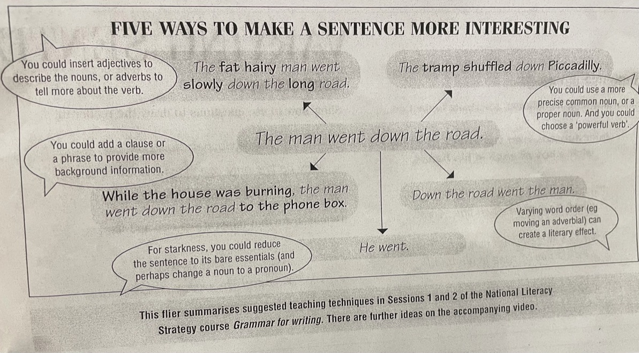

Slide 78
Insert adjectives to describe nouns or adverbs to tell us more about the verb.
Add a more precise common noun, or a proper noun. And you could use a powerful verb.
Add a clause or phrase to provide more background information.
Reduce the sentence to its bare essentials and perhaps change the noun to a pronoun.
Varying the word order such as moving an adverbial.

Slide 79
In an intervention group the sentence daily will work really well to support.
Science - topic is Living things and their habitats. So I could use information gap task to compare and contrast different animals and their features
We could use the tell me grid for our topics; Ancient Egypt, Ancient Greece, class names (Saltaire and Jowett) research. History focus here
Tell me grid: Ancient Greeks (History) I actually used information gap teaching ancient greeks also to compare Spartans and Atheneans

Slide 80
Take it apart - when we go on class trips, get the leaflet and see if they can work out where they're going (Leeds City Museum) or even put it back together
We were discussing Info Gap and how AMAZING that will be instead of children using ICT to research and basically copy text word for word. This activity gets the children to scan, understand the text and make notes. Then the partner has to listen and make their own notes so it makes sense to them. Therefore, the work produced at the end will be completely their own work that they understand. I am going to do this when we research who lived at Shibden Hall in Tudor times

Slide 81
Tell me grid - all subjects incl’ curriculum. Useful across the board. Adapt titles. Modelling - writing lessons.
I'm going to adapt the tell me grid to fit in colour coding as well to help children access the information so instead of places, use where. Instead of people/plants, use who/what. Instead of time, use when/how. Then can adapt up to vocabulary terms to support understanding

Slide 82
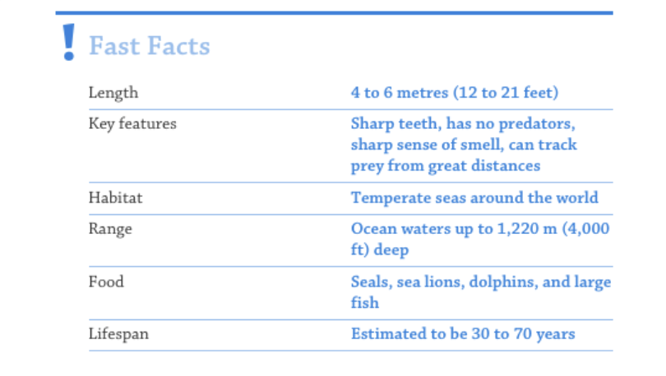
Building and joining sentences
The great white shark is big.
Monday: Introduce the basic sentence + adding in
Tuesday: Revisit the basic sentence + adding in + can we add on?
Wednesday: Revisit the basic sentence + adding in + adding on can we change words or word order?
Thursday: Add another sentence
Friday: Could we join sentences?

Slide 83
Sentence Daily - Y2
Subordinating conditions ( when, that, because, if)
Coordinating conjunctions ( and, or, but)
Expanded noun phrases for description and specification
Use of full stops, question marks and exclamation marks to demarcate sentences. Use of commas in lists Apostrophes to mark where letters are missing in spelling and to mark singular possession in nouns ( for example, the girl’s name)
Monday: + adding in
Tuesday: + adding on
Wednesday: +changing words
Thursday: +adding another sentence
Friday: +joining sentences?

Slide 84
Sentence Daily - Y5
Relative clauses beginning with who, which, where, when, whose, that
Indicating degrees of possibilities using adverbs ( perhaps, surely) or modal verbs( might, will, should, must)
Adverbs (then, next, soon, therefore)
Brackets, dashes or commas to indicate parentheses. Use of commas to clarify meaning or avoid ambiguity.
Monday: + adding in
Tuesday: + adding on
Wednesday: +changing words
Thursday: +adding another sentence
Friday: +joining sentences?
Y2 - Use of full stops, question marks and exclamation marks
to demarcate sentences.

Slide 85
Sentence Daily - Y6
Use of the passive to affect presentation of information in a sentence
The difference between structures typical of informal speech and writing ( for example, use of question tags : He’s your friend, isn’t he?)
The use of subjunctive forms such as If I were or Were they to come in some very formal writing or speech.
Use of colon, semi colon and dash to mark the boundary between independent clauses ( for example, it’s raining; I’m fed up) Use of the colon to introduce a list and semi colons within lists. Punctuation of bullet points to list information. How hyphens can be used to avoid ambiguity ( for example, man eating shark versus man-eating shark or recover versus re-cover.)
Monday: + adding in
Tuesday: + adding on
Wednesday: +changing words
Thursday: +adding another sentence
Friday: +joining sentences?
Y2 - Use of full stops, question marks and exclamation marks
to demarcate sentences.

Slide 86
Eating large fish, the great white shark is very big.
With their sharp sense of smell, the great white shark is a colossal creature of the sea.
The great white shark, is an extremely powerful fish, which can grow up to 6 metres in length.
With extremely sharp teeth and sense of smell, the great white shark is a predator of the sea.
The great white shark is an immensely powerful fish, capable of reaching lengths up to 6 meters.

Slide 87
The great white shark is an immensely powerful fish, capable of reaching lengths up to 6 meters.

Slide 89
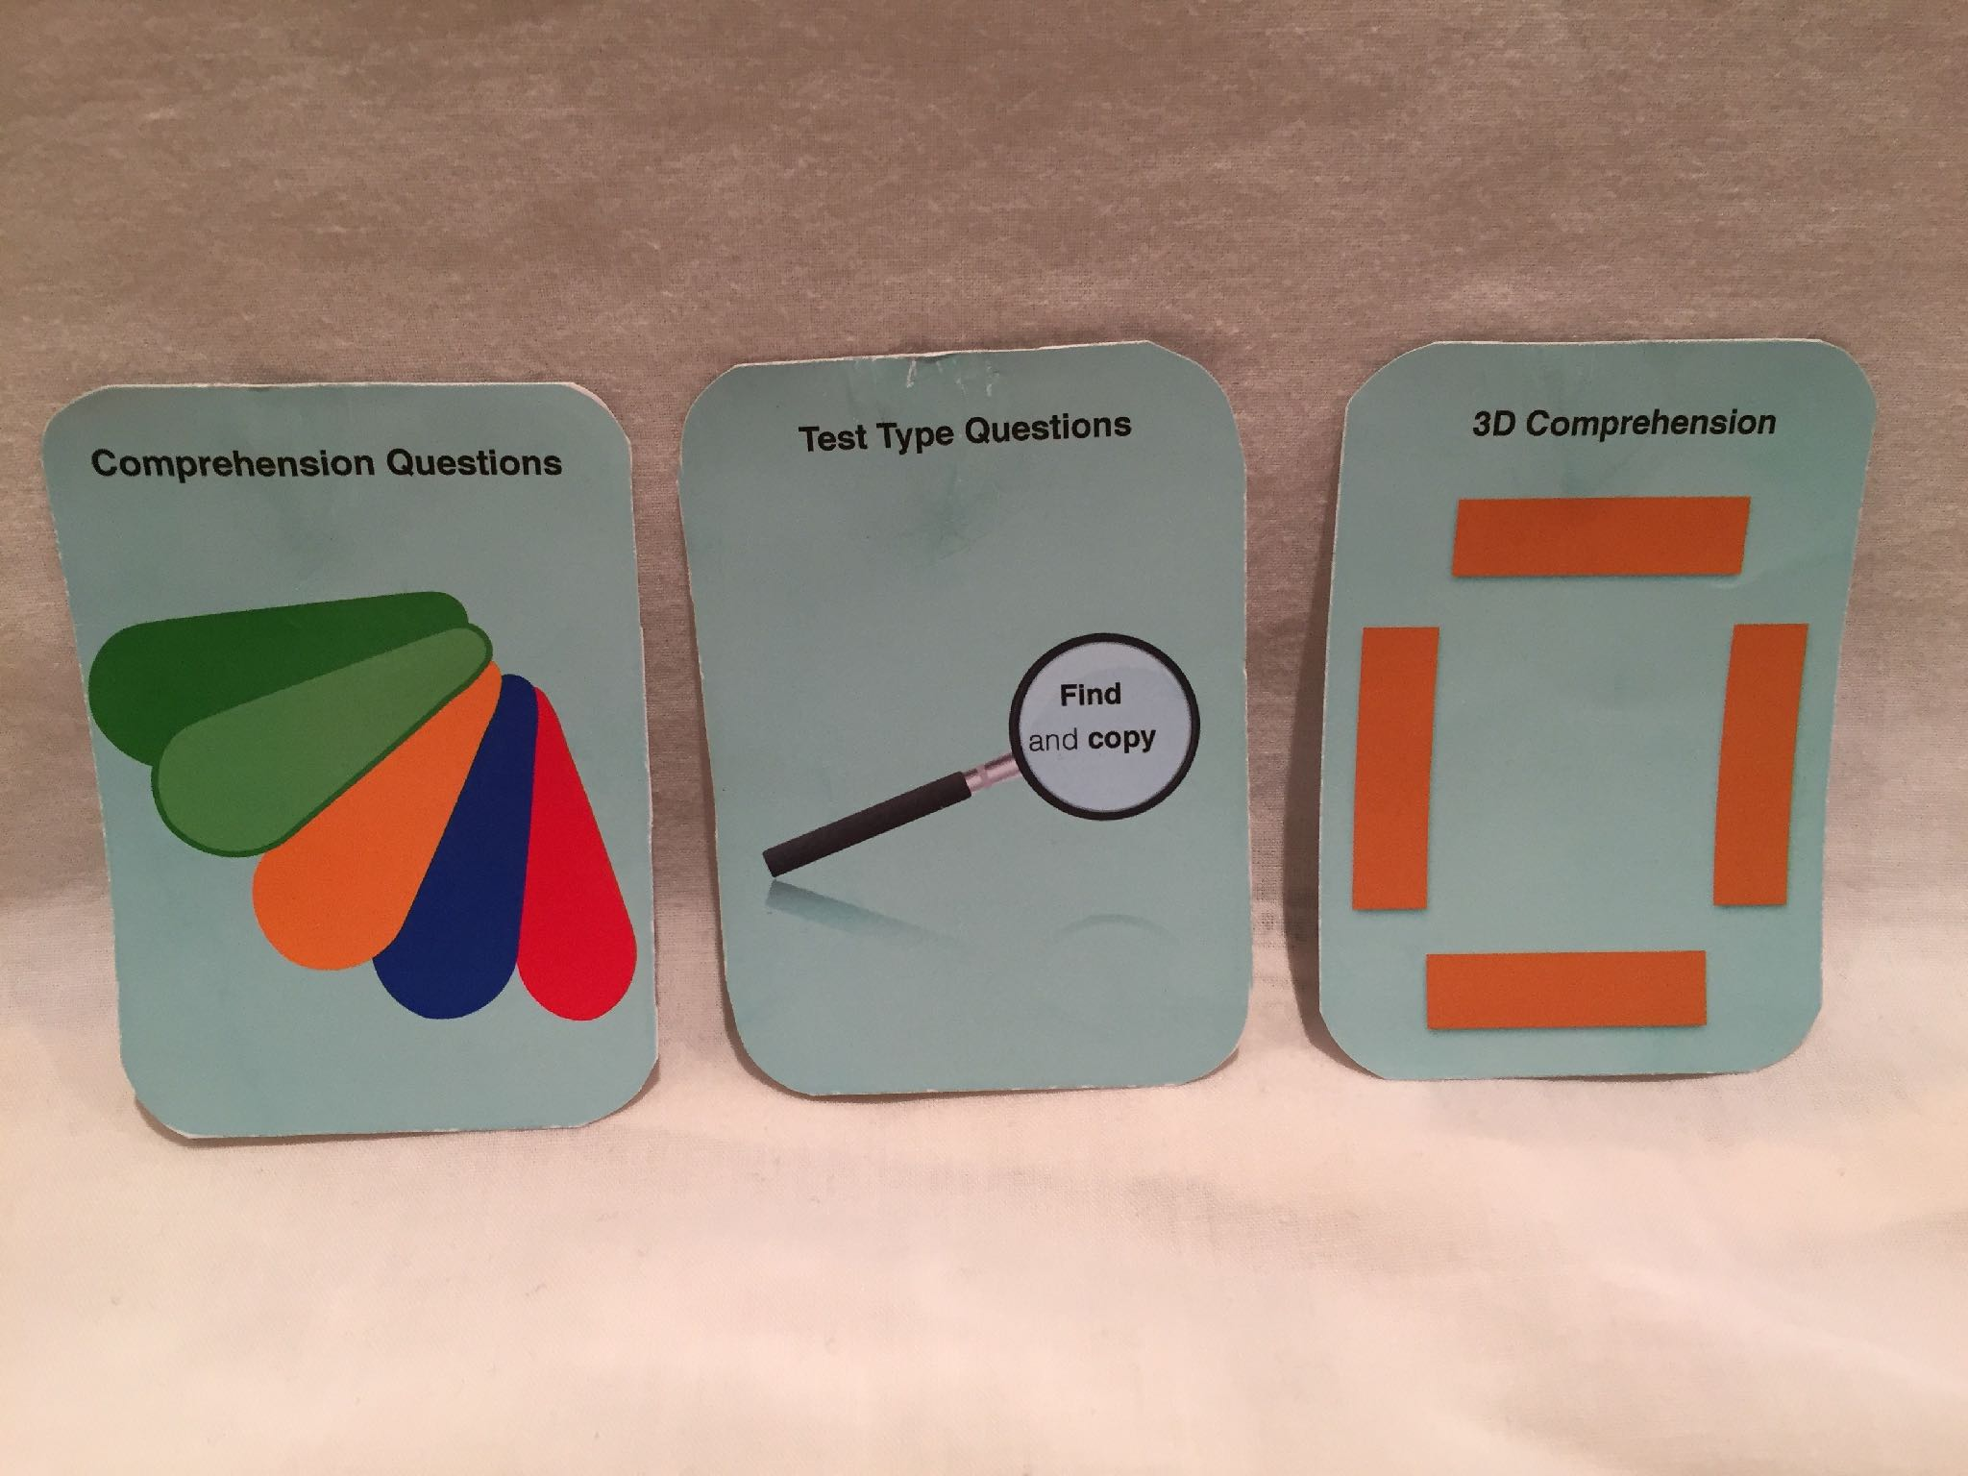

Slide 90
Sharks comprehension - DKfindout
What does a whale shark eat? Tick 3
small fish
seaweed
plankton
squid
coral
 | TRUE | FALSE
The mother whale shark’s eggs hatch inside her.
It lives in cool waters.
It is the largest fish in the world.

Slide 91
Dictogloss
Listen to the text being read aloud
Listen to the text being read aloud again
Listen to the text being read aloud and write down some key points and phrases you can hear
Share your notes with a partner. Work together to improve what you produced in pairs.
One set of partners join another to form a group of four. Improve your writing again.
Write your text on a large piece of paper

Slide 92
The great white shark is massive in size and is known to be a powerful predator. This awesome shark is found across the Pacific, Atlantic, and Indian oceans, and can weigh more than 2.2 tonnes. It is the largest of the predatory sharks, capable of eating seals whole. It attacks its prey ferociously, injuring it so that prey weakens and is unable to swim too far. The shark returns later to feed on the prey undisturbed. Attacks on humans are rare and possibly occur when the sharp mistakes a person for its usual prey, the seal. Extensive hunting has endangered the species across the world, and its numbers are dropping rapidly. The great white shark can sniff out a single drop of blood in 100 litres of water.

Slide 93
Writing about Setting
Teaching with tiny texts
Adding in - adding on - changing words - combining sentences

Slide 94
Describing a Scene
Write a sentence to describe an object in the scene on slide X using words related to colour and shade.
Write a sentence to describe the setting using words related to colour and shade.
Describe a noise you might be able to hear.
Write down what is happening in the scene.

Slide 95
Tiny texts from last time
object
setting
noise
happening

Slide 96
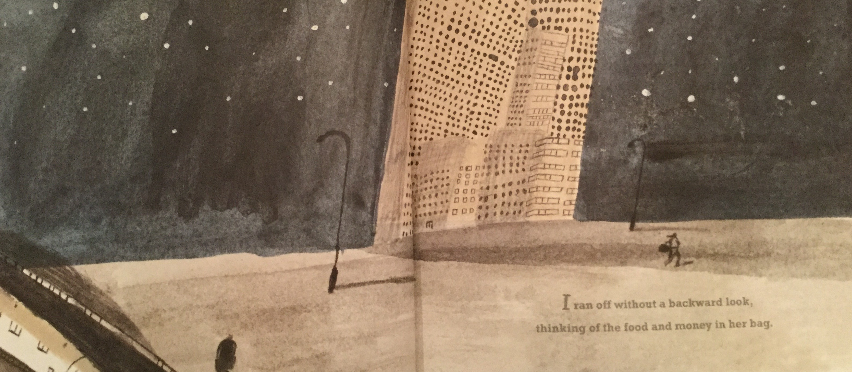
Teach drafting with tiny texts
object | The bright stars shone.
setting | The dark sky loomed.
noise | All you could hear were footsteps.
happening | The thief ran away.

Slide 97
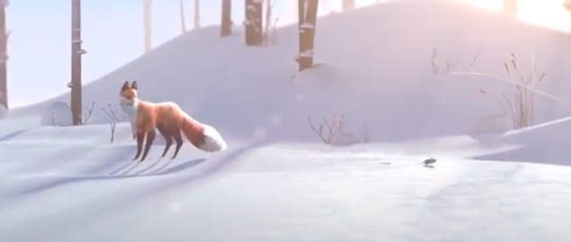
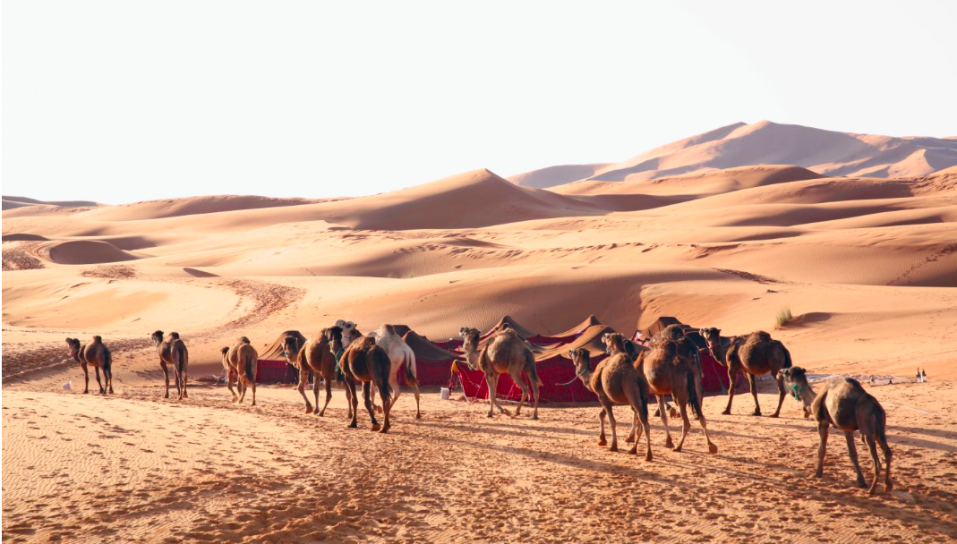
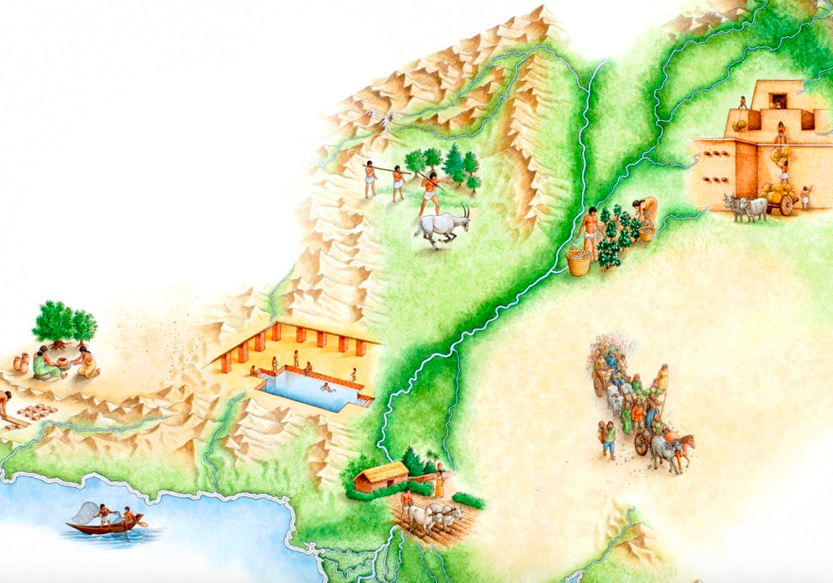
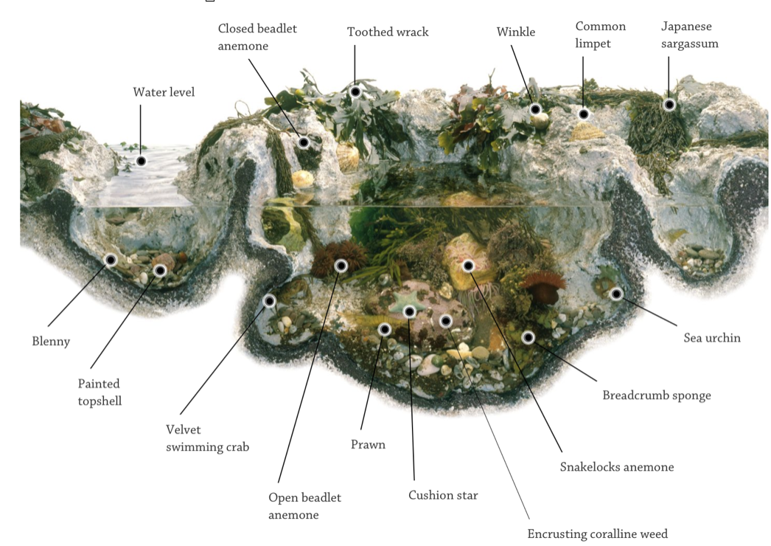
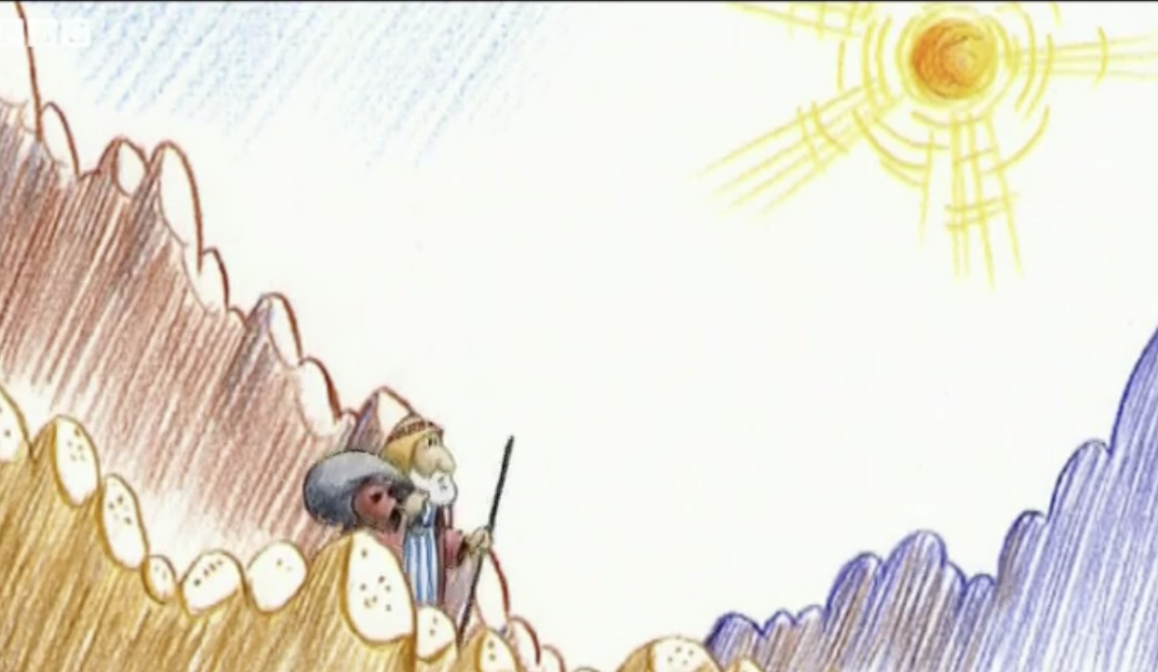
Describing a…
Landscape
Scene - fiction
Landscape
Historical site
Bible story
Habitat
fiction
Historical site
Habitat
Bible story

Slide 98
Describing a Scene : RE
object
setting
noise
happening

Slide 99
Describing a landcape

Slide 100
Describing a landscape
Write a sentence to describe an object in the scene on slide X using words related to colour and shade.
Write a sentence to describe the setting using words related to colour and shade.
Describe a noise you might be able to hear.
Write down what is happening in the scene.

Slide 101
object | The large red nomadic tent stands in the centre.
setting | Golden sand dunes cast dark shadows in the desert.
noise | The hooves of the camels make a strange shuffling sound.
happening | The caravan of camels is on the move again.

Slide 102
Edit to taste (and ARE!)
The large red nomadic tent stands in the centre.
Golden sand dunes cast dark shadows in the desert.
The hooves of the camels make a strange shuffling sound.
The caravan of camels is on the move again.
The large, red nomadic tent stands in the centre as golden sand dunes cast dark shadows in the desert.
The hooves of the camels make a strange shuffling sound; the caravan is on the move again.

Slide 103
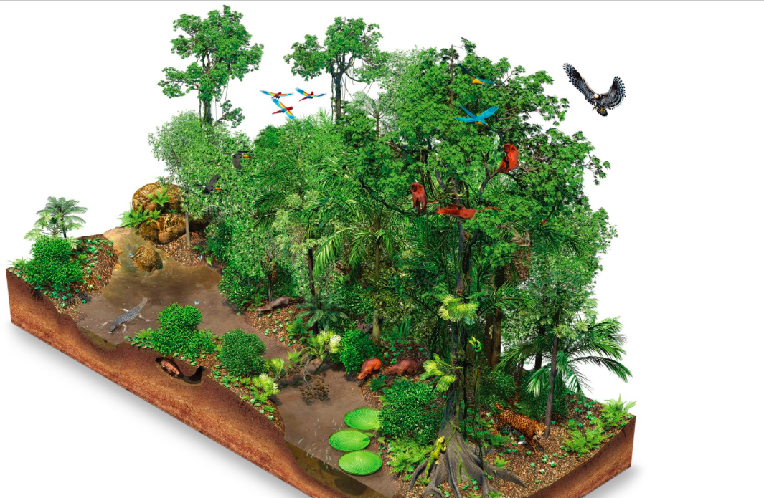

Slide 104
Describing a historical site
object
setting
noise
happening

Slide 105
First draft
object
setting
noise
happening
ARE amendments

Slide 106
In the swimming baths, the young children played their games. The water of the pool was a serene shade of turquoise and the children's shrieks of pleasure, mingled with wild splashing, could be heard for miles around.
Winding rivers flow through lush, green valleys, passing imple dwellings made from wood. Wooden carts pulled by horses can be heard crossing the plain, whilst hunters spear their prey.
The swimming pool was pale blue echoing the pale green of the grass. It was a bright and sunny day; blisteringly hot! The water lapped gently on the shore as the busy farmers worked their land.
On a calm, windless day, the two fisherman sailed out from the port. The waves splashed and hit the boat as they threw their nets into the cool, blue sea.
The acacia boat bobbed to fro on the cerualen lake as the waves lapped gently against its hull softly caressing it. Whilst this was happening, the hard working fishermen cast their nets wide and far.

Slide 107
A group of hard-working servants in the middle of a huge, desolate field while the luscious, green leaves glow in the burning hot sun. Rustling of branches as a gentle breeze weaves through the people; they are collecting for their master as he watches on.
Beneath the Andes mountains, the deperate hunters attacked the powerful bison. The trees rustled as hooves trampled the rough, muddy ground.
This particular area in the Indus Valley was surrounded by high mountains in which rivers flowed majestically. The trees rustled and the birds chirped overhead, creating a peaceful environment in which the people worked.

Slide 108
In the heart of an expansive, barren field, a dedicated group of hard-working servants toil under the scorching sun, their bodies surrounded by the radiant glow of lush, green leaves. The branches rustle gently, stirred by a mild breeze, as the diligent labourers gather resources for their watchful master.

Slide 109
The snow white goat meandered naively through the barren field, as the warriors aimed their razor sharp spears. The towering grey mountains looked down over the vast sprawling landscape. The sound of gushing water, which had travelled many miles, echoed around the valley. Farmers peacefully harvested their crops in the light of the midday sun.
The large, golden building stands tall on the hill as crystal clear waters flow steadily through the valley. Hooves of cattle can be heard plodding through the soft sand while people bath happily under the scorching sun.

Slide 110
A mixture of people, old and young, traipse forwards through the dusty, lifeless desert that extends across the landscape. Muttering, muted voices of weary travellers echo hollowly in the arid atmosphere. The caravan shuffles on its endless journey; no reprieve in sight.
The long, blue river winds through the countryside beneath golden sandy hills which rise above the vast grassy plains. The cries of the hunters suddenly break through the breeze as the graceful antelope falls to the ground. Dead.

Slide 111
The long, blue river winds through the countryside beneath golden sandy hills which rise above the vast grassy plains. The cries of the hunters suddenly break through the breeze as the graceful antelope falls to the ground. Dead.
A lush valley splits the land in half with a river running through it from the mountains to sea. A caravan of horses and carts kicks up dust as it moves across the plains to the west.

Slide 112
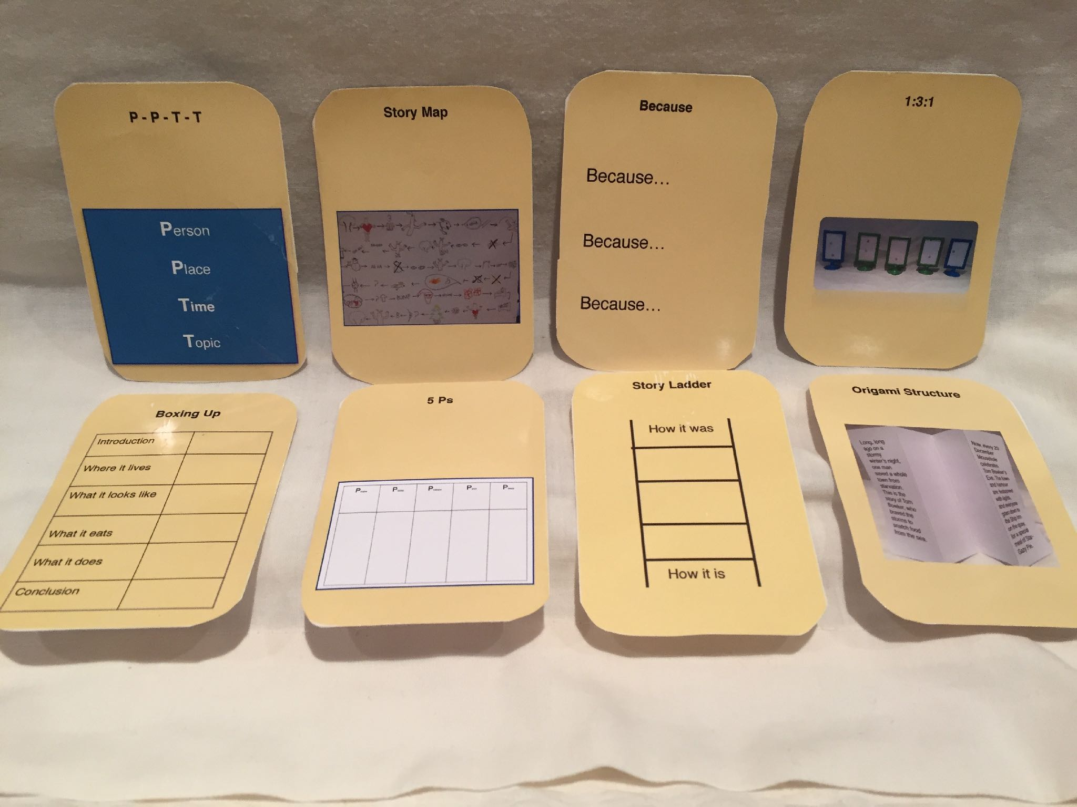

Slide 114
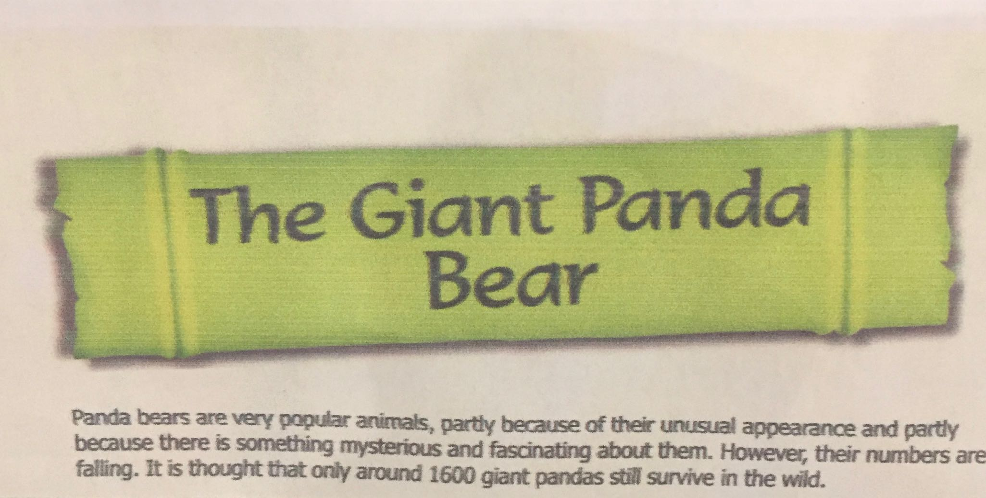
Introduction

Slide 115
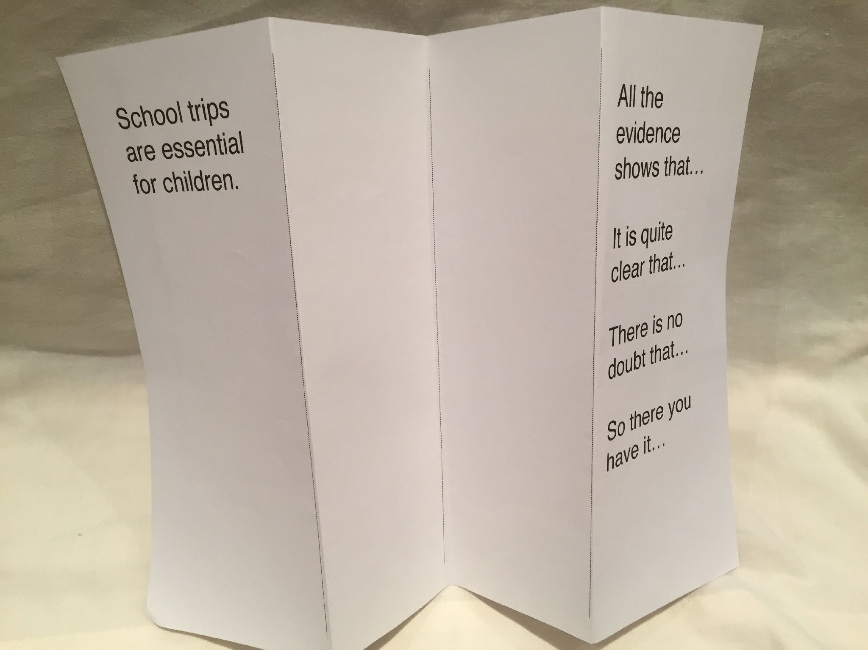

Slide 116
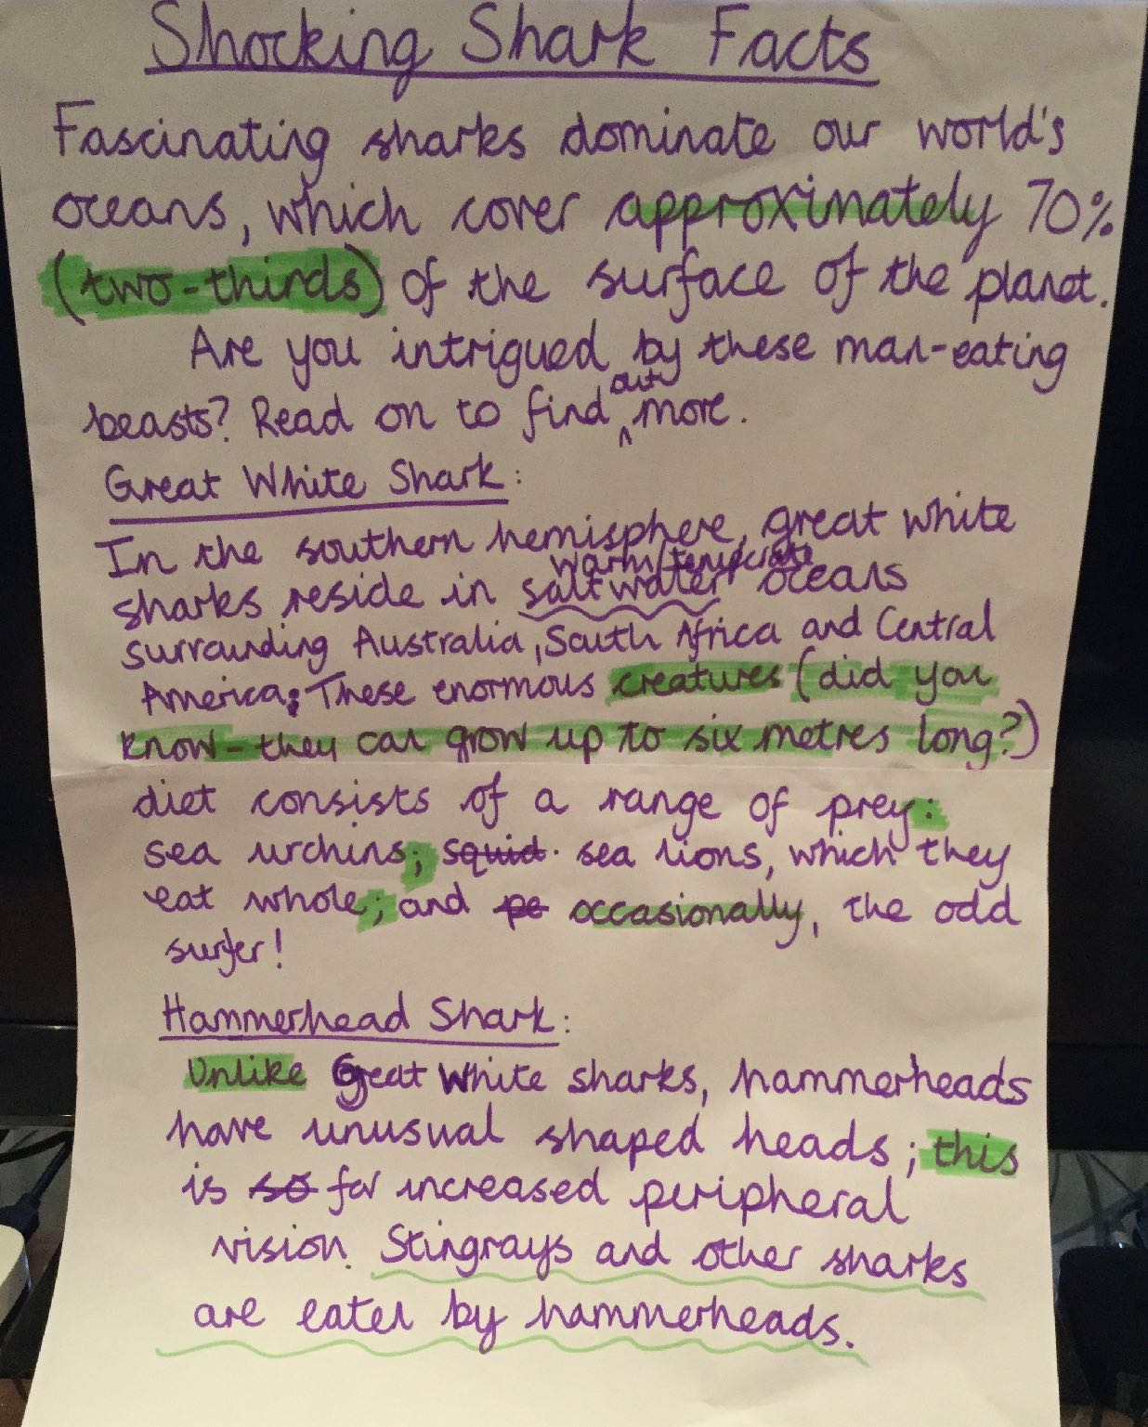
Phase 3/4 - Planning - Drafting - Editing

Slide 117
Phase 2 - TSO and SPaG
How is it organised?
  we now know
How is it written?
  teach and practise

Slide 118
Y5
Subordinating or
coordinating
conjunction
Relative clause
who - which -
where
Time adverbial
Relative clause
with -why -
whose - that
Number adverbial
Modal verbs -
might or could
Brackets, dashes
or commas
Modal verbs -
will or must
Place adverbial

Slide 119
Y6
Subordinating or
coordinating
conjunction
Sentence with a
relative clause
Time adverbial
Powerful verb
Modal verbs
Simile
Brackets, dashes
or commas
Sentence with a
pronoun
Place adverbial

Slide 120
Y5
Working at the expected standard in Y5
The pupil can:
use adverbs to add detail, qualification and precision
write effectively for a range of purposes and audiences, selecting language that shows good awareness of the reader (e.g. the use of the first person in a diary; direct address in instructions and persuasive writing)
in non-narrative writing, use simple devices to structure the writing and support the reader (e.g. headings, sub-headings, bullet points)
begin to use a range of devices to build cohesion (e.g. conjunctions, adverbials of time and place, pronouns, synonyms) across paragraphs

Slide 121
Y6
Working at the expected standard in Y6
The pupil can:
write effectively for a range of purposes and audiences, selecting language that shows good awareness of the reader (e.g. the use of the first person in a diary; direct address in instructions and persuasive writing), using similar writing as a model (WAGOLL and other texts)

Slide 122
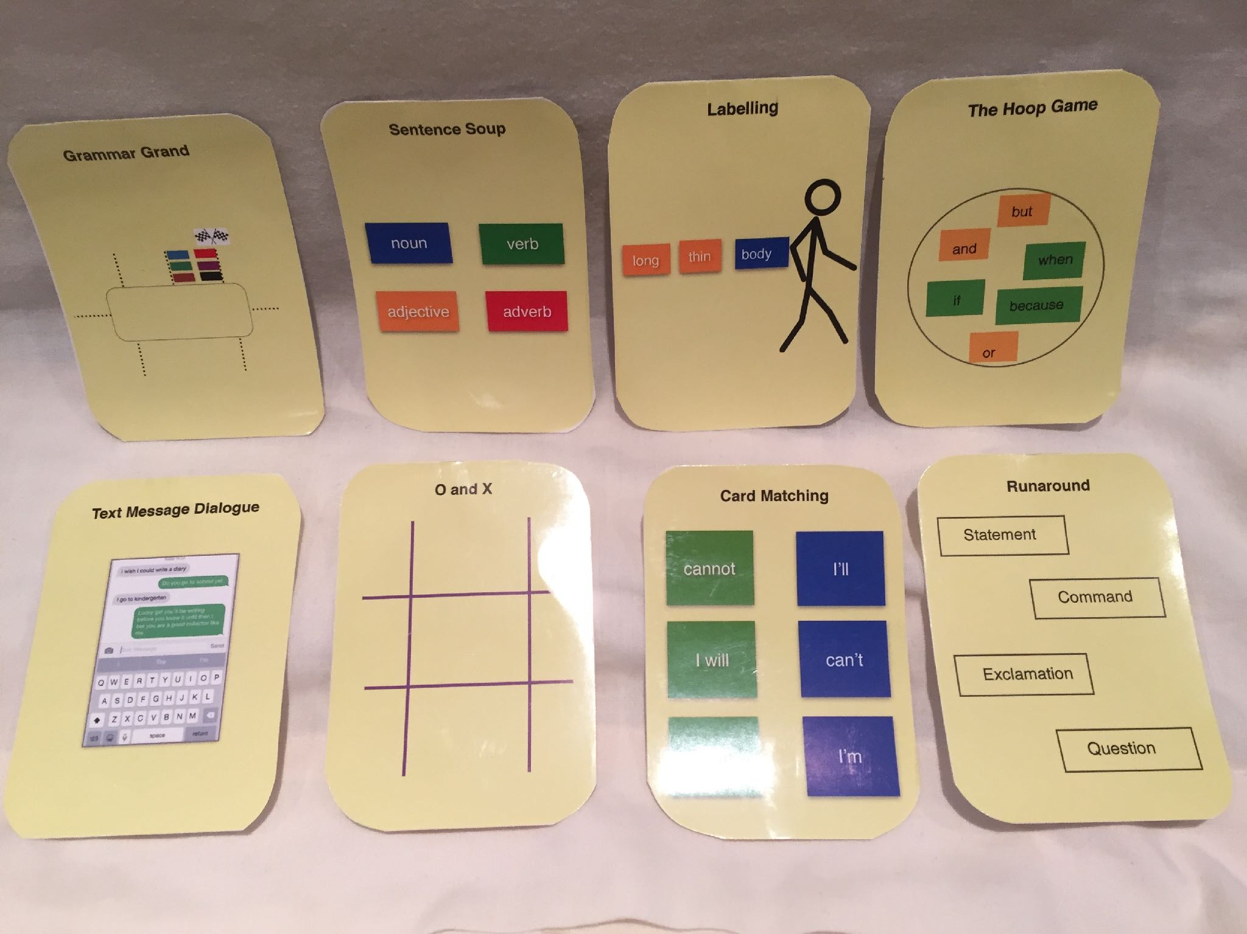

Slide 123

sharp
,
pointed
teeth
symmetrical
tail fin
Notes:
noun phrases

Slide 124

Grammar for Writing Revisited

Slide 125
GfW
Activity | Purpose | Page
Function | Investigate word class, sentence structure or punctuation | 156
Compare | Understand principles by comparing two texts with different facets of the same feature | 157
Cloze | Considering the effectiveness of a word within a sentence to suit the audience and purpose of the text | 159
Construct | Experiment with sentence structure to reinforce knowledge of word class and sentence construction | 158
Punctuate | Practice punctuation | 159
The Complex Sentence game | Practice in constructing subordinate clauses | 159

Slide 126

The Complex Sentence Game
Change the first word or phrase of the subordinate clause | 4 points
Change subordinate clause | 4 points
Change the main clause | 2 points
Change the verb in the main clause | 2 points
Create a completely new sentence | 6 points
Change subject in main clause | 2 points
Move the subordinate clause | 6 points
Miss a turn | 0 points

Slide 127
The Complex Sentence Game
Write a complex sentence on the board
Player picks up a card, suggests an answer and checks with the group
Teacher judges its suitability
Teacher records sentences on whiteboard as it is modified
Teacher keeps the score
First to 10 wins

Slide 128
The great white shark is the largest of the predatory sharks, capable of eating seals whole.

Slide 129
here
sentence daily
crafting great…
couch to…

Slide 130
Back to basics!

Slide 131
Traffic light sentences
So the boy decided to help the penguin find its way home. He
checked in the Lost and Found office.But no one was missing a penguin.

Slide 132
Traffic Light Sentences
He wanted to help the penguin but he didn’t know how to.

Slide 134
Sentence count
Once there was a boy and one day he found a penguin at his door. The boy didn’t know where it had come from but it began to follow him everywhere. The penguin looked sad and the boy thought it must be lost.

Slide 135
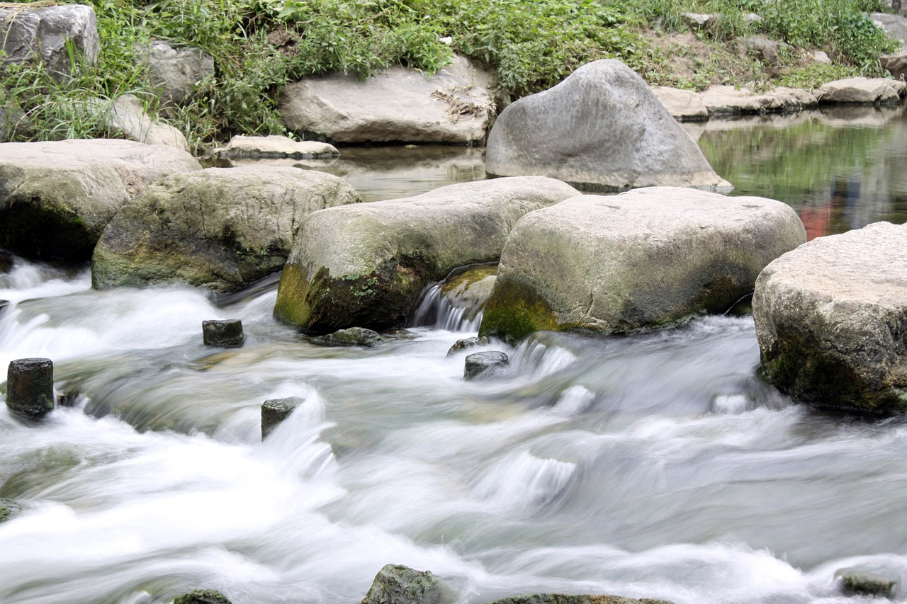
Stepping stones - word level
word
word
word
word
word
The
girl
opened
the
door.

Slide 136
Stepping stones - sequencing sentences
Sentence
Sentence
Sentence
Sentence
Sentence

Slide 137
Stepping stones - sequencing sentences
The girl opened the door.
What she saw took her breath away
Sentence
Sentence
Sentence

Slide 138
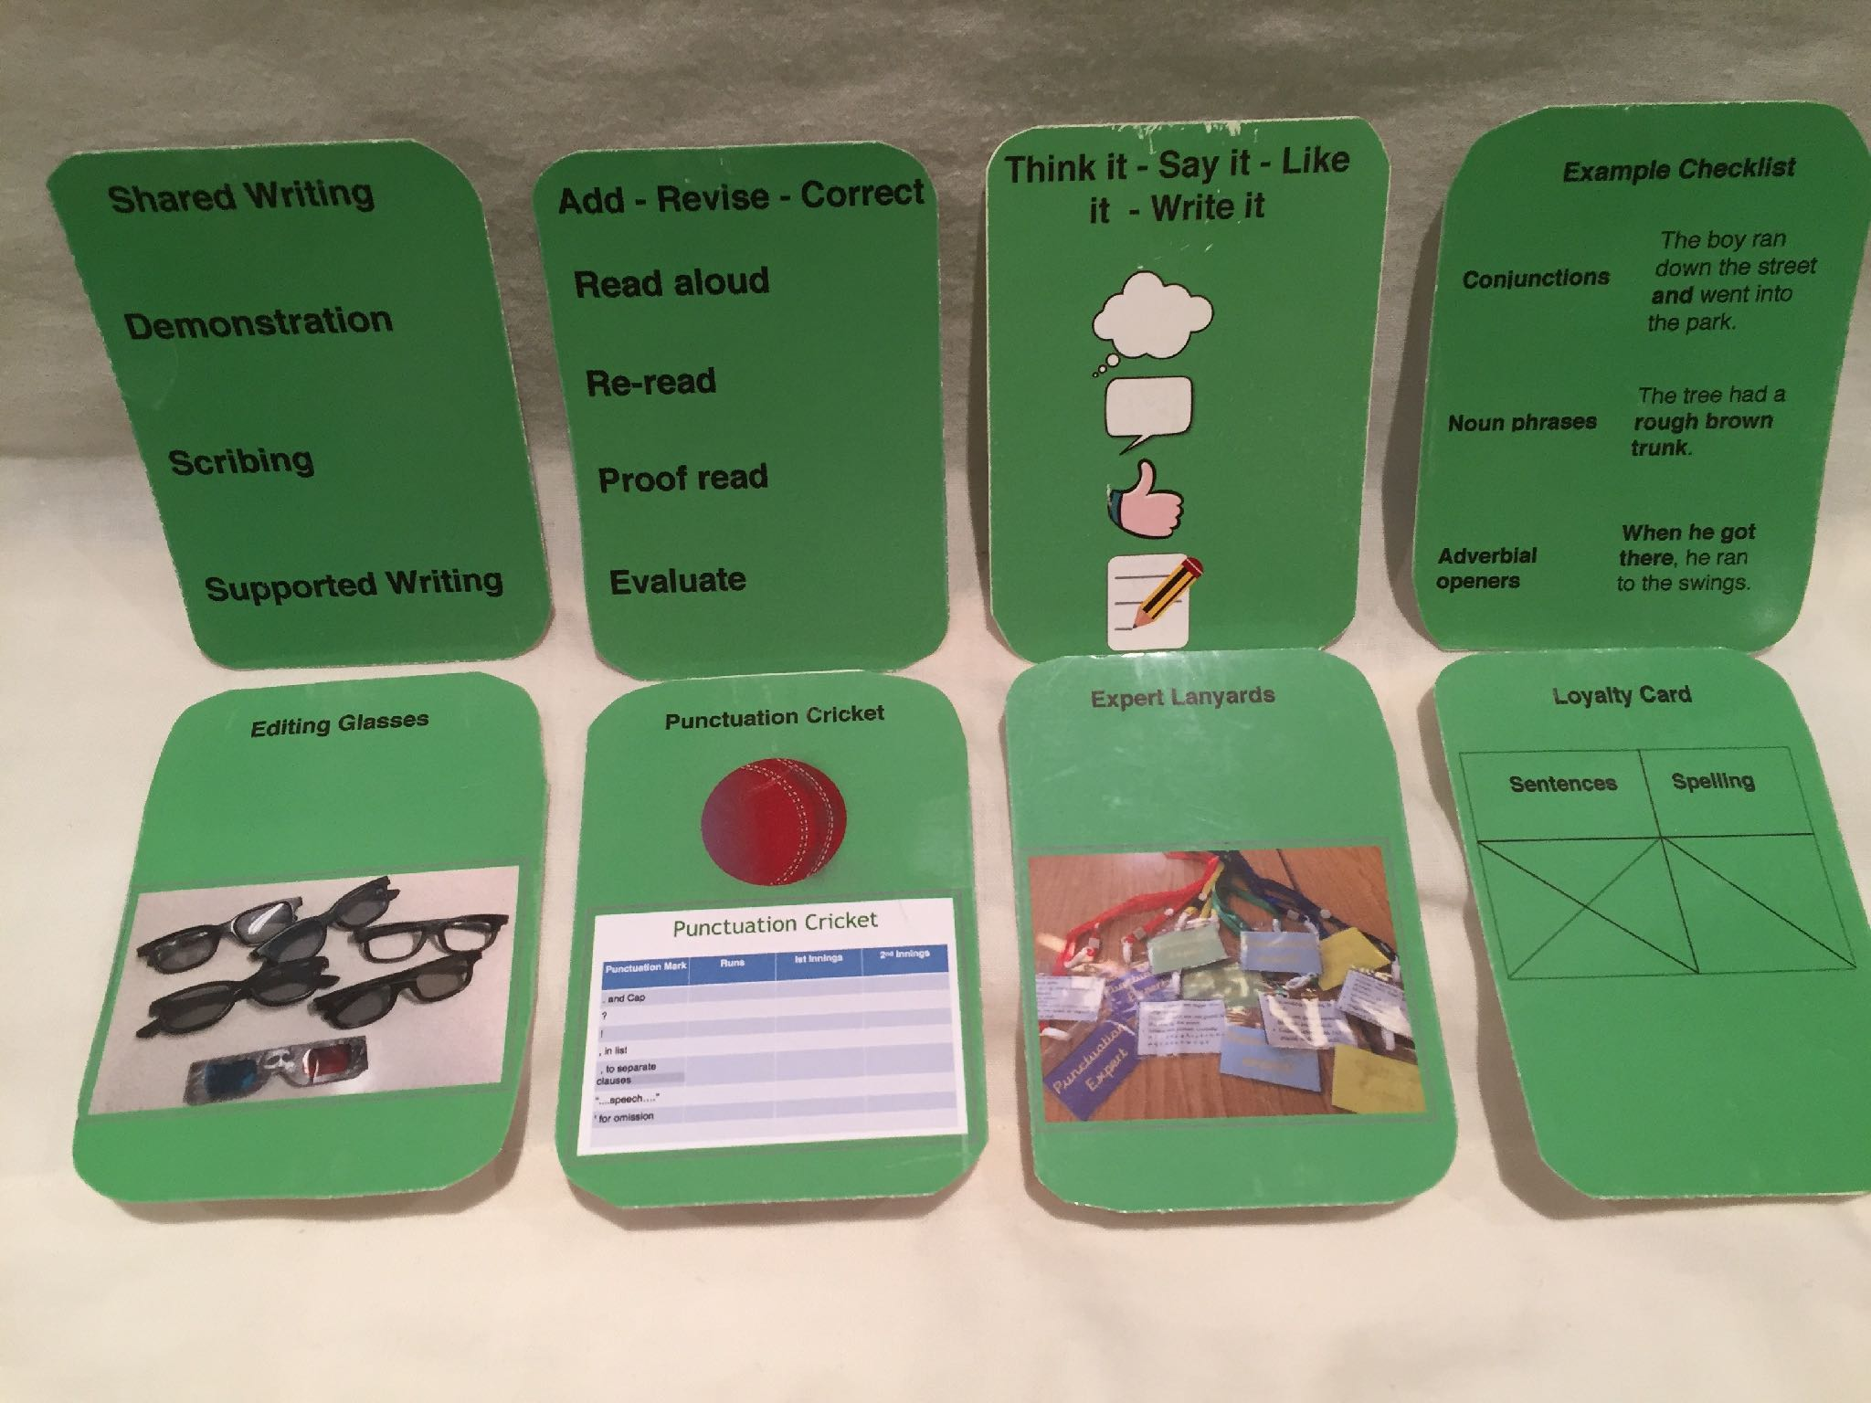

Slide 139
Modelling
I/We/You
I - you explain and model
We - paired or guided
You - independent writing

Slide 140
Recording

Slide 141
Phase 4 - Publishing
How is it organised?
How is it written?

Slide 142
Shark Trading Card
Fear Factor
Strength
Beauty
Notes:
short, sharp writing in comprehension phase - practise grammar here

Slide 143
What about Greater Depth?
‘They’ve got flair.’

Slide 144
What about Greater Depth?
Who are your potential GD children?
Why are they potential GD
      Discuss
Flair and creativity, good knowledge and understanding of grammar, basic skills secure
Also those who can include the age related skills independently without scaffolding. They don't shadow the WAGOLL.

Slide 145
What about Greater Depth?
Who are your potential GD children?
Why are they potential GD
      Discuss
What has come up in moderation?

Slide 146

CIA
Consistency
Independence
Accuracy

Slide 147
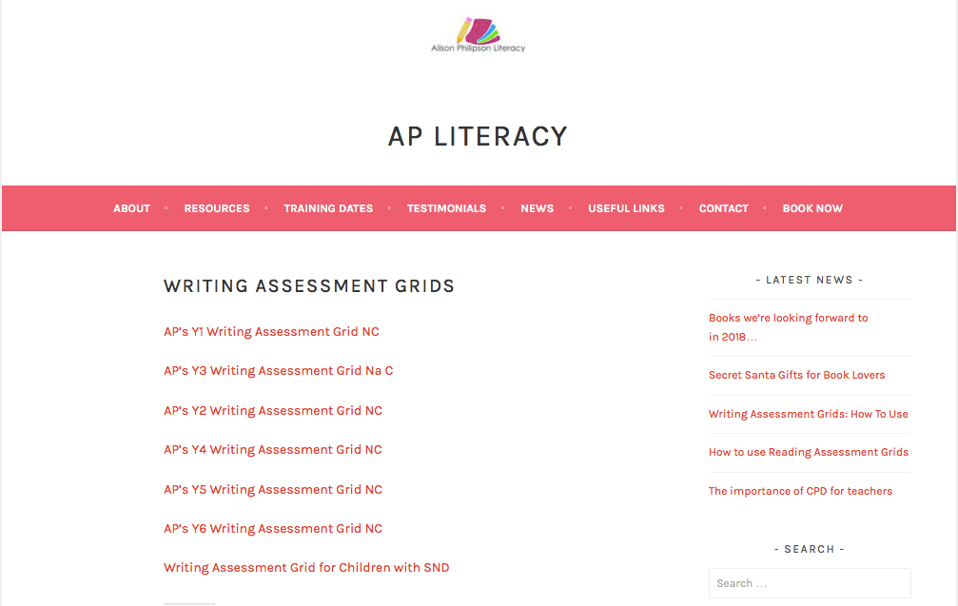

Slide 148
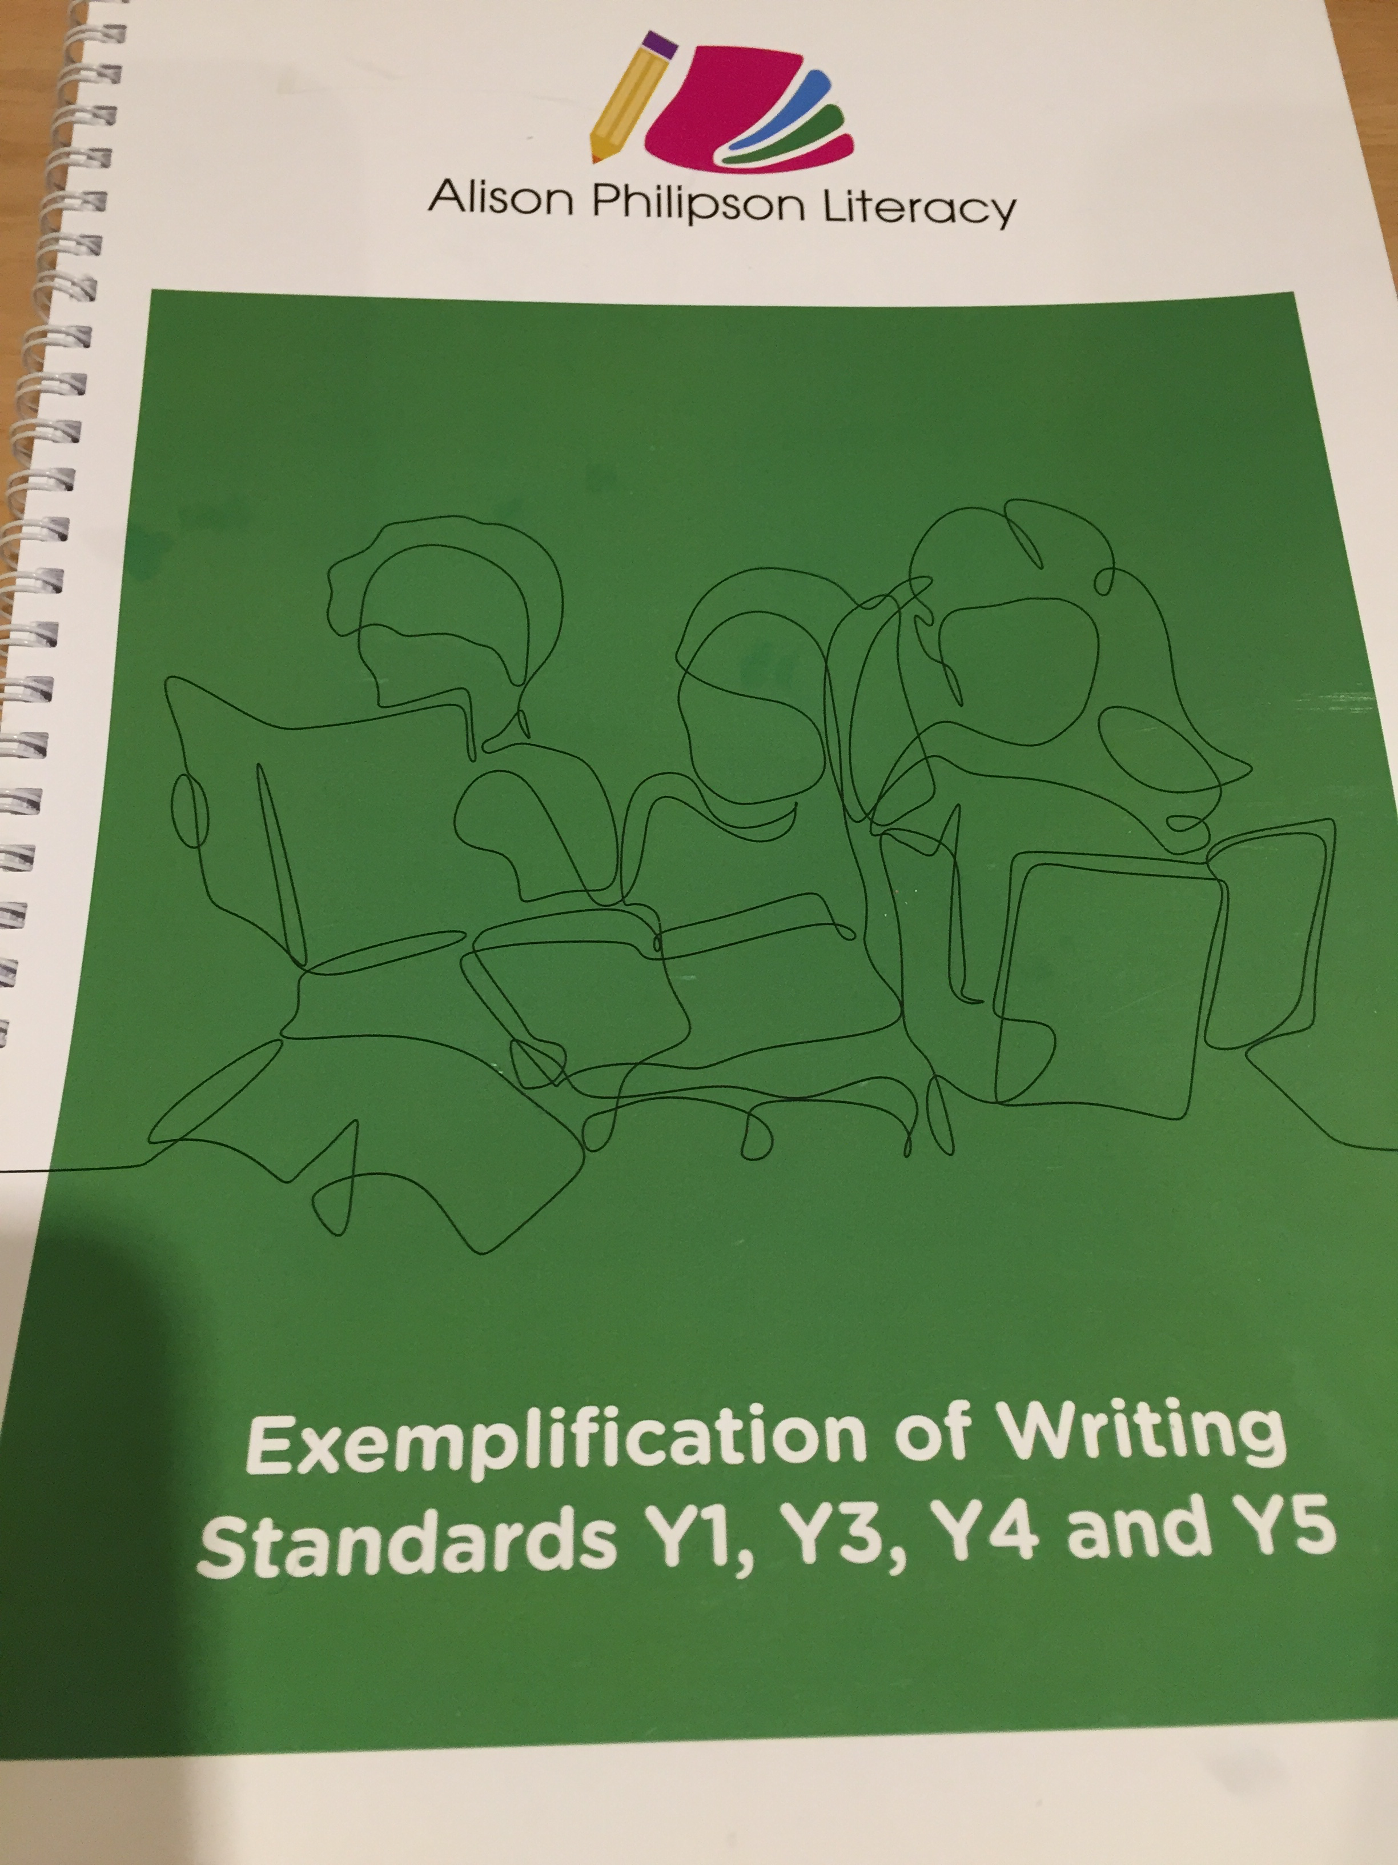

Slide 149
The pupil has embedded all Y5 learning and is using it independently and accurately when writing at length for different purposes and audiences (including a short story)
Working at greater depth in Y5
The pupil can:
in narratives, describe settings, characters and atmosphere
integrate dialogue in narratives to convey character and advance the action
select precise vocabulary and grammatical structures that reflect the level of formality required mostly correctly
Knowing how to make writing succinct by using all grammar and punctuation taught so far precisely to engage the reader, sometimes showing and not telling
using the full range of punctuation taught correctly and appropriately
Composition and Effect
Grammar
Punctuation
Vocabulary
Formality

Slide 150
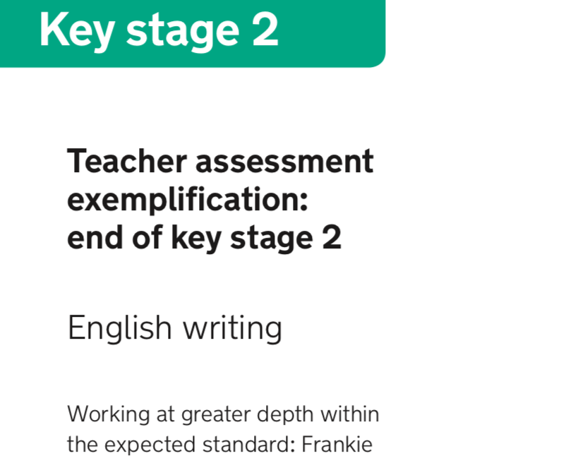

Slide 151
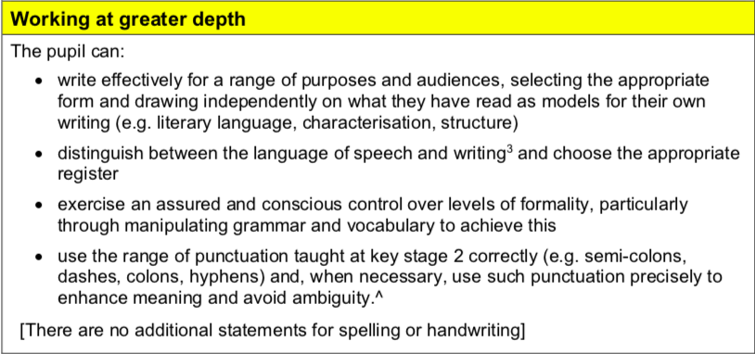
Year 6

Slide 152
The pupil has embedded all primary phase learning and is using it independently and accurately when writing shorter and more extended pieces for a range of different purposes and audiences.They can manage shifts between levels of formality through selecting vocabulary more precisely and by manipulating grammatical structures and can select verb forms for meaning and effect.
Working at greater depth in Y6
The pupil can:
write effectively for a range of purposes and audiences, selecting the appropriate form and drawing independently on what they have read as models for their own writing (e.g. literary language, characterisation, structure)
distinguish between the language of speech and writing³ and choose the appropriate register
exercise an assured and conscious control over levels of formality, particularly through manipulating grammar and vocabulary to achieve this
use the range of punctuation taught at key stage 2 correctly (e.g. semi-colons, dashes, colons, hyphens) and, when necessary, use such punctuation precisely to enhance meaning and avoid ambiguity
Range
Composition and Effect
Grammar
Punctuation
Vocabulary
Formality

Slide 153
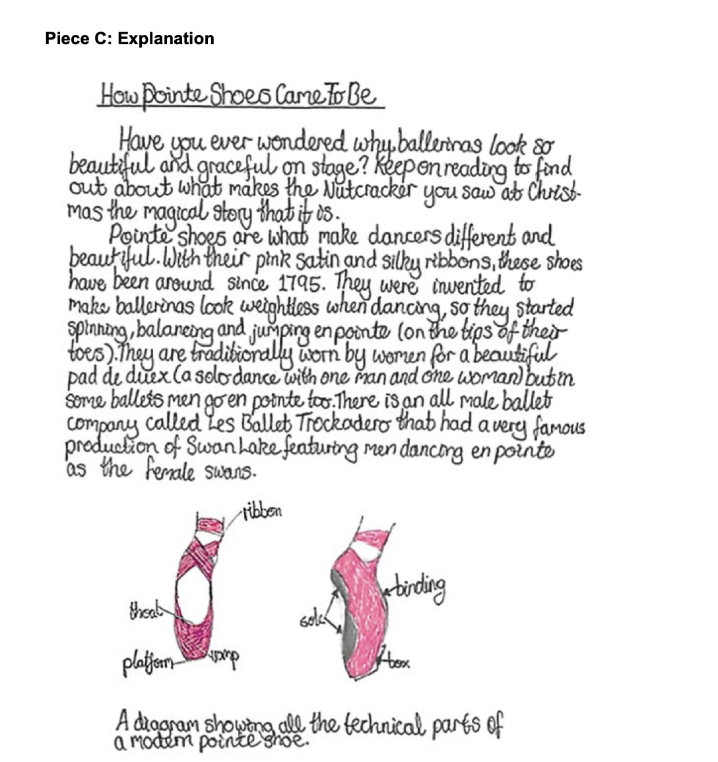
whiteboard.fi

Slide 154
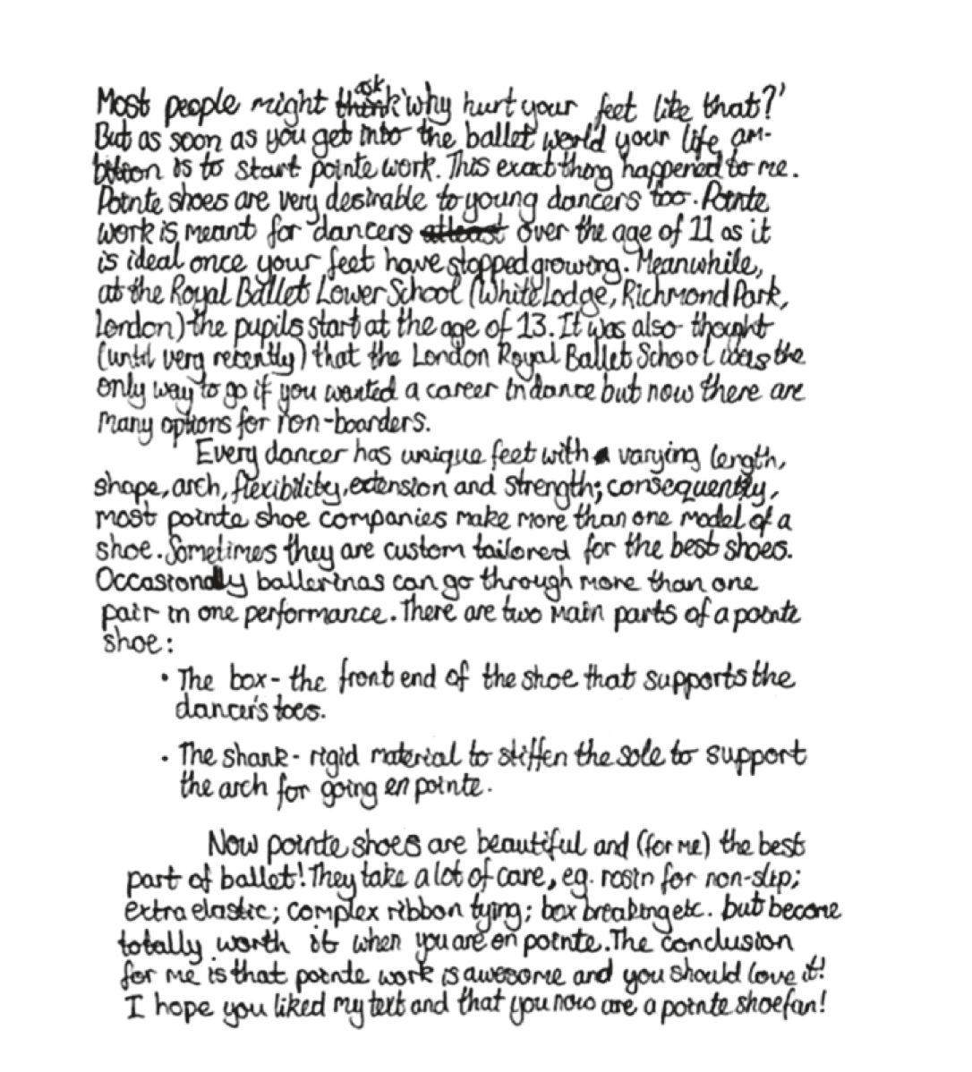

Slide 155
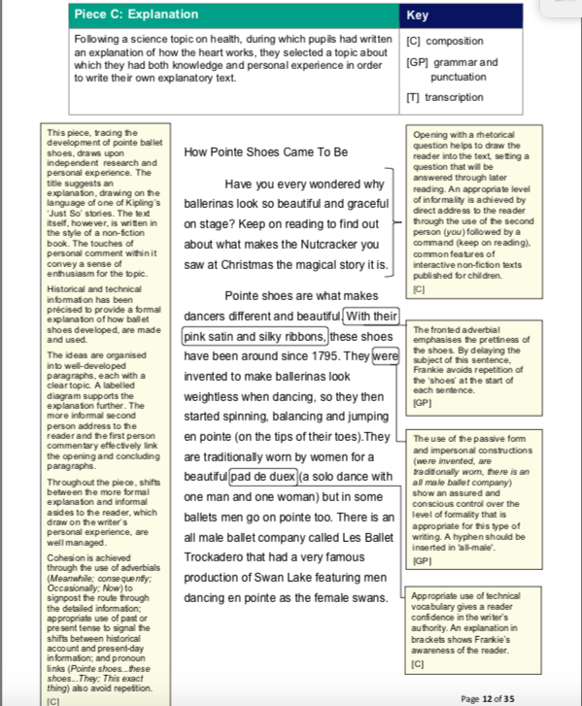

Slide 156
Full range of punctuation used correctly - brackets - dashes - commas - hyphens - colon - semi colon
C
Composition
T
Transcription
GP
Grammar and Punctuation
Frankie - explanation
Spelling mostly correct
Historical and technical information
Joined handwriting is legible
Well developed paragraphs each with a clear theme
Opening and closing paragraphs linked
Shifts in formality including passive voice
Cohesion achieved through use of adverbials
Use of rhetorical question for an effective opening
Good use of key features for the genre and appropriate use of technical vocabulary
Multi clause sentences including coordination and subordination
Precise use of nouns

Slide 157
GD Writing Workshops
Dates
Year 2 | Year 3 and Year 4 Combined |  | Year 5 | Year 6 | Year 1
23 January 2025 - am | 5 March 2025 - pm |  | 5 March 2025 - am | 23 April 2025 - am | 24 April 2025 - am
29 January 2025 - am | 13 March 2025 - pm |  | 13 March 2025 - am | 30 April 2025 - am | 1 May 2025 - am
5 February 2025 - am | 27 March 2025 - am |  | 19 March 2025 - am | 7 May 2025 - am | 8 May 2025 - am
13 February 2025 - am | 3 April 2025 - am |  | 26 March 2025 - am | 21 May 2025 - am | 22 May 2025 - am

Slide 158
MAKE IT SING! GREATER DEPTH WRITING CPD
This half day CPD was originally commissioned by two large multi-academy trusts in Yorkshire and is now available for other schools and organisations. The input is targeted at leaders, especially English leaders, but is also suitable for class teachers. During the session we will cover the following items:
Introduction – What do we mean by GD writers and who are yours?
Your moderation experiences
What about Greater Depth in mixed ability class?
The curse of the WAGOLL!
The very obvious importance of reading
Stealing the style and Sprinkling the Magic
Crafting great sentences
Handwriting 101
Some ideas for challenges
Making it happen
Feedback from the first two sessions has been really, really positive.
Thank you so much – really enjoyed this morning
Thank you so much – lots of interesting resources for me to feedback to staff. Going to use the 4 statements for description and the planning board to focus on audience and purpose
Thank you! I loved the changing the purpose/audience and I thought the add in/add on/ change words/add sentence/ join sentence was great and easily applicable
This is not a writing moderation session. It is designed to give practical and workable solutions for all year groups from Year 1 and above. There is a big focus upon audience and purpose and the use of children’s reading and ’stealing the style’.
https://philipwebbliteracy.com/2024/12/15/make-it-sing-greater-depth-writing-cpd/

Slide 159
Return to Reading and Non-Fiction

Slide 160
Numbers Prediction
first
1875
twenty-two
twenty-seven-year-old
1872

Slide 161
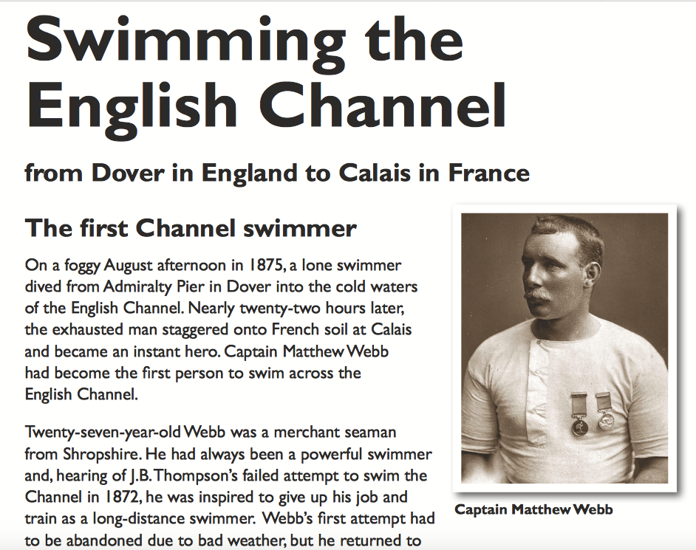

Slide 162
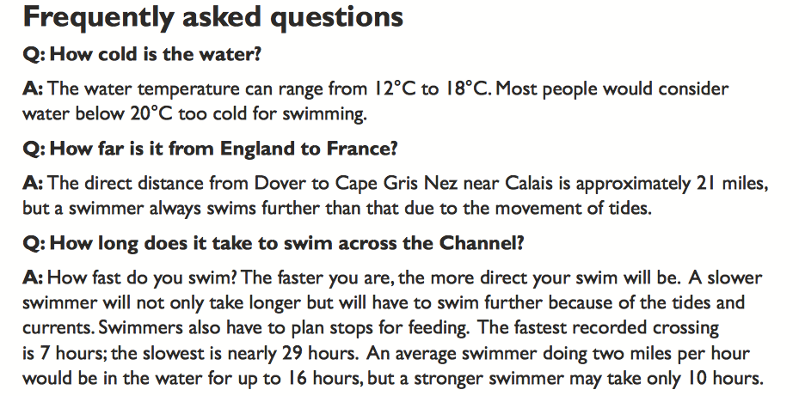
Magazine format

Slide 163
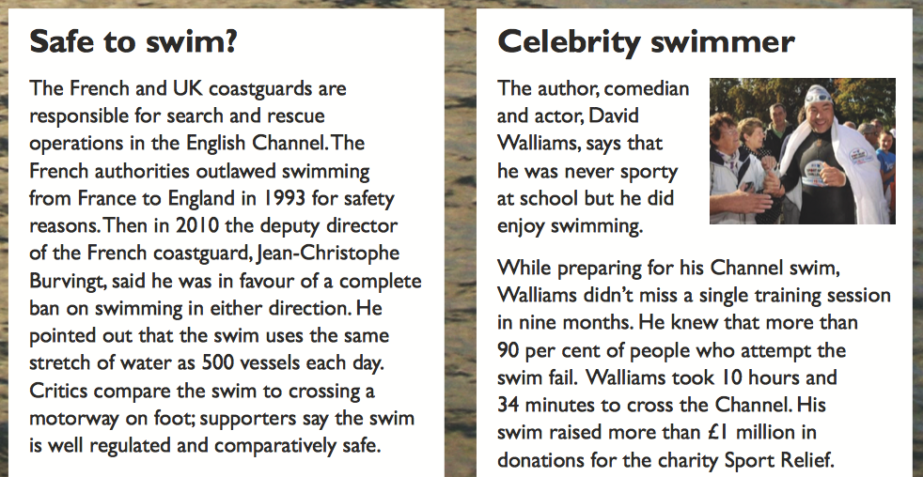
Skimming and Scanning for Numbers
Write down all of the numbers in the text
Sort the numbers

Slide 164
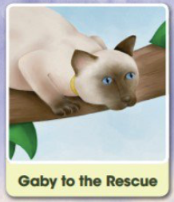
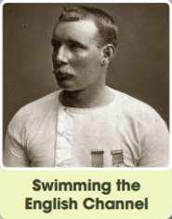

retrieval (33%) inference (33%) and vocabulary (27%)
summarising (2%)
2F
retrieval (47%) vocabulary (24%) inference (18%) summarising (1%)
explaining how content is related (1%)
2:4:2
2C
vocabulary (11%) retrieval (5.5%)
how meaning is enhanced through language (5.5%)
inference (78%).
…every one of the last thirteen marks of the test assessed inference.

Slide 165
NF Text breakdown 2024
Streaky and Squeaky
the Leopard
2b: Retrieve and record info’ / identify key details from F and NF
2d: Make inferences from the text / explain and justify inferences with evidence from the text

Slide 166
Whole Class Reading
Non-fiction
Some ideas to extract

Slide 167


Picture Prediction

Slide 168
Pull Quotes Prediction
…she began to feel anxious as the Electra dipped suddenly and entered a massive, rain-dark cloud
With a shock the teenager realised she was somehow outside of the aeroplane
Looking up at the trees she knew she had survived an air disaster,
Climbing the path took all her strength as she was so tired and hungry, but at the top she found a small shack.

Slide 169
Chapter Prediction
Juliane Koepcke
The Girl Who fell from the sky
(Peru, 1971)
Douglas Mawson
The Man who came home alone
(Antarctica, 1912)
Hans Peter Strelczyk and Gunter Wetzel
The friends who crossed the border by balloon
(Germany , 1979)

Slide 170
Look out for names
On Christmas Eve, seventeen-year-old Juliane Koepcke was flying high above the South American rainforest when the airliner carrying her and her mother was hit by a violent storm. The previous evening had been prom night at Koepcke’s school, but now term was over and they were heading home for the holidays. Home meant the remote Amazonian town of Pucallpa in Peru, where Koepcke’s father, Hans-Wilhelm, worked as a biologist. Her mother, Maria, was an ornithologist who studied birds and their behaviour. Sharing her parents’ passion for science and nature, Koepcke planned to follow their example by studying biology at university.

Slide 171
Surveying the text
Punctuation
Names
Run ons
Chunking
Dialogue
Speech verbs
Challenging vocabulary
Text Organisation clues

Slide 172
Surveying a text
Tricky name
The Dark
Laszlo was afraid of the dark. The dark lived in the same house as Laszlo. A big place with a creaky roof, smooth, cold windows and several flights of stairs.
Sometimes the dark hid in the cupboard. Sometimes it sat behind the shower curtain.
But mostly it spent its time in the basement.
All day long, the dark would wait in a distant corner, far from the squeaks and rattles of the washing machine, pressed up against some old, damp boxes and a chest of drawers nobody ever opened.
At night, of course, the dark went out and spread itself against the windows and doors of Laszlo’s house. But in the morning, the dark would be back in the basement, where it belonged. Laszlo would peek at the dark every morning.
“Hi,” he would say. “Hi, dark.”
Run on sentence
Long sentence
Dialogue

Slide 173
Run ons
Word by word readers often assume that a sentence finishes at the. End of line of text they place a non existent full stop at the end of.
each line.
But texts are written to flow – to follow an idea to its conclusion and often the words in a sentence flow over the line end. They run on.

Slide 174
The Girl Who Fell from the Sky
Through her window Koepcke could see flashes of lightning around the aircraft. With the storm obviously closing in she too began to feel scared. Above the sound of the propellers several passengers could be heard crying as she reached across for her mother’s hand.
The violent pitching continued like this for nearly ten minutes, throwing the aircraft this way and that. Gripping her mother’s hand more tightly now, Koepcke looked out of the window and saw that one of the engines was glowing brightly. Her mother also noticed this and very quietly said, ‘That is the end. It’s all over.’ These were the last words Koepcke ever heard her say.
Moments later the cabin was plunged into darkness, and the Electra went into a steep nosedive. Koepcke couldn’t see anything in the pitch black, and could hear nothing but the roar of the engines. Then, just as suddenly, everything went silent. With a shock the teenager realised she was somehow outside the aeroplane, still strapped in her seat but tumbling over and over and over. With nothing around her but the rush of cold air, she was plummeting down towards the jungle.

Slide 175
Tricky name
The Girl Who Fell from the Sky
Through her window Koepcke could see flashes of lightning around the aircraft. With the storm obviously closing in she too began to feel scared. Above the sound of the propellers several passengers could be heard crying as she reached across for her mother’s hand.
The violent pitching continued like this for nearly ten minutes, throwing the aircraft this way and that. Gripping her mother’s hand more tightly now, Koepcke looked out of the window and saw that one of the engines was glowing brightly. Her mother also noticed this and very quietly said, ‘That is the end. It’s all over.’ These were the last words Koepcke ever heard her say.
Moments later the cabin was plunged into darkness, and the Electra went into a steep nosedive. Koepcke couldn’t see anything in the pitch black, and could hear nothing but the roar of the engines. Then, just as suddenly, everything went silent. With a shock the teenager realised she was somehow outside the aeroplane, still strapped in her seat but tumbling over and over and over. With nothing around her but the rush of cold air, she was plummeting down towards the jungle.
Run on sentence
Dialogue
punctuation

Slide 176

360°
The next
20%

Slide 177

Header
Heading
Photograph
360°
Text box
Main text
More information
The next
20%

Slide 178
The next
20%

Slide 179
The Girl Who Fell from the Sky
Coming out of the clouds she momentarily glimpsed the tops of the trees spinning up to meet her like a patch of giant broccoli. It was petrifying, but she must have passed out immediately because the next thing she remembered was waking up the following morning. It was Christmas Day. She was still strapped into her seat, but it was now wedged firmly into the ground.
Forty minutes after taking off, the aircraft had apparently been struck by lightning, one deadly bolt causing a fuel tank to explode and rip off the right wing. As the fuselage began to disintegrate around her, Koepcke had been thrown clear of the airborne wreckage and then fell more than two miles down into the jungle Despite the trauma of this experience, she realised at once what had happened.

Slide 180
Vocabulary check
violent pitching - plunged - plummeting
Seven Steps
Contextualise
Repeat the word
Child friendly definition
Give other examples
Relate to experience
Engage in other ways
Record

Slide 181

Read Aloud
Comprehension Tennis

Slide 182
Comprehension Tennis
On Christmas Eve, seventeen-year-old Juliane Koepcke was flying high above the South American rainforest when the airliner carrying her and her mother was hit by a violent storm. The previous evening had been prom night at Koepcke’s school, but now term was over and they were heading home for the holidays. Home meant the remote Amazonian town of Pucallpa in Peru, where Koepcke’s father, Hans-Wilhelm, worked as a biologist. Her mother, Maria, was an ornithologist who studied birds and their behaviour. Sharing her parents’ passion for science and nature, Koepcke planned to follow their example by studying biology at university.
On board the four-engined Lockheed Electra aeroplane she could hear other passengers complaining because their flight had been delayed by nearly seven hours. But they were airborne now and Koepcke was happy to be on holiday and looking forward to seeing her father. From her window seat she noticed storm clouds in the distance, but she loved flying and had no reason to feel afraid.

Slide 183

Timing a read: matching the teacher
Her mother felt less relaxed about the storm. Never quite believing that something metal could rival the birds she studied, Maria didn’t like flying at the best of times. Now she began to feel anxious as the Electra dipped suddenly and entered a massive, rain-dark cloud. Before long the plane was being buffeted about by the air currents, and after a few minutes even Koepcke began to feel that something wasn’t quite right.
Bags and other pieces of luggage started to fall from the overhead racks and drinks tipped into passengers’ laps. Soon Christmas presents and parcels began bouncing around the cabin as the aircraft was pitched up and down by the turbulence.

Slide 184
Chunking
Through her window Koepcke could see flashes of lightning around the aircraft. With the storm obviously closing in she too began to feel scared. Above the sound of the propellers several passengers could be heard crying as she reached across for her mother’s hand.
The violent pitching continued like this for nearly ten minutes, throwing the aircraft this way and that. Gripping her mother’s hand more tightly now, Koepcke looked out of the window and saw that one of the engines was glowing brightly. Her mother also noticed this and very quietly said, ‘That is the end. It’s all over.’ These were the last words Koepcke ever heard her say.

Slide 185
Rapid Retrieval
Why did she begin to feel scared?
How long did the violent pitching last for?
What was plunged into darkness?
Whose hand did she grip?
When did she wake up and what was special about the day?
Where did she land?

Slide 186
Coming out of the clouds she momentarily glimpsed the tops of the trees spinning up to meet her like a patch of giant broccoli. It was petrifying, but she must have passed out immediately because the next thing she remembered was waking up the following morning. It was Christmas Day. She was still strapped into her seat, but it was now wedged firmly into the ground.
Who? |  | What?
Where? | The Girl Who Fell from the Sky | When?
 |  | Christmas Eve Christmas Day
Why? |  | How?

Slide 187
True or False
 |  | TRUE | FALSE
Juliane’s mother was an ornithologist.
The aeroplane had four engines.
Forty minutes after take off the aircraft had been hit by lightning.
Juliane fell more than three miles into the jungle.

Slide 188
Find and Copy
Explain (your choice) fully
Short Sentence
KS2
G
Gold
Give two
Long Sentence Sentence
Write down…
Silver
1.
Bronze
2.

Slide 189
Tick one/two
Sequence the text
Circle the correct option
KS2
text
Statement…
Statement…
1
text
text
text
text
text
G
text
Statement…
Gold
text
Statement…
Draw Lines
True or False
Silver
Bronze

Slide 190
Inference
Why could several passengers be heard crying?

Slide 191
Why?

Slide 192
Why could several passengers be heard crying?
Because they were going to die weren’t they.
1

Slide 193
Why could several passengers be heard crying?
Because bags were falling, drinks were being spilt, the aircraft was being pitched up and down and they could see that a lightning storm was getting close. This made them think that they might crash.
2

Slide 194
Why could several passengers be heard crying?
Bags and other pieces of luggage started to fall from the overhead racks and drinks tipped into passengers’ laps. Soon Christmas presents and parcels began bouncing around the cabin as the aircraft was pitched up and down by the turbulence.
Through her window Koepcke could see flashes of lightning around the aircraft. With the storm obviously closing in she too began to feel scared. Above the sound of the propellers several passengers could be heard crying as she reached across for her mother’s hand.
3

Slide 195
The IQ
Why did Koepcke’s mother say these words quietly “That is the end. It’s all Over.”
What would be your model answer?

Slide 196
Summary
Which of the following would be the most suitable summary of the whole text?
Tick one
Escape from the jungle
Surviving the air disaster
Flying home for Christmas
Flying over the jungle

Slide 197
Text: The Girl Who Fell From The Sky
Prediction | 1) Reveal two pictures one by one from the text. 2) Pull Quote Prediction
Vocabulary Check - 7 Steps | eg violent pitching - plunged - plummeting
Modelling and echo reading | P2 - Through her window…
Repeated re-reading | P2 - Through her window… to …, she realised
Performance reading | Choose a paragraph
Timed retrieval | Why did she begin to feel scared? How long did the violent pitching last for? What was plunged into darkness? How long did the violent pitching last for? Whose hand did she grip? When did she wake up and what was special about the day? Where did she land?
Test question practice - Graphic question | Fact or opinion

Slide 198
The IQ | Why did Koepcke’s mother say these words quietly “That is the end. It’s all Over.”
Test question practice | The Why Factor - Why could several passengers be heard crying?
Summary | Which of the following would be the most suitable summary of the whole text? Escape from the jungle Surviving the air disaster Flying home for Christmas Flying over the jungle

Slide 199
Poetry

Slide 200
It’s Spring
It's spring
It's spring
And the garden is changing its clothes,
Putting away It's dark winter suits
It's dull scarves
And drab brown overcoats
Now, it wraps itself in green shoots,
Slips on blouses
Sleeved with pink and white blossom,
Pulls on skirts of daffodil and Primrose,
Snowdrop socks and purple crocus shoes,
Then dances in the sunlight.
1) Who or what is changing its clothes?

Slide 201
Poetry 2018 - number of questions
14 questions - 17 marks

Slide 202


Slide 203
A teaching sequence
Phase 1
Phase 2
Phase 3
Reading aloud
New vocabulary
The poetry grid
Writing frame
Writing sequence
Prediction
Comprehension
Technical
vocabulary
Performing and evaluating
Learning by heart
Use of ICT
Notes:
writing sequence - show models - critique models - adapt models - plan - draft - improve - publish

Slide 204
Prediction - word cloud
What can you say about this poem?
Notes:
wordle
what can you say about this poem?

Slide 205

Prediction - hide the title
Postcard from school camp
Dear Mum and Dad,
Weather’s poor. Foods bad.
Teachers are grumpy. Instructors are mad.
Cramped in a tent. Cold at night.
No dry clothes. Boots too tight.
Didn't like canoeing. The hiking was tough.
All in all, I’ve had enough.
Bye for now. MAY see you soon.
If I survive this afternoon.
Your loving son
Ben xx
P.S can I come again next year?
Richard Caley

Slide 206


The Poetry Grid
Title of poem and name of poet
New Words | What is the poem about? | How are the words working?
Collect new vocabulary from the poem |  | rhythm rhyme adjectives nouns powerful verbs patterns onomatopoeia
 | Poem Paste your poem or extract here…
simile metaphor personification |  | long lines? short lines? shape poem? … but mainly how is it different to prose?
Are there any images |  | What is the shape of the lines?

Slide 207


Slide 208
Title
New Words | What is the poem about? | How are the words working?
 | How would you like it- Supposing that you were a snail, And your eyes grew out on threads, Gentle, and small, and frail - If an enormous creature, Reaching almost up to the distant skies, Leaned down, and with his great finger touched Your eyes Just for the fun Of seeing you snatch them suddenly in And cower, quivering back Into your pitiful shell, so brittle and this? Would you think it was fun then? Would you think was fun?
Are there any images |  | What is the shape of the lines?

Slide 209
From a Railway Carriage
New Words | What is the poem about? | How are the words working?
meadows plain | The view from a train when it’s travelling through the countryside | The last words at the end of the line rhyme. For example witches and ditches and battle and cattle The rhythm is like a train
 | Faster than fairies, faster than witches. bridges and houses, hedges and ditches, And charging along like troops in a battle, All through the meadows, the horses and cattle: All of the sights of the hill and the plain Fly as thick as driving rain; And ever again in the wink of an eye, Painted stations whistle by
And charging along like troops in a battle, Fly as thick as driving rain
Are there any images? |  | What is the shape of the lines?

Slide 210
Title
New Words | What is the poem about? | How are the words working?
 | And how would you like it, Supposing you were a frog, An emerald scrap with a pale, trembling throat In a cool and shadowed bog, If a tremendous monster, Tall, so tall that his head seemed lost in the mist, Leaned over, and clutched you up in his great fist Just for the joy Of watching you jump, scramble, tumble, fall, Into graceless, shivering dread, Back into the trampled reeds that were grown so tall? Would you think it a joy then? Would you think it a joy?
Are there any images |  | What is the shape of the lines?

Slide 211

https://www.clpe.org.uk/poetryline

Slide 212
Notes:
essential resources

Slide 213
The wood in late Autumn
2
Fog crawls
Over the wood
Wrapping its grey blanket
Round the shivering bare shoulders
Of trees.
4
6
8
2
Notes:
so go outside - have a wonder - senses - write a cinquain to share around your tables - complete poetry grid

Slide 214
Migration
Blackcap
Leaves, flies, stops, settles
Cold winter in Britain
Springtime arrives, heading homeward
Survived.
Notes:
so go outside - have a wonder - senses - write a cinquain to share around your tables - complete poetry grid

Slide 215


Slide 217
Moments later the cabin was plunged into darkness, and the Electra went into a steep nosedive. Koepcke couldn’t see anything in the pitch black, and could hear nothing but the roar of the engines. Then, just as suddenly, everything went silent. With a shock the teenager realised she was somehow outside the aeroplane, still strapped in her seat but tumbling over
and over and over. With nothing around her but the rush of cold air, she was plummeting down towards the jungle.

Slide 218
Plunged into darkness,
Steep nosedive.
Pitch black
Nothing but the roar of the engines.
Suddenly, everything went silent …

Slide 219
Coming out of the clouds she momentarily glimpsed the tops of the trees spinning up to meet her like a patch of giant broccoli. It was petrifying, but she must have passed out immediately because the next thing she remembered was waking up the following morning. It was Christmas Day. She was still strapped into her seat, but it was now wedged firmly into the ground.

Slide 220

Hadrian’s Wall

Slide 221
The Poetry Machine
A noun
A fact about the noun
3 adjectives to describe the noun
Simile as
Simile like
The noun again
3 verbs
Another fact about the noun
I’d like to…

Slide 222
What will you?
Stop doing
Start doing
Keep doing

Slide 223
Spelling
Test strand
Writing strand at ARE
Y5/6 Spelling curriculum
What has gone before
Some quick and easy ideas
Memory strategies
One grid - four games

Slide 224
Quickwrite - spelling
Doubling (eg stop / stopping)
Dropping (eg shine / shining
Adding (total/totally)
Phoneme check

Slide 226
enlist |  |  |  |  |  | Total
e | n | l | i | s | t
1 | 1 | 1 | 1 | 1 | 1 | 6
allied
a | l | l | i | e | d | d
1 | 1 | 1 | 1 | 1 | 2 | 7
empire
e | m | p | i | r | e
1 | 3 | 3 | 1 | 1 | 1 | 10
enlist |  |  |  |  |  | Total
e | n | l | i | s | t
allied
a | l | l | i | e | d
empire
e | m | p | i | r | e

Slide 227
70% from Year 3/4
30% from Year 5/6
2018

Slide 228

https://www.risingstars-uk.com/media/Rising-Stars/Blog/KS2-SATs-past-spelling-test-words.pdf

Slide 229

https://www.risingstars-uk.com/media/Rising-Stars/Blog/KS2-SATs-past-spelling-test-words.pdf

Slide 230
Y3/4 Homophones
mail/male,
main/mane,
meat/meet,
medal/meddle,
missed/mist,
peace/piece,
plain/plane,
rain/rein/reign,
scene/seen,
weather/whether,
whose/who’s
accept/except,
affect/effect,
ball/bawl,
berry/bury,
brake/break,
fair/fare,
grate/great,
groan/grown,
here/hear,
heel/heal/he’ll,
knot/not,

Slide 231
Y5/6 Homophones
principal: adjective – most important (e.g. principal ballerina) noun – important person (e.g. principal of a college)
principle: basic truth or belief
profit: money that is made in selling things
prophet: someone who foretells the future
stationary: not moving
stationery: paper, envelopes etc.
steal: take something that does not belong to you
steel: metal
wary: cautious
weary: tired
who’s: contraction of who is or who has
whose: belonging to someone (e.g. Whose jacket is that?)
60

Slide 232

Expected

Slide 233

Spelling 2019
https://www.risingstars-uk.com/blog/june-2019-(1)/thoughts-on-the-2019-sats-grammar,-punctuation

Slide 234
From previous test(s)
Suffixes
-ly | -ation | -ous | suffixes beginning with vowel letters to word of more than one syllable
likely | sensation | nervous | inspiring
originally |  | previous | disobeyed
ferociously |  |  | polishing
 |  |  | offering
 |  |  | nationality

Slide 235
From previous test(s)
Endings
-able and -ible -ably and -ibly | -ant -ance - ancy -ent -ence -ency | sound like… | sound like ‘shun/ spelt -tion -sion -ssion —cian
probable | substance | facial | variation
sensibly | violence | sound like… | operation
washable | distance | vision | percussion
 | brilliant |  | passion

Slide 236
From previous test(s)
Silent Letters | Prefixes |  | Letter string -ough-
straight | -dis | -mis | toughest
bruise | disorder | misplaced | thoughtless
knock

Slide 237
From previous test(s)
Homophones | sound/spelt
prey | /u/ spelt -ou- | /ey/ sound spelt -ei- -eigh- -ey- | /k/ spelt /ch/ | /i/ spelt y in words
coarse | cousin | lightweight | monarch | sympathetic
 | thorough |  |  | /i/ spelt -ei- after c
 |  |  |  | ceiling

Slide 238
One grid - Four Games - Y3/4 grid 1
6 | accident | centre | decide | describe | complete | business
5 | different | breathe | diffficult | experiment | build | actually
4 | calendar | address | certain | caught | accidentally | circle
3 | actual | consider | busy | disappear | continue | breath
2 | bicycle | experience | early | exercise | answer | eight
1 | earth | believe | appear | eight | enough | arrive
 | 1 | 2 | 3 | 4 | 5 | 6
spelling coordinates - pairs game - now you see me - connect four

Slide 239
One grid - Four Games - Y3/4 grid 1 - Spelling Coordinates
6 | accident | centre | decide | describe | complete | business
5 | different | breathe | diffficult | experiment | build | actually
4 | calendar | address | certain | caught | accidentally | circle
3 | actual | consider | busy | disappear | continue | breath
2 | bicycle | experience | early | exercise | answer | eight
1 | earth | believe | appear | eight | enough | arrive
 | 1 | 2 | 3 | 4 | 5 | 6

Slide 240
One grid - Four Games - Y3/4 grid 1- The Pairs Game
One grid - Four Games - Y3/4 grid 1- Now you see me
accident | centre | decide | describe | complete | business
different | breathe | diffficult | experiment | build | actually
calendar | address | certain | caught | accidentally | circle
actual | consider | busy | disappear | continue | breath
bicycle | experience | early | exercise | answer | eight
earth | believe | appear | eight | enough | arrive

Slide 241
Now you see me …
Score Board
Player 1 |  | Player 2
Word | Points | Word | Points
Score Board
Player 1 |  | Player 2
Word | Points | Word | Points

Slide 242
One Grid - Four Games - Blank Template
6
5
4
3
2
1
 | 1 | 2 | 3 | 4 | 5 | 6

Slide 243
Clear the Board

Slide 244

Clear the board
Player 1……………….
Player 2……………….

Slide 245
One grid - Four Games - Y3/4 grid 1 - Connect 4
accident | centre | decide | describe | complete | business
different | breathe | diffficult | experiment | build | actually
calendar | address | certain | caught | accidentally | circle
actual | consider | busy | disappear | continue | breath
bicycle | experience | early | exercise | answer | eight
earth | believe | appear | eight | enough | arrive

Slide 246
Clear the Board
accident | centre | decide | describe | complete | business
1 | 2 | 3 | 4 | 5 | 6
different | breathe | diffficult | experiment | build | actually

Slide 247


Slide 248


Slide 249
You Spell Terrible - Homophones
You Spell Terrible
One player answers the question and their partner has to spell it
A sweet course after the main course of a meal.
dessert
You Spell Terrible
One player answers the question and their partner has to spell it
A barren place usually very hot but can also be very cold.
desert

Slide 250
Homophone Bingo

Slide 251
Pyramid Spelling
p
p
e
p
e
d
p
e
d
l
p
e
d
l
a
p
e
d
l
a
r
cemetery

Slide 252
Words without vowels
Endings which sound like…
v_c_ _ _ s
c_ _ t_ _ _ s
c_nsc_ _ _ s
_nf_ct_ _ _ s
Notes:
vicious - cautious - conscious - infectious

Slide 253
vicious
cautious
conscious
infectious

Slide 254



Mini-dictation
Show me what you know
Spell the word – use different words that use the same convention
Write the sentence
What I have I learnt?
I was gauging her reaction. I gauged it incorrectly.
Notes:
Gauge
Gauging
Gauged
I was gauging her reaction. I gauged it incorrectly.

Slide 255
Flash Spelling
A daily activity to support focused spelling
  Write up a word on the board
  Discuss
    Meaning
    Easy bits
    Tricky bits
  Suggest ‘fixing’ strategies

Slide 256
Flash Spelling
accommodate
accommodate
  Look at the word for 10 seconds and say it
  Close your eyes and picture the word
  Write the word with your finger on the table
  Write on a whiteboard
  SHOW ME!
Remember to discuss strategies that will help children to remember spellings
embarrassed
embarrassed
cemetery
cemetery
Notes:
accommodate
cemetery
embarrassed
harassed
necessary
unparalleled
ecstasy
lady’s

Slide 257

Memory Strategies 1
Syllables
  Break into smaller bits to remember

Slide 258

Memory Strategies 2
root words
  Find the base word (e.g smiling – base =smile + ing

Slide 259

Memory Strategies 3
Analogy
  Use words we already know
  could: would, should

Slide 260



Memory Strategies 4
Mnemonics
  Making up a sentence to help to remember
  Necessary – one collar - two sleeves
  Could – O U Lucky Duck
  People – people eat orange peel like elephants

Slide 261
Memory Strategies 4
Mnemonics
  Making up a sentence to help to remember
  separate – there’s a rat in separate
  ight – I go home tonight
  rhythm – rhythm helps your two hips move

Slide 262
Memory Strategies 5
Find and focus
  on the tricky part of the word
cemetery

Slide 263
Memory Strategies 6
Words within words
unparalleled
sovereign

Slide 264
Memory Strategies 7
Exaggerate the pronunciation
Pedlar

Slide 265
Agenda - Morning Session
Character Inference
A non-fiction teaching sequence and ideas
Non-fiction SATS
Reading to writing ideas
Writing expectations and effective practice
Greater Depth in writing
        CIA
        Exemplar materials

Slide 266
Agenda - afternoon Session
Poetry
  A teaching sequence and ideas
  SATS
Previous tests
Ideas for teaching spelling
Memory strategies
Spelling games and resources

